Slide 1
“PENSAR EN EL FUTURO” PROCESAMIENTOS DE OSEC EN FILIPINAS
18 de septiembre de 2019

Slide 2
PRESENCIA MUNDIAL
IJM R.U.
IJM PAÍSES BAJOS
IJM CANADÁ
IJM ALEMANIA
INDIA
CALCUTA CHENNAI BANGALORE
DELHI BOMBAY
SEDE CENTRAL IJM
TAILANDIA
CHIANG MAI BANGKOK
FILIPINAS
MANILA CEBÚ
GUATEMALA
CIUDAD DE GUATEMALA
GHANA
ACRA
EL SALVADOR
SAN SALVADOR
UGANDA
GULU
FORT PORTAL
KAMPALA
KENIA
CAMBOYA
NOM PEN
REPÚBLICA DOMINICANA
SANTO DOMINGO
NAIROBI
BOLIVIA
LA PAZ
TRABAJO FORZOSO/ESCLAVITUD
IJM AUSTRALIA
TRÁFICO SEXUAL
TRÁFICO DE SEXO CIBERNÉTICO
VIOLENCIA SEXUAL HACIA NIÑOS
VIOLENCIA CONTRA MUJERES Y NIÑOS
ABUSO DEL PODER POLICIAL
VIOLACIÓN DE DERECHOS CÍVICOS
DEPARTAMENTO DE DESARROLLO
Notes:
International Justice Mission is a global organization that protects the poor from violence throughout the developing world. We work in different parts of the world on a range of issues like forced labor slavery, sex trafficking, cybersex trafficking, sexual violence, land theft, violent crimes, and police abuse of power. Our vision is to rescue millions, protect half a billion, and make justice for the poor unstoppable.

Slide 3
ASIA
TRABAJO SOCIAL DE OFICINAS EXTERIORES
TRABAJO FORZOSO/ESCLAVITUD
TRÁFICO DE SEXO CIBERNÉTICO
VIOLENCIA SEXUAL
VIOLACIÓN DE DERECHOS CÍVICOS
TRÁFICO SEXUAL
Tailandia
CHIANG MAI BANGKOK
Filipinas
MANILA CEBÚ
India
Camboya
NOM PEN
BOMBAY
DELHI BANGALORE
CHENNAI CALCUTA
Notes:
In the Philippines, our focus is online sexual exploitation of children—sometimes referred to as cybersex trafficking. It is a notorious form of cybercrime and a growing concern in my country.

Slide 4
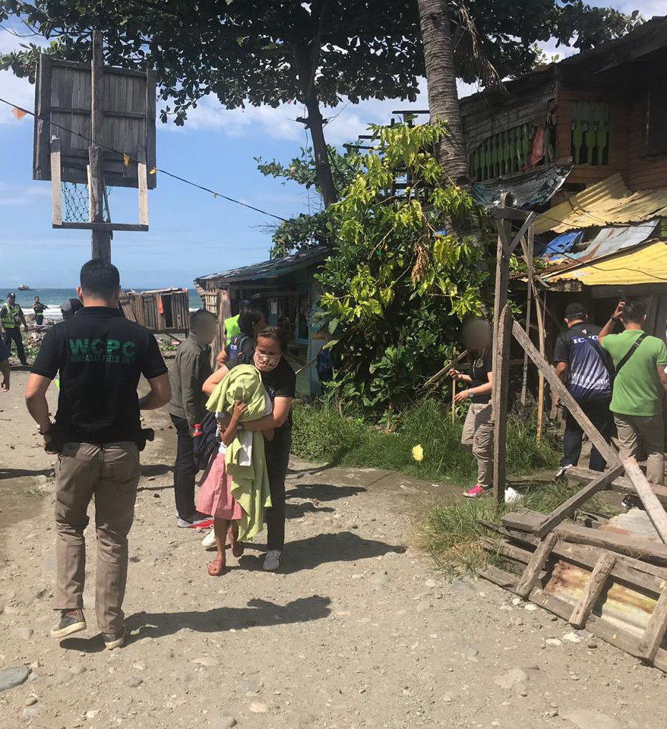
La historia de Marj*

Slide 5
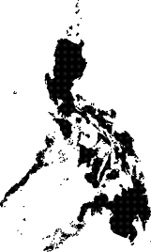
Cómo ocurre en general
US, Canada, Australia, UK, Germany and other Western European Countries
Agresores Locales / Facilitadores
Depredadores Sexuales Online
Internet (redes sociales, aplicaciones para enviar mensajes, etc.)
Víctima
Transferencia de dinero
Notes:
A typical OSEC case involves livestream abuse committed by local facilitators who have access to children like Marj* in exchange for payment by a foreign online sex predator. Marj’s story is not an isolated incident. Since 2011, IJM has supported the government rescue over 500 victims. In a unique legal landscape that allows non-government lawyers to prosecute criminal cases, we have supported the prosecution of about 180 cases so far.

Slide 6
Si se demuestra la culpabilidad por fuera de toda duda razonable, la sanción puede ser tan grave como cadena perpetua.
Notes:
In the Philippines, perpetrators of OSEC are commonly charged with a variety of crimes including violation of the Anti-Trafficking Act, the Anti-Child Pornography Act, the Anti-Cybercrime Act, and the Anti-Child Abuse Act. If proven guilty beyond reasonable doubt, the penalty can be as high as life imprisonment.
In my experience, however, it is extremely difficult to get convictions without the child’s actual court testimony. In this sense, our court system relies heavily on victim testimony. Furthermore, the transnational and technical nature of the crime have made investigations and prosecutions difficult. Prosecutors must be adept at handling and presenting digital evidence, be familiar with the rapidly changing technology, and should recognize the need not only for local coordination but also international cooperation.

Slide 7
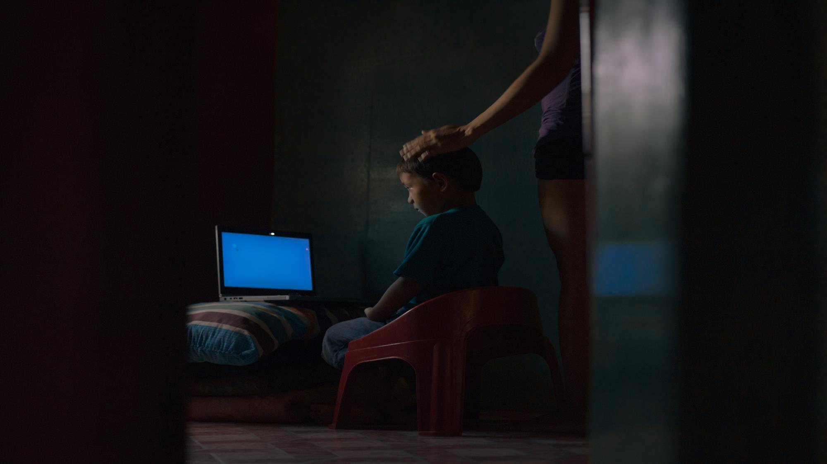
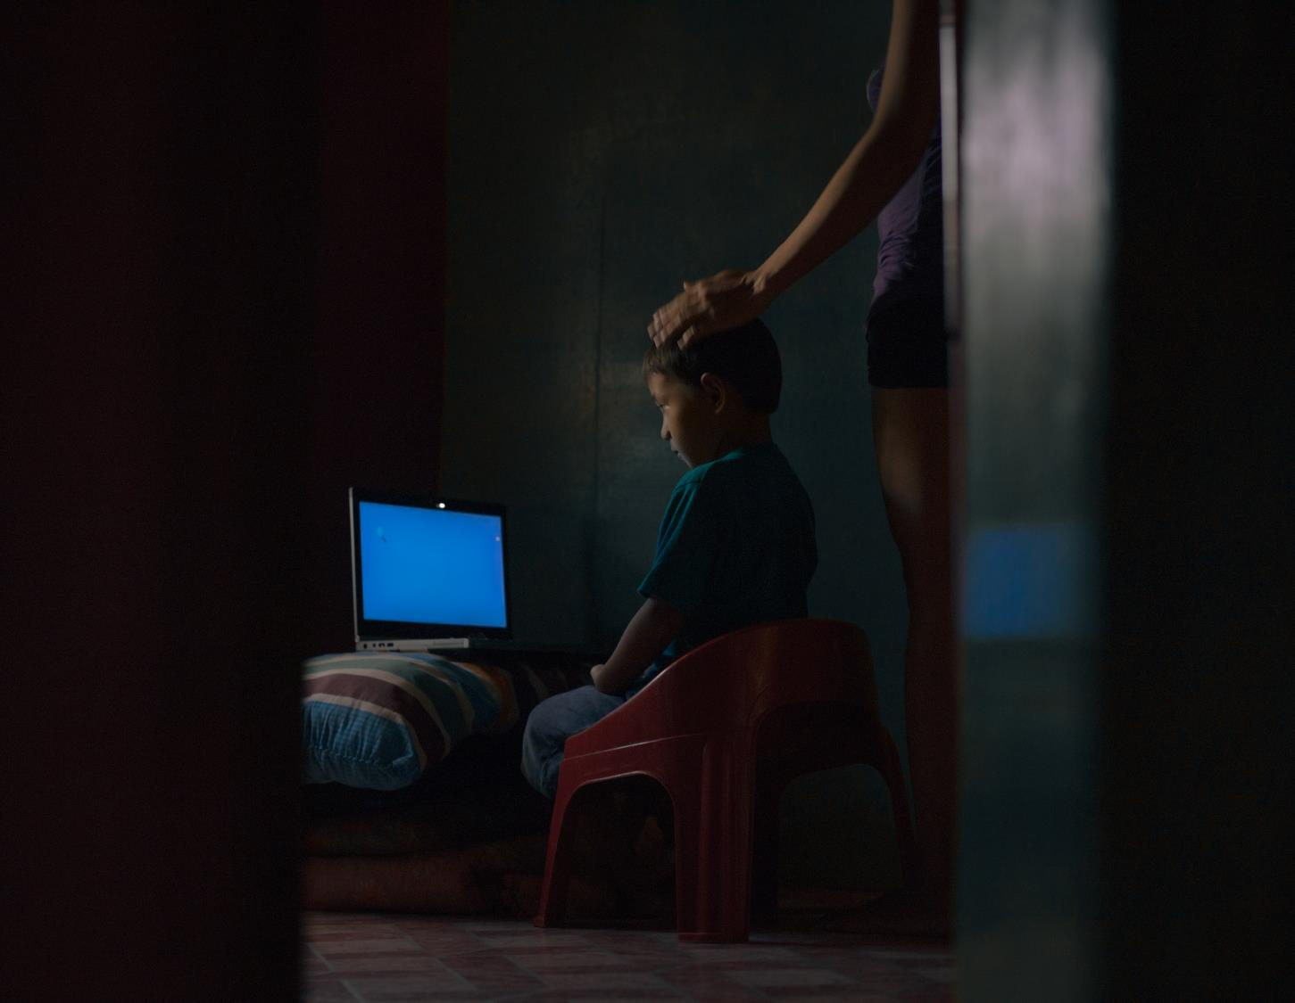
Lo que hemos aprendido
527 Víctimas de Tráfico de Sexo Cibernético Rescatadas*
Edad no especificada
Adultos
87.86% menores
*Recopilación de datos de IJM hasta el día 2 de septiembre de 2019
*Trabajo social desde 2011
Notes:
Our casework data shows that 50 percent of the victims are below 12 years old.

Slide 8
Lo que hemos aprendido
157 casos de OSEC respaldados por IJM*
17%
19%
*Recopilación de datos de IJM hasta el día 2 de septiembre de 2019
*Trabajo social desde 2011
Notes:
Our data also shows that 70 percent of the cases involve perpetrators who are related to the victims—meaning, in a lot of these cases, it is the parents or aunts and uncles who exploited their own kin.

Slide 9
EJECUCIÓN EFICAZ DE LA LEY
LA SOLUCIÓN:
UNA ESTRATEGIA COORDINADA
ELIMINAR EL TRÁFICO DE SEXO CIBERNÉTICO Y RECUPERAR A LOS SOBREVIVIENTES AFECTADOS
PROCESAMIENTO EFICAZ
ATENCIÓN ULTERIOR EFICAZ
ENTORNO COMPRENSIVO
Notes:
An effective solution includes a combination of quality law enforcement action, appropriate aftercare intervention to survivors, “forward-thinking” prosecution, and a supportive environment. In the Philippine context, “forward-thinking prosecution” means a departure from what is traditionally a heavy reliance on victims to prove a case; but uses data, technology, and collaboration with both local and international stakeholders to drive strategies. Forward-thinking means a shift in mindset; it is creating and innovating even within the confines of a rigid legal system.

Slide 10
Notes:
The first “forward-thinking” strategy is plea bargaining. You might ask why this is “forward-thinking” when plea bargaining is a common practice in a lot of jurisdictions. In the Philippines, too, plea bargaining has been in our rule book for a long time. However, it has rarely been used, especially in OSEC cases, until recently. We have also now started to frame how we see plea bargaining as a child protective measure. Furthermore, it also cuts significantly the time to complete the legal process. Since 2015, we have seen that about 80 percent of cases were under plea bargaining. This means that a lot of these children no longer had to participate in the trial and could focus instead on their healing and recovery.

Slide 11
Video de Entrevistas Detalladas
Notes:
Another “forward thinking strategy” is the use of video in-depth interviews. The Rules governing the children witnesses allow for the presentation of video in-depth interviews taken as a substitute to the actual live testimony of a child under certain circumstances. And yet this has been rarely used.

Slide 12
Notes:
Another solution: Prosecuting Online Sexual Exploitation of Children (POSE) Trainings, which are targeted, specific trainings geared towards capacitating court prosecutors in the handling, appreciation, and use of digital evidence to prove their case.

Slide 13
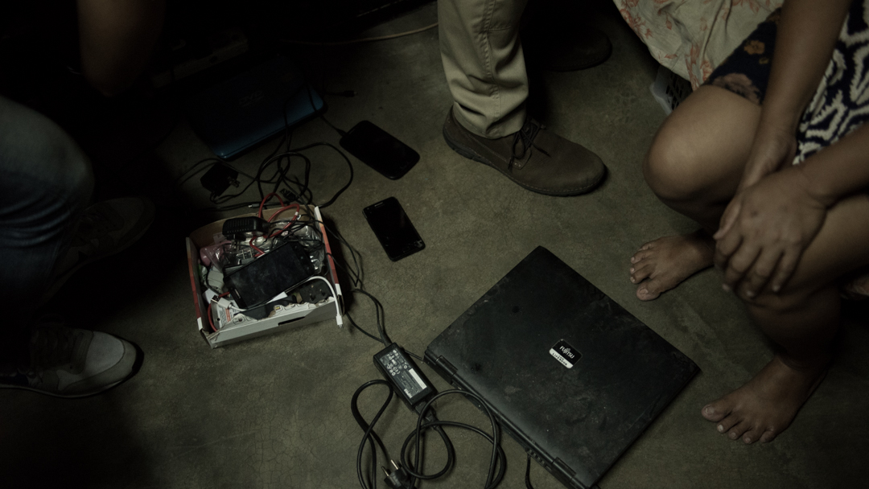
La Historia de Jane*
Notes:
Cooperation, both local and international, is also critical, as demonstrated in Jane’s story.

Slide 14
Resumen
Los datos de trabajo social brindan enfoques útiles.
Las medidas para lograr una menor dependencia del testimonio de las víctimas y para proteger a los niños deberían ser una prioridad para los procesamientos de OSEC.
Es crucial que la se conciba la capacitación dirigida a los fiscales teniendo en cuenta el sistema legal local y el tipo de delito.
La colaboración, tanto local como internacional, ha sido esencial para el éxito.

Slide 15
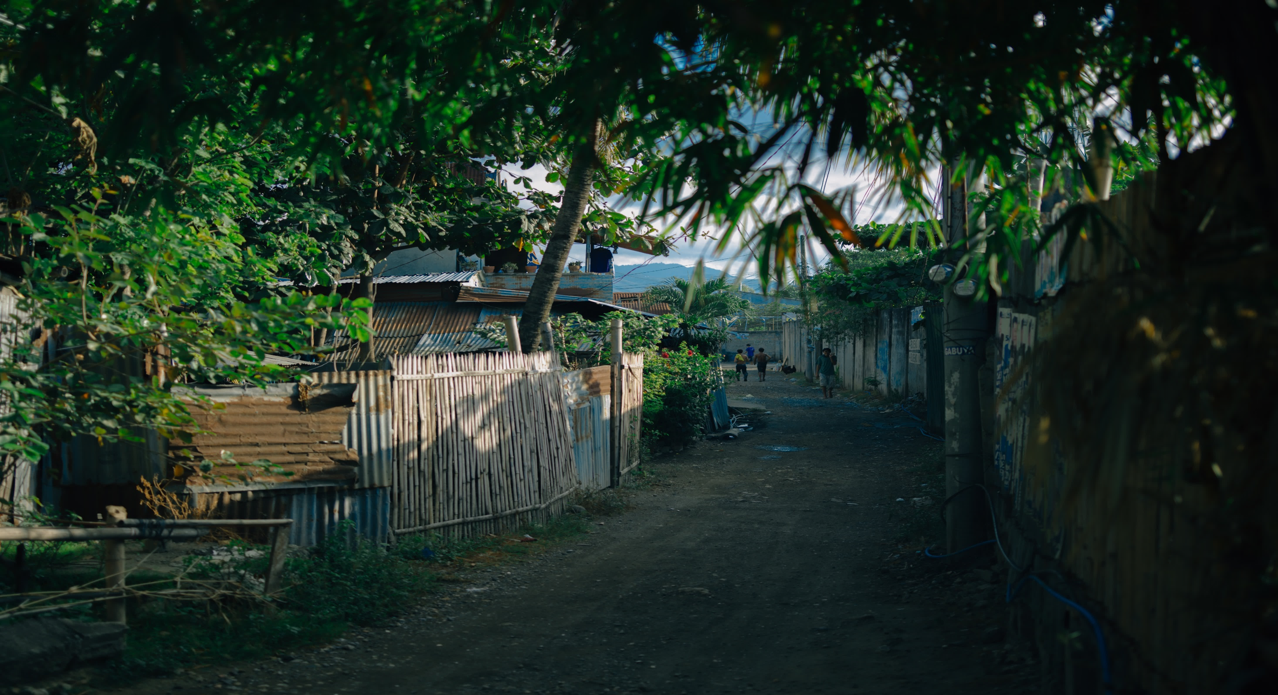
Ralph Vincent Catedral Manila, Filipinas INTERNATIONAL JUSTICE MISSION 🌏 ijm.org ✉ rcatedral@ijm.org
Notes:
IJM is committed to being a resource to other agencies and governments as they design solutions to stop violence and engage with justice systems. If your organization would like to explore ways that IJM could advise and assist you, please let us know.

