Slide 1
MUTUAL LEGAL ASSISTANCE IN THE
COLLECTION AND SHARING OF EVIDENCE
Challenges and Responses

Slide 4
DEMAND FOR MORE AND FASTER MUTUAL LEGAL ASSISTANCE
Evidence increasingly located across borders
“Perishable” electronic evidence

Slide 5
IMPROVING EFFICIENCIES IN WORKING ACROSS JURISDICTIONS
Better dissemination of information

Slide 6
IMPROVING EFFICIENCIES IN WORKING ACROSS JURISDICTIONS
Better dissemination of information
Template forms

Slide 7
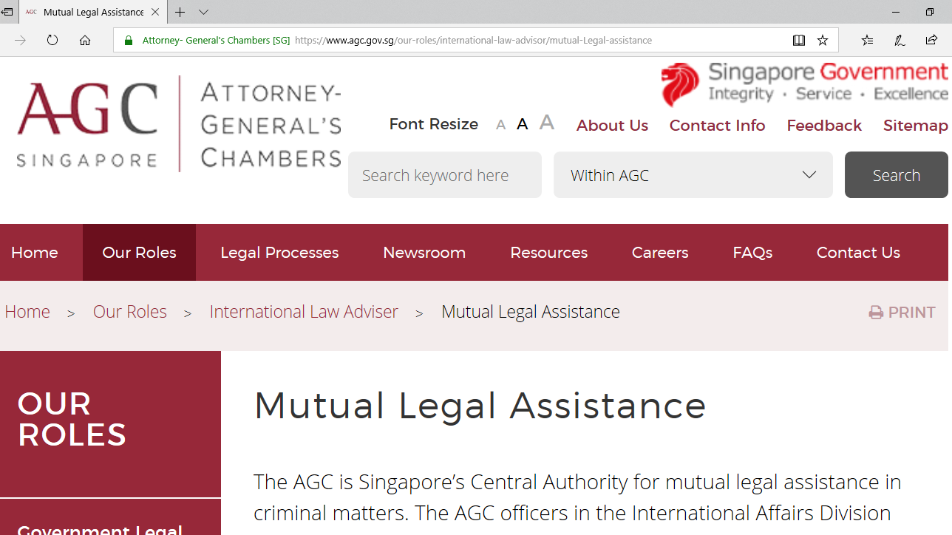
Attorney-General’s Chambers website (www.agc.gov.sg)

Slide 8
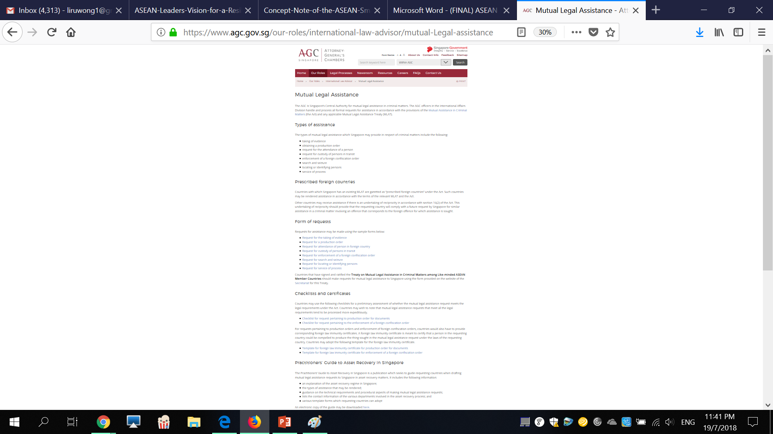
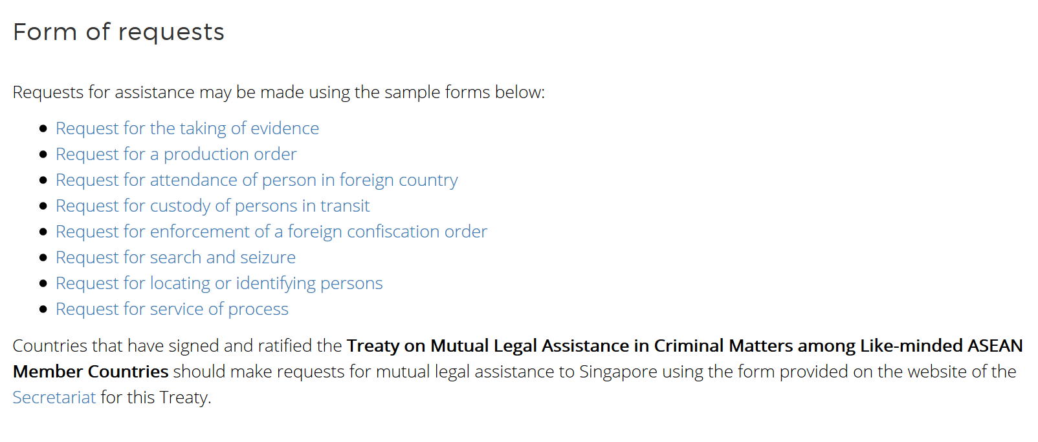

Slide 9
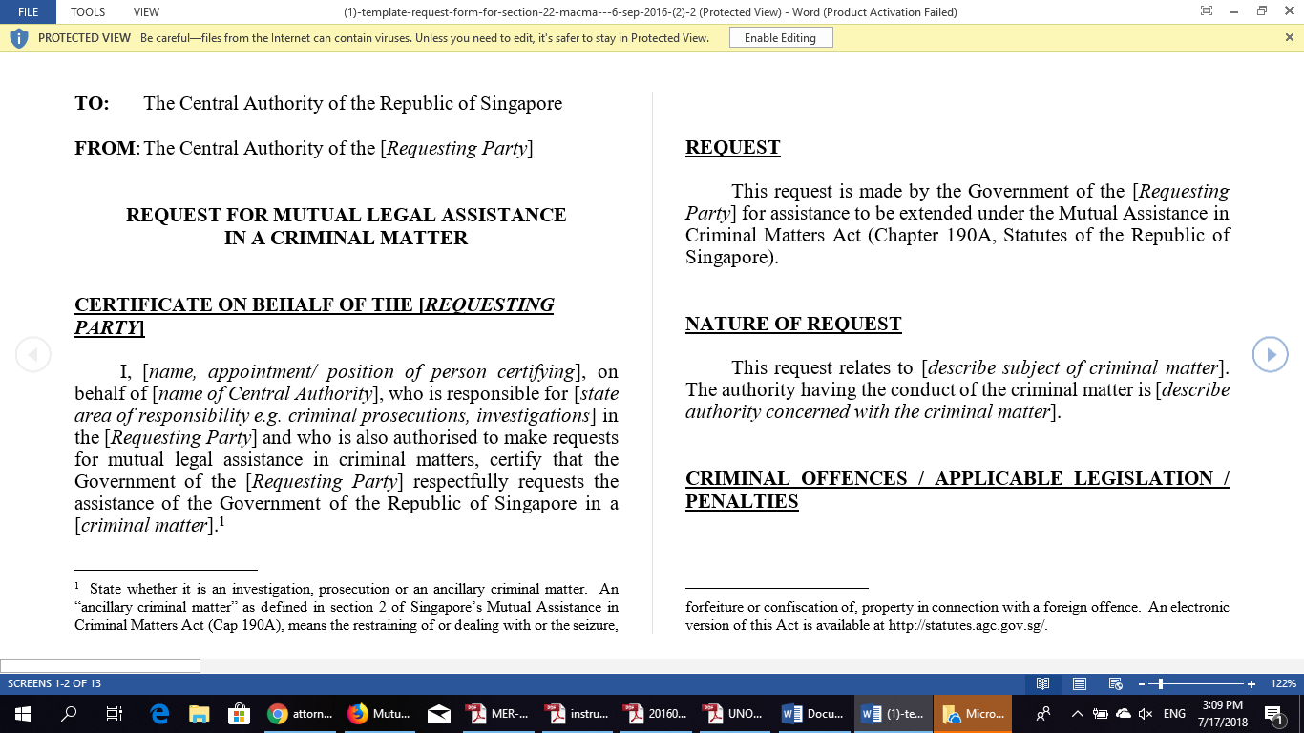

Slide 10
IMPROVING EFFICIENCIES IN WORKING ACROSS JURISDICTIONS
Better dissemination of information
Template forms
Addressing language barriers

Slide 11
Source:
Microsoft,
The AI Blog
https://blogs.microsoft.com/ai/chinese-to-english-translator-milestone/

Slide 12
IMPROVING EFFICIENCIES WORKING ACROSS JURISDICTIONS
Better dissemination of information
Template forms
Addressing language barriers
Diplomatic channels: do we still need them?

Slide 13
IMPROVING EFFICIENCIES WORKING ACROSS JURISDICTIONS
Better dissemination of information
Template forms
Addressing language barriers
Diplomatic channels: do we still need them?
Increasing contact and channels of communications

Slide 14
IMPROVING INTERNAL EFFICIENCIES
Better inter-agency coordination

Slide 15
IMPROVING INTERNAL EFFICIENCIES
Better inter-agency coordination
Changing organisational structures and processes

Slide 16

ADDRESSING THE CHALLENGES OF ELECTRONIC EVIDENCE

Slide 17
ADDRESSING THE CHALLENGES OF ELECTRONIC EVIDENCE
Review whether court approvals required
Provide for expeditious preservation orders
Facilitate more efficient use of electronic evidence

Slide 18
Example of WeChat messages extracted by forensics team

Slide 19
MUTUAL LEGAL ASSISTANCE IN THE
COLLECTION AND SHARING OF EVIDENCE
Challenges and Responses

