Slide 1
The IAP/Commonwealth ExCHANGE Programme – The TCI ODPP Experience

Slide 2
A PRESENTATION AT THE INTERNATIONAL ASSOCIATION OF PROSECUTORS 24th Annual CONFERENCE Buenos Aires, Argentina, September 2019 Presenter: Eugene Otuonye, Q.C. DPP, Turks and Caicos Islands

Slide 3
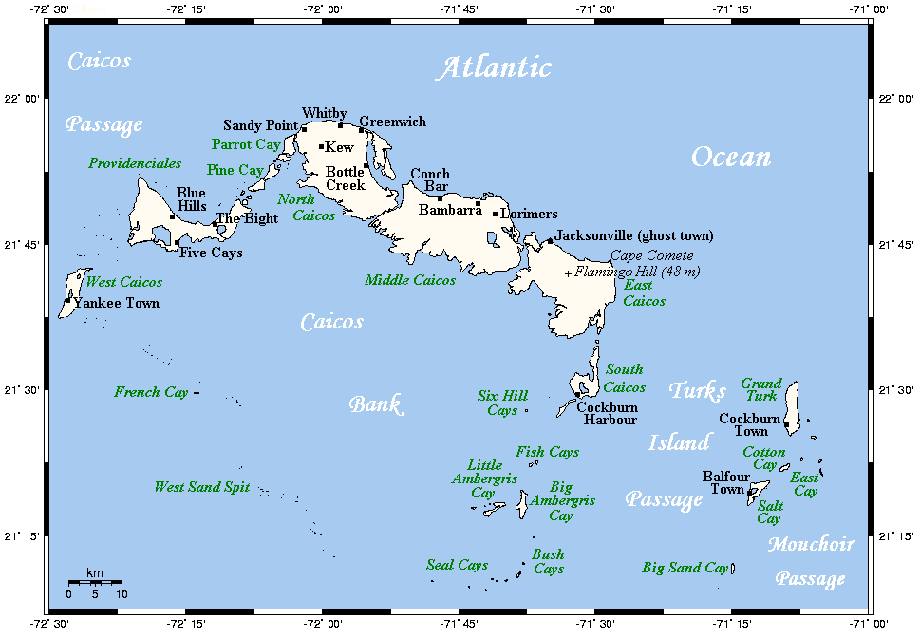
INTRODUCING THE TURKS AND CAICOS ISLANDS (TCI)
“Beautiful By Nature”

Slide 4
THE TURKS AND CAICOS ISLANDS:
One of U.K. Caribbean Overseas Territories;
It consists of an archipelago of small islands south of the
Bahamas; 612 miles south east of Miami; 90 miles north of Haiti
and the Dominican Republic;
Comprises of 40 islands and cays;
Land area of 190 square miles;
Total population of approx. 36,000
(excluding illegal immigrants);
Some of the islands have high quality and expensive tourist
developments and private homes.

Slide 5
BEFORE THE EXCHANGE PROGRAMME
The ODPP was created in 2012 under TCI Constitution;
3 DPPs between 2012-2018;
Institutional and leadership challenges that impeded strategic direction;
Unacceptable state of affairs - a grave concern to staff, CJS Partners, TCI Public.

Slide 6
THE BREAKTHROUGH
14 January 2019 New DPP took office;
High Public Expectation and ideas of new direction but not exactly how;
Waited for breakthrough;
April 1, 2019, Rachael Weir arrived under the Exchange Programme;
She brought the Breakthrough.

Slide 7
EVIDENCE OF THE BREAKTHROUGH
Held first staff General Meeting-Very Productive;
Team-building get away to TCI more tranquil islands;
Collaborative efforts of Rachael and Hilary Ryan(CJA from UK CPS)- the synergies were huge and instant;
Placement time extended for tangible outcomes;
Emerging of a cohesive Team.

Slide 8
SPECIFIC ACHIEVEMENTS
Draft Mission and Vision Statements;
Draft 5-Year Strategic Plan;
Detailed Action Plan – including formulation of Prosecution Policy
On – going mentoring Programme.

Slide 9
MUTUAL BENEFITS
“As much as the primary focus of the programme was on capacity building in ODPP, it was invaluable to me in the opportunity it afforded to develop my own legal and leadership skills, to reflect on prosecution practice in Scotland and in the scope to take my learning back to Scotland.”
Per: Rachael Weir

Slide 10
RECOMMENDATIONS
Increase Placement period to 6-12 weeks;
Follow up visits.

Slide 11
APPRECIATION
TO:
The International Association of Prosecutors;
The Commonwealth Secretariat, London;
The Crown Office and Procurator Fiscal Services, Scotland;
M/s. Rachael Weir, Placement Special Prosecutor;
M/s Hilary Ryan, CJ Adviser, UK CPS.

Slide 12
Many Thanks FOR LISTENING
Contact:
Eugene Otuonye, Q.C.
DPP, Turks and Caicos Islands
Tel: 1-649-2318886
Email: EOtuonye@gov.tc
QUESTIONS/
COMMENTS

