Slide 1
The role of the Prosecutor’s Office of the Russian Federation in environmental protection, including international cooperation for the protection of transboundary water resources
2

Slide 2
As a result of the Year of Ecology in Russia negative impact on the environment has been reduced
reduced emissions of air pollutants
mitigation of negative impact of industrial and household waste
reduced discharge of polluted wastewater in water bodies

Slide 3
Federal Law as of 17.01.1992 No 2202-1 On the Prosecutor’s Office of the Russian Federation
The Prosecutor’s Office of the Russian Federation is the single federal centralized system of bodies in charge of supervision on behalf of the Russian Federation over compliance with the Constitution of the Russian Federation and execution of the laws acting on the territory of the Russian Federation
3

Slide 4
Objects of inspections for compliance with environmental legislation
State and local authorities, their officials
Legal entities of all forms of ownership and entrepreneurs
10

Slide 5
The system of prosecution authorities of the Russian Federation includes 90 specialized environmental prosecutor's offices
The Prosecutor General’s Office of the Russian Federation
(Department for Supervision over Execution of Environmental Legislation and Natural Resources Management of the General Department for Supervision over Execution of Federal Legislation)
3
Interregional Environmental Prosecutor's Offices
(Amur, Baikal and Volga
environmental prosecutor's offices)
The Prosecutor’s Offices of the subjects of the Russian Federation
31
interdistrict environmental prosecutor's offices
56
interdistrict environmental prosecutor's offices
in the subjects of the Russian Federation
4

Slide 6
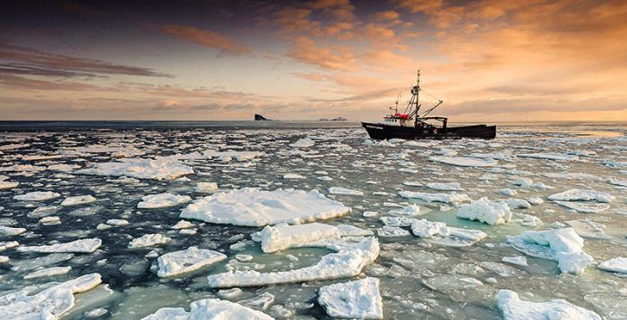
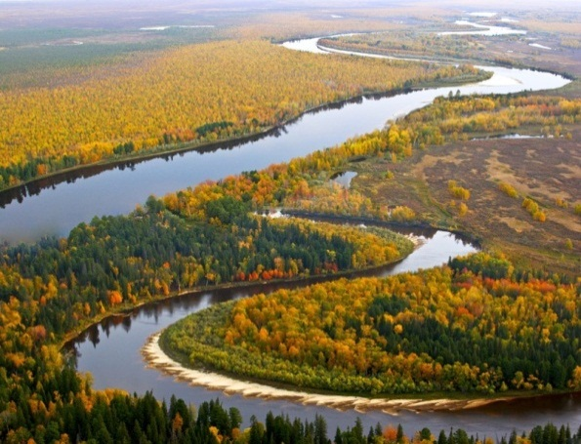
Water resources of the Russian Federation
The Russian Federation is washed by 12 seas, which belong to
3 oceans, as well as by the inland Caspian Sea
There are more than 2,5 mln. large and small rivers, more than 2 mln. lakes. on the territory of the Russian Federation
Russian water reserves
accounts for 22 % of world supply

Slide 7
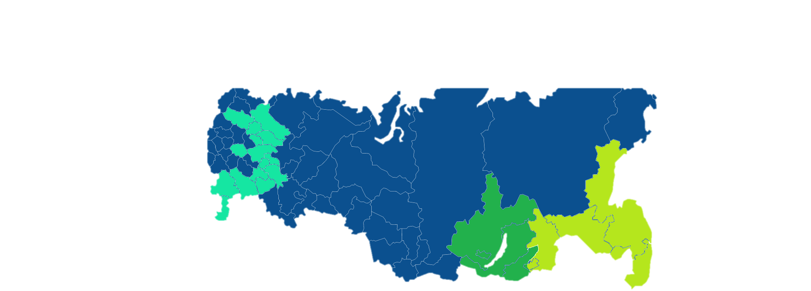
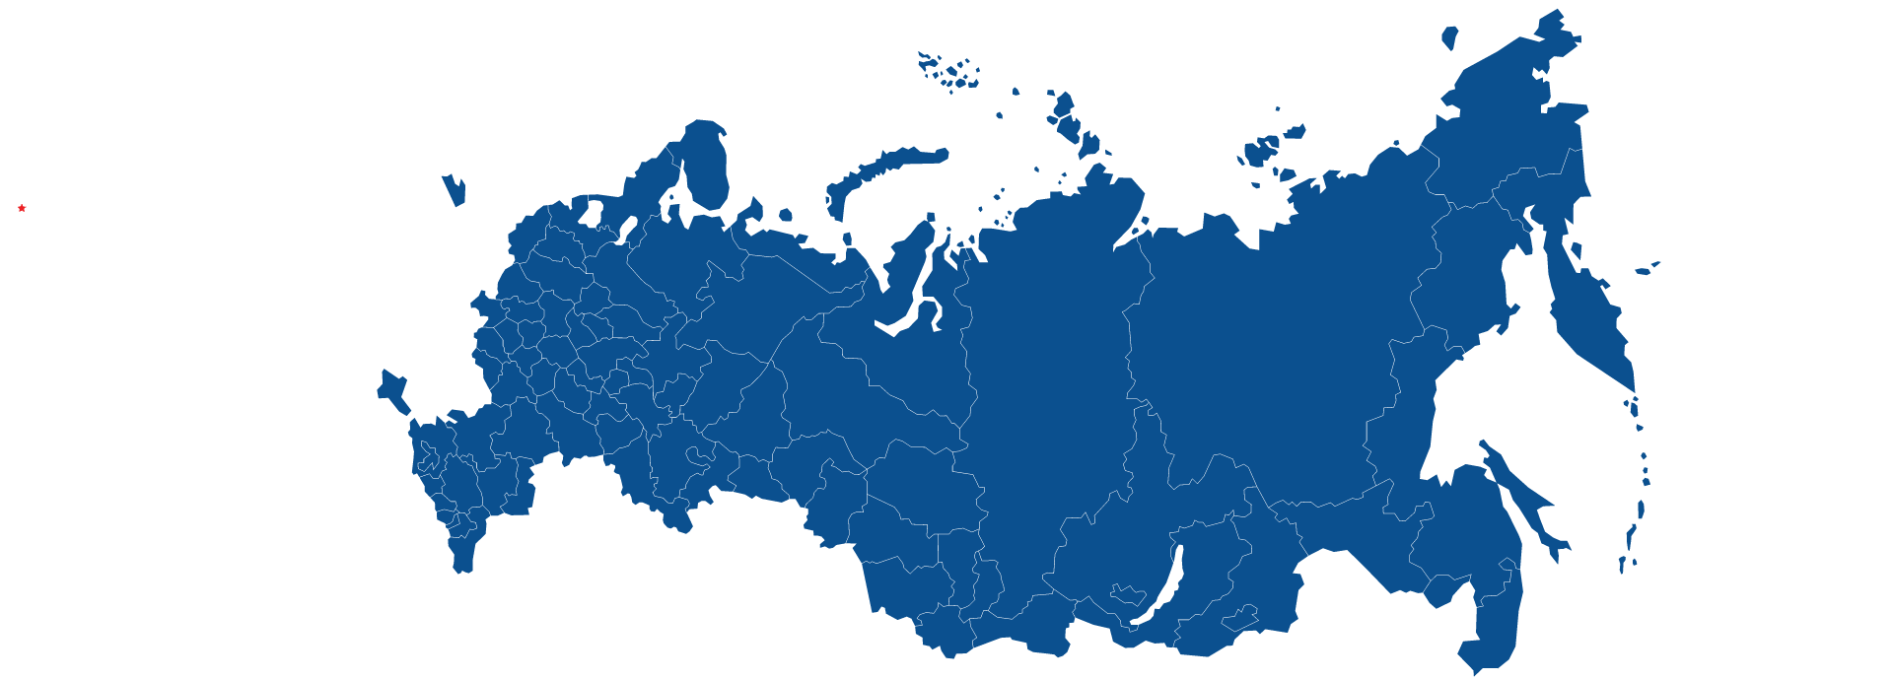
Volga interregional environmental prosecutor's office
Baikal interregional environmental prosecutor's office
Amur Basin environmental prosecutor's offices

Slide 8
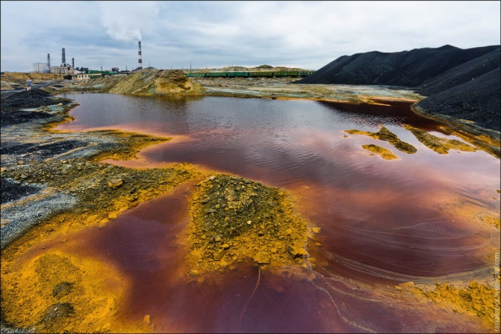
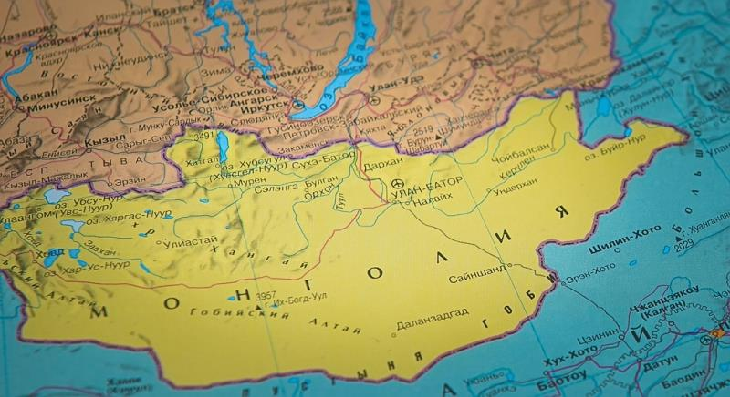
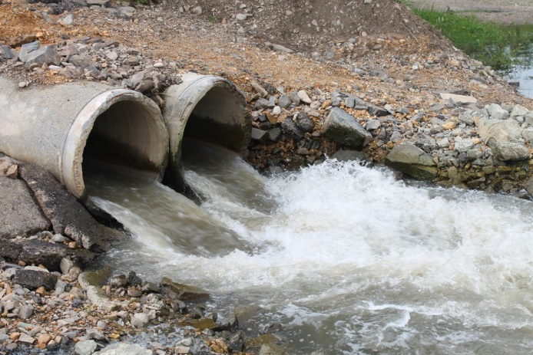

Slide 9
Priority areas of prosecutor's supervision in the sphere of environmental protection
The execution of legislation:
on the protection of water and air protection
land, soil and subsurface resources
fauna
aquatic bioresources
on forest management
on industrial and household waste

Slide 10
The main task of supervision over compliance
with the environmental legislation – safeguarding
and protection of constitutional rights of
citizens to favourable environment
13

Slide 11
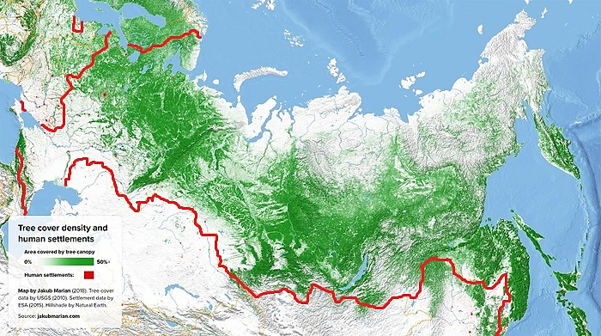
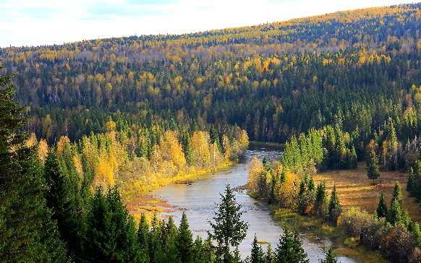
AREA OF FORESTS IN RUSSIA
approx.
800 mln. ha

Slide 12
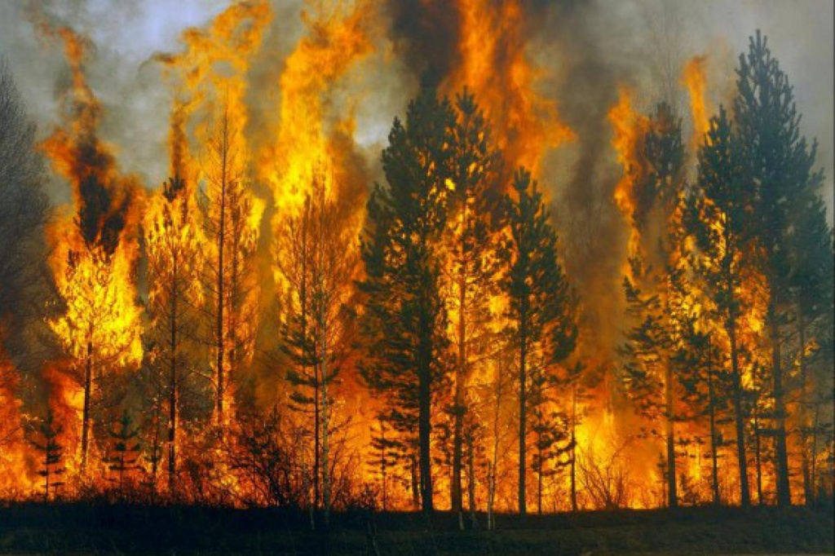
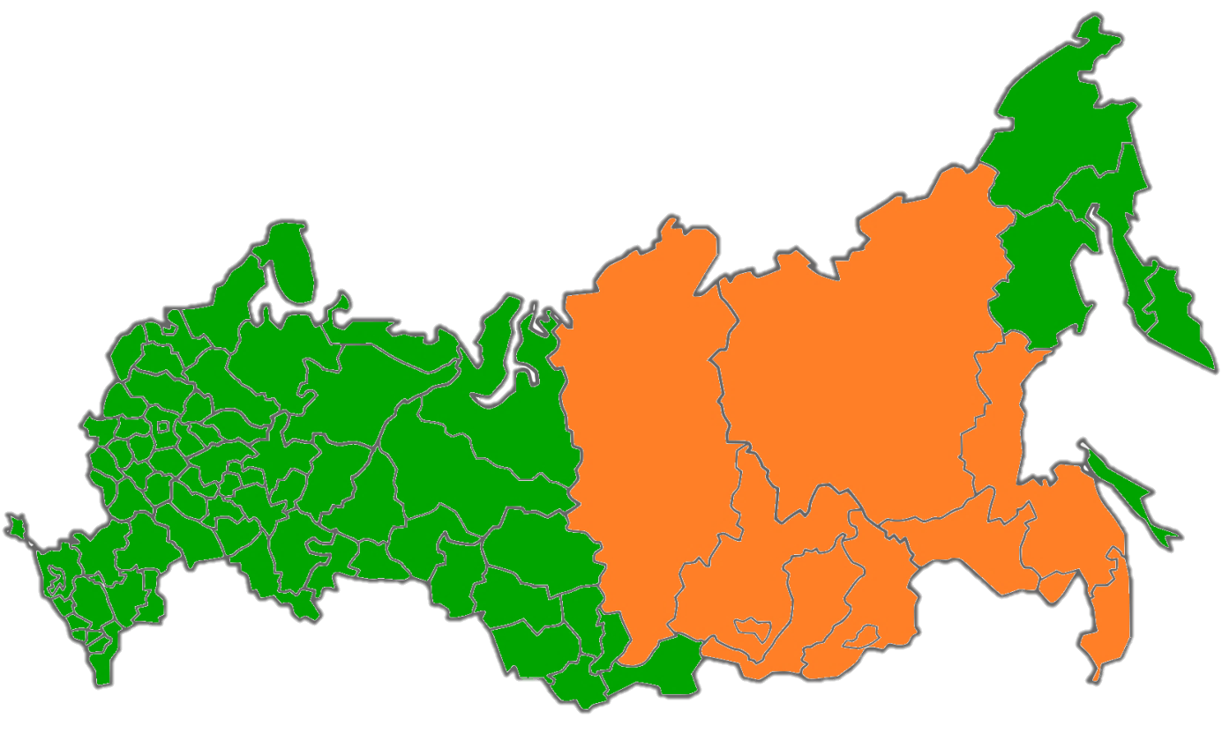
Most fire hazardous regions:
the Republic of Buryatia
the Republic of Sakha (Yakutia)
Zabaikalye Territory
Krasnoyarsk Territory
Primorye Territory
Khabarovsk Territory
Amur Region
Jewish Autonomous Region

Slide 13
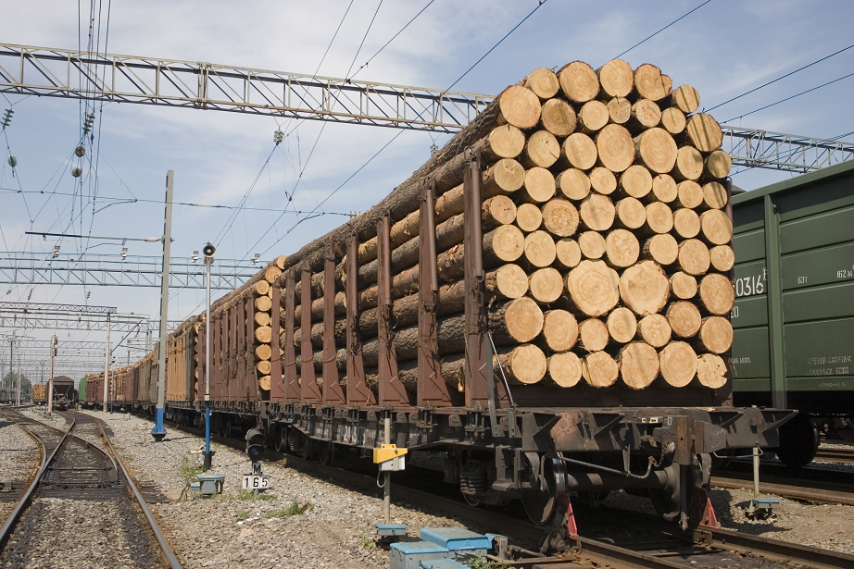
ILLEGAL TRAFFICKING OF TIMBER AMOUNTS TO 10 MLN. TONNES PER YEAR
UPON THE RESULTS OF 2018, BASED ON THE FACTS OF TIMBER EXPORT WITH VIOLATIONS OF LAW
MORE THAN 700 CRIMINAL CASES WERE INITIATED

Slide 14
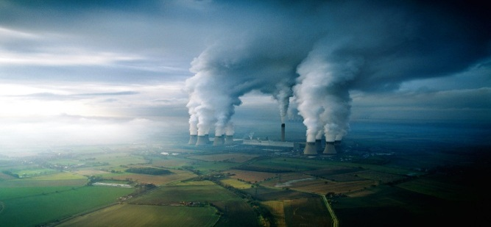
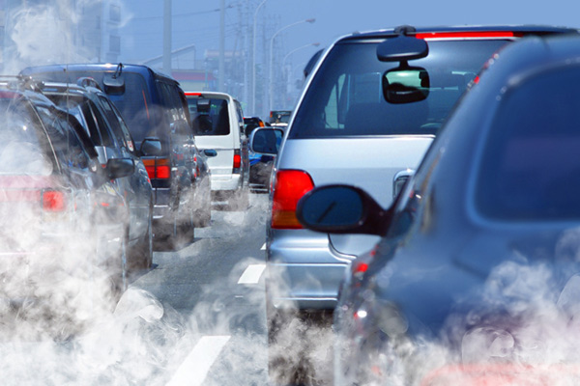
Emissions into the atmosphere
Annually more than 30 mln. tonnes of pollutants are emitted into the atmosphere
17 mln. tonnes by stationary sources
14 mln. tonnes by mobile sources

Slide 15
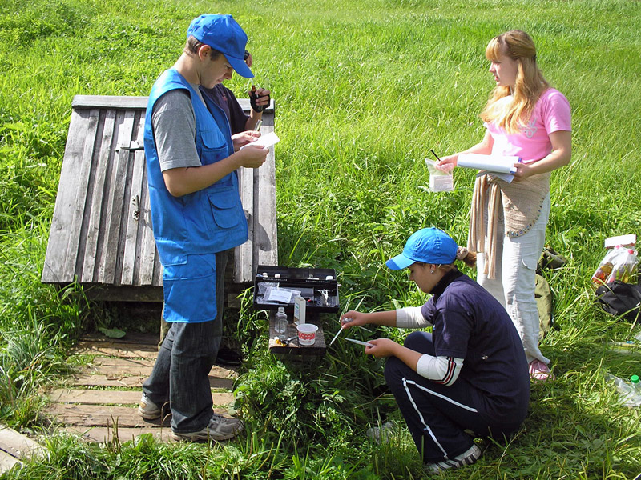
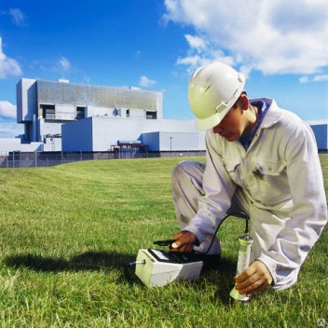
The efficiency of prosecutor’s supervision increases when environmental experts are engaged in inspections

Slide 16
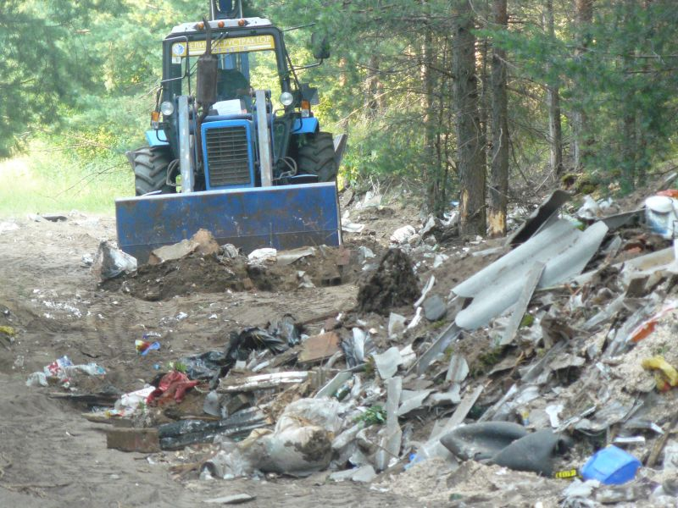
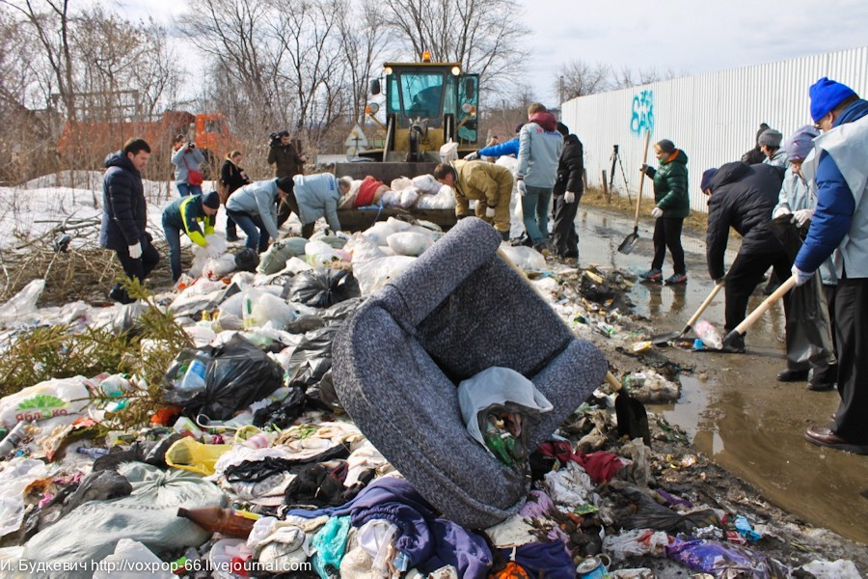
As a result of prosecutor’s interference in 2019 to date
more than 6 000 unsanctioned waste dumps have been eliminated

Slide 17
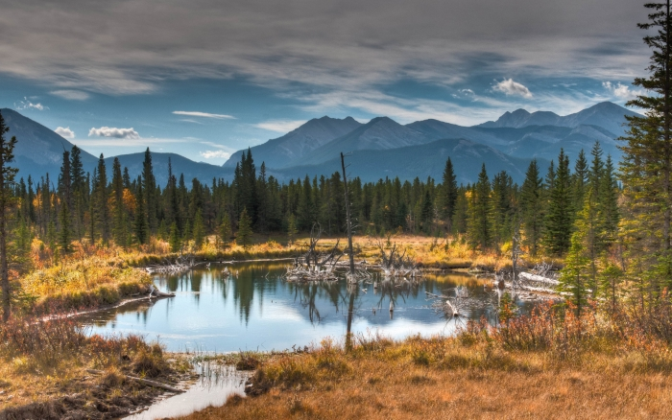
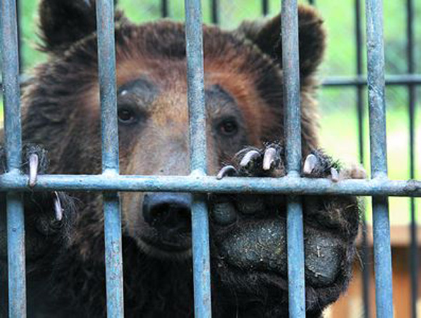
For the last 1,5 year prosecution authorities stopped 300 cases when animals were kept in semi-free conditions without permits

Slide 18
Principal measures of prosecutor’s response
Protest
made against unlawful legal act
Remedial action order
issued in order to eliminate detected violations
Act
issued when violations implying administrative liability are detected
Caution
given in order to prevent violations of the law
Application to court
submitted in order to compensate damage to environment, eliminate violations on a compulsory basis
Referring inspection materials to preliminary investigation bodies
applied when signs of crime are detected
11

Slide 19
Initiation of administrative proceedings by the prosecutor
Detecting administrative violation during the inspection
The prosecutor issues resolution to commence proceedings
Referring the case to the authorized body or court for consideration on the merits
Court’s (other authorized body) decision on the case of administrative offence
The review of the legality of the decision by the prosecutor, the possibility of appeal

Slide 20
The performance of prosecutors with regard to supervision over execution of environmental legislation in 2018
278 000
detected violations
10 000 protests
against unlawful legal acts
25 000 applications submitted to court
for a total amount of 2,8 bln. rubles
64 000 submissions
26 000 individuals brought to administrative liability
2 000 criminal cases initiated as a result of prosecutors’ inspections
6

Slide 21
The performance of prosecutors with regard to supervision over execution of environmental legislation in the first half of 2019
171 000
detected violations
8 000 protests
against unlawful legal acts
15 000 applications submitted to court
for a total amount of 2,3 bln. rubles
44 000 submissions
13 000 individuals brought to administrative liability
1 000 criminal cases initiated as a result of prosecutors’ inspections
6

Slide 22
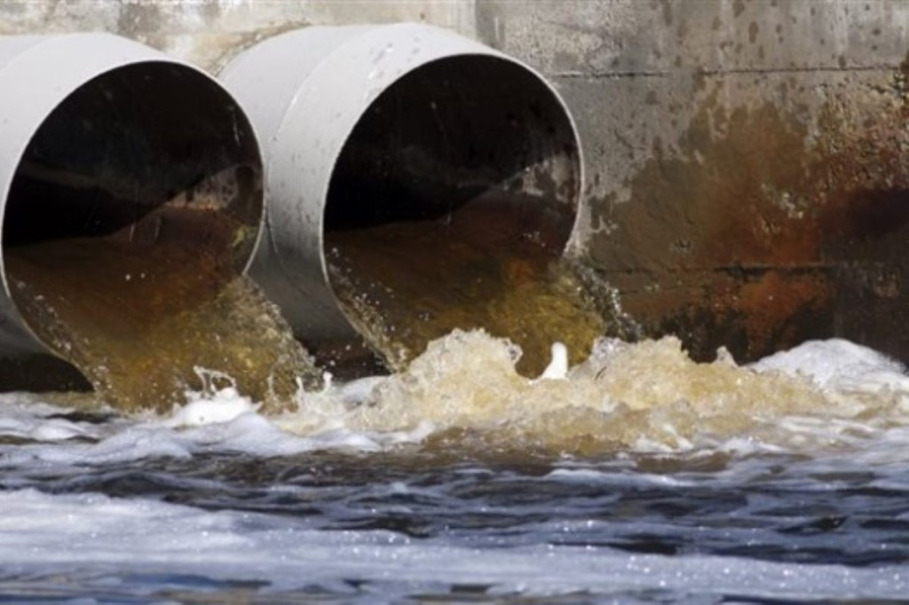
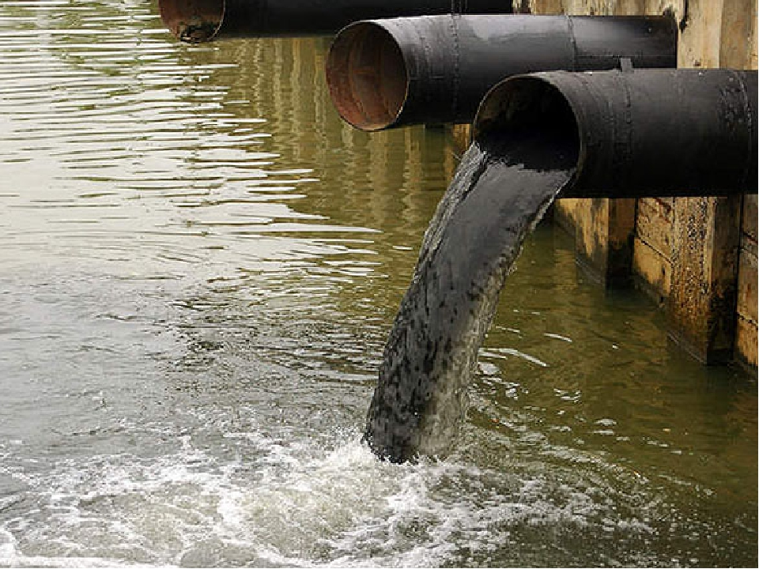
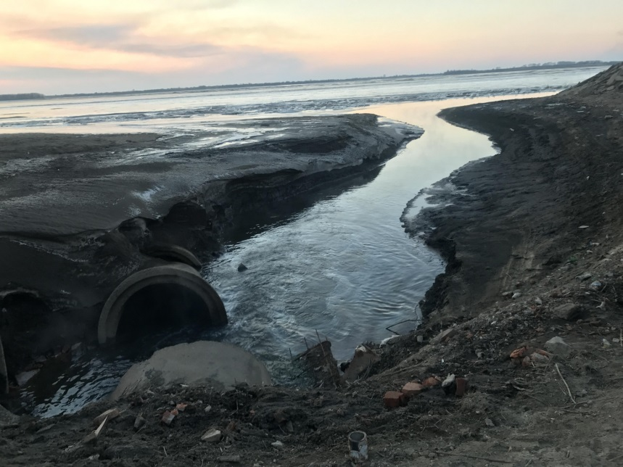

Slide 23
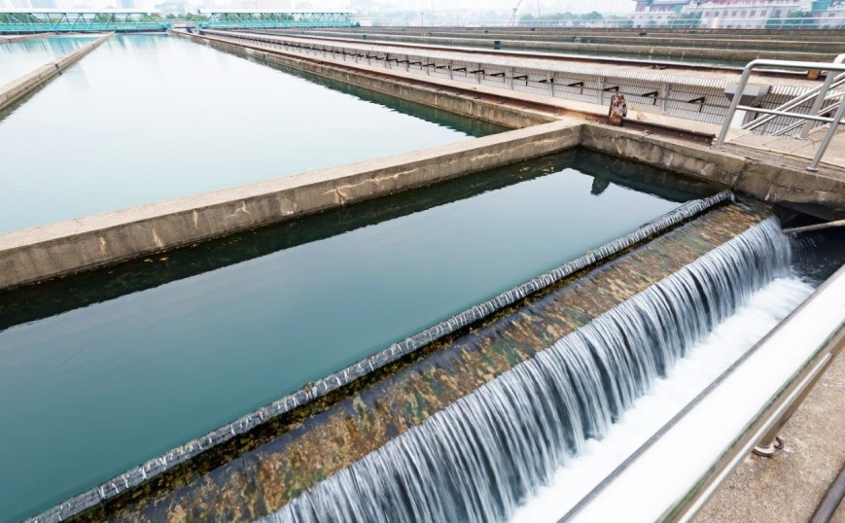
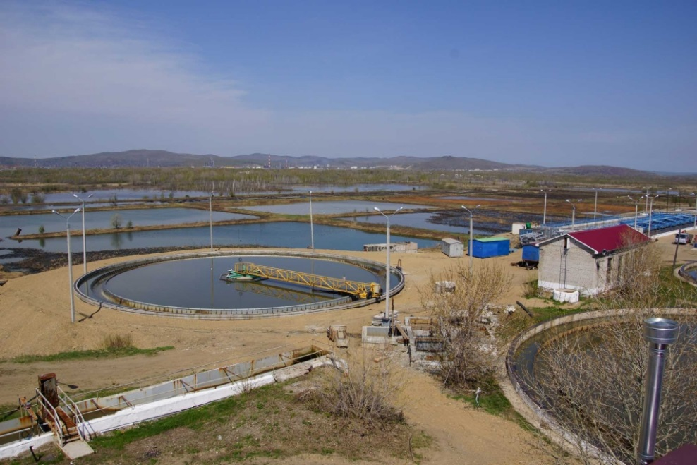
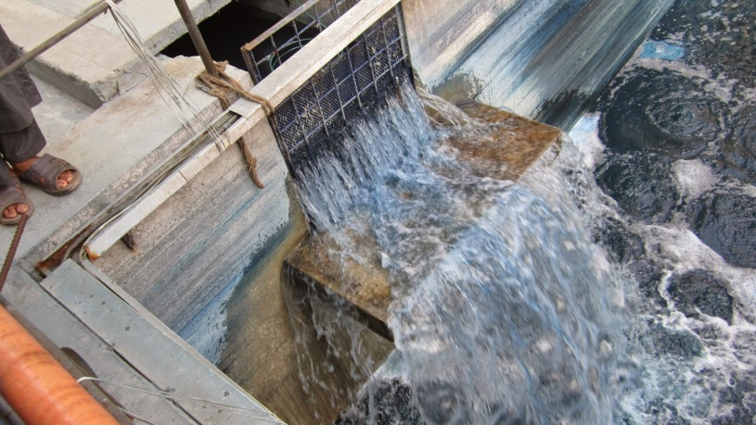

Slide 24
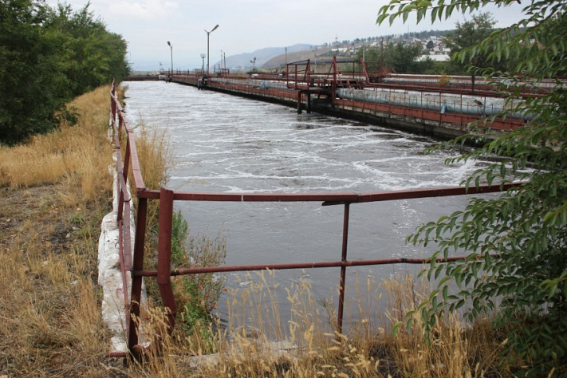
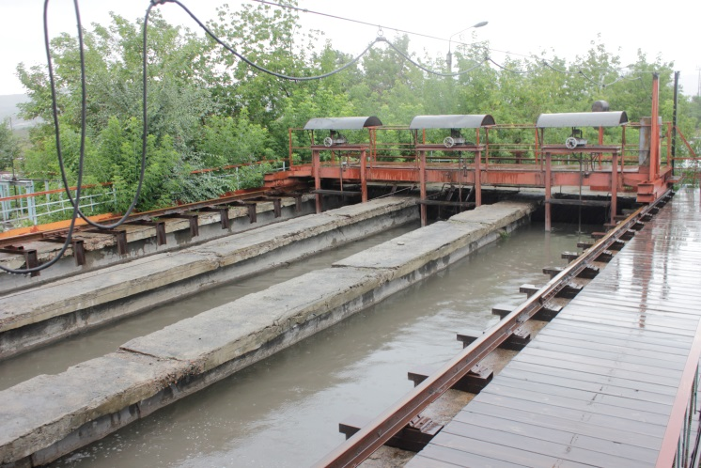
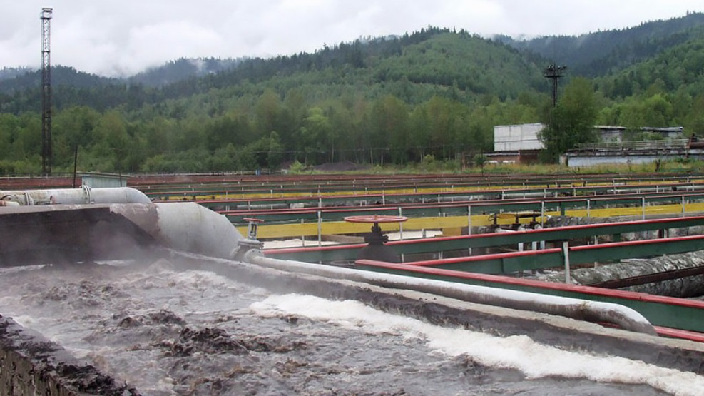
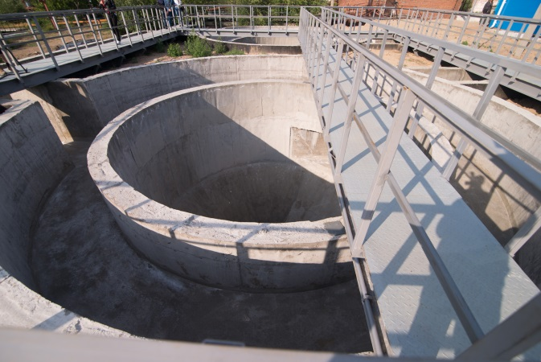

Slide 25
Thank you for your attention!

