Slide 1
iberoamerican network
regional cooperation between prosecutors in human trafficking cases

Slide 2
main topics
THE IMPORTANCE OF INTERNATIONAL LEGAL COOPERATION IN HUMAN TRAFFICKING CASES.
INTERNATIONAL OBLIGATIONS TOWARDS VICTIMS OF HUMAN TRAFFICKING.
THE IMPORTANCE OF A MUTUAL PROTOCOL BETWEEN PROSECUTORS.
THE “IBEROAMERICAN NETWORK OF SPECIALIZED PROSECUTORS AGAINST TRAFFICKING IN PERSONS AND SMUGGLING OF MIGRANTS.” *REDTRAM*.

Slide 3
THE IMPORTANCE OF INTERNATIONAL COOPERATION IN TIP CASES
PALERMO PROTOCOL. ARTICLE 2.
IN THE IBEROAMERICAN REGION: THE CONCLUSION OF MANY GENERAL ASSEMBLY OF THE IBEROMERICAN ASSOCIATION OF PUBLIC PROSECUTOR´S OFFICE.
IN LATINOAMERICA THE ROUTES OF THIS CRIME USUALLY INCLUDES TWO OR MORE COUNTRIES OF THE SAME REGION.
THIS CRIME IS CONSIDERED A VIOLATION OF BASICS HUMAN RIGHTS AND THE VICTIMS ARE VULNERABLE AND MAY NEED URGENT CARE AND REPATRIATION.

Slide 4
THE IMPORTANCE OF INTERNATIONAL COOPERATION IN TIP CASES

Slide 5
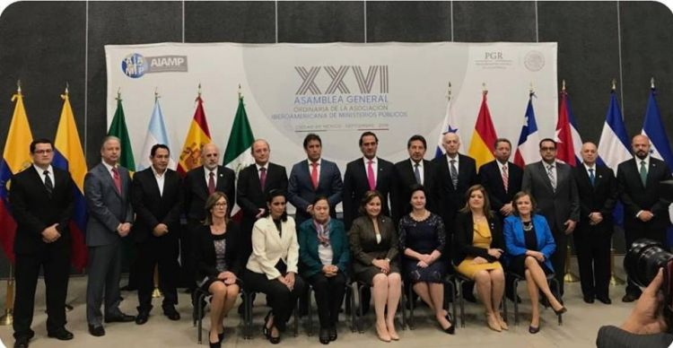
THE IMPORTANCE OF COOPERATION BETWEEN PROSECUTORS IN TIP CASES.
SOME PRACTICAL EXAMPLES ABOUT THE IMPORTANCE OF HAVING AN EFFECTIVE INTERNATIONAL COOPERATION BETWEEN PROSECUTORS IN TIP CASES.
THE BENEFITS OF THE “JOINT INVESTIGATION TEAMS”.
THE NEW DOCUMENTS ADOPTED IN THE GENERAL ASSAMBLY OF THE IBEROAMERICAN ASSOCIATION OF PUBLIC PROSECUTOR`S OFFICE (AIAMP):
MODEL AGREEMENT FOR THE CREATION OF JOINT INVESTIGATION TEAMS.
Steps for the creation of joint investigation teams.

Slide 6
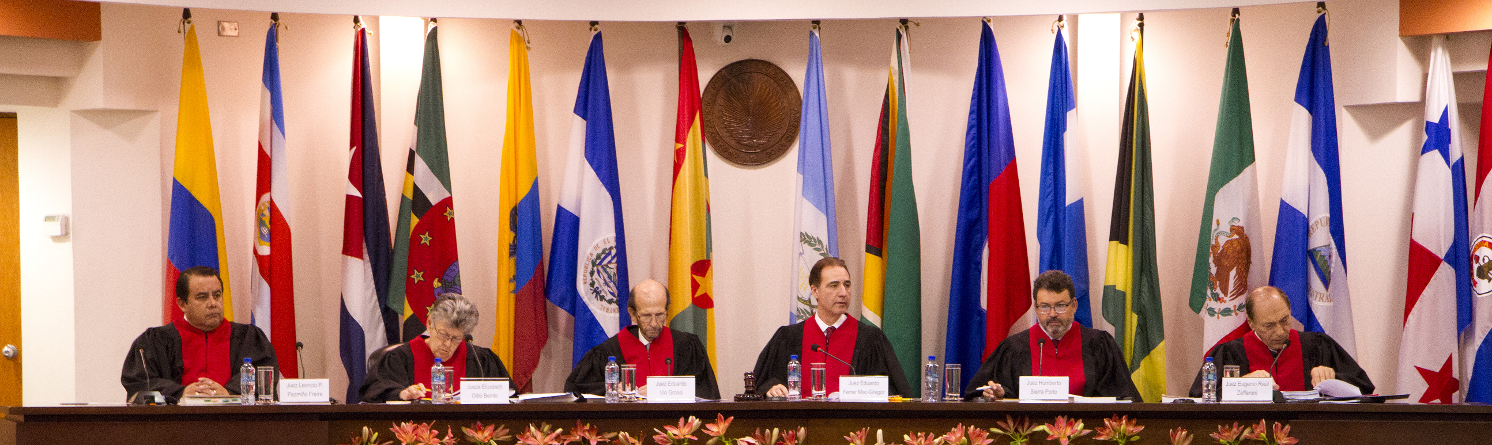
INTERNATIONAL OBLIGATIONS UPON STATES TOWARDS HUMAN TRAFFICKING VICTIMS.
“HACIENDA BRASIL VERDE WORKERS VS. BRAZIL”, INTERAMERICAN COURT OF HUMAN RIGHTS. THE FIRST PRECEDENT OF THIS COURT ABOUT HUMAN TRAFFICKING.
MAIN OBLIGATIONS:
CREATE THE NECESSARY CONDITIONS SO THAT NO-ONE IS SUBJECTED TO HUMAN TRAFFICKING OR EXPLOITATION.
ADOPT ALL THE STEPS TU PUT AN END TO SUCH PRACTICES.
EFFECTIVELY PREVENT AND INVESTIGATE HUMAN TRAFFICKING CASES
PROTECT AND ASSIST HUMAN TRAFFICKING VICTIMS.

Slide 7
INTERNATIONAL STATES OBLIGATIONS TOWARDS HUMAN TRAFFICKING VICTIMS
TO ACHIEVE THESE AIMS IN TRANSNATIONAL CASES, STATES MUST COOPERATE WITH EACH OTHER.
PROSECUTORS ARE CRUCIAL TO GUARANTEE AN EFFECTIVE ACCESS TO JUSTICE:
A. THE VICTIM’S ASSISTANCE, PROTECTION, THE RETURN TO THEIR HOME COUNTRY, ETC.
B. THE COMPENSATION THROUGH THE ASSET RECOVERY PROCESS.

Slide 8

REDTRAM
IBEROAMERICAN NETWORK OF SPECIALIZED PROSECUTORS AGAINST TRAFFICKING IN PERSONS AND SMUGGLING OF MIGRANTS.
REDTRAM
Created in 2011 within the Iberoamerican Association of Public Prosecutor’s Offices (AIAMP)
Each one of the 21 States parties appointed a specialized prosecutor as member of the network.
Prosecutors cooperate with each other in hard cases, emergency, international complains, etc.

Slide 9


Slide 10
redtram
IN 2017 WE’VE SIGNED THE PROTOCOL OF INTER-INSTITUTIONAL COOPERATION TO STRENGTHEN THE INVESTIGATION, ATTENTION AND PROTECTION TO VICTIMS OF THE CRIME OF TRAFFICKING IN PERSONS AND SMUGGLING OF MIGRANTS AMONG IBERO-AMERICAN PUBLIC PROSECUTOR’S OFFICES (AIAMP)
AIMS:
STRENGTHEN THE INTERNATIONAL COOPERATION.
SPONTANEOUS EXCHANGE OF INFORMATION
CREATION OF A GENERAL DATABASE
COMMITMENT TO ESTABLISH JOINT INVESTIGATION TEAMS.
ESTABLISHMENT OF MINIMUM PARAMETERS RELATED TO PROTECTION, ASSISTANCE AND REPATRIATION OF VICTIMS.

Slide 11
REDTRAM
WEB PLATAFORM TO SECURE EXCHANGE OF INFORMATION AND MUTUAL ASSISTANCE.
COMPLEMENTED WITH INFORMAL MEANS OF COMMUNICATION TO ALERT ABOUT EMERGENCIES.
SOME EXAMPLES OF BEST PRACTICES AND CASES.

Slide 12



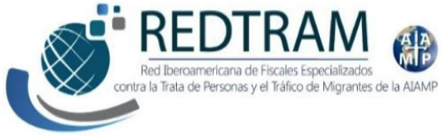
REDTRAM IS SUPPORTED BY AIAMP, UNODC, AECID AND THE DIFFERENT PUBLIC PROSECUTOR OFFICES.

Slide 13
CONCLUSIONS
TRANSNATIONAL ORGANIZED CRIME PROMOTES THE NECESSITY TO ACTUALIZE THE ENTIRE MUTAL JUDICIAL ASSISTANCE SYSTEM.
WE NEED NEW TOOLS OF INTERNATIONAL COOPERATION IN ACCORDANCE TO THE WORLD INTEGRATION OF ECONOMY, POLITICAL AND SCIENCE.
THIS IS MORE IMPORTANT WHEN WE ARE WORKING WITH THE MOST VULNERABLE VICTIMS IN THE WORLD.
PROSECTORS ARE CRUCIAL TO GUARANTEE VICTIM’S PROTECTION, ASSISTANCE AND COMPENSATION.

Slide 14
THANK YOU
MUCHAS GRACIAS
María Alejandra Mángano
Fiscal
República Argentina.

