Slide 1
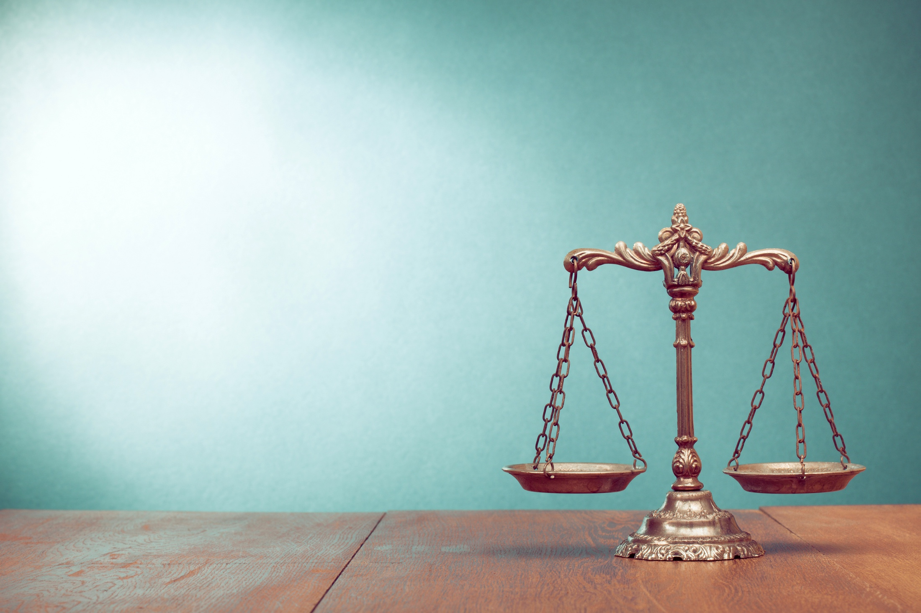
International Cooperation in Corruption Cases
International Association of Prosecutors
2019 Meeting
Buenos Aires, Argentina
NAAG Executive Director Christopher Toth

Slide 2
Presentation Overview
Information Sharing
MLATs
INTERPOL
Role of Media in the Fight Against Corruption
Panama Papers

Slide 3
Information Sharing: MLATs
Mutual Legal Assistance Treaties (“MLATs”)
U.S. Dep’t of Justice Office of International Affairs (“OIA”) handles
Prosecutors in U.S. request assistance through OIA; OIA has request translated, if necessary, and sent to its counterpart in other country
And vice versa…
Can include requests for:
Documents
Witness interview
VTC testimony
Arrest

Slide 4
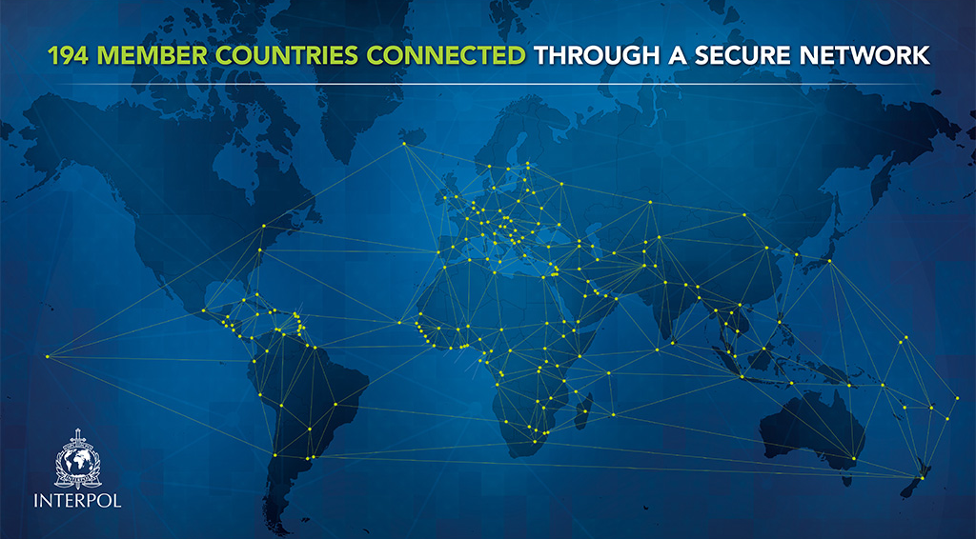
Information Sharing: INTERPOL
International Criminal Police Organization
Helps police in 194 member countries
Maintains 17 police databases
Names
Fingerprints
Stolen passports
Offers investigative support
Forensics
Analysis
Fugitive location
https://www.interpol.int/Who-we-are/What-is-INTERPOL

Slide 6
INTERPOL Example Notice: Red Notice
Request to law enforcement worldwide to locate and provisionally arrest person pending extradition, surrender, or similar legal action
Two types of info:
Identity of wanted person (name, photos, hair and eye color, fingerprints)
Type of crime person alleged to have committed/ convicted of committing
Not an arrest warrant itself
58,000 valid Red Notices
7061 public
4 wanted by Dominican Republic
109 wanted by Azerbaijan
334 wanted by U.S.
2589 wanted by Russia
https://www.interpol.int/How-we-work/Notices/Red-Notices

Slide 7
Role of Media in the Fight Against Corruption
Journalism can reveal schemes that prosecutors can choose to investigate
Prosecutors must do independent investigation to
→ Determine if allegations of impropriety fulfill all elements of a crime
Not everything scandalous or “bad” is a crime
→ Ensure information is reliable
Interview again any witnesses cited by press (and others)
→ Obtain admissible evidence
E.g., subpoena or obtain search warrants to seize original documents
One reason free press is important
Several studies show high levels of press freedom lead to lower levels of corruption
https://pdfs.semanticscholar.org/72a2/2b5a28772d654cde4df1ec528e90be7a8752.pdf

Slide 8
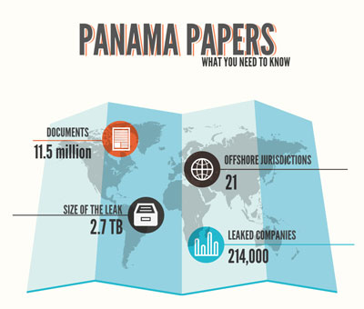
https://www.worldpress.org/article.cfm/panama-papers-explained

Slide 9
Panama Papers: By the Numbers
Reporting by International Consortium of Investigative Journalists (“ICIJ”):
> 500 reporters in nearly 90 countries working on investigation
76 countries simultaneously published stories
4,700 stories by the end of 2016
ICIJ finds connected to secret offshore companies:
12 heads of state
> 60 relatives & associations of heads of state and politicians
128 other public officials
https://reutersinstitute.politics.ox.ac.uk/sites/default/files/2019-03/Graves_Gauging_the_Global_Impacts_of_the_Panama_Papers_FINAL_0.pdf
https://www.bbc.com/news/world-35954224

Slide 10
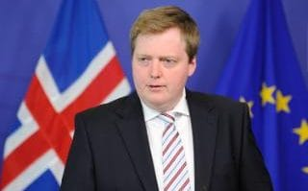
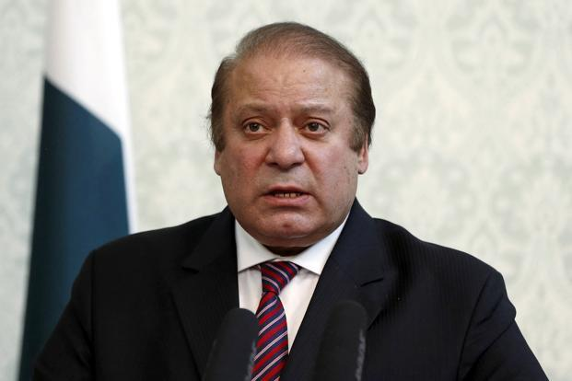
Panama Papers
Early April 2019: ICIJ published findings from documents leaked from Panamanian law firm reflecting that heads of state, their families, and other public officials were connected to secret offshore companies
Iceland Prime Minister
Sigmundur Davíð Gunnlaugsson
Pakistan Prime Minister Nawaz Sharif
https://www.livemint.com/Politics/e5PYXPT3229Uibpe5EaxuI/Chronology-of-Panama-Papers-scandal-in-Pakistan.html

Slide 11
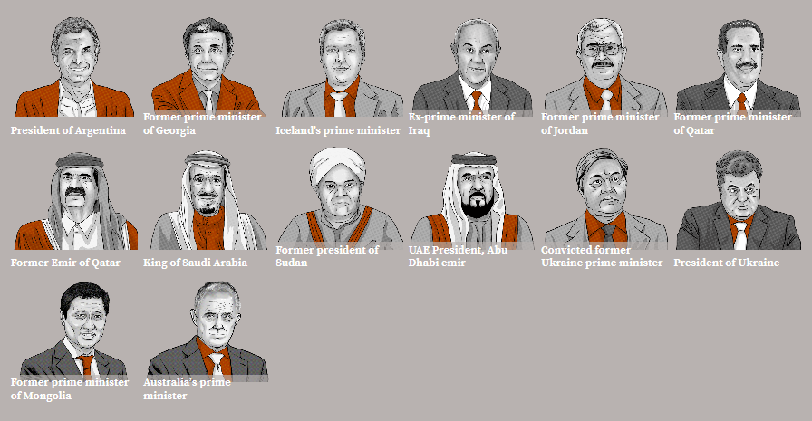
Panama Papers: Heads of State
https://www.icij.org/investigations/panama-papers/the-power-players/

Slide 12
https://www.icij.org/investigations/panama-papers/what-happened-after-the-panama-papers/

Slide 13
Panama Papers
RESIGNED
OUSTED
CONVICTED
Iceland Prime Minister
Sigmundur Davíð Gunnlaugsson
Pakistan Prime Minister Nawaz Sharif
https://www.politico.eu/article/iceland-prime-minister-sigmundur-david-gunnlaugsson-seeks-early-elections-panama-papers-tax-haven/
https://www.nytimes.com/2018/12/24/world/asia/pakistan-nawaz-sharif-sentenced.html

Slide 14
The Panama Papers: Gov’t Investigations Spurred by ICIJ Work
More than $1.2 billion has been recouped in 22 countries. (Dark Green). Investigations were sparked in more than 82 countries. (Light Green)
https://www.icij.org/investigations/panama-papers/panama-papers-helps-recover-more-than-1-2-billion-around-the-world/

Slide 15
Panama Papers: Prosecutions
https://www.icij.org/investigations/panama-papers/what-happened-after-the-panama-papers/

Slide 16
https://www.icij.org/investigations/panama-papers/what-happened-after-the-panama-papers/

Slide 17
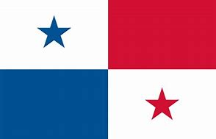
Panama Papers: Example U.S. Prosecution
Defendants:
Ramses Owens, Panamanian
Arrested in Panama
Dirk Brauer, German
Arrested in Paris, France
Richard Gaffey, 74, American
Arrested in Boston, Mass.
Harald Joachim Von Der Goltz, German
Arrested in London, U.K.
Charges:
Wire fraud
Tax fraud
Money laundering
Others
Timeline:
May 2016: investigation began
Dec. 2018: indictment unsealed
Jan. 2020: trial date
https://www.justice.gov/usao-sdny/pr/four-defendants-charged-panama-papers-investigation

Slide 18
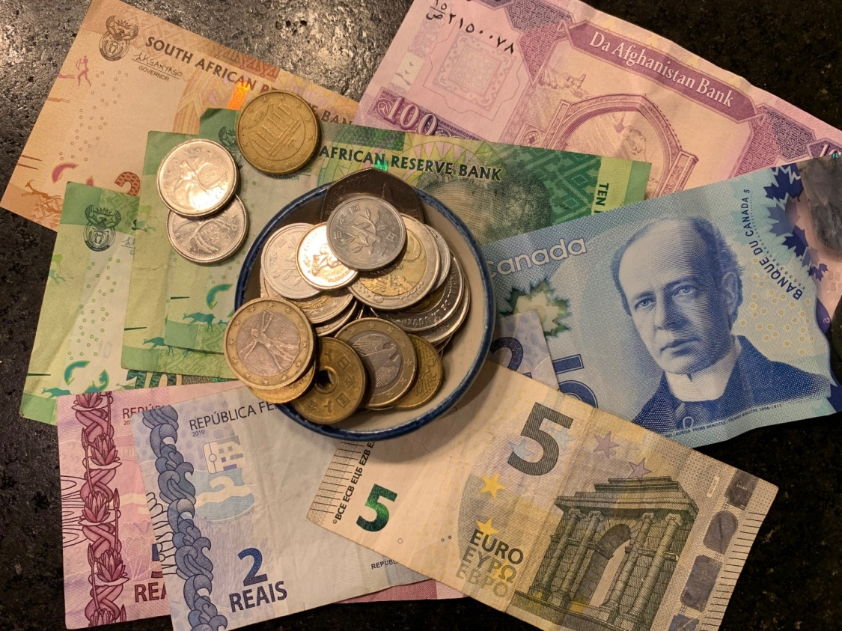
The Panama Papers: Fines & Taxes
As of April 2019, taxes & fines of over $1.2 billion collected by governments, including:
U.K.: $252 million
Germany: $183 million
France: $136 million
Australia: $92 million
Colombia: $88 million
Iceland: $25 million
Mexico: $21 million
Panama: $14 million
https://www.icij.org/investigations/panama-papers/panama-papers-helps-recover-more-than-1-2-billion-around-the-world/

Slide 19
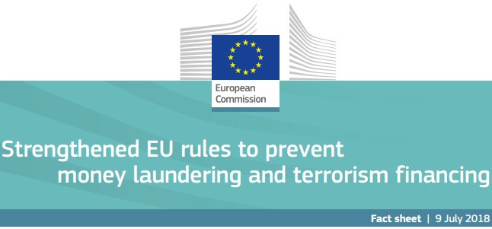
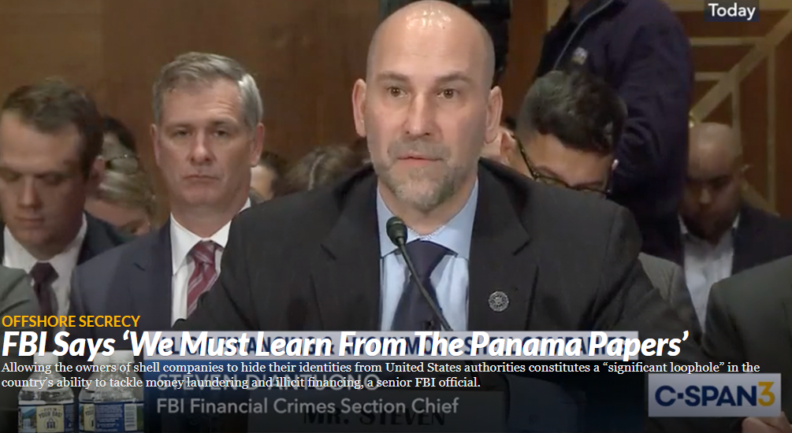
The Panama Papers: Selected Legislation
2017: New Zealand strengthened laws to fight tax evasion and money laundering.
2018:
EU released fifth EU Anti-Money Laundering Directive
Public access to beneficial ownership information
Member states must keep PEP lists
Facilitates cooperation & info exchange among authorities
Indonesia requires companies reveal true owners
2019: U.S. & Canada discussing beneficial ownership transparency
https://globalcompliancenews.com/eu-5th-anti-money-laundering-directive-published-20180716/; https://eur-lex.europa.eu/legal-content/EN/TXT/?uri=uriserv:OJ.L_.2018.156.01.0043.01.ENG; https://ec.europa.eu/info/files/factsheet-main-changes-5th-anti-money-laundering-directive_en; https://www.icij.org/investigations/panama-papers/fbi-says-we-must-learn-from-the-panama-papers/; https://www.fin.gc.ca/n19/19-063-eng.asp

Slide 20
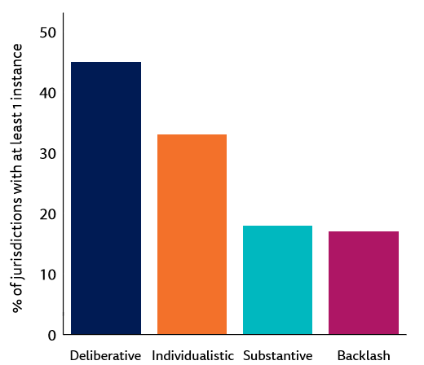
Panama Papers: Public Impact as of March 2019
Deliberative: Public protest, cross-border data sharing, investigations
Individualistic: Criminal or civil punishments of corrupt actors
6 cases of high officials resigning/ being removed
Substantive: Rule/ law changes
16 countries
Backlash: Violence, threats, or restrictions against journalists
15 countries; almost all with low ranking in the World Press Freedom Index
https://reutersinstitute.politics.ox.ac.uk/sites/default/files/2019-03/Graves_Gauging_the_Global_Impacts_of_the_Panama_Papers_FINAL_0.pdf

Slide 21
[T]he Panama Papers reveal an industry that flourishes in the gaps and holes of international finance. They make clear that policing offshore banking and tax havens and the rogues who use them cannot be done by any one country alone. Lost tax revenue is one consequence of this hidden system; even more dangerous is its deep damage to democratic rule and regional stability when corrupt politicians have a place to stash stolen national assets out of public view.
Editorial, “The Panama Papers' Sprawling Web of Corruption,” New York Times, Apr. 5, 2019.

Slide 22
International Cooperation in Corruption Cases
Please contact
NAGTRI Center for Ethics & Public Integrity Director Amie Ely
at aely@naag.org
with any questions

