Slide 1
The Impact of Alternatives to Prosecution on International Co-operation
Indian perspective
Thursday, 19 September
Padmarao Lakkaraju
Advocate, Bar Council of Telangana, India

Slide 2
Introduction
From times immemorial India, “Bharath” believed in
“Dand shasthi pragna sarva danda evabhi rakshathi dand sumtheshu jagarthi dand dharma vidhurvada”
which means
‘Punishment remains awake when the people are asleep, so the wise have recognized punishment itself as a form of Righteousness’.

Slide 3
Evolution
Later it was modified innumerable times as per the need and circumstances. Today it is followed under Criminal procedure Code in India with due amendments
1. Vak-danda means Admonition
2. Dhik-danda means Censure
3. Dhana-Danda means Fine (Penalty)
4. Badha-Dhanda means Physical Punishments
Manu also stated that the different types of punishments may be combined to serve as a just punishment and further confiscation of property and public humiliation
The evolution of the LAW by Sage Manu, which was taught in 1250 BCE cites four types of punishment:
The severity of punishment increases to Censure, Penalty and Physical punishments
Admonition is the least severe type of punishment

Slide 4
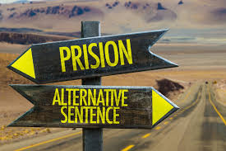
PLEA BARGAIN
COMPOUNDING OF OFFENCES
PROBATION
ARBITRATION
COMPENSATION
OPEN PRISONS
IMMUNITY FROM PROSECUTION FOR VOLUNTEERING NARCOTIC ADICTS

Slide 5
PLEA BARGAIN
The plea bargaining shall be available to the accused who is charged of any offence other than offences punishable with death/imprisonment for life or of an imprisonment for a term exceeding to seven years.
The accused who has voluntarily preferred the application, who was not previously been convicted by a court in a case in which he had been charged with the same offence, the court shall issue notice to the public prosecutor concerned, investigating officer and the victim of the case and the accused to participate in the meeting to work out a satisfactory disposition of the case. If no such disposition has been worked out, the Court shall record such observation and proceed further in accordance with the Law
The Court must hear the parties on the quantum of the punishment or accused entitlement of release on probation of good conduct or after admonition.
Court can either release the accused on probation under Cr.Pc or under the Probation of Offenders Act, or under any other legal provisions in force, or punish the accused, passing the sentence.
Concept of “PASCHYATHAPA” - repentance
and introduction in criminal procedure code
There is an age old concept of “Paschyathapa” in India which means the repentance for the mistake or crime committed advertently or inadvertently based on which the guilty is exonerated after the conclusion by the Judge and Victim that there is sense of repentance in the accused.
The above concept of “Paschyathapa” or repentance is reinforced into the Criminal procedure Code under the heading “PLEA BARGAINING”.
Introduced in 177th Law commission report and was made part of the criminal procedure code under the leadership of Ex Prime Minister, Sri Atal Bihari Vajpayee
Procedure to be followed for “plea bargain”
Myth: The Accused always lives in the hope that he gets acquittal. In order to get the conviction, the case against the accused has to be proved by the prosecution,” beyond reasonable doubt”. In Plea bargaining he demands an assurance in advance, that his offence to be compounded without sentence. This cannot be pronounced by the court in advance. Hence the Plea bargaining is not 100% successful. The accused further has apprehension that his confession of offence could prejudice the mind of the court in case the Plea Bargaining fails. Further the fear of disqualification
Amendment in the Summons to the Accused: The summons to the accused also mentions the option of the plea bargaining to educate the Accused

Slide 6
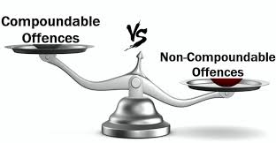
COMPOUNDABLE OF OFFENCES
The offences punishable under these sections of the Indian Penal Code requires the permission of the Court before which any prosecution for such offence is pending, be compounded by the persons affected.
When an offence is compoundable under this section, the abetment of such offence or an attempt to commit such offence when such attempt is itself an offence) or where the accused is liable for abatement or cooperated may also be compounded in like manner.
When the person who would otherwise be competent to compound an offence under this section and if the victim is under the age of eighteen years or is an idiot or a lunatic, any person competent to contract on his behalf, may, with the permission of the Court compound such offence. In case of the dead person, the deceased legal representative, may, with the consent of the Court compound such offence.
When the accused has been committed for trial or when he has been convicted and an appeal is pending no composition for the offence shall be allowed without the leave of the Court to which he is committed, or, as the case may be, before which the appeal is to be heard.
A High Court or Court of Session acting in the exercise of its powers of revision, may allow any person to compound any offence which such person who is competent to compound under this section.
No offence shall be compounded if the accused is, by reason of a previous conviction, liable either to enhanced punishment or to a punishment of a different kind for such offence.
Compoundable offences – OFFENCES NOT EXCEEDING 7 YEARS PUNISHMENT
The offences which do not exceed the punishment for more than seven years like Uttering offensive words against anyone or causing hurt voluntarily or wrongful confinement or theft or cheating Etc can be compounded with consent of the victims usually. The composition of an offence under this section shall have the effect of an acquittal of the accused with whom the offence has been compounded.
Procedure for “Compounding of offences”
Short Coming: The possibility of the victim making disproportionate demands taking advantage of the Accused’s anxiety for compounding of the offences

Slide 7
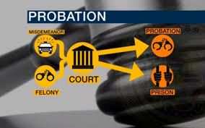
PROBATION
The Probation of Offenders Act, 1958 is intended to reform the offenders below the age of 21 years by rehabilitating them in the society and to prevent them from getting influenced by the seasoned criminals by not keeping them in jails along with hardened criminals.
It aims to release first time offenders, after due admonition or warning with advice who are alleged to have committed an offence punishable for the offences of theft and Cheating and also in case of any offence punishable with imprisonment for not more than two years, or with fine, or with both.
The Court may order for payment by the offender such compensation and a cost of the proceedings as it thinks reasonable for loss or injury caused to the victim.
The Act provides the freedom to Court to vary the conditions of bond when an offender is released on probation of good conduct and to extend the period of probation not to exceed three years from the date of original order.
The Act empowers the Court to issue a warrant of arrest or summons to him and his sureties requiring them to attend the Court on the date and time specified in the summons, if an offender released on probation of good conduct fails to observe the conditions of bond.
The Act provides an important role to the probation officers to help the Court and to supervise the probationers put under him and to advise and assist them to get suitable employment.
PROBATION – AN EARLY REFORMATION
Probation is one of the outstanding non-custodial measures which is designed to work for early reformation and re-socialization of criminals while they remain in the communities as ordinary citizens by subjecting them to certain conditions with which they must comply.
The Probation of Offenders Act, 1958
Short Coming: The possibility of the victim making disproportionate demands taking advantage of the Accused’s anxiety for compounding of the offences

Slide 8
more ALTERNATIVES
ARBITRATION
COMPENSATION
OPEN PRISONS
NARCOTIC CONSUMPTION
This method is also more or less that of compounding of offences in which an Arbitrator/mediator negotiates between both the parities to come to certain amicable solution and later the prosecution is withdrawn. This also applicable to the offences punishable for less than 7 years and is successful for the offenses committed under Negotiable instruments Act and Motor vehicles Act.
Courts may order offenders to pay such compensation as the court thinks reasonable for loss or injury caused to any person by the commission of the offences.
Open prisons in one form or another have been in existence in India for a long time. In India, there are many open prisons. Prisoners serving life sentence on the basis of their good conduct are shifted to the open prisons. They are permitted to stay with their families and go out during the day outside the jail to make their living.
It would be surprising to know that the organic farming done in the open Prisons in India has lot of demand and plans are being designed for exports of the produce farmed in these open prisons particularly mangoes.
Immunity from prosecution to addicts volunteering for treatment: Any addict, who is charged with an offence punishable involving small quantity of narcotic drugs or psychotropic substances, who voluntarily seeks to undergo medical treatment for de- addiction from a hospital or an institution maintained or recognised by the Government or a local authority and undergoes such treatment shall not be liable to prosecution, Provided that the said immunity from prosecution may be withdrawn if the addict does not undergo the complete treatment for de- addiction".

Slide 9
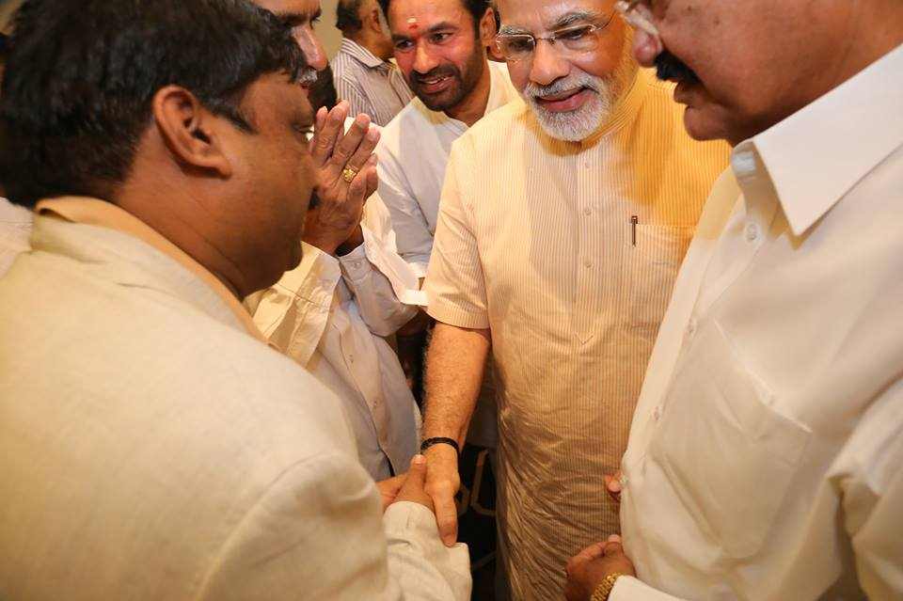
RECENT LEGISLATIVE CHANGES IN INDIA THE CURRENT HON’BLE PRIME MINISTER OF INDIA MR.MODI ,Mr. Venkaiah NAIDU Hon’ble Vice President of india and Mr.kishan reddy honble home minister of state government of india and padmarao lakkaraju member iap
JUVENILE JUSTICE ACT
TAXATION ACT

Slide 10
JUVENILE JUSTICE ACT
Where a Juvenile Justice Board is satisfied on inquiry that a child irrespective of age has committed a petty offence, or a serious offence, or a child below the age of sixteen years has committed a heinous offence, then, notwithstanding anything contrary contained in any other law for the time being in force, and based on the nature of offence, specific need for supervision or intervention, circumstances as brought out in the social investigation report and past conduct of the child, the Board may, if it so thinks fit,—
Allow the child to go home after advice or admonition by following appropriate inquiry and counselling to such child and to his parents or the guardian;
Direct the child to participate in group counselling and similar activities;
Order the child to perform community service under the supervision of an organisation or institution, or a specified person, persons or group of persons identified by the Board;
Order the child or parents or the guardian of the child to pay fine, provided that, in case the child is working
Direct the child to be released on probation of good conduct and placed under the care of any parent, guardian or fit person, for the good behaviour and child’s well-being for any period not exceeding three years;
Direct the child to be sent to a special home, for such period, not exceeding three years, as it thinks fit, for providing reformative services including education, skill development, counselling, behaviour modification therapy, and psychiatric support during the period of stay in the special home:
One of the greatest amendment that was made under the leadership of our current Hon’ble Prime Minister of India Mr. Narendra MODI is with regard to Special provisions for heinous offences committed by children above the age of sixteen years – Under this MODIfication, special provisions have been made to tackle child offenders committing heinous offences in the age group of 16-18 years. The Juvenile Justice Board is given the option to transfer cases of heinous offences by such children to a Children’s Court (Court of Session) after conducting preliminary assessment. The provisions provide for placing children in a ‘place of safety’ both during and after the trial till they attain the age of 21 years after which an evaluation of the child shall be conducted by the Children’s Court. After the evaluation, the child is either released on probation and if the child is not reformed then the child will be sent to a jail for remaining term. The law will act as a deterrent for child offenders committing heinous offences such as rape and murder and will protect the rights of victim.

Slide 11
TAXATION ACT
ATRI SAMHITHA:1500 to 200BCE
It is said the Government should collect taxes from his subjects just as cowherd collects milk from the cow, firstly by feeding it properly and then extracting milk without hurting it. He should not treat it like a butcher who kills and sells its meat.
RECENT AMMENDMENTS
The TAX evaders can be prosecuted in India under various sections of LAW. Again the Current Government brought such amendments, where in, the Tax offenders are Penalised heavily usually as the first option and if required, they are prosecuted. This saves particularly their family members from humiliation.

Slide 12
THE IMPACT ON INTERNATIONAL COOPERATION OF ALTERNATIVES TO PROSECUTION
India has undergone treaties with various countries in the world and is trying to be next to none in extending its cooperation not just limiting to the Alternates to the Prosecution but also in combatting variety of crimes in exchange of information, knowledge and training as well.
Chanakya Said “ whoever imposes severe punishment becomes repulsive to the people; while he who awards mild punishment becomes contemptible. But whoever imposes punishment as deserved becomes respectable. For punishment when awarded with due consideration, makes the people devoted to righteousness and to works productive of wealth and enjoyment; while punishment, when ill-awarded under the influence of greed and anger or owing to ignorance, excites fury even among hermits and ascetics dwelling in forests, not to speak of householders”.

Slide 13
Thank you!
PROSECUTORRAO@GMAIL.com
+91-9052407111

