Slide 1
Network of Anti-Corruption Prosecutors (NACP) ANTI-CORRUPTION REFORMS IN AZERBAIJAN 17 September 2019, Buenos Aires
Dr. Kamran Aliyev Deputy Prosecutor General Director of the ACD

Slide 2
The Republic of Azerbaijan
Capital and the largest city is Baku Area 86.600 km² Population – 10 million

Slide 3
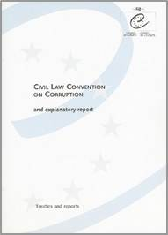
Azerbaijan in international initiatives
Ratifications:
UN conventions
Convention against Transnational Organized Crime (in 2003)
Convention against Corruption (in 2005)
Council of Europe Conventions (in 2004)
Criminal Law Conventions on Corruption
Civil Law Conventions on Corruption
Implementation Review Mechanism
a member of the Group of States against Corruption (GRECO)
a member of the OECD Anti-Corruption Network for Eastern Europe and Central Asia

Slide 4
Implemented anti-corruption measures
Development of legislation in-line with international standards;
Reorganization of judicial system;
Reforms in civil service;
Establishment of specialized anti-corruption agencies;

Slide 5
Current approach to anti-corruption
Deepening reforms in the following dimensions:
corruption as an aspect of development
more accent on prevention of corruption
focus on increasing effectiveness and efficiency of judiciary

Slide 6
Corruption as a development problem
aim at strengthening economic and social development,
diversification of the national economy, and
establishing a favourable business environment.
Those efforts to be accompanied by the relevant anti-corruption measures.

Slide 7
Better to prevent than…
Azerbaijan relies on transparent public service delivery and achievements of high technologies.
ASAN Service model - delivery of
a wide range of public services through
the one-stop-shop principle.
E-Government – speedy, accessible
and efficient.
DOST Centers - transparency in the provision of public services in employment, labour,
and social protection spheres.

Slide 8
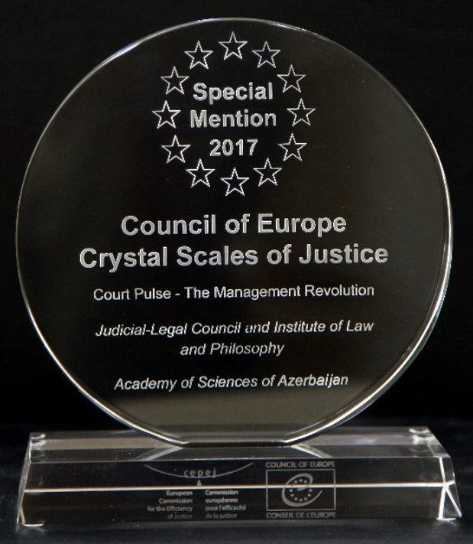
Accessible, modern, and efficient justice
A new phase of reforms started with the Presidential Decree adopted in April 2019.
Aims at:
easing access to justice,
increasing its quality,
strengthening independence and
impartiality of the judiciary,
enhancing the efficiency of the judicial system.
E-Court system,
Establishment of commercial courts,
New legislation on mediation.

Slide 9
Thanks for your attention.

