Slide 1
IAP 24th Annual Conference and General Meeting, Argentina 2019
Plenary 3: The Role of Prosecutors in Cross-border Investigations
Israeli and Brazilian Cooperation in the Fight against Organized Crime – the story behind “case 512”
Edson Oliveira de Almeida, Associate Prosecutor General, Federal Prosecution Service, Brazil
Yuval Kaplinsky, Director of the Department of International Affairs, Office of the State Attorney, Israel

Slide 2
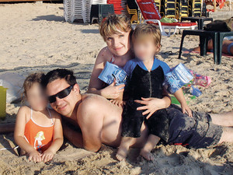
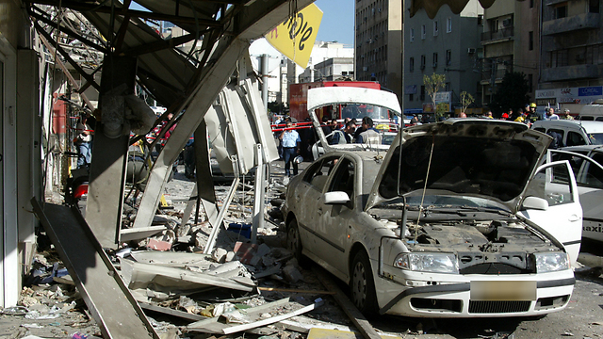
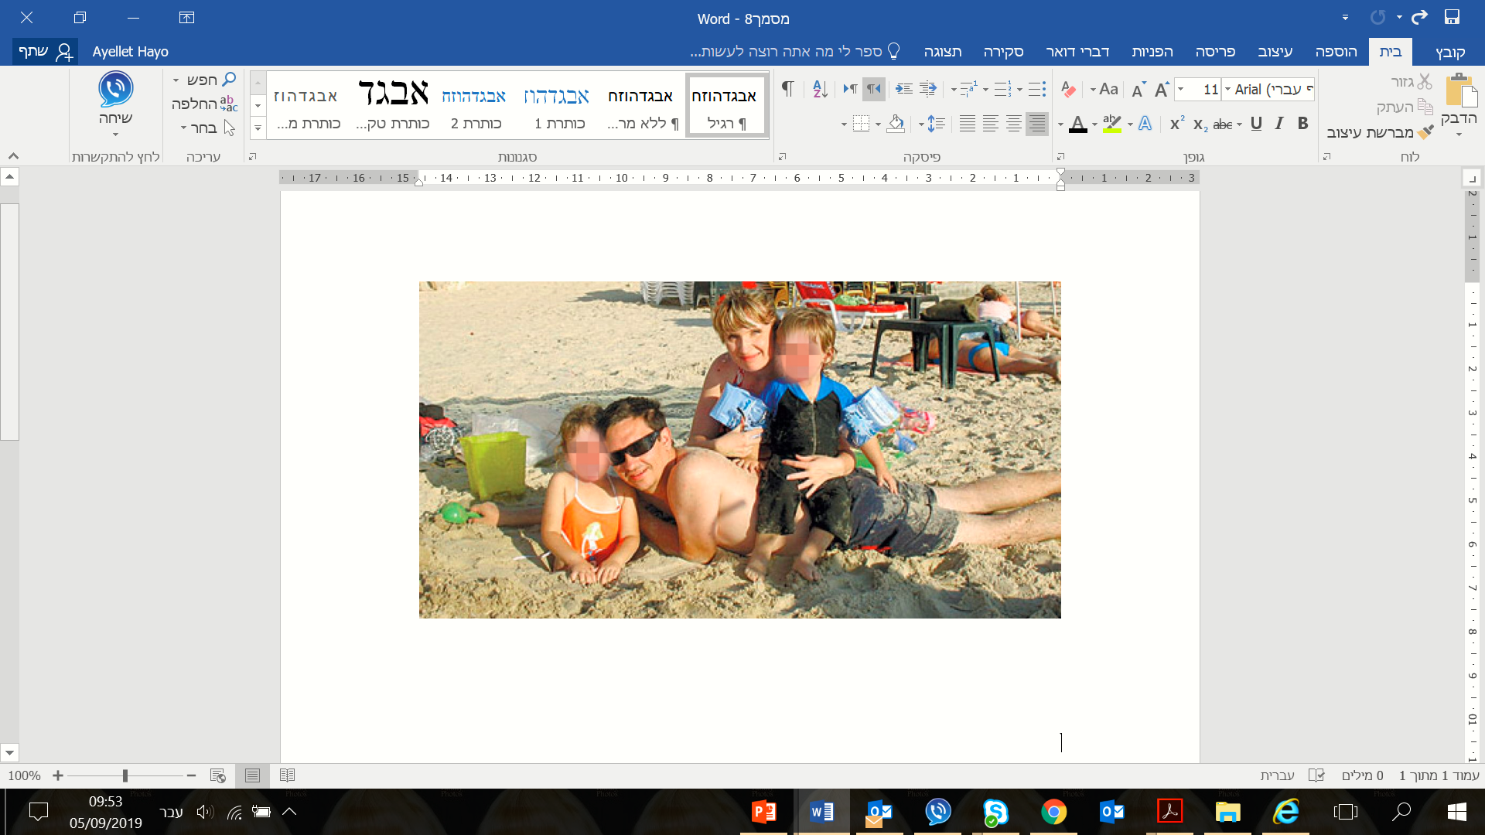

Slide 3



One of the main witnesses for the 512 case, ”X”, was located in Brazil
His presence at trial in Israel is crucial for the case
Ultimately, eight MLAT Requests were sent from Israel to Brazil

Slide 4

United Nations Convention against Transnational Organized Crime (UNTOC), also known as the Palermo convention
Article 18. Mutual legal assistance –
10. A person who is being detained or is serving a sentence in the territory of one State Party whose presence in another State Party is requested for purposes of identification, testimony or otherwise providing assistance in obtaining evidence for investigations, prosecutions or judicial proceedings in relation to offences covered by this Convention may be transferred if the following conditions are met: (a) The person freely gives his or her informed consent; (b) The competent authorities of both States Parties agree, subject to such conditions as those States Parties may deem appropriate.

Slide 5



Developments surrounding X’s first appearance at Israeli court
The refusal
The reassessment
Successful resolution

Slide 6




Developments surrounding X’s second appearance at Israeli court
Thinking outside the box
Multi-factor approach, involving different authorities
Utilizing internal state law – Brazilian Immigration law

Slide 7
