Slide 1
International Cooperation in Israeli Corruption Cases
IAP 24th Annual Conference and General Meeting, Argentina 2019
Plenary 2: COLLECTION AND SHARING OF EVIDENCE
Shai Nitzan, State Attorney of Israel

Slide 2
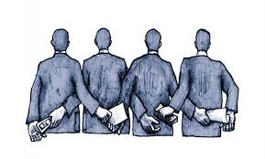
“Do not pervert justice or show partiality. Do not accept a bribe, for a bribe blinds the eyes of the wise and twists the words of the innocent.”
Deuteronomy 16:19

Slide 3
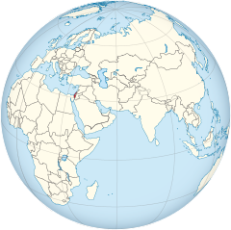
International COOPERATION
-
-
-
-

Slide 4
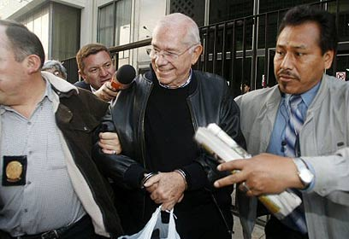
The extradition of Dan cohen
A former judge at the Beer Sheva District Court.
While sitting in the board of directors of the governmental Electric Corporation, Cohen helped several companies to carry out multimillion-dollar deals in return for financial benefits of over 65 million dollars.
In 2005, in the midst of the investigation, Cohen fled to Peru. In 2013 he was extradited.

Slide 5
The investigation into Siemens

Slide 6
corruption Cases: 1000, 2000, 4000
Case 1000: PM accused of receiving gifts from very wealthy businessmen, in breach of his duties
Case 2000: PM accused of offering a publisher to curb a rival newspaper publication in exchange for positive press coverage
Case 4000: PM accused of pushing telecom merger in exchange for content control in media site owned by same telecom company owner
Netanyahu received gifts from Hollywood mogul Arnon Milchan, in return for political favors
Pre-indictment suspicions: Fraud and breach of trust
Netanyahu and “Yedioth Ahronoth” publisher Arnon Mozes plotted a deal: Favorable coverage in return for legislation to damage Sheldon Adelson – owner of competing newspaper “Israel Hayom”
Pre-indictment suspicions: breach of trust
As communication minister,
Netanyahu took steps that
benefited Shaul Elovitch who
controlled Bezeq – in Return
for content control in Bezeq’s
Walla News site
Pre-indictment suspicions: Bribery, fraud and
breach of trust

Slide 7
corruption scandals: 1000, 2000, 4000
Seven Mutual Legal Assistance Requests were sent to over five countries
Multiple witnesses were questioned in 4 different countries

Slide 8
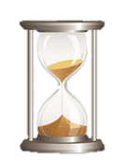
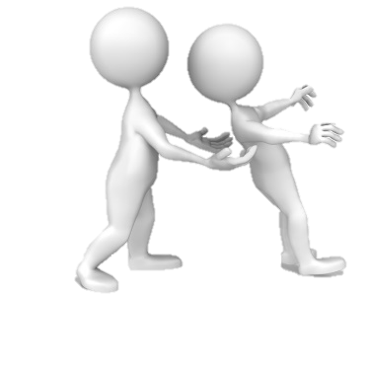
SPECIAL CHALLENGES – obtaining Milchan’s testimony
Time (a race against the clock)
Familiarity (the right people)
Overcoming bureaucratic hurdles (trust)

Slide 9
governmental officials
high profile individuals in the public and the private sphere
Multiple Mutual Legal Assistance Requests to various countries
intensive communication with law officers (e.g. immunity wavers)
intense media scrutiny

Slide 10
International Cooperation in Israeli Corruption Cases
IAP 24th Annual Conference and General Meeting, Argentina 2019
Plenary 2: COLLECTION AND SHARING OF EVIDENCE
Shai Nitzan, State Attorney of Israel

