Slide 1
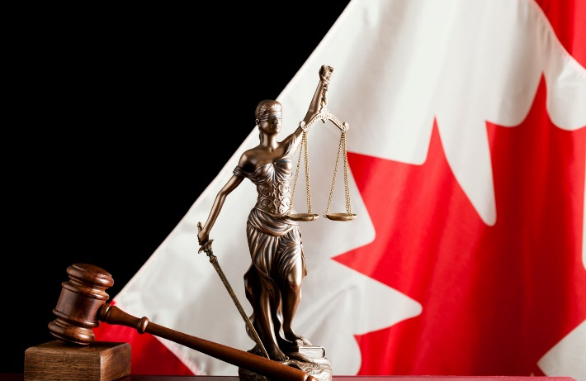
ALTERNATIVES TO MLA The Canadian Experience
Janet Henchey, General Counsel/Director General
International Assistance Group, DOJ, Canada
International Association of Prosecutors
24th Annual Conference 2019 - Buenos Aires
15-19 September 2019

Slide 2
Importance of Non-MLA Channels
Direct agency-to-agency cooperation in criminal matters remains the fastest and, in certain cases, the most effective route to obtaining foreign assistance.
Supreme Court of Canada: “[C]rime does not stop at national borders, and police routinely share information that they have lawfully obtained under warrant with their counterparts in other countries” (Wakeling v. United States of America, [2014] 3 SCR 549).

Slide 3
MLA Fills the Gap
MLA is also a key tool in the arsenal of investigators and prosecutors. MLA supplements agency-to-agency cooperation - Does not replace it In general, MLA kicks in when agency-to-agency cooperation is not available for the specific assistance sought.

Slide 4
Limiting Use of MLA
Because MLA can be a longer process to follow, Canada urges authorities to use it as a measure of last resort.
In general, MLA should be limited to: Assistance requiring court authorization; Cases where the law of the foreign state require MLA; Sensitive/high profile cases (it may be advisable to pursue the matter under MLA as most treaties contain a contractual requirement for confidentiality)

Slide 5
Canadian Assistance that May be Provided Outside MLA
Anything that is in the public domain
e.g. materials in a court file, unless the proceedings are sealed, corporate registration records; open source info
Anything that is provided voluntarily by the holder of the information, if not contrary to Canadian law
e.g voluntary statements/testimony; business records, physical evidence

Slide 6
Assistance that May be Provided Outside MLA, cont’d
Locating suspects, accused persons and witnesses
Surveilling a suspect / conducting undercover measures that do not require court authorization.
Obtaining copies of materials in Canadian police files, e.g. police reports, “will-say” statements, transcripts of recorded statements, photographs

Slide 7
Assistance that May be Provided Outside MLA, cont’d
Fruits of wiretaps that were obtained pursuant to Canadian court authorization
Copies of the fruits of search warrants executed by Canadian police (usually involves caveats on use; originals will usually require an MLA order)
Already seized contraband (e.g. firearms that have been ordered forfeited to the Crown; drugs with the required permits; child pornography)

Slide 8
Assistance that May be Provided Outside MLA, cont’d
Criminal Records (if fingerprints are incl. to confirm ID of the record-holder)
Existing records of suspect biometrics (DOB, fingerprints, DNA)
Existing drug forensic analysis reports
Service of documents

Slide 9
LIMITS ON DIRECT SHARING Case-by-Case Assessment
Direct sharing must comply with Canadian law.
In particular, Canadian law enforcement agencies are mindful of statutory limits on disclosure of information (e.g. under Canadian Charter of Rights and Freedoms, Criminal Code, Privacy Act, DNA Identification Act.
As well, sharing is not permitted where Canadian info could be used in unfair trials - neither MLA, nor direct cooperation can be used in these cases.

Slide 10
Other Available Assistance Without MLA

Slide 11
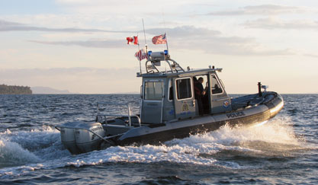
Shiprider Program – A Form of Joint Investigation Team
Integrated Cross-border Maritime Law Enforcement Operations (since 2012) - cooperative approach to combating cross border crime on Canadian and U.S. shared waterways.
Canada-U.S. Shiprider removes the international maritime boundary as a barrier to law enforcement by enabling seamless continuity of enforcement and security operations across the border.

Slide 12
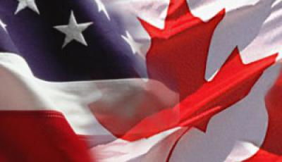
Shiprider Program – A Form of Joint Investigation Team, cont’d
Canada-U.S. Shiprider removes the international maritime boundary as a barrier to law enforcement by enabling seamless continuity of enforcement and security operations across the border.
Involves vessels jointly crewed by specially trained and designated Canadian and U.S. law enforcement officers authorized to enforce the law on both sides of the international boundary line.

Slide 13
Digital Evidence – Legal Challenges
R v Spencer, 2014 - Supreme Court of Canada held that a reasonable expectation of privacy attaches to Canadian ISP data.
The result? Canadian police can no longer request voluntary production of those records – need court order. Pre-Spencer, Canadian police were routinely obtaining subscriber data from ISPs on a voluntary basis and sharing it with foreign law enforcement partners.

Slide 14
Digital Evidence – Legal Challenges, cont’d
Spencer applies to Canadian police only.
Therefore, no express prohibition against a foreign authority contacting a Canadian ISP directly to obtain subscriber records on a voluntary basis.
However, post-Spencer, some Canadian ISPs are reluctant to voluntarily disclose to foreign authorities in non-exigent circumstances.

Slide 15
Challenges in Seeking to Obtain Foreign E-Evidence Via Domestic Orders
Canadian courts have recently been adjudicating on the question of whether they have the authority to issue production orders for data stored abroad:
British Columbia (Attorney General) v. Brecknell, 2018 BCCA 5
In the Matter of an application to obtain a Production Order pursuant to section 487.014 of the Criminal Code of Canada, 2018, 2018 CanLII 2369 (NL PC)

Slide 16
Challenges in Seeking to Obtain Foreign E-Evidence Via Domestic Orders, cont’d
Facebook Challenge in Ontario Murder Prosecution (pending): Canadian police obtained a domestic production order for content data from Facebook. Facebook had advised the police to seek the evidence via MLAT. They declined to engage MLA on the basis that the process is too slow and cumbersome.
Facebook is now challenging the Canadian order on the basis that the evidence is located outside of Canada and therefore, Facebook has no authority to act on it. Proceedings are ongoing in this matter.

Slide 17
Digital Evidence Exploring Solutions
Multilateral initiative within the Council of Europe undertaken by the Parties to the Cybercrime Convention.
Negotiating a Protocol that would,
streamline MLA procedures to get quicker access to electronic evidence and,
where possible, offer avenues of assistance outside the MLA process to further expedite data production.

Slide 18
Giving Extraterritorial Effect to Domestic Production Orders
Both the pending Protocol to the Cybercrime Convention and the U.S. executive agreements under the CLOUD Act propose models that involve the extraterritorial execution of domestic orders for ISP records.
These models suggest greater efficiencies in obtaining access to digital evidence with much-needed benefits to law enforcement efforts.
Canada is closely examining these models.

Slide 19
Thank you

