Slide 1
International Association of Prosecutors 24th Annual Conference

Slide 2
Combating Bribery of Public Officials in International Business Transactions
Focus on the “supply side” of the bribery, specifically on multinational corporations
Not on Public Officials
Not on individuals

Slide 3
Main Difficulties
Multiple jurisdictions
Multiple legislations
Investigation inefficiencies
Enforcement inefficiencies
Double jeopardy
Possible Solutions
Local legislation with extraterritorial reach
Detect, investigate and sanction
Non-trial resolutions (leniency programs)
Multilateral conventions
Standardize legislations
Avoid piling up sanctions

Slide 4
Top Sanctions

Slide 5
Organization for Economic Cooperation and Development (OECD)
Intergovernmental economic organization founded in 1961 to stimulate economic progress and world trade
36 members countries
Convention on Combating Bribery of Foreign Public Officials in International Business Transactions of 1997
Recommendation for Further Combating Bribery of Foreign Officials in International Business Transactions of 2009
Principles for Non-Trial Resolutions of 2019

Slide 6
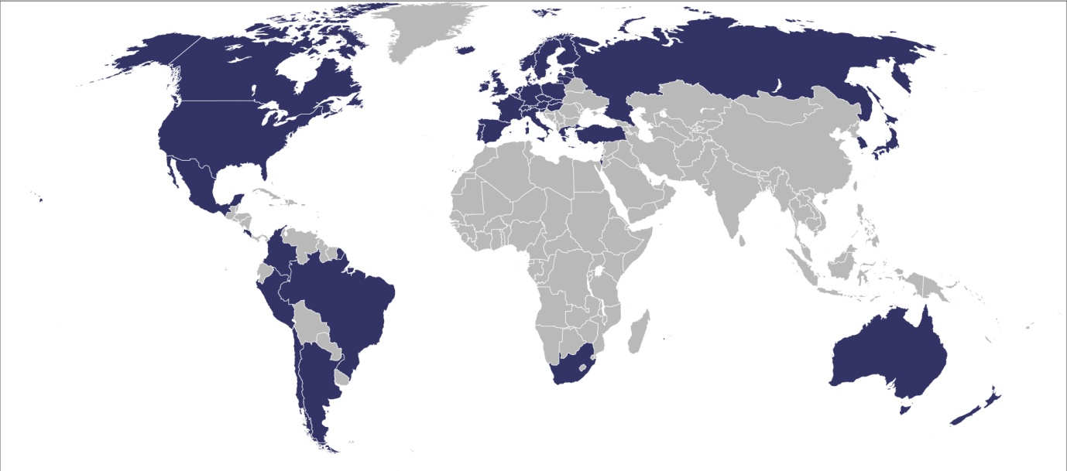
OECD Anti-Bribery Convention
Aimed at reducing political corruption and corporate crime in developing countries
Requires adherents to criminalize companies and businessmen for offering or giving bribes
44 countries have ratified the Convention

Slide 7
Recommendation on Further Combating Bribery in International Business Transactions
Good Practice Guidance on Internal Controls, Ethics and Compliance
Principles for the implementation and use of Non-Trial Resolutions of foreign bribe cases
8 principles addressed to Departments of Justice, Ministries of Justice, Enforcement Officials and government agencies empowered to impose civil penalties against organizations and individuals

Slide 8
Principles for the Implementation and Use of Non-Trial Resolutions of Foreign Bribe Cases
First Principle
Non-Trial Resolutions (NTRs) are designed and implemented with the purpose of deterring bribery, enhance law enforcement and promote compliance
Sanctions should be effective, proportionate and dissuasive
NTRs should not be used as a means of reducing law enforcement or diminishing any Member country’s commitment to the elimination of bribery

Slide 9
Principles for the Implementation and Use of Non-Trial Resolutions of Foreign Bribe Cases
Second Principle
NTRs are a privilege of government to offer, not a fundamental right of an accused
NTRs that offer predictable sanctions and leniency for self-disclosure and cooperation are effective in deterring bribery
NTRs are compatible with the criminal, administrative and civil law traditions and practices of all member countries
Member countries should publicize standards for NTRs and their methods of determining constituent sanctions

Slide 10
Principles for the Implementation and Use of Non-Trial Resolutions of Foreign Bribe Cases
Third Principle
NTRs may range between decisions not to charge a putative defendant, formal admissions of guilt or the imposition of non-criminal or civil penalties
NTRs should be proportionate to the gravity of the offenses alleged while taking into account such mitigating factors as voluntary disclosure and effective and timely cooperation
Effective deterrence does not require an admission of guilt, but does require a recognition of responsibility

Slide 11
Principles for the Implementation and Use of Non-Trial Resolutions of Foreign Bribe Cases
Fourth Principle
If reasonably appropriate, the investigation, negotiation, penalties and remediation constituting NTRs should be coordinated among countries with jurisdiction over claims against suspected offenders
Coordination should promote efficient investigations and prompt NTRs and should ensure that aggregate sanctions across all countries are appropriate given the nature of the offenses charged and fairly allocated among the countries participating in the enforcement actions, taking into account the primacy of jurisdiction

Slide 12
Principles for the Implementation and Use of Non-Trial Resolutions of Foreign Bribe Cases
Fifth Principle
Bribery is effected by individuals working for the organizations involved in bribery. Those individuals should be held accountable too
Their civil and procedural rights must be observed, and not compromised for the sake of achieving a prompt NTR

Slide 13
Principles for the Implementation and Use of Non-Trial Resolutions of Foreign Bribe Cases
Sixth Principle
NTRs should be subject to checks and balances to ensure fairness and conformity with the rule of law
Control can be exercised by an independent judiciary, another independent government branch, or through a robust internal review process

Slide 14
Principles for the Implementation and Use of Non-Trial Resolutions of Foreign Bribe Cases
Seventh Principle
The process of concluding NTRs should, where appropriate, provide for consideration of potential remedies for injured parties without compromising the goals of law enforcement

Slide 15
Principles for the Implementation and Use of Non-Trial Resolutions of Foreign Bribe Cases
Eighth Principle
Member countries should collect, share and disclose information and metrics concerning enforcement practices regarding NTRs, particularly through the Working Group on Bribery

Slide 16
Maipú 1300, Piso 11 (C1006ACT) Buenos Aires, Argentina Tel: (54-11) 4318-9900 - Fax: (54-11) 4318-9999 info@allendebrea.com.ar

