Slide 1

Office of Overseas Prosecutorial Development, Assistance and Training
(OPDAT)

Slide 2
OPDAT
Created by DOJ in 1991 – in response to growing threat of international crime.
Draws on DOJ resources and expertise to enhance the administration of justice abroad.
Core Competencies – justice sector reform, ROL, Human Rights, and international cooperation (task force model)
Expertise Areas – counter-terrorism, TIP, OC, Anti-corruption, judicial independence, MLAR, cyber-crime, gender-based violence, & Trial Advocacy.

Slide 3
OPDAT
OPDAT programs are part of DOJ two-pronged law enforcement strategy:
Operational – targeting transnational criminal organizations
Capacity-building – Designed to increase the ability of our foreign partners to investigate & prosecute these criminal groups before their criminal activities reach the U.S.

Slide 4

OPDAT Field Presence
Global Programs
Serbia
North Macedonia
EUCOM
AFRICOM
Ukraine
Croatia
Romania
Bosnia
Bulgaria
OPDAT HQ
Kosovo
Georgia
China
Albania
Pakistan
Kuwait
Nepal
Judicial Studies Institute (PR)
Morocco
Algeria
Bangladesh
Hong Kong
Mexico
Int’l Institute of Justice (Malta)
Guatemala
Qatar
UAE
Laos
Senegal
Niger
El Salvador
Mali
Burma
Philippines
Honduras
Burkina Faso
Malaysia
Ghana
Sri Lanka
Colombia
Cameroon
Kenya
Indonesia
Nigeria
Tanzania
Timor-Leste
Paraguay
Argentina
Brazil
August 2019

Slide 5





Georgia Programs
Resident Legal Advisor Program
* 1 DoJ Prosecutor
* 2 Georgian Staff Attorneys
Judicial Legal Advisor Program
* 1 DoJ Prosecutor
* 1 Georgian Staff Attorney
* Cadre of U.S.-based judges

Slide 6





Core Focus Areas
Legislative Skills Institutional
Reform Training Reform

Slide 7
Criminal Justice
Legislation
Criminal & Procedure Code
Counter-terrorism
Organized Crime
GBV (DV and stalking)
Victim Witness Services
Digital Evidence
Child Exploitation

Slide 8
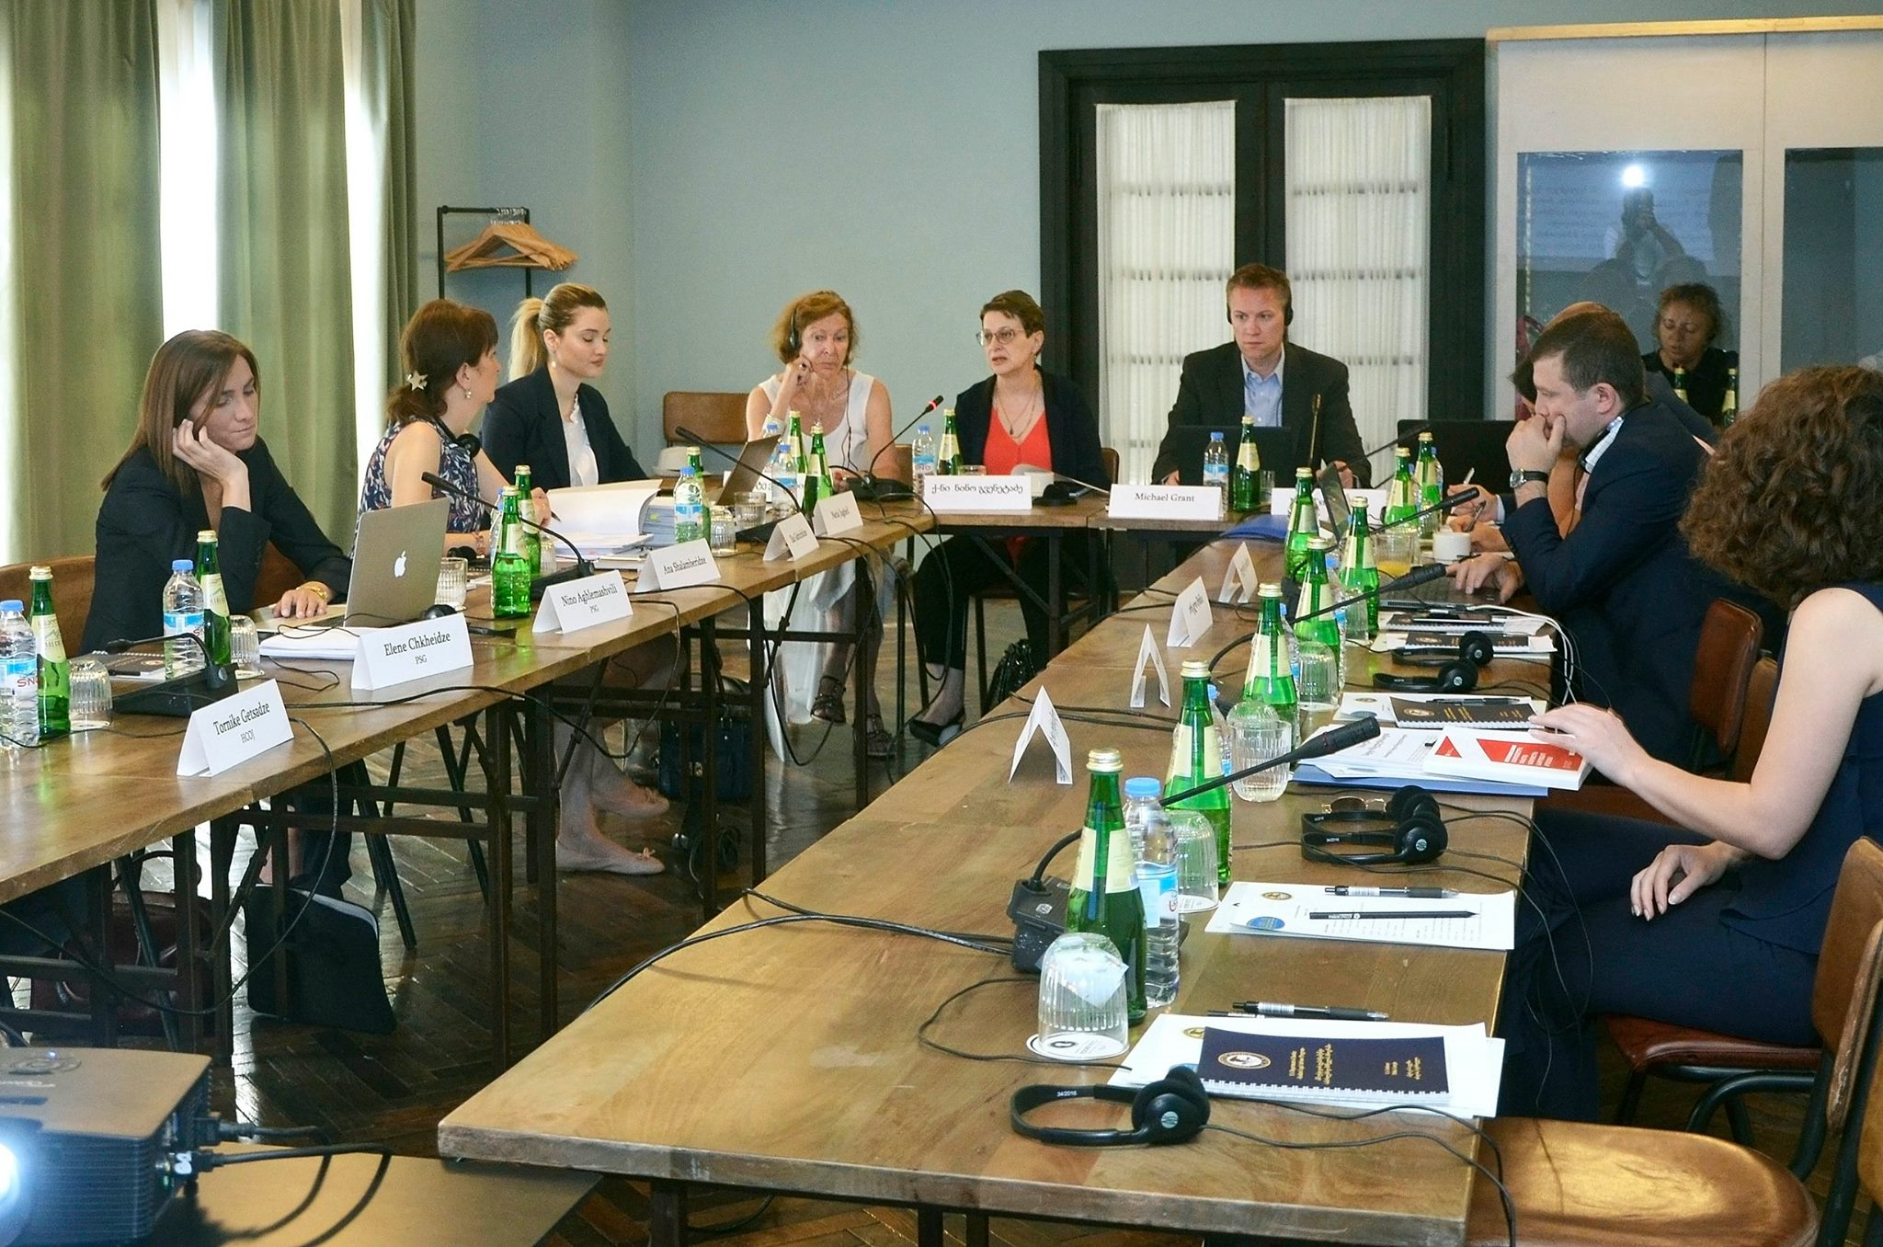
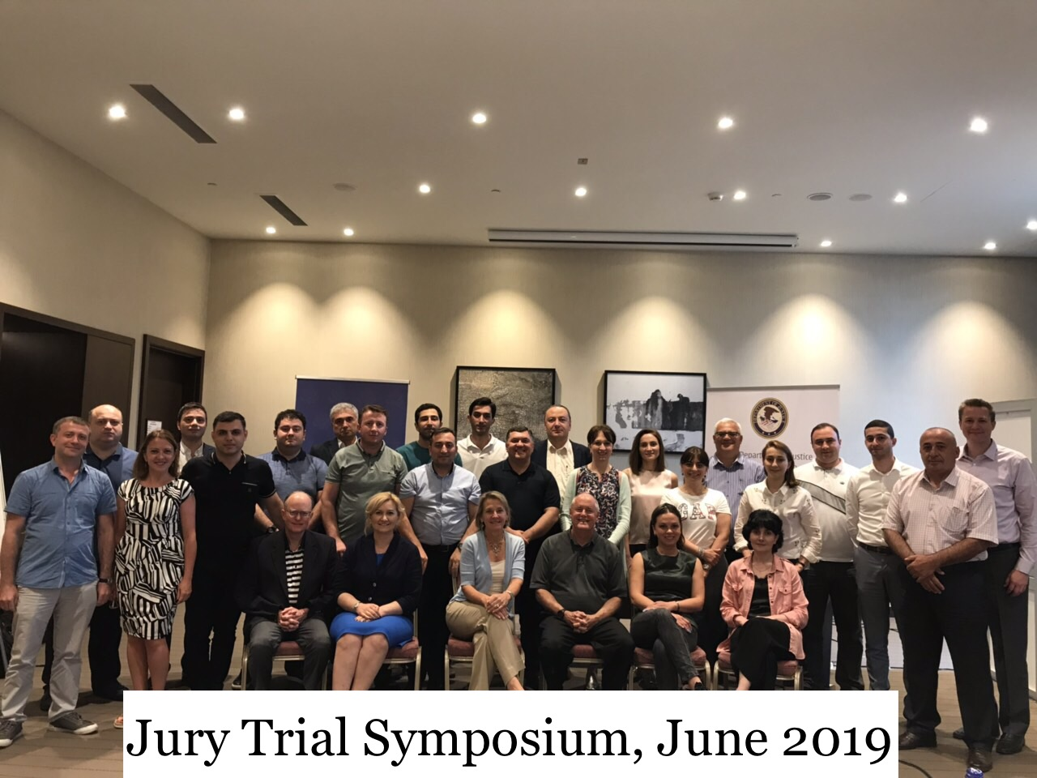
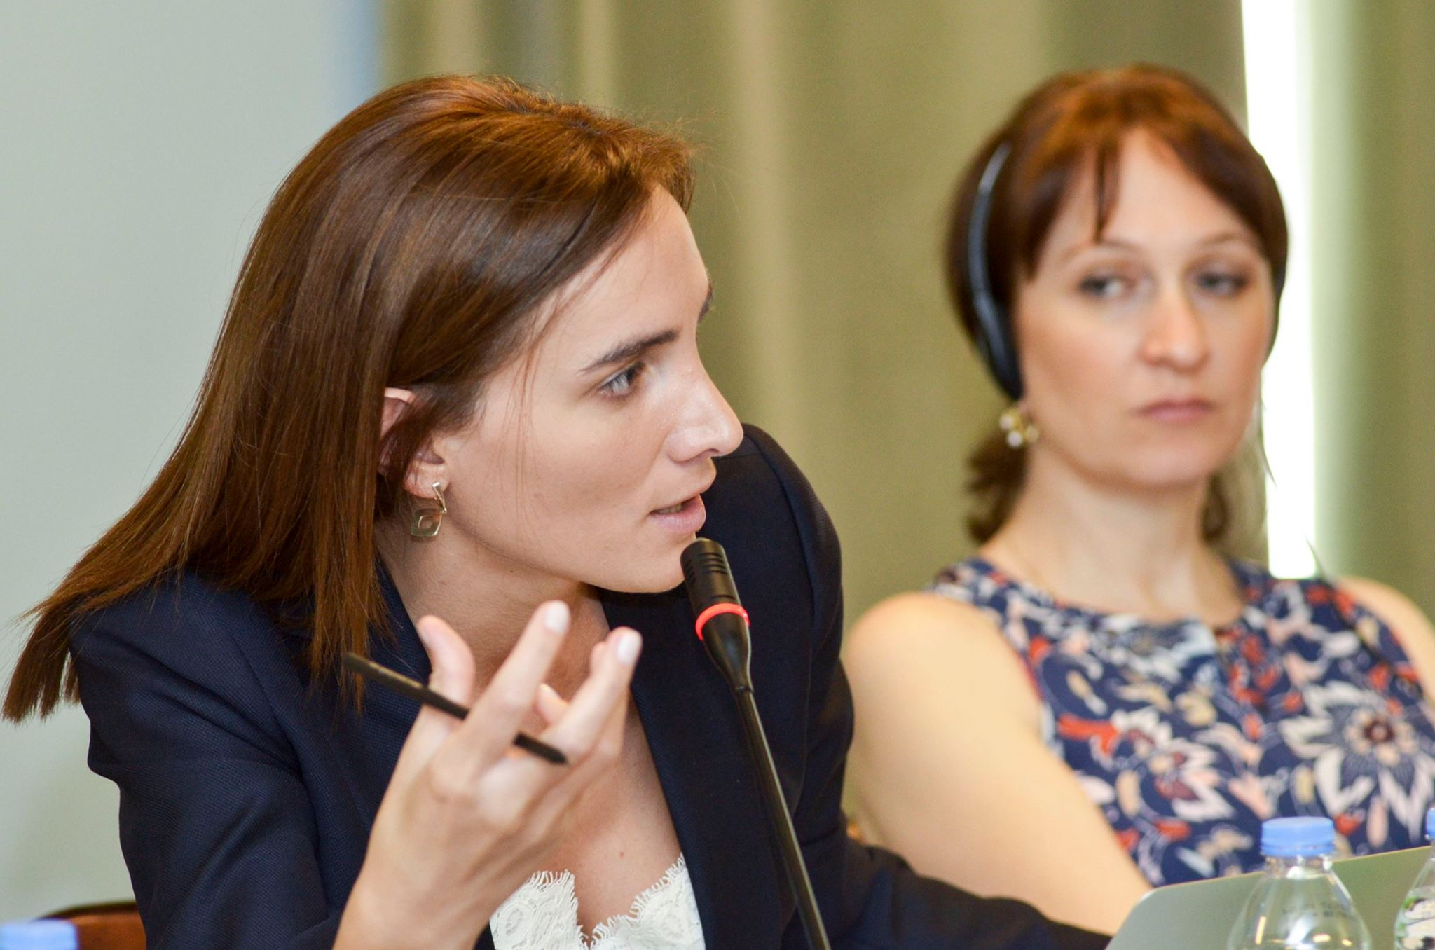
Working Group Level

Slide 9
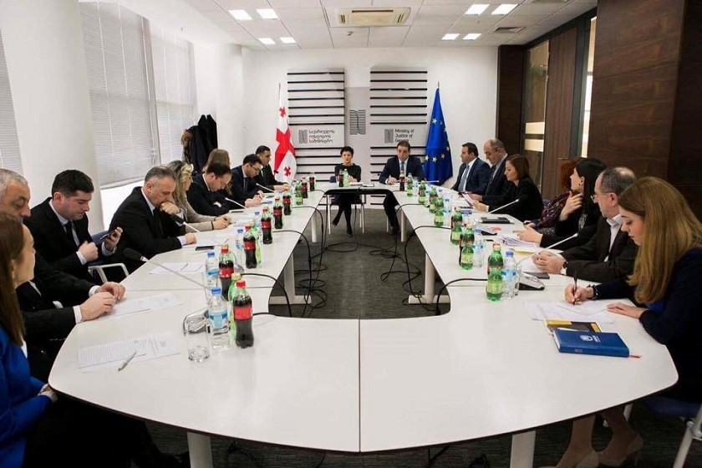
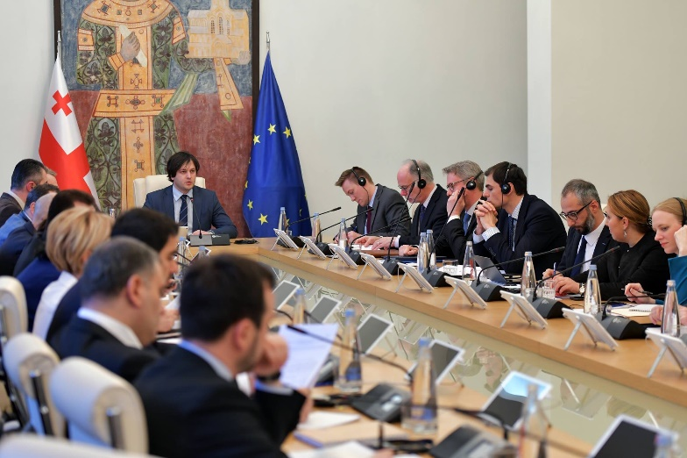
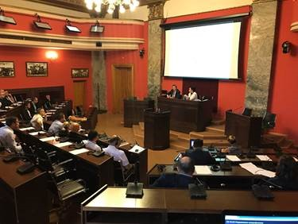
Ministry of Justice
&
Parliament

Slide 10
Prosecution Service Internal Reform
5-Year National Strategy
Modernize Administration
Specialized Pros Units
Victim-Witness Coordination
Plea Bargaining Refrom
Ethics Code
Prosecutorial Council

Slide 11
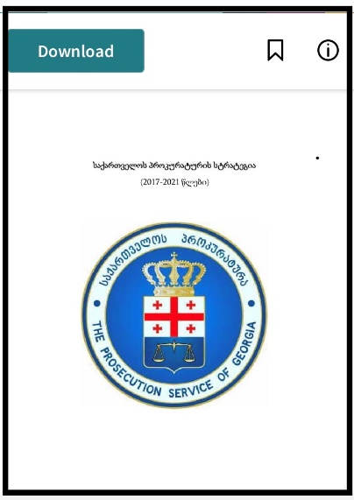
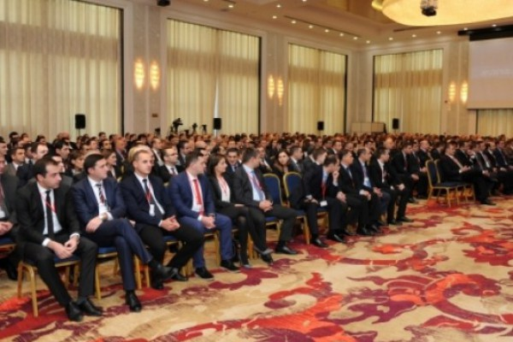
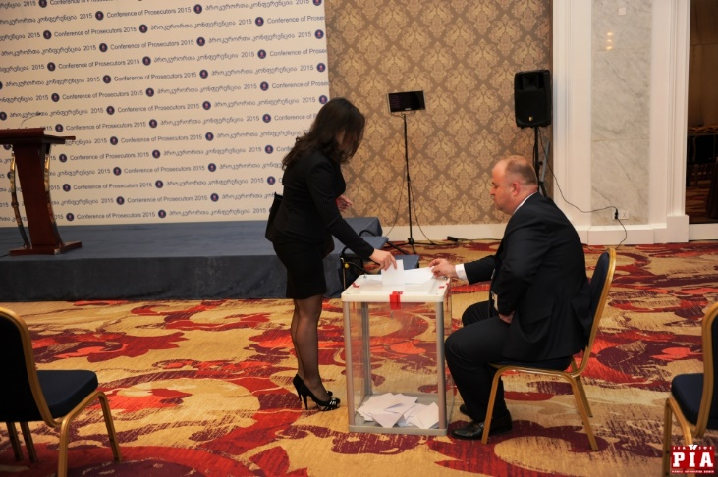
5-Year Strategy
&
Prosecutor Council

Slide 12


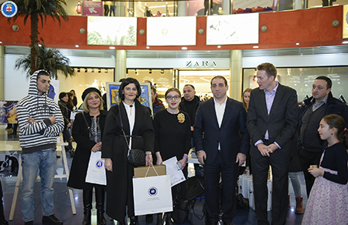
Victim Witness Assistance Unit
&
Local Outreach

Slide 13
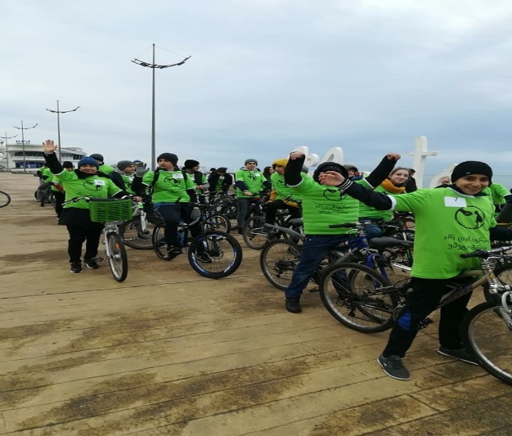
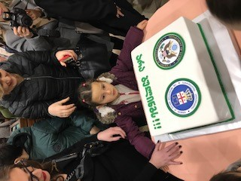
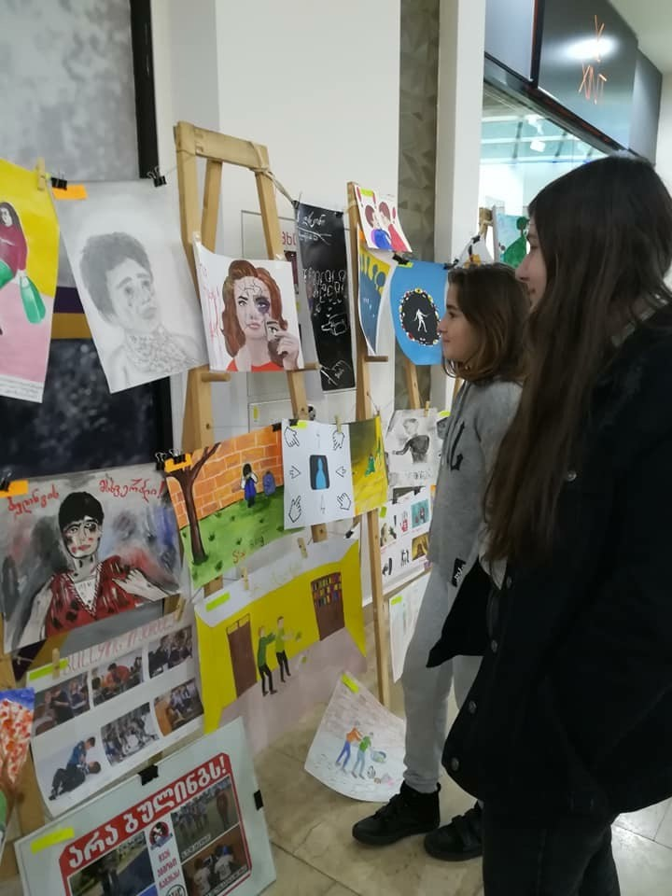
Victim Witness Assistance Unit
&
Local Outreach

Slide 14
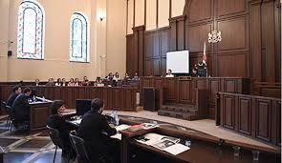
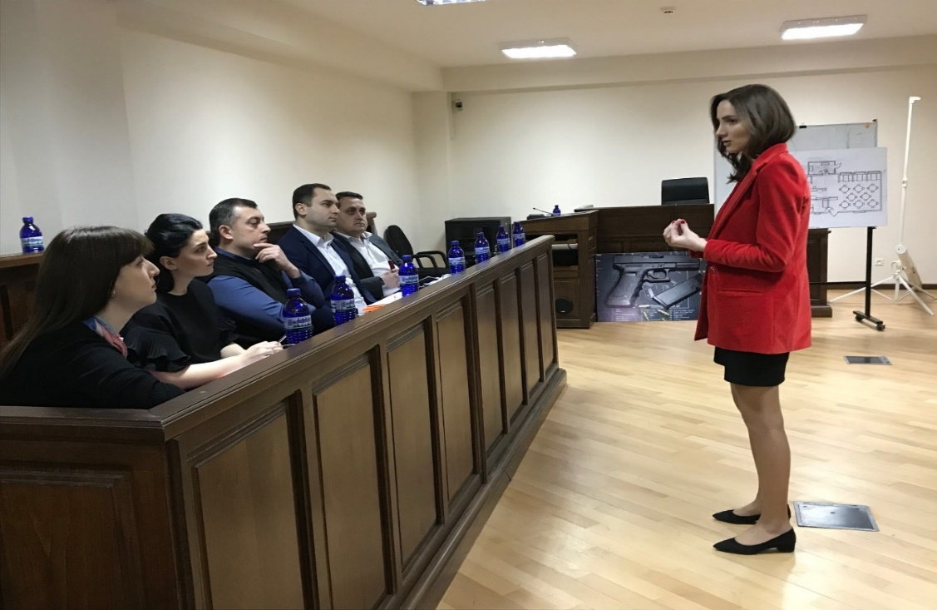
Jury Trial Unit

Slide 15
Skills-Based Training
Trial Skills (95% trained)
Counter-terrorism and FTF
Domestic Violence
Trafficking in Persons (TIP)
Child Exploitation
Public Corruption
Cyber, Cyber, Cyber!

Slide 16
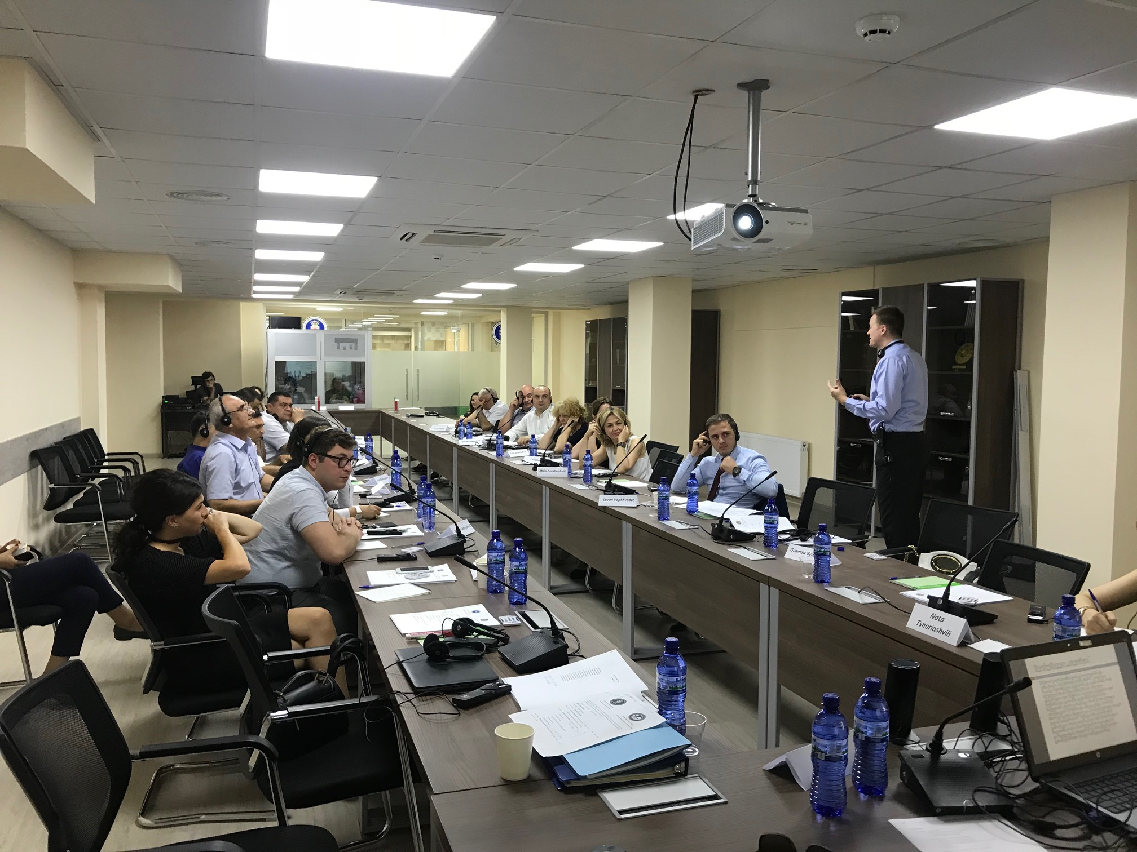
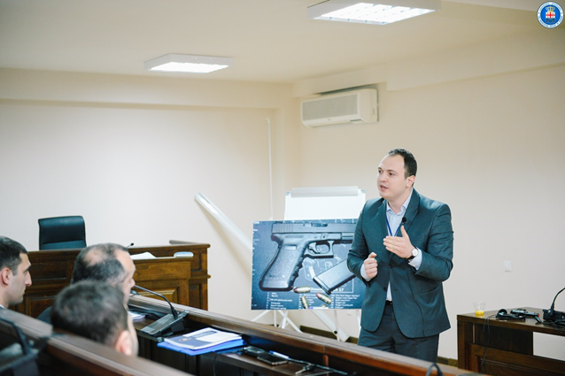
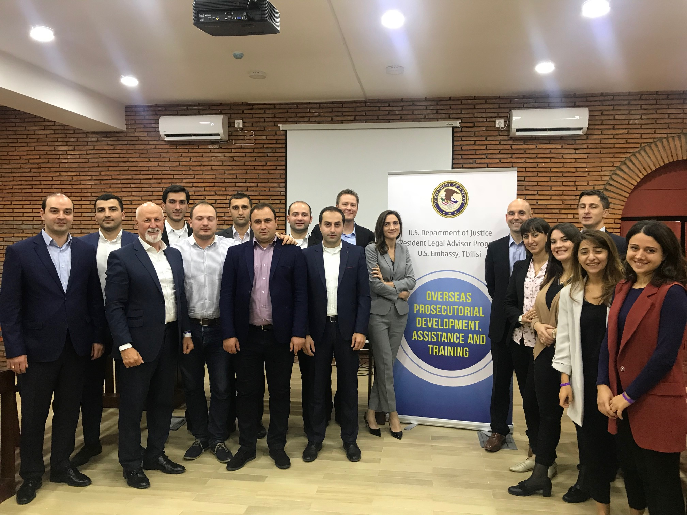
Trial Skills Training

Slide 17

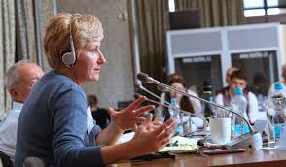

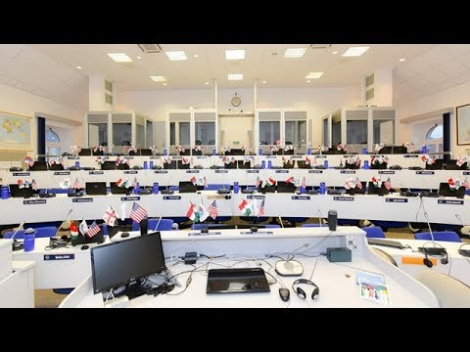
Anti-Corruption Training

Slide 18
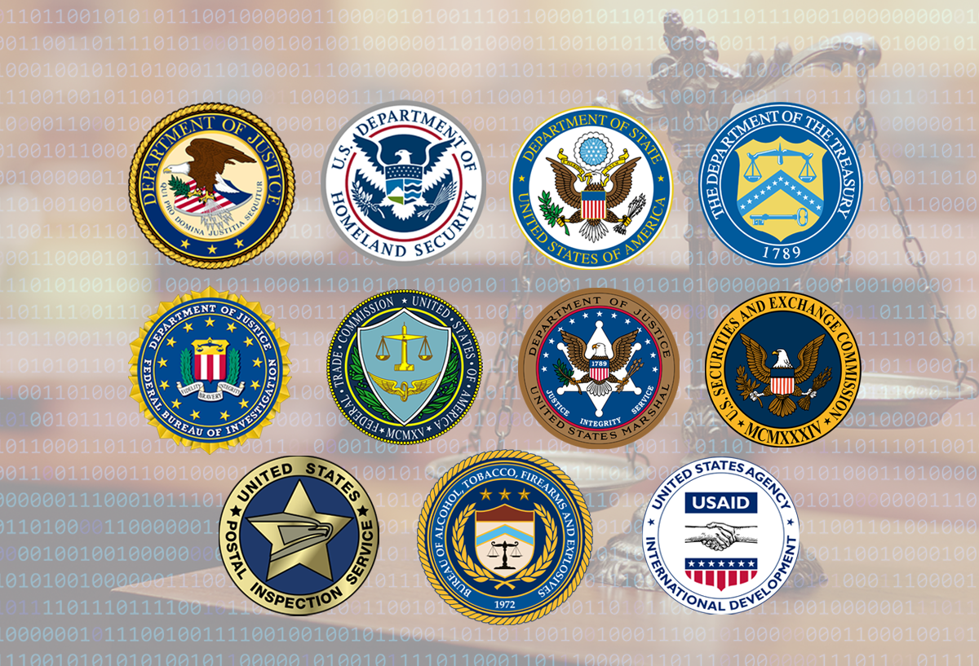
Cyber Crime

Slide 19

Questions?

