Slide 2
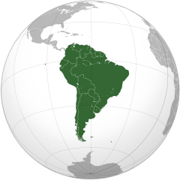
corruption: the thorn in Latin America’s side
By Gina Cabrejo.

Slide 3
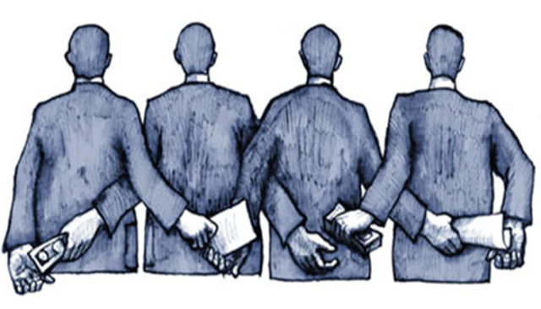
corruption
Breach of public trust.
Abuse of discretion or position.
Obtain a pecuniary benefit or any advantage.
Using private sector accomplices to obtain bribes .
This Photo by Unknown Author is licensed under CC BY-NC-ND

Slide 4
Main Topics
Odebrecht as a company and its origin
Odebrecht Largest foreign bribery in Latin America
Odebrecht case & international judicial cooperation
Why international cooperation matters and recommendations

Slide 5
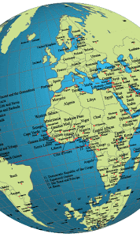
Odebrecht origin
The Americas, the Caribbean, Africa, Europe and middle east
This Photo by Unknown Author is licensed under CC BY
This Photo by Unknown Author is licensed under CC BY
This Photo by Unknown Author is licensed under CC BY-SA

Slide 6
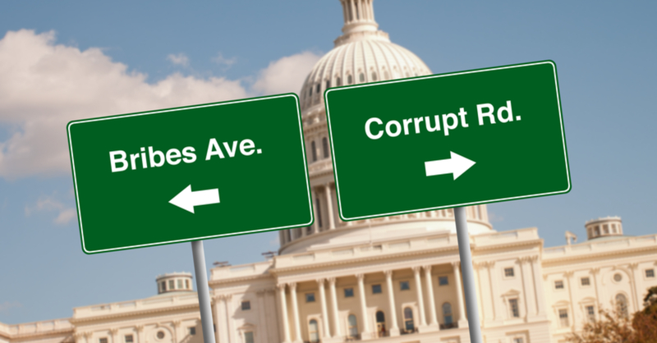
Largest foreign bribery ScanDAL in latin america
Country | US $ Bribes
Argentina | 35 million
Brazil | 349 million
Colombia | 12 million
Ecuador | 33,5 million
Guatemala | 18 million
Country | US $ Bribes
Mexico | 39 million
Panama | 60 million
Peru | 29 million
Dominican Republic | 92 million
Venezuela | 98 million
This Photo by Unknown Author is licensed under CC BY-SA-NC

Slide 7
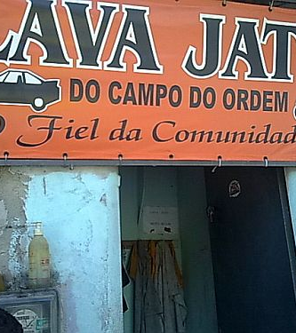
Car wash lava jato: The case
Gas Station and car wash where payoffs were laundered
Ongoing investigation by the Federal Police of Brazil
Money laundering lead to corruption
US $ 788 million in bribes
Won contracts and other benefits around $3,34 billion
This Photo by Unknown Author is licensed under CC BY-SA
This Photo by Unknown Author is licensed under CC BY-SA

Slide 8
The SCheme
Highest Level within Odebrecht,
Secret Financial Structure “Division of Structured Operations” = Bribery Department
Wire transfers, cash payments
Off-shore entities, off-shore bank accounts and off-shore book transactions
2014-2015 Meetings in MIA, movement of criminal proceeds
This Photo by Unknown Author is licensed under CC BY

Slide 9
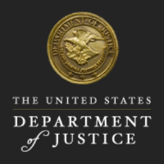
Largest foreign bribery in latin America
USDOJ Criminal Division Fraud Section & the U.S Attorney's office in the U.S. District Court for the Eastern District of NY
Criminal Division Office of International Affairs
AGO Brazil and Switzerland
This Photo by Unknown Author is licensed under CC BY-NC-ND
This Photo by Unknown Author is licensed under CC BY
This Photo by Unknown Author is licensed under CC BY-SA

Slide 10
International cooperation in the car wash case
Multinational agreements have been signed:
2017 The Brasilia Declaration for International Judicial Cooperation was signed by the countries involved in the scheme, to permit additional cross jurisdictional cooperation in investigating and prosecuting bribery, money laundering and corruption involving government officials. In the broadest, fastest and most efficient way.
2018 an Agreement between Brazil and Argentina was signed to share evidence.
2018 in Lima Peru at the Eighth Summit of the Americas the Lima Commitment was signed by various representatives of the countries that participated in the Summit. To promote coordination and the exchange of information and evidence in the investigations within Latin America countries.

Slide 11
Individual Country Responses in the car wash case
Peru: in 2018 issued Law 30424 which provides civil penalties, suspension, dissolution of companies involved in public corruption and corporate fines.
Argentina: issued a similar regulation, Law 27.401, which provides not only corporate liability to both domestic and foreign companies involved in domestic or international bribery but also vicarious liability and corporate fines.
Uruguay: Issued Law 19,574 to consolidate different regulations and laws in the country regarding money laundering and terrorism financing

Slide 12
Why international cooperation matters & Recommendations
Data Analysis to increase transparency.
The importance of monitoring financial transactions
Monitor irregularities in transactions and payments to government officials when dealing with contracts
Discretionary principle, principio de oportunidad criterio de oportunidad
Compliance programs, Urge the companies to assess their compliance programs, to have a mechanism of verification and transparency of their internal regulations and procedures.
Request the support of investigators from other jurisdictions who are accountants, experts in budget and credit analysis.

Slide 13
Why international cooperation matters & Recommendations
Mutual Legal Assistance MLA works but there are challenges (long process, authorizations)
Bilateral agreements allow prosecutors to take testimony and statements, request documents and records, request search and seizures, seek assistance in forfeiture of assets, fines, restitutions.
Counterparts in foreign jurisdictions, law enforcement officials, to maintain channels of communications as pre- MLA assistance
Networks bring together practitioners specialized in corruption
Use of liaison officers in foreign jurisdictions
Meetings with colleagues, exchange of knowledge, skills and recommendations
Flexibility and adaptability to change, new data and ways to commit crimes, and if necessary, familiarity with judicial practices in other countries.

Slide 14
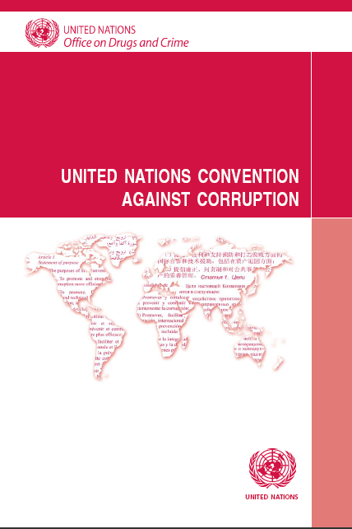
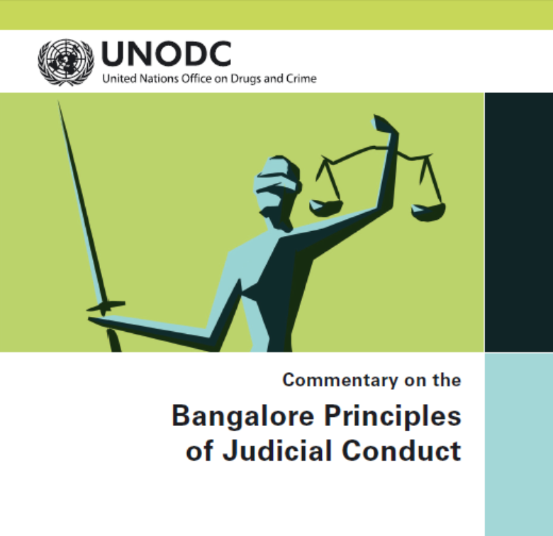
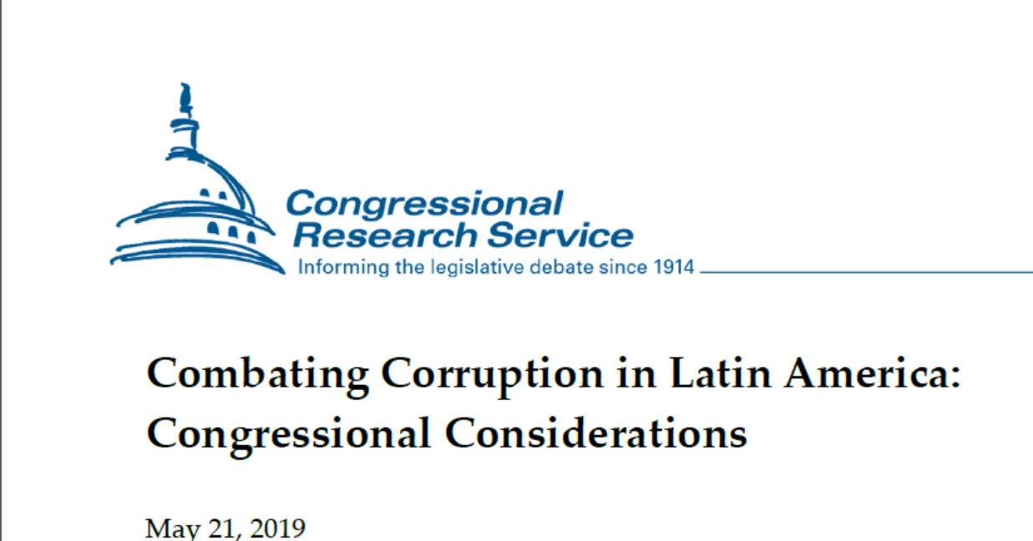

Slide 15
Continuing education

Slide 16
Video https://www.youtube.com/watch?v=WNWZLldPfDU

Slide 17
Thank you, GRACIAS, OBRIGADO.

