Slide 1
The Framework of International Cooperation & ARIN-AP
Jeehye Son
Supreme Prosecutors’ Office, Republic of Korea
ARIN-AP Secretariat
17th Sep. 2019. 24th IAP Annual Conference in Buenos Aires

Slide 2
CONTENTS
Framework – MLA vs. International Law Enforcement Cooperation
The ICC of the SPO & Cases
III. ARIN-AP & Cases
IV. Conclusion
2) Relationship between Prosecutors and LEO
3) Arrest & Detention
3. Prosecution

Slide 3
Traditional Framework of Int’l Cooperation
Difficulties from the internationalization of crime
(1) The suspect is located beyond the reach of the home country’s territorial jurisdiction
(2) Essential evidence is located across borders and in foreign locations.
Legal Mechanisms
(1) → Extradition
(2) → Mutual Legal Assistance

Slide 4
Procedure of MLA in Korea, Republic
Requested by Foreign Jurisdiction
The Ministry of Foreign Affairs →The Ministry of Justice
Reviewed by the MOJ
Whether to meet requirements etc.
Via ICC of the SPO
ICC gives an order to the DPO to fulfill the request
fulfillment by the DPO
Reply to the requested
Via ICC of the SPO
Via the ministry of Foreign Affairs

Slide 5
CASE
Recovery of the fraud victims’ loss
The Defendant, July 2007. ~ May 2008. established investment corporation, and deceived their investors that they would get huge returns based on high interest rates.
Total number of victims – over 1,500
Total damages – over $ 220M.
He was sentenced to eight years in prison.
It turned out that he committed an additional offense of concealing his illegal assets. On Nov. 2007. he bought a luxury residence with his fraudulent gains in the US.

Slide 6
CASE
Recovery of the fraud victims’ loss
Typical Procedure of asset recovery from a foreign country through MLA
Court Order to confiscating or freezing the assets → MLA request to the foreign country where the assets are located
However, in THIS case
Impossible to get a Court order under related domestic laws
Solution → International Law Enforcement Cooperation
(Informal & Direct Cooperation)
Notes:
여기까지 7분 걸림….

Slide 7
Int’l Law Enforcement Cooperation
ILEC
▪ Directly contact foreign agencies
▪ Based on MOU or Human Network
MLA
Use formal & conventional
diplomatic channels
▪ Based on treaties between nations

Slide 8
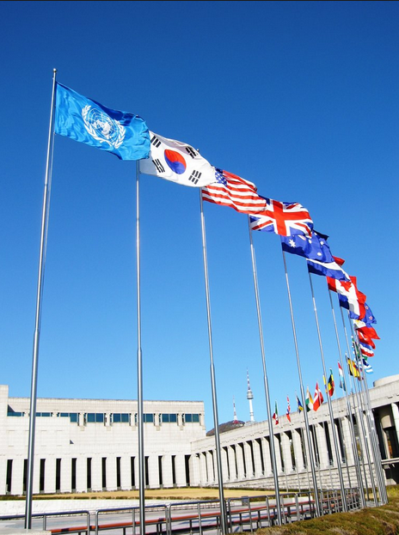
Grounds for ILEC
Recommended by Int’l Conventions
Article 48, 50 of UNCAC
Article 6, 27 of UNTOC
Article 9 of United Nations Convention Against Illicit Traffic in Narcotic Drugs and Psychotropic Substances
FATF 40+9 Recommendations
Notes:
probably skip

Slide 9
Advantages & Limitation
Swift Exchange of Information
Simple & Easy way of communication
Usefulness as Pre-MLA
Not always admissible as evidence

Slide 10
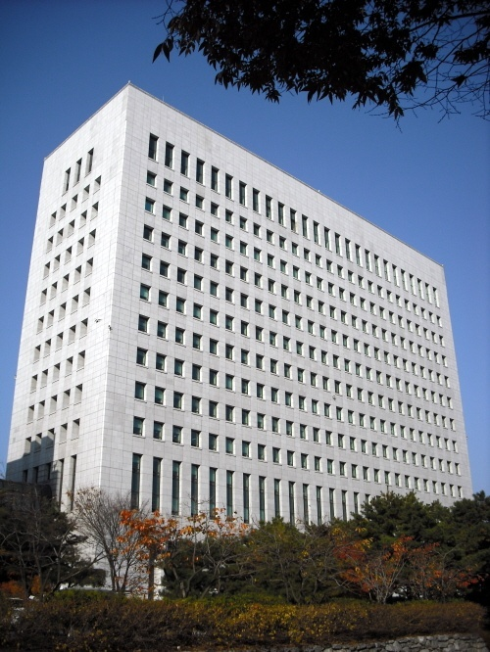
What Korean Prosecution did
The foremost authority in charge of
investigation and prosecution in Korea
25 MOUs with various foreign authorities
Hosted 4th World Summit & 16th IAP Annual Conference
Established International Cooperation Center in 2010
Permanent Secretariat of ARIN-AP
Notes:
skip

Slide 11
International Cooperation Center
Direct Cooperation between Investigation Agencies
▶ MLA is implemented between central governments based on treaties
(responsibility of Int’l Criminal Affairs Division, MOJ)
▶ Int'l Law Enforcement Cooperation is implemented between law
enforcement agencies around the world by ICC, SPO
Scope of cooperation
Information
exchange
Joint Investigation
Deportation
of Criminals
Notes:
skip

Slide 12
International Cooperation Center
Request of prosecutors’ office for overseas info
Requesting assistance
Analyzing info before sending to prosecutors’ office
US DOJ and Federal Prosecutors
Chinese Procuratorate and MPS
Canada Federal Prosecutors and
RCMP
ICC
Japan’s prosecutors
Australian Prosecutors
and AFP
CID
Law enforcement of Europe and Asia
FBI
DCIS
HSI

Slide 13
Restriction
Personal Information Protection Act
Article 15 (Collection and Use of Personal Information)
3. Where it is inevitable so that a public institution may perform the duties under its jurisdiction as prescribed by statutes, etc.
Article 18 (Limitation to Out-of-Purpose Use and Provision of Personal Information)
7. Where it is necessary for the investigation of a crime, indictment and prosecution

Slide 14
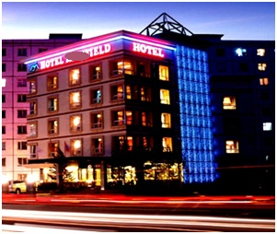
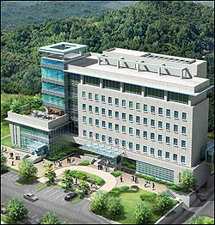
Asset Recovery
Illegal Casino
Hotel in Mongol
$1.7M outflow
35% Share
SPO
Mongol GPO
$ 360,000
Wire transfer
509 M Tug
Seoul North DPO
Mongol Bailiff Office
Notes:
.

Slide 15
Repatriation of Criminal
Tracing and Detecting
Extradition Request based on Reciprocity
Refusal / trying alternatives for repatriation
Notes:
정한근 송환사례 설명…

Slide 16
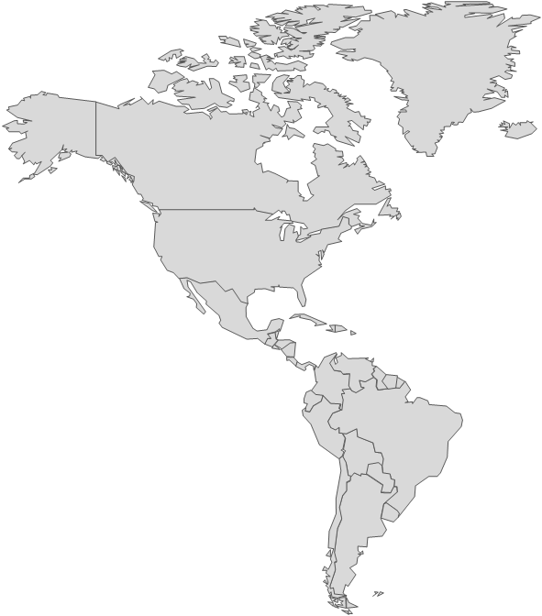
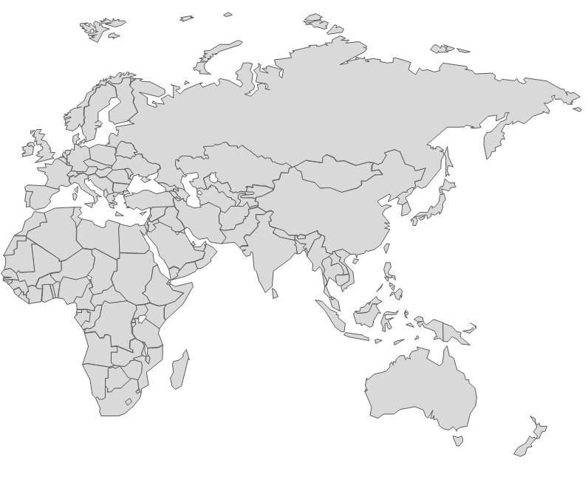
Repatriation of Criminal
LA
8.5h
Korea
14h
22 JUNE 12:15 Arrival
Dubai
Panama
21 JUNE 03:55 Arrival
22 JUNE 03:35 Departure
7h
Ecuador
Brazil

Slide 17
What is ARIN-AP?
Informal network of contacts and a cooperative group involved in all aspects of recovering the proceeds of crime.
Focus on the proceeds of all crime, promote the exchange of information and best practice
Network of practitioners from various jurisdictions and international organizations.

Slide 18
Current Member
No. | Member |  | Note
1 | Australia | Australian Federal Police | 2015 Presidency
2 | Brunei | Attorney Generals Chambers
3 | Cambodia | General Prosecution Office
4 | Indonesia | Attorney Generals Office | 2014 & 2018 Presidency
5 | Japan | Ministry of Justice, Ministry of Foreign Affairs | 2017 Presidency
6 | Korea | Ministry of Justice, SPO | Secretariat/ 2016 Presidency
7 | Mongolia | Office of the Prosecutor General | 2019 Presidency
8 | New Zealand | New Zealand Police
9 | Sri Lanka | Attorney Generals Department
10 | Chinese Taipei | Ministry of Justice
11 | Thailand | Office of the Attorney General
12 | Timor-Leste | Prosecutor General Office
13 | Cook Islands | Cook Islands Police Service, FIU
14 | India | Directorate of Enforcement
15 | Malaysia | Royal Malaysia Police
16 | Pakistan | National Accountability Bureau
17 | Tonga | Attorney General’s Office
18 | Kazakhstan | Prosecutor General’s office
19 | Myanmar | FIU, Attorney General Office
20 | Singapore | Attorney-General’s Chambers, Singapore Police Force
21 | Nepal | Department of Money Laundering Investigation, FIU
22 | Kyrgyzstan | Prosecutor General Office, FIU
23 | Palau | Office of the Attorney General, FIU
24 | Philippines | The Anti-Money Laundering Council
Notes:
update

Slide 19
Asset Recovery Inter-Agency Networks
CARIN
ARIN-WCA
ARIN-AP
ARIN-WA
ARIN-CA
ARIN-EA
RRAG
ARIN-SA
Notes:
ARIN-SA 추가

Slide 20
Asset Recovery via ARIN-AP
Cooperation within ARIN-AP
Korea
SPO
Mongolia
PO

Slide 21
Significance
Direct Contact Direct contact through ARIN Network facilitates the Speedy Response.
Informal contact between law enforcement agencies also facilitates the Speedy Response.
Each ARIN Body is a regional network but it is connected one another, after all to the whole world

Slide 22
Homepage www.arin-ap.org
Email arin-ap@spo.go.kr

Slide 23
THANK YOU

