Slide 1
Satyajit Boolell, SC, Director, Office of the Director of Public Prosecutions – Mauritius
Rich Goldberg, Senior Counsel for Complex Litigation, U.S. Department of Justice-United States
Laura Alejandra Perugin, Prosecutor in Contentious and Administrative Matters – Argentina
Sidney Rosa da Silva Junior, Coordinator, Prosecutor's Offices in Consumer Protection Matters, Public Prosecution of the State of Rio de Janeiro - Brazil
Abigail Stempson, Director, NAGTRI Center for Consumer Protection, NAAG-United States

Slide 2
Who Are We?
An IAP network focused on civil and criminal prosecution of consumer protection law violators across the globe
The PCPN will work to provide a much-needed forum for practitioners to communicate, exchange ideas and experiences, stay informed and collectively innovate and problem solve to advance approaches and techniques, and undermine fraudulent enterprises that harm consumers
The leadership group currently consists of IAP members from Argentina, Brazil, Mauritius, and the United States

Slide 3
Goals
Development of a webpage containing information about current trends in schemes, investigations, court cases, legislation, media coverage, and other relevant issues
A discussion board for exchanging questions, ideas, and precedents

Slide 4
Goals
Creation and maintenance of a database/contact list of:
Enforcers to facilitate international inter-agency cooperation and long-lasting professional partnerships
Experts for use in investigations and cases
Private industry representatives with resources available to assist in protecting the public
Periodic specialized conferences, webinars, and workshops addressing transnational investigations and cooperation, mutual legal assistance, emerging trends, and other relevant issues

Slide 5
Website
https://www.iap-association.org/PCPN/Home
General information about the PCPN
Contact information of leadership group and others
Announcements
Events/Meetings
Discussion Board
Resources
Press
PCPN Publications
Library
Country Factsheets

Slide 6
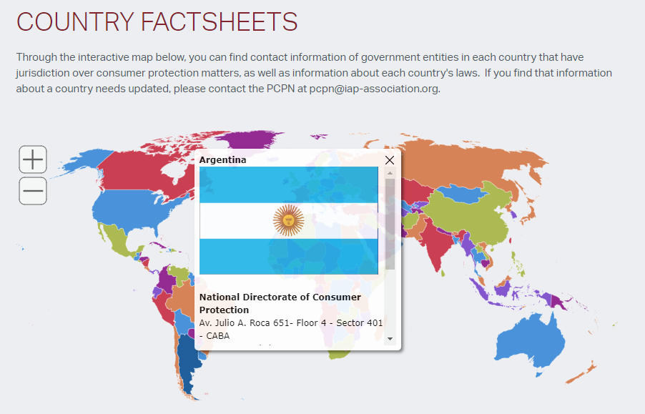
Country Factsheets

Slide 7
Contact Us
Prosecutors Consumer Protection Network
Email: pcpn@iap-association.org

Slide 8
Combatting Transnational Mass Marketing Fraud

Slide 9
Transnational Mass Marketing Fraud
What does this encompass?

Slide 10
Transnational Mass Marketing Fraud
Which schemes are the most prevalent in your country?
Domestic schemes victimizing consumers abroad
International fraudsters victimizing consumers at home

Slide 11
Transnational Mass Marketing Fraud
What techniques do you use to identify and investigate fraudsters outside of your country?

Slide 12
Transnational Mass Marketing Fraud
Are you working with law enforcement from other countries?
Successes?
Failures?

Slide 13
Transnational Mass Marketing Fraud
Do you engage in bilateral or multilateral groups that help facilitate cooperation in these cases?

Slide 14
Transnational Mass Marketing Fraud
How are fraudsters being prosecuted?
Civilly?
Criminally?
How does this affect methods for cross-border cooperation?

Slide 15
Transnational Mass Marketing Fraud
How can IAP provide a platform for cross-border cooperation in TMMF investigations?

Slide 16
Transnational Mass Marketing Fraud
Questions or comments?

Slide 17
PCPN Roundtable
Is consumer protection enforcement typically civil or criminal?
What remedies are available?
Who is the enforcing body?
Good laws vs. laws that need improvement?
What are the biggest issues facing consumers in your country?
How can PCPN help you?

