Slide 1
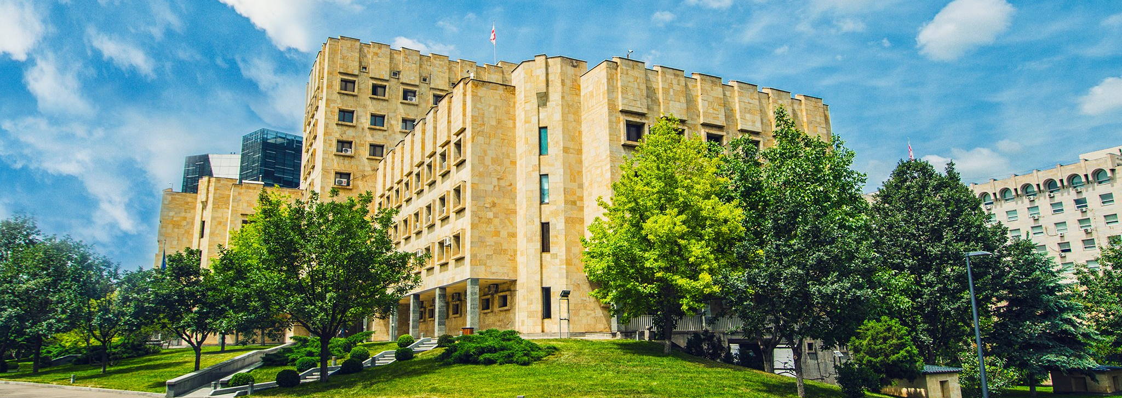
PARALLEL FINANCIAL INVESTIGATION
I A P
2022

Slide 2
Importance of Parallel Financial Investigations in Investigating Money Laundering
.
Freezing/recovering/confiscating proceeds of crime
Detection of money laundering - the offense associated with the predicate act
Identifying members of a criminal organization, revealing the structure/hierarchy of the organization
.
Implicating members of the criminal organization
.
.
Target offenses
Offenses motivated by obtaining material benefit
Predicate offenses determined by the National Risk Assessment Report
WWW.POG.GOV.GE

Slide 3
What Are the Preconditions of Effective Financial Investigation?
Challenges of conducting parallel financial investigations
Georgia’s experience – steps toward increased effectiveness
Domestic policy documents – guidelines / recommendations.
Retraining and specialization of investigators/prosecutors.
Monitoring crimes motivated by obtaining material benefit.
Existence of effective interagency coordination mechanisms.
Effective International Cooperation.
Effective Mechanisms for tracing/recovering movable/immovable property/virtual assets.
Utilizing intelligence – information obtained by the Financial Monitoring Service.
Utilizing artificial intelligence in course of analysis.
Joint investigation teams – financial experts
WWW.POG.GOV.GE

Slide 4
Domestic Policy Documents - Guidelines
Recommendation by the Prosecutor General of Georgia of August 4, 2015, on Certain Actions to Be Carried out in Criminal Proceedings.
2022 Guideline on Conducting Parallel Financial Investigations
Introducing international standards in practice.
Establishing a uniform practice for conducting parallel financial investigation on the domestic level
Retraining and specialization of investigators/prosecutors.
Monitoring offenses motivated by obtaining material benefit.
Monitoring of compliance with recommendations.
Monitoring associated offenses.
Monitoring proactive parallel financial investigations
WWW.POG.GOV.GE

Slide 5
Standing Interagency Operational-Analytical Platform
Engagement of law enforcement authorities, monitoring institutions, and FMS
Analyzing common – newly-identified typologies
Sharing information/experience
WWW.POG.GOV.GE

Slide 6
International Cooperation – Flexible Judicial Mechanisms
Cooperation within the scope of mutual legal assistance requests
Cooperation through foreign liaison prosecutors or liaison prosecutors in foreign countries
Providing and exchanging information through Georgia’s FMS - EGMONT
Cooperation via CARIN - asset recovery network
Use of police cooperation networks
WWW.POG.GOV.GE

Slide 7
Tracing / Recovering Assets
Tracing proceeds of crime or their equivalent
Immovable and movable property.
Money, securities, virtual assets, jewelry, etc.
Shares, stocks, brokerage accounts.
Using wide investigative techniques in course of asset tracing
Seeking out information from public / restricted sources.
Using international cooperation mechanisms when following the money.
Directly accessing analytical platforms/databases.
Utilizing financial intelligence.
Using temporary coercive measures (freezing/seizure)
Developing a strategy for freezing
Introducing a uniform practice
WWW.POG.GOV.GE

Slide 8
Actions to Be Carried out in Course of Parallel Investigations
Joint investigation teams – financial experts
Creating multidisciplinary working groups.
Inviting financial experts, auditors, computer experts.
Joining international investigation teams.
Utilizing artificial intelligence in investigations – analytical software
Analyzing large volumes of electronic data in a short period of time.
Categorizing, structuralizing, visualizing raw data.
Identifying hidden links, monitoring criminal operation.
Detecting latent threats.
WWW.POG.GOV.GE

Slide 9
Financial Intelligence
The FMS role in parallel financial investigations
Cooperating with FMS / providing information proactively
Using financial intelligence in parallel financial investigations
Obtaining/requesting information from FMS
WWW.POG.GOV.GE

Slide 10
THANK YOU FOR YOUR ATTENTION!

