Slide 1
Freedom of Expression and Social Media, a few viewpoints of interest to prosecutors
Kristjan Burgess | IAP Annual Conference, Tbilisi, September 2022

Slide 4
Growing spread of misinformation and disinformation through digital technologies.
Absence of inclusive global Internet governance frameworks facilitates the spread of hate speech, increasing risk of conflict.
Protection and promotion of information as a common good as a premise to address the regulation of digital platforms.
Key
challenges
Notes:
The crucial work of journalists in providing reliable information to citizens is undermined by increasing restrictions on freedom of expression and by persistent online and physical attacks. Women journalists are particularly subject to harassment and threats, especially online.
At the same time, the use of digital technologies for content personalization and moderation can impact freedom of expression and facilitate the spread of misinformation and disinformation. Misleading or false information undermines societal trust and imperils access to reliable and verified information. This, in turn, risks distorting citizens’ understanding of critically important issues as well as disrupting democratic processes, such as elections.

Slide 5
Key
challenges
New Data from the Reuters Institute Digital News Report
USA. Only 26% of Americans trust news generally, a 3-point decrease and the lowest figure on our sample.
India is a strongly mobile-focused market, with 72% accessing news through smartphones.
South Africa. 65% share news via social or email.
UK. 46% say they avoid the news sometimes or often. This is almost twice the level seen in 2016.

Slide 6
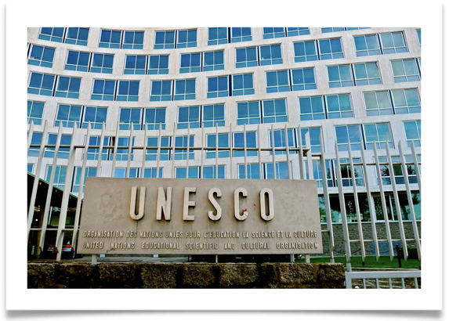
UNESCO works to promote freedom of expression online at a time when the digital ecosystem offers new opportunities but also multiplies challenges for freedom of expression.
Guided by the Windhoek +30 Declaration on information as a public good, we advocate for greater transparency and accountability of digital platforms , including to counter mis- and disinformation and hate speech.
We empower people with media and information literacy skills, support media viability and work to build societal resilience to harmful content online through a range of partnerships and collaborations. We support trustworthy, independent media and work with journalists to address information needs in times of emergencies.
We also train judicial and law enforcement actors on international standards on freedom of expression to tackle these challenges with a human rights-based approach, and advocate for a digital ecosystem based on the R.O.A.M.-X principles (human rights-based, open, accessible, and multi-stakeholder).

Slide 7
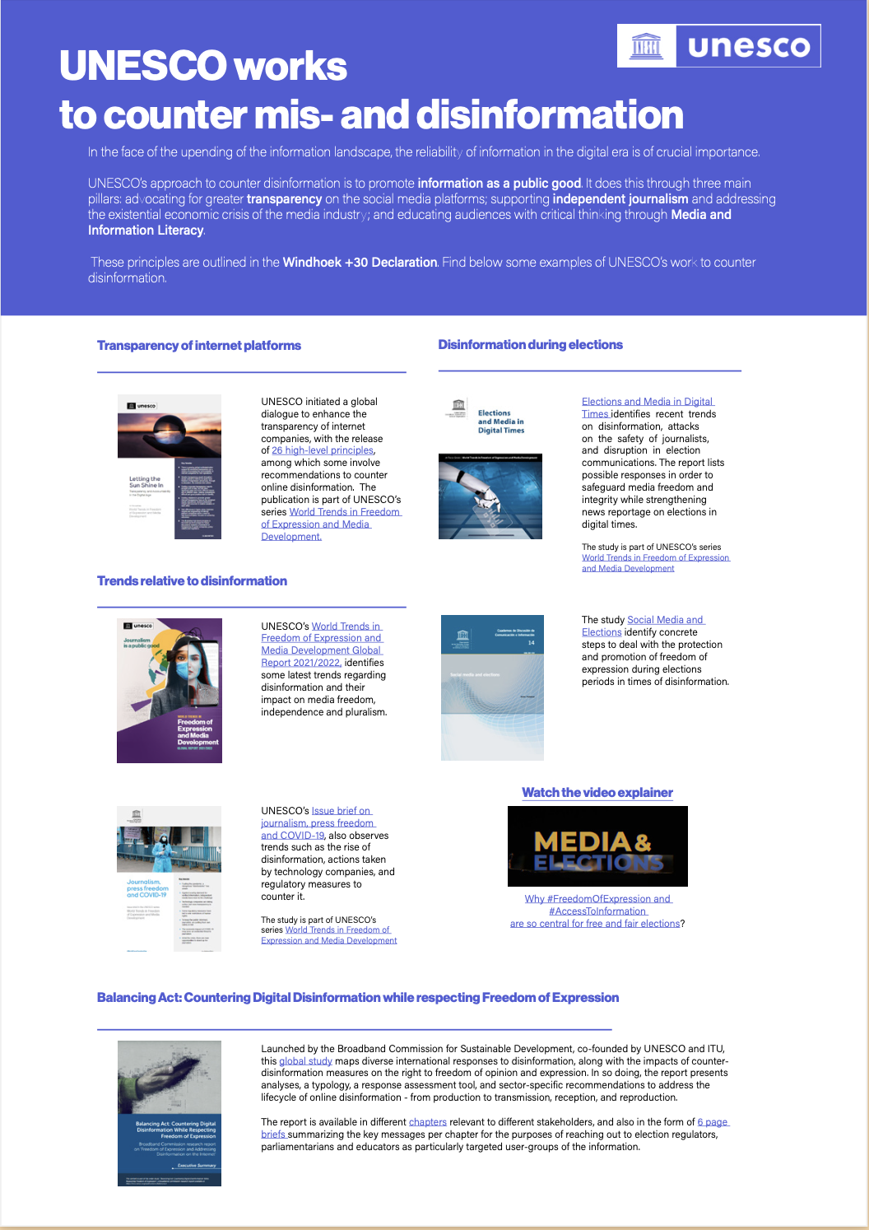
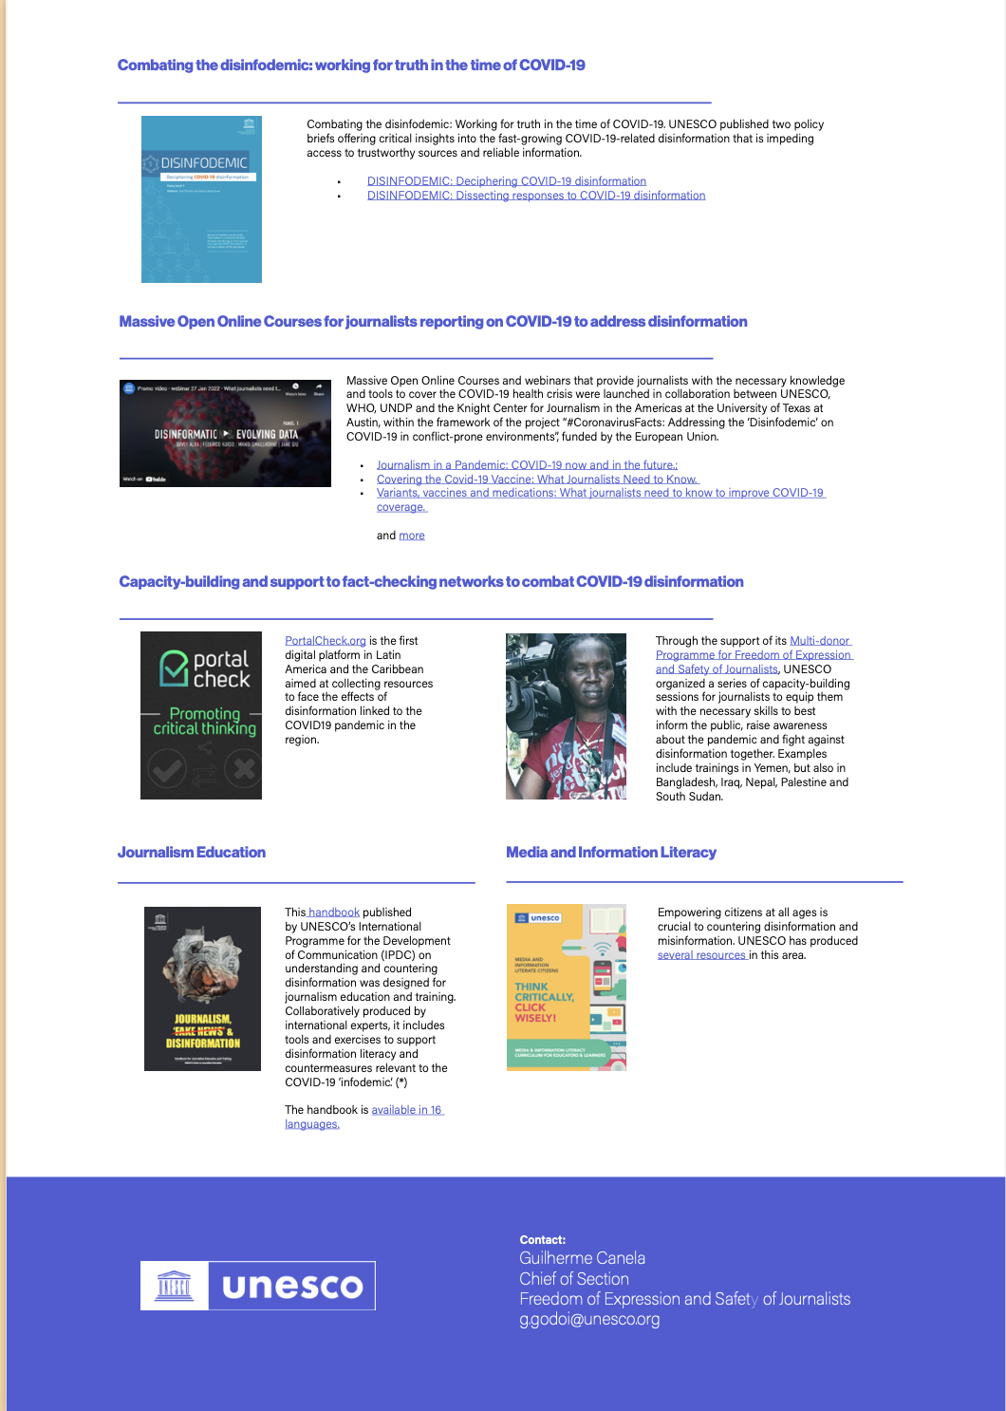
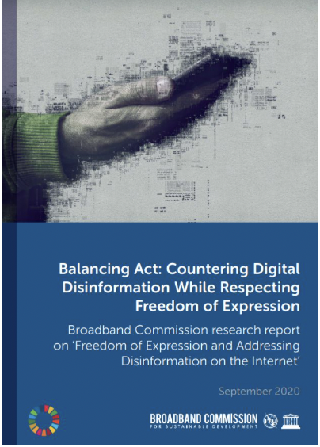
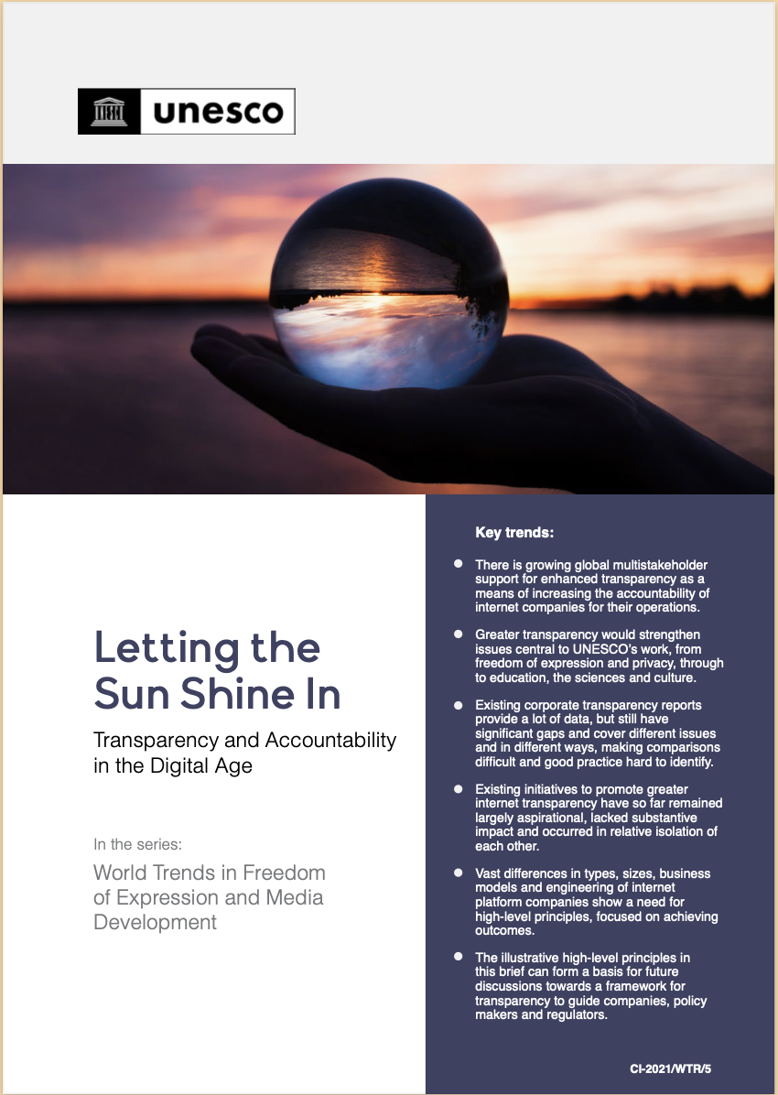

Slide 8
Video explainers available online

Slide 9
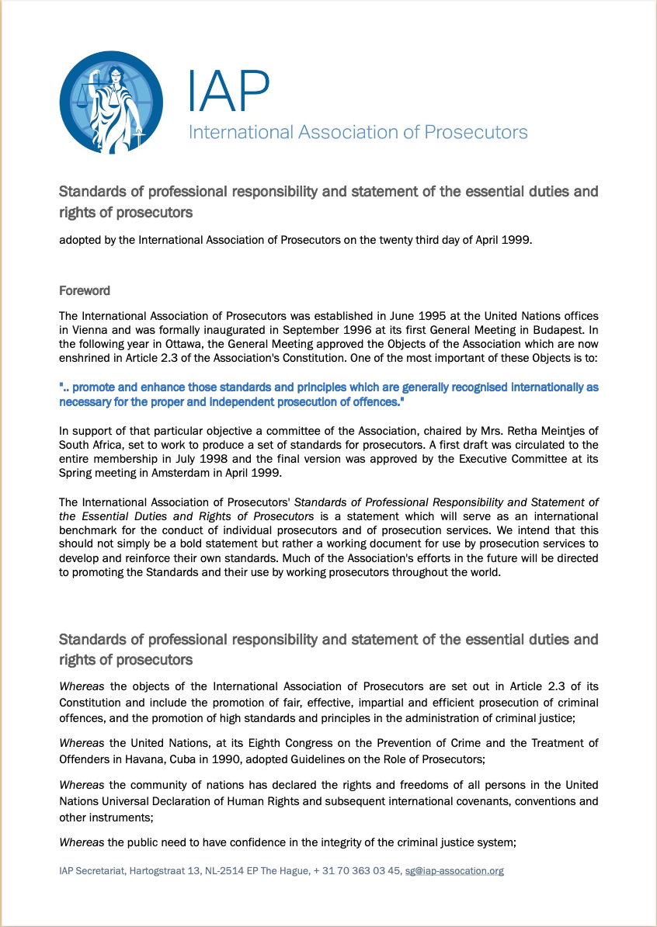
IAP Standards of professional responsibility and statement of the essential duties and rights of prosecutors
Professional Conduct
Prosecutors shall:
a) at all times maintain the honour and dignity of their profession; b) always conduct themselves professionally, in accordance with the law and the rules and ethics of their profession; c) at all times exercise the highest standards of integrity and care; d) keep themselves well-informed and abreast of relevant legal developments; e) strive to be, and to be seen to be, consistent, independent and impartial; f) always protect an accused person's right to a fair trial, and in particular ensure that evidence favourable to the accused is disclosed in accordance with the law or the requirements of a fair trial; g) always serve and protect the public interest; and h) respect, protect and uphold the universal concept of human dignity and human rights.

Slide 10
Risks and opportunities in judges’ awareness and use of social media
It is important that judges, both as citizens and in their judicial role, should be involved in the communities they serve. In an era where such involvement increasingly includes online activities, judges should not be prohibited from appropriate participation in social media.
The public benefit of such judicial involvement and participation must, however, be balanced with the need to maintain public confidence in the judiciary, the right to a fair trial and the impartiality, integrity and independence of the judicial system as a whole.
The Bangalore Principles of Judicial Conduct and other existing international, regional, and national rules, standards, and conventions of judicial conduct and judicial ethics apply to judges’ digital lives as much as to their real lives.
Social media opens up interesting challenges and opportunities and engages the Bangalore Principles in different ways, and judges should be aware of those. There may also be additional requirements that would inform judges’ discretion in using this technology.

Slide 11
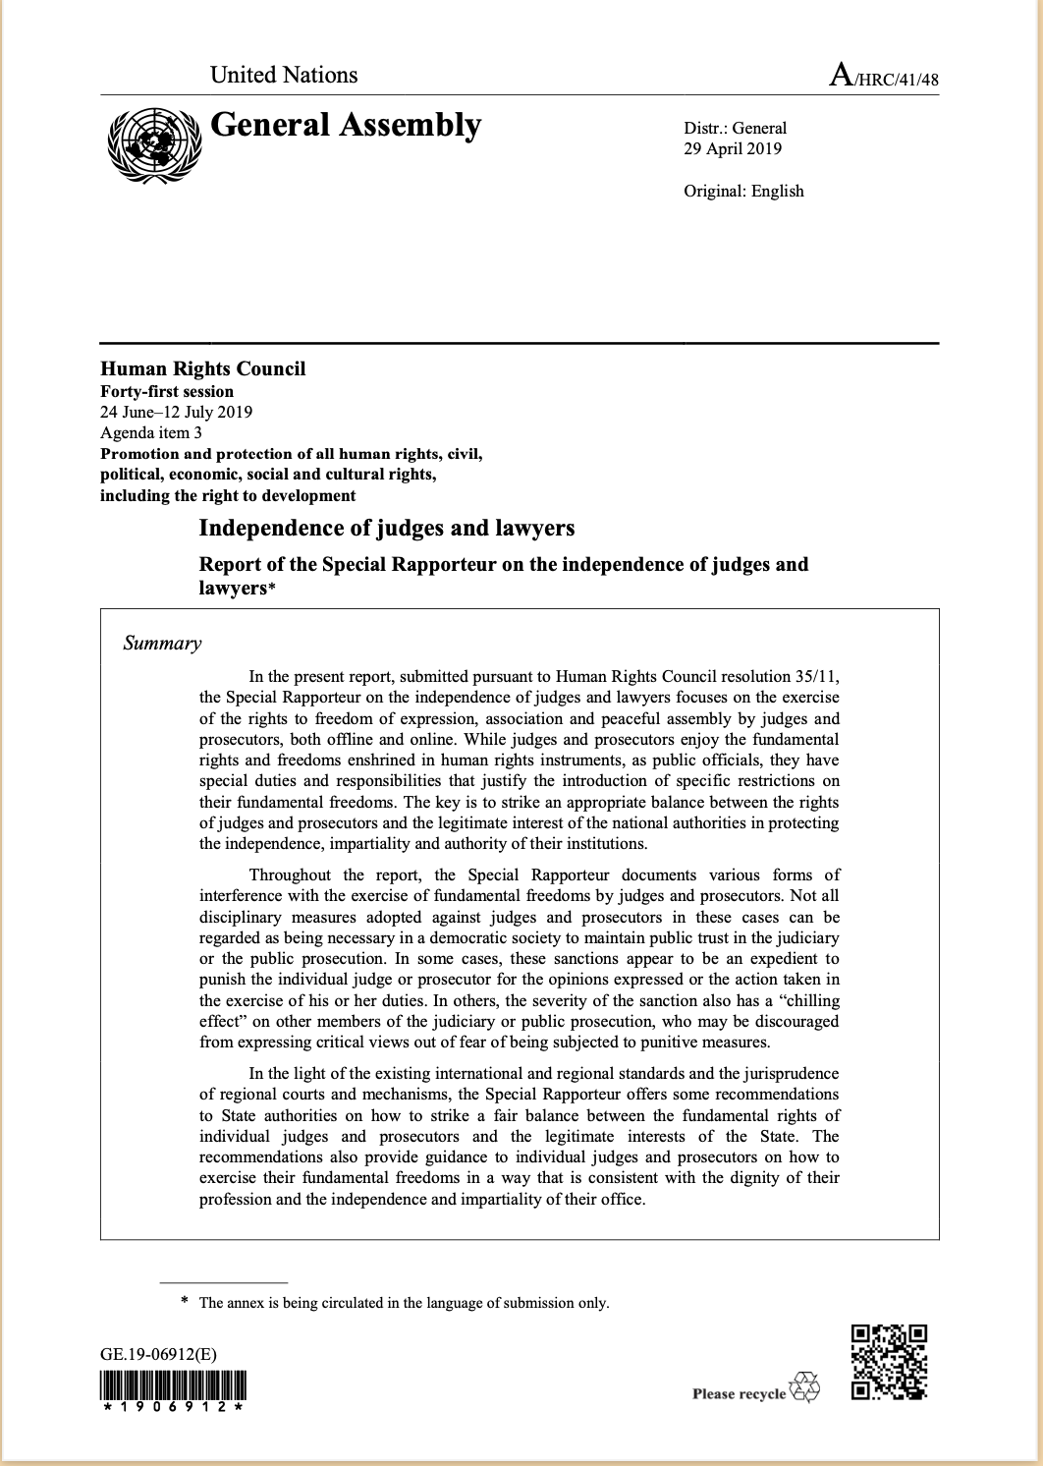
2019 Report of the Special Rapporteur on the Independence of Judges and Lawyers
80. The behaviour of judges and prosecutors on social media is visible to the public. Any comment or statement posted by a judge or a prosecutor should reaffirm the people’s faith in the judiciary and be consistent with the dignity of his or her office and with the independence and impartiality of the judiciary. As civil servants, judges and prosecutors must ensure that the expression of their personal views and convictions does not adversely affect their official duties, reflect poorly on their status as civil servants or call into question their impartiality or their duties of loyalty and responsibility to their office. In expressing their views and opinions online, they should always respect and honour their office, and strive to maintain and enhance confidence in the judicial system. They should refrain from any online activity that may harm the public trust in the judiciary, or raise doubts as to its independence and impartiality.

