Slide 1
Freedom of expression and the safety of journalists
Role of judicial actors
Kristjan Burgess | IAP Annual Conference, Tbilisi, September 2022

Slide 2
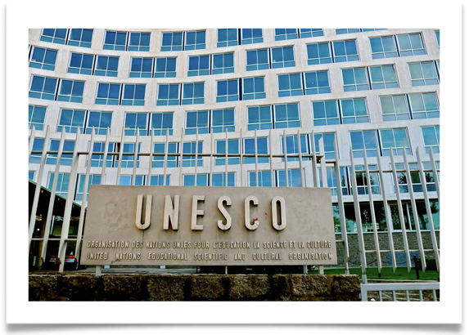
A foundational mandate: Specialized UN agency with the mandate to promote freedom of expression and its corollaries, access to information and press freedom.
The right to freedom of expression and access to information are fundamental freedoms as well as enablers to ensure the rule of law, and human rights more broadly.
Judiciary systems are essential to protect freedom of expression through the enactment and enforcement of laws and policies.

Slide 3
Freedom of expression and Safety of journalists -
Key challenges
High number of killing of journalists, 950 in the last decade and 66 killed already in 2022. 86% of cases met with impunity.
Increasing restrictions on freedom of expression — 85% of the world’s population experiencing a decline in press freedom.
Persistent online and physical attacks against journalists. Harassment and threats, disproportionally against women journalists.
Notes:
The crucial work of journalists in providing reliable information to citizens is undermined by increasing restrictions on freedom of expression and by persistent online and physical attacks. Women journalists are particularly subject to harassment and threats, especially online.
At the same time, the use of digital technologies for content personalization and moderation can impact freedom of expression and facilitate the spread of misinformation and disinformation. Misleading or false information undermines societal trust and imperils access to reliable and verified information. This, in turn, risks distorting citizens’ understanding of critically important issues as well as disrupting democratic processes, such as elections.

Slide 4
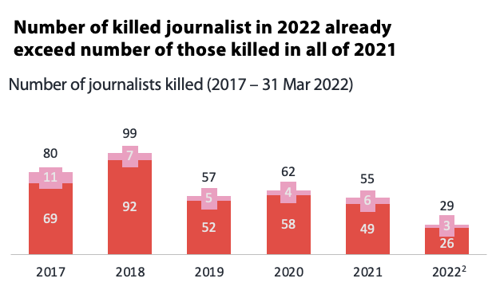
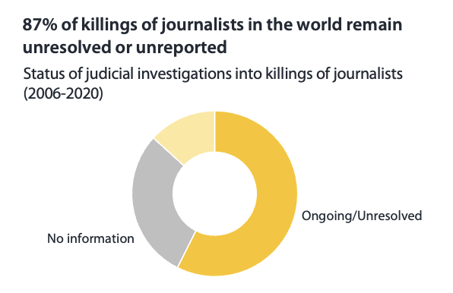
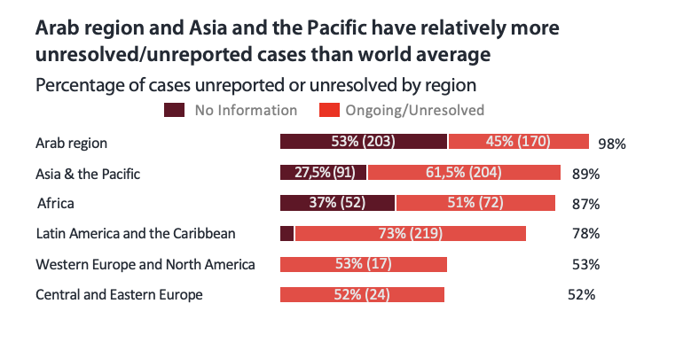
Global Trends in the Safety of Journalists
Global Trends in the Safety of Journalists
15 Sep
66
8
58
Notes:
The increased use of digital platforms in the absence of inclusive, global Internet governance frameworks has also led to the spread of hate speech, which fuels online and offline discrimination, hostility and violence.
Addressing these challenges calls for the protection and promotion of information as a common good that is available to all and that contributes to the achievement of peace and sustainable development.

Slide 5
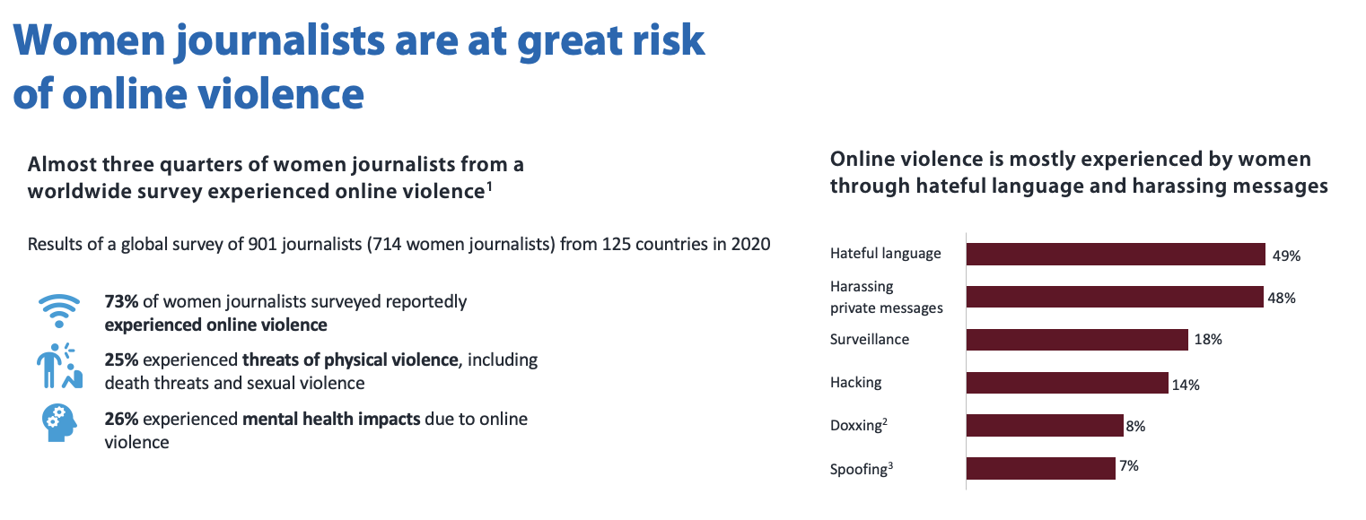
Women journalists are at great risk of online violence
Women journalists are at great risk of online violence

Slide 6
Key
challenges
in the digital era
Growing spread of misinformation and disinformation through digital technologies.
Absence of inclusive global Internet governance frameworks facilitates the spread of hate speech, increasing risk of conflict.
Protection and promotion of information as a common good as a premise to address the regulation of digital platforms.
Notes:
The crucial work of journalists in providing reliable information to citizens is undermined by increasing restrictions on freedom of expression and by persistent online and physical attacks. Women journalists are particularly subject to harassment and threats, especially online.
At the same time, the use of digital technologies for content personalization and moderation can impact freedom of expression and facilitate the spread of misinformation and disinformation. Misleading or false information undermines societal trust and imperils access to reliable and verified information. This, in turn, risks distorting citizens’ understanding of critically important issues as well as disrupting democratic processes, such as elections.

Slide 7
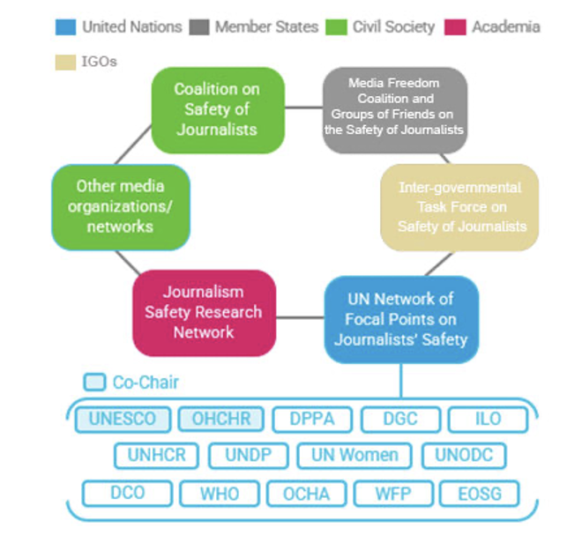
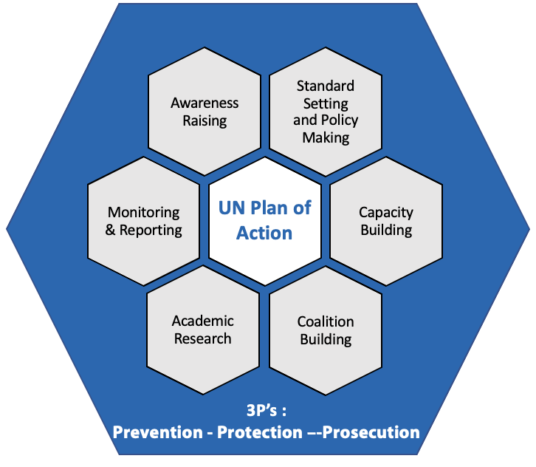
UN Plan of Action on the Safety of Journalists and the Issue of Impunity
UNESCO’s actions in these areas fall within the framework of the UN Plan of Action on Safety of Journalists and the Issue of Impunity,
This is the only systematic UN-wide plan that aims to create a free and safe environment for journalists and media workers, including social media producers, in both conflict and non-conflict situations.
UNESCO’s activities contribute to the achievement of the Sustainable Development Goals, particularly SDG 16 and as in the case of cooperation with different stakeholders - SDG 17.
Notes:
Organizing capacity-building activities for women journalists and media managers on ensuring their safety and launching a global study on violence against women journalists.
Rallying support of top newspapers, media outlets and influential journalists around the world to disseminate UNESCO’s awareness-raising campaigns for World Press Freedom Day and International Day to End Impunity for Crimes against Journalists. As an example, in celebration of World Press Freedom Day 2020, UNESCO highlighted the critical role of journalism in the context of the COVID-19 crisis through the widely disseminated FACTS media campaign.

Slide 8
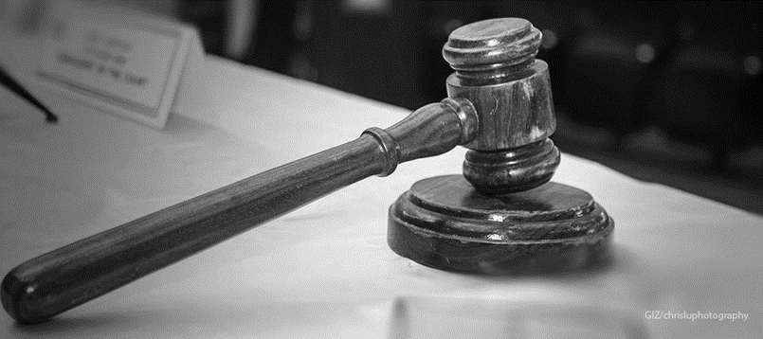
UNESCO’s
Judges Initiative
Prevention, Protection, Prosecution

Slide 9
UNESCO’s
training of judicial actors on freedom of expression and safety of journalists
Goal: Reinforcing capacities and knowledge of judges, prosecutors, lawyers and other actors of judicial systems on international and regional standards on freedom of expression issues.
Through on-the-ground trainings, trainings of trainers’ workshops at regional or national level and a Massive Open Online Course (MOOC) for judiciary members and civil society representatives.
Access to information is a key component of UNESCO-led training activities for judicial actors: as guarantors of the right to access information, judges, prosecutors and judicial actors also fall under the obligation to act in transparency themselves.

Slide 10
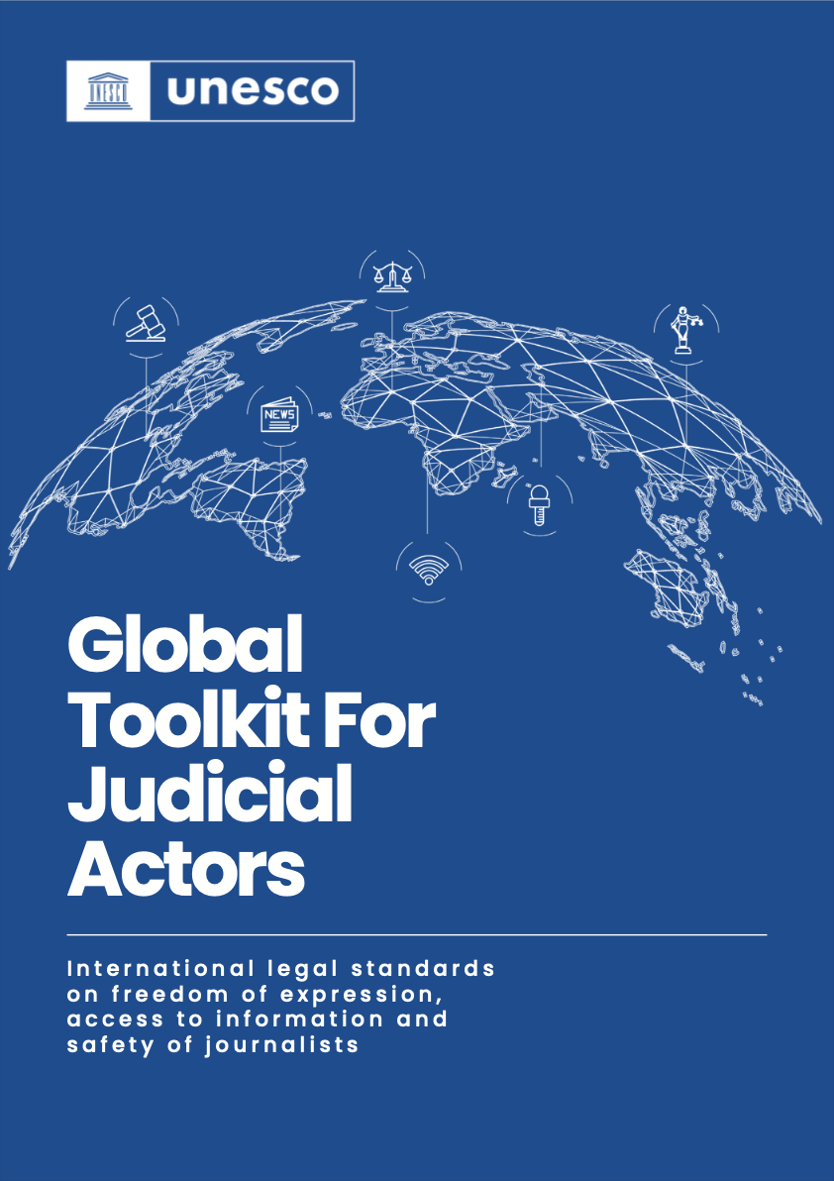
UNESCO’s
training of judicial actors on freedom of expression and safety of journalists
UNESCO’s Judges Initiative: Training more than 24,000 judicial actors and 11,000 law enforcement agents on freedom of expression since 2013.
Cooperation agreements with Regional Courts of Justice in Africa and Latin America, International Association of Prosecutors and the International Police Association.
Providing practical tools, policy briefs and guidelines for media professionals, policy makers, judges, prosecutors, security forces and others.
Making jurisprudence available, Columbia University database
Notes:
Contributing to the liberation of imprisoned journalists - the 2016, 2017 and 2018 laureates of the UNESCO/Guillermo Cano World Press Freedom Prize, which acknowledges outstanding contributions to the defence and promotion of press freedom, were released after having received the award.
Training more than 17,000 judicial actors from over 60 countries and 3,400 law enforcement agents from over 17 countries on freedom of expression, access to information and the safety of journalists, through UNESCO programmes such as the Judges Initiative.

Slide 11
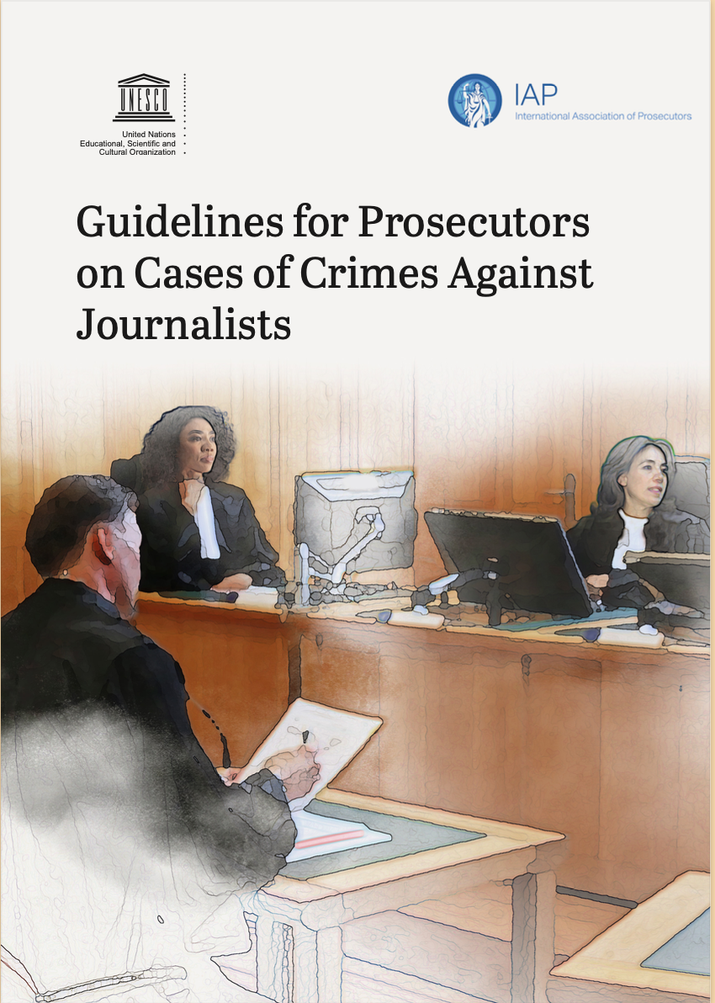
Global Toolkit for Judicial Actors and Guidelines for Prosecutors
The Global Toolkit reinforces the practical application of universal standards on human rights, by bringing in approaches of the human right bodies and regional human rights courts as well as perspectives from national legal systems
The toolkit incorporates also examples and debates originating in different legal traditions, including the common law and civil law systems, to provide a global framework on freedom of expression for judges and judicial actors around the world.
The Guidelines for Prosecutors are a practical guide in 7 chapters on key issues for prosecutors to keep at heart when looking at crimes against journalists.
Available in Arabic, Chinese, English, French, Portuguese, Russian and Spanish

Slide 12
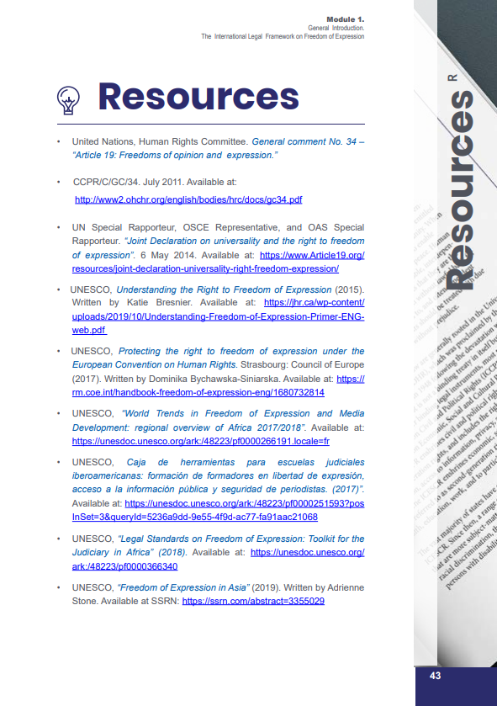
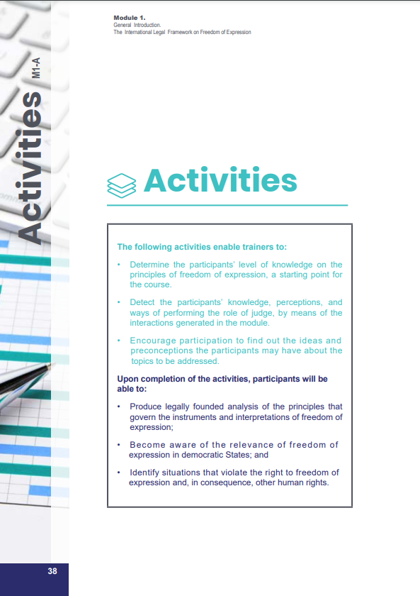
Global toolkit for judicial actors
Through 5 comprehensive modules, the Toolkit focuses on:
The International Legal Framework on Freedom of Expression;
The Legitimate Restrictions on the Exercise of Freedom of Expression;
The Right to Access Information;
Attacks against Freedom of Expression and the Role of the Judiciary; and
Freedom of Expression on the Internet.
At the end of each module, assessments, case studies and resources are proposed to test one’s knowledge and command of the topics under consideration

Slide 13
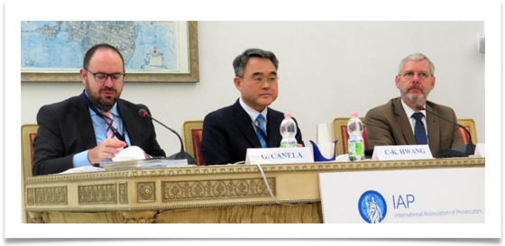
Key
challenges
Training Course by UNESCO, IAP in partnership with the Siracusa Institute
5-day ‘International Training Course for Prosecutors on Investigating and Prosecuting Crimes against Journalists and the Protection of Freedom of Expression’. February 14 - 18, 2022, in Siracusa, Italy,
The course brought together 22 prosecutors and representatives of judicial training academies from 12 countries (Bangladesh, Brazil, Georgia, Honduras, India, Kenya, Lebanon, Nigeria, Pakistan, Somalia, Thailand and Uzbekistan).
The training course was organized to build on the Guidelines for Prosecutors on Cases of Crimes Against Journalists developed by the IAP and UNESCO, available in 18 languages.

Slide 14
Key
challenges
The purpose of the course was to
increase the awareness of the participants of the fundamentals of the freedom of expression,
to provide them with operational tools for investigating and prosecuting crimes against journalists and media workers, and
to explore mechanisms for the protection of journalists and their sources, victims, and witnesses.
The course also served as a platform for enhancing international and regional cooperation by establishing an informal network of prosecutors specialized in the field.

Slide 15
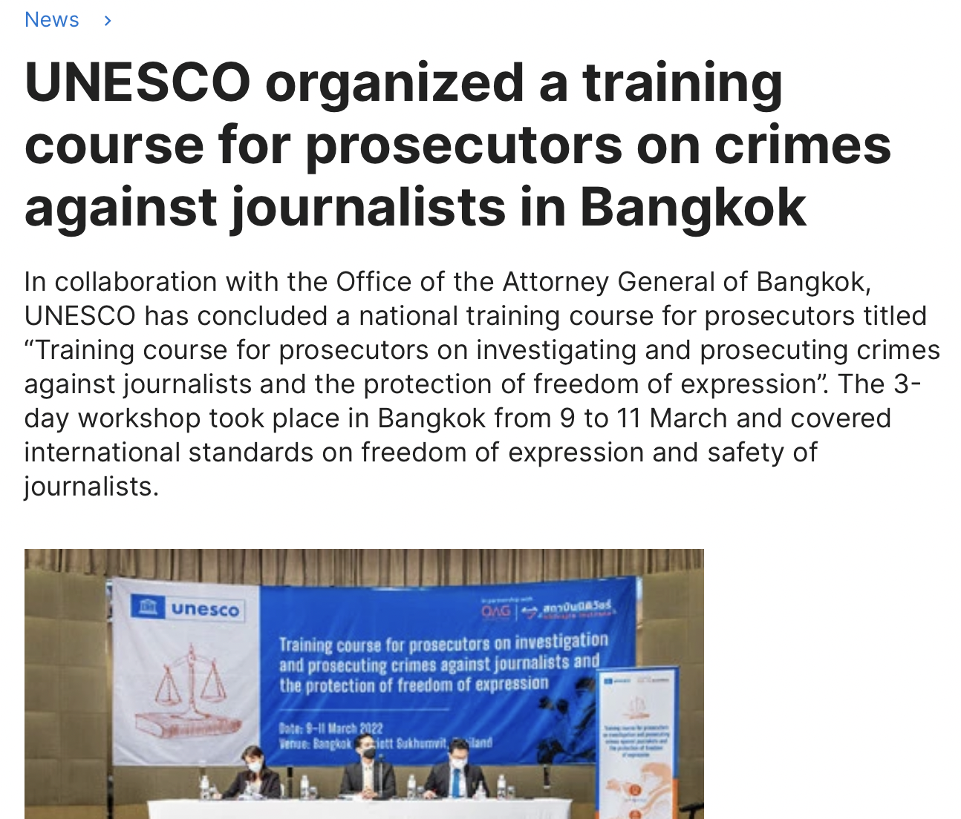
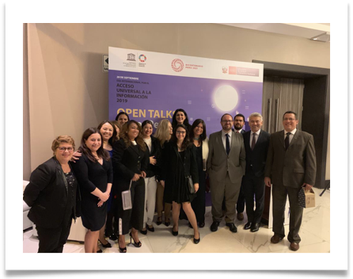
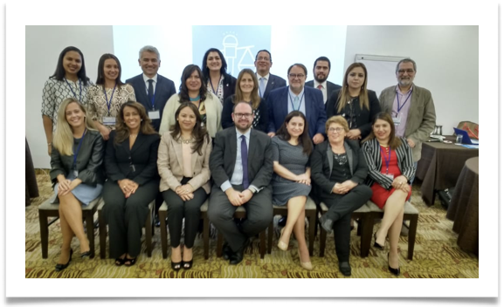
Specialized trainings in Italy, Uruguay, Paraguay, Perú, Uzbekistan, Thailand…

Slide 16
Freedom of expression is a fundamental right which is also an enabler of other human rights. When addressing the issue in trainings with judicial actors, UNESCO seeks to highlight permissible restrictions on freedom of expression, access to information and press freedom according to international standards, citing some examples of how international and regional bodies and courts have interpreted or embedded these standards

Slide 17
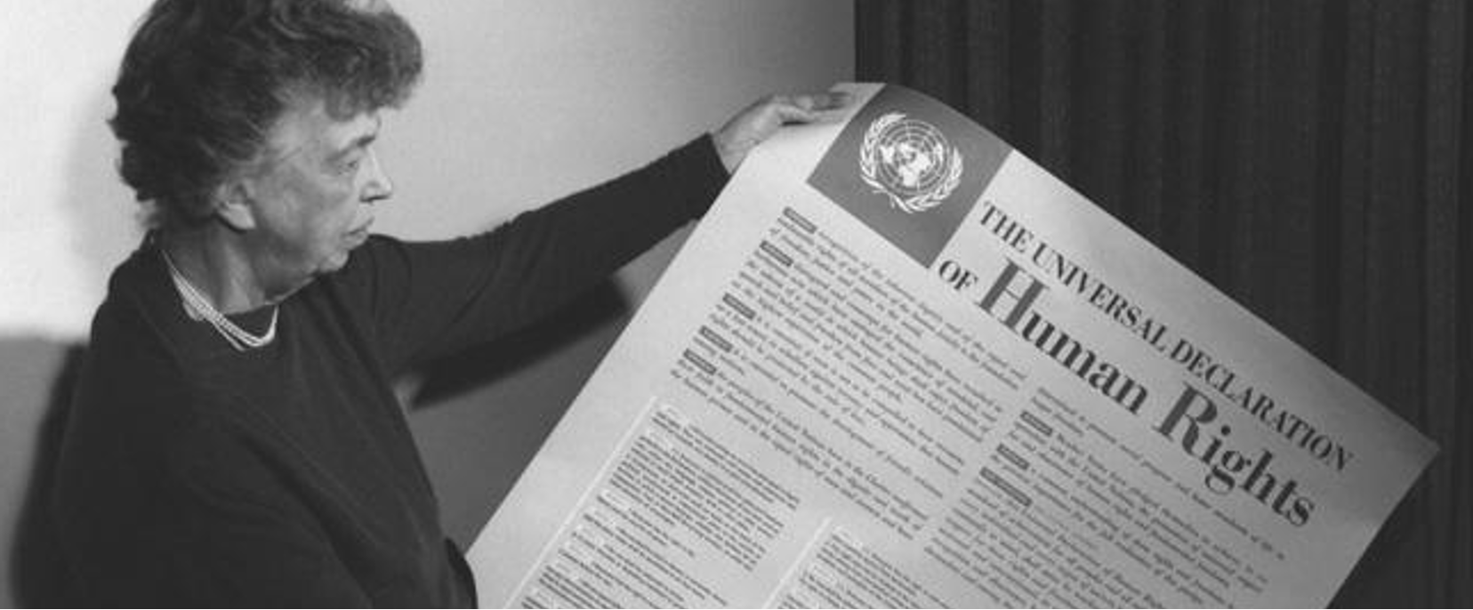
Article 19 of the Universal Declaration of Human Rights adopted in 1948 provides that:
“Everyone has the right to freedom of opinion and expression; this right includes freedom to hold opinions without interference and to seek, receive and impart information and ideas through any media and regardless of frontiers.”

Slide 18
Article 19 of the International Covenant on Civil and Political Rights (ICCPR) signed in 1966 – effective in 1976
(1) Everyone shall have the right to hold opinions without interference.
(2) Everyone shall have the right to freedom of expression; this right shall include freedom to seek, receive and impart information and ideas of all kinds, regardless of frontiers, either orally, in writing or in print, in the form of art, or through any other media of his choice.
Notes:
The UDHR inspired the ICCPR, which include a verification mechanism of compliance

Slide 19
Freedom of expression is not absolute and can (and sometimes must) be restricted; however, under international standards, its limitations must fall within strict and narrow restrictions. Restrictions are the exception.
Art.19 (3) ICCPR; The exercise of the rights provided for in paragraph 2 of this article carries with it special duties and responsibilities. It may therefore be subject to certain restrictions, but these shall only be such as are provided by law and are necessary:
a) For respect of rights or reputations of others;
b) For the protection of national security or of public order (order public), or of public health or morals.” .

Slide 20
To be justifed, any limitation of the right to freedom of expression must meet a three-part test requiring that:
it must be provided for by law;
it must pursue a legitimate aim;
it must be necessary for a legitimate purpose.
These conditions are cumulative.
Ultimately, when contested, it is for a court or an appropriate tribunal to determine whether the test has been met properly, both procedurally and substantively, following due process of the law.
Notes:
It is important to note that all three legs of the three-part test must be satisfied in relation to a limitation of the right

Slide 21
Resources for judicial actors
The Legitimate Limits to Freedom of Expression: the Three-Part Test
Subtitles available in Arabic, Chinese, English, French, Portuguese, Russian and Spanish.
Two motion-design videos on the legitimate limits to freedom of expression to illustrate some of the key legal tools to take decisions on potential legitimate limits to freedom of expression according to international standards
The Rabat Plan of Action on the Prohibition of Incitement to Hatred
Subtitles available in Arabic, Chinese, English, French, Portuguese, Russian and Spanish.

Slide 22
Kristjan Burgess, UNESCO
k.burgess@unesco.org

