Slide 1
Public Health Responses to Crime : The ceara prosecution service case
ENEAS ROMERO DE VASCONCELOS, STATE PROSECUTOR, COORDINATOR OF THE COVID TASK FORCE (mpce)
http://www.mpce.mp.br/coronavirus/

Slide 2
The ceara prosecution service case IN THE COVID-19 PANDEMIC
ENEAS ROMERO DE VASCONCELOS, STATE PROSECUTOR, COORDINATOR OF THE COVID TASK FORCE (mpce)
ENEAS.VASCONCELOS@MPCE.MP.BR
ENEASROMERO@HOTMAIL.COM
http://www.mpce.mp.br/coronavirus/

Slide 3
The problem
TOTAL DEATHS IN THE WORLD 6.536.722
TOTAL DEATHS IN BRAZIL 685,837

Slide 4
LOCAL SITUATION
27.650 DEATHS
https://integrasus.saude.ce.gov.br/#/indicadores/indicadores-coronavirus/coronavirus-ceara

Slide 6
HOW TO DEAL WITH THE PROBLEM
Unexpected event: Covid pandemic
Predictable, but not predicted
How should prosecution service act?

Slide 7
Prosecution service decision making
The role of science: evidence-based decision making
Coordination
Focus on Civil and Crime prevention rather than repression

Slide 8
Prosecution service in brazil
Federal Prosecution
State Prosecution
Military Prosecution
Labour Prosecution

Slide 9
Need of coordination
TASK FORCE: FEDERAL, STATE AND LABOUR PROSECUTIONS SERVICE
WORKING GROUP WITH MAJOR STAKE HOLDER AT CEARÁ
STATE PROSECUTION SERVICE AT CEARA TASK FORCE (GT COVID)

Slide 10
Gt covid
COORDENATION: LEADER AND CHIEF PROSECUTOR
CRIMINAL
HUMAN RIGHTS
CONSUMERS LAW
PUBLIC HEALTH

Slide 11
Brazilian prosecution service
CRIMINAL LITIGATION: crime
CIVIL LITIGATION: human rights

Slide 12
Prosecution servisse in the Brazilian constitucional
In charge of defending the democratic regime and the inalienable social and individual interests (Art. 127 Caput)
Article 129 of the Constitution
i – to initiate, exclusively, public criminal prosecution
iii – to institute civil investigation and public civil suit to protect public and human rights

Slide 13
CIVIL LITIGATION
Controlling public policies: expanding Hospital and other Health Care Facilities Capacity
Protective Measures
Vaccination

Slide 14
CRIMINAL LITIGATION
PREVENTION AND REPRESSION
CRIME IN GENERAL
HEALTH CARE AND COVID CRIMES

Slide 15
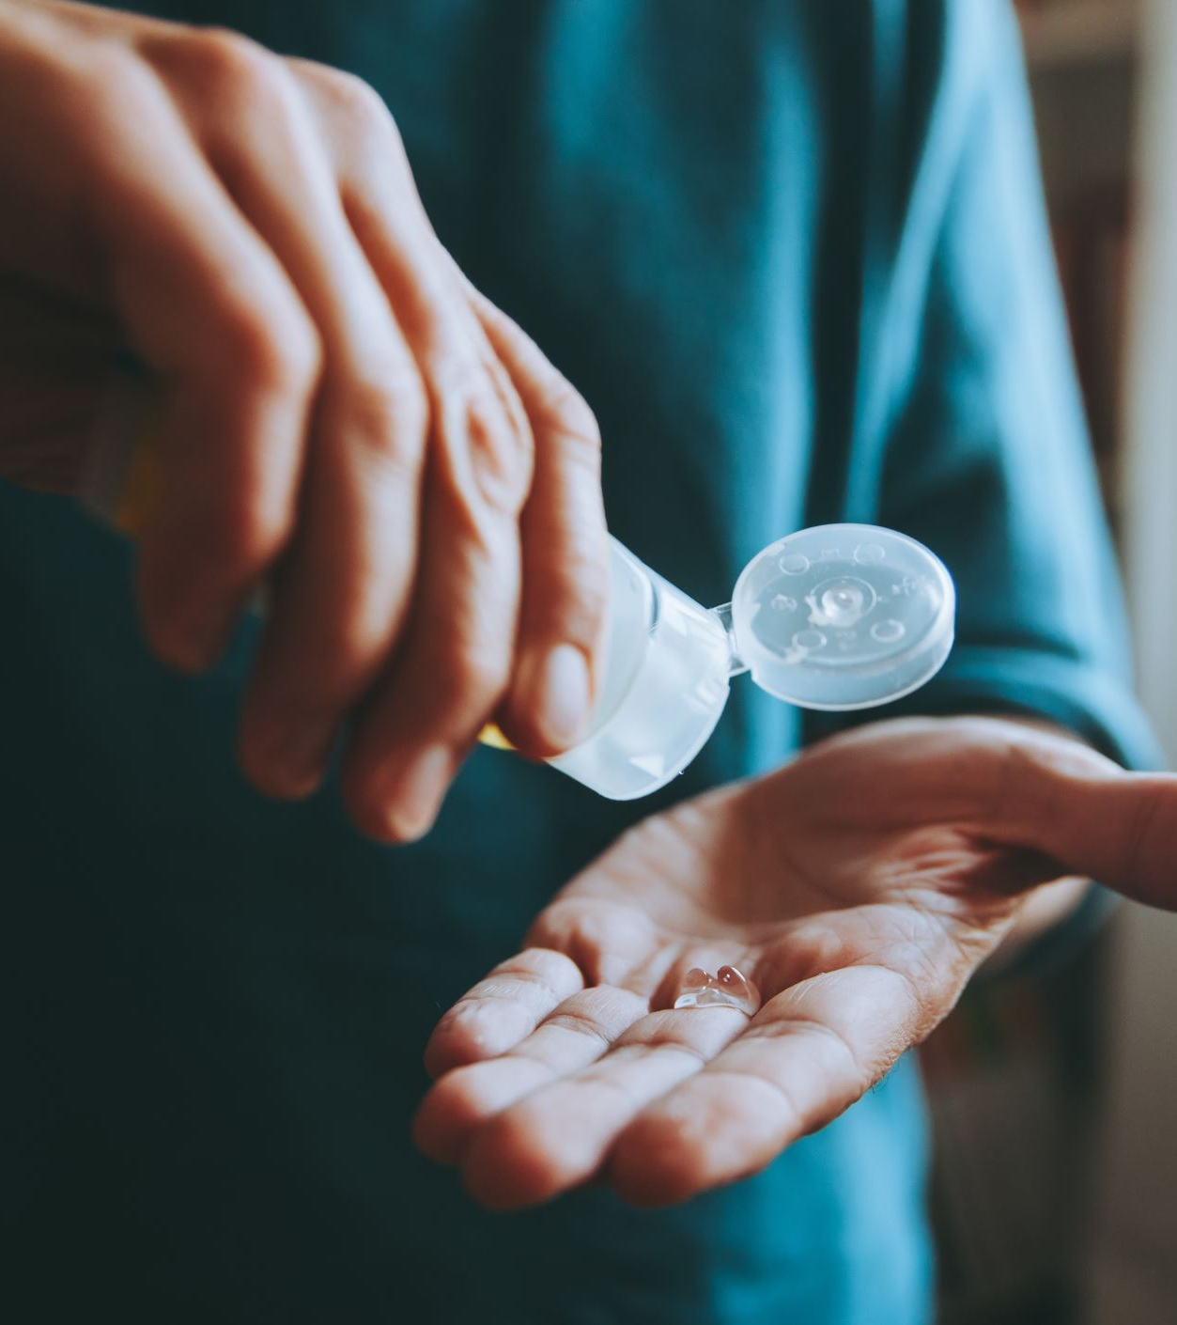
Crime prevention
TRANSPARENCY

Slide 16
CRIME PREVENTION: transparency
EXPENDURE
COVID DATA
VACCINATION

Slide 17
Mpce transparency
http://www.mpce.mp.br/coronavirus/
E-mail: covid19.denuncia@mpce.mp.br
E-mail and telefon contact to all prosecutors
Judicial and extrajudicial online systems

Slide 18
Crime repression
Crimes against Health and Covid
PPE and Masks supply
Crimes Against the administration: corruption
Oxygen supply
Vaccination

Slide 19
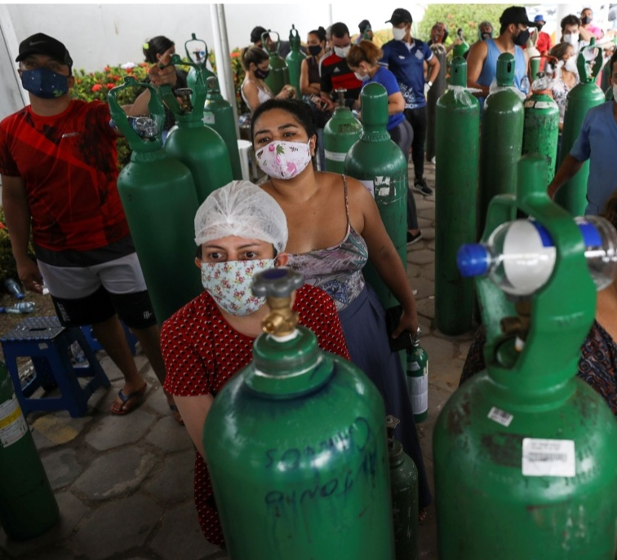
The 2021 oxygen supply crisis

Slide 20
CRIME TASK FORCES
Field Hospital investigation
Oxygen supply
Vaccination distribution based on scientific criteria: risk of exposure and group risk

Slide 21
LESSONS FROM THE PANDEMIC TO THE PROSECUTION
NEED OF COORDENATION AT ALL LEVELS: THE LARGER THE STATE, MORE DIFICULT IS THE COORDINATION
TASK FORCES ARE IMPORTANT
EVIDENCE-BASED DECISIONS: THE ROLE OF SCIENCE. HOW TO DEAL WITH UNCERTAINTY?
FOCUS ON PREVENTION

Slide 22
CHALlENGES
LACK OF SPECIAL LEGISLATION
DECENTRALIZATION
COORDENATION AT DIFFERENT LEVELS: GLOBAL, REGIONAL, NATIONAL AND LOCAL

