Slide 1
Context:
Alarming situation of democracy decline (Freedom House)
Reporters without borders
UNESCO reports on the state of the Freedom of expression
The necessity of transparency and accountability of governments and other political institutions acting on behalf of the people.
Notes:
From mid 90’s to first decade of the 21 first century, it was a fleurishing desire towards a new system of representaion :Democracy
Human rights conventions and others international instruments we put in place (Merida convention, Palermo convention)
Reporters without Borders: 32 killed 509 in jail.

Slide 2
What do you need to make a sense out of it?
Awareness instinct leads you to…
Information
News
Quality of democratic life depends:
Public having the facts
Making sense of them
John Dewey said : The goal of democracy is not to manage public affairs efficently, it is to help people develop their fulliest potentiel. The purpose of the news id to help people self-govern
Notes:
Expert note:
To make a sense of what is out there, you need adding more context, helping you answer questions you may raise about a situation, an event a political turmoil.
Since ancient time, prehistoric time, since the invention of language, exchange of information has been a cornerstone of our lives. ~:
John Dewey (american philosopher) said : The goal of democracy is not to manage public affairs efficently, it is to help people develop their fulliest potentiel. The purpose of the news id to help people self-govern.

Slide 3
What do you need to make you own opinion?
State propaganda?
Fake news?
Ideological news?
Fragmentation?
Algorithm news or Conspiracy theory?
Independent, reliable, accurate and comprehensive information
Notes:
Expert notes:
The Prosecutor General office of Russia has ordered to close news media using the term WAR. Not ban the term but close the news oulets.

Slide 4
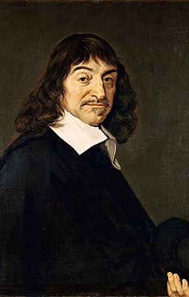
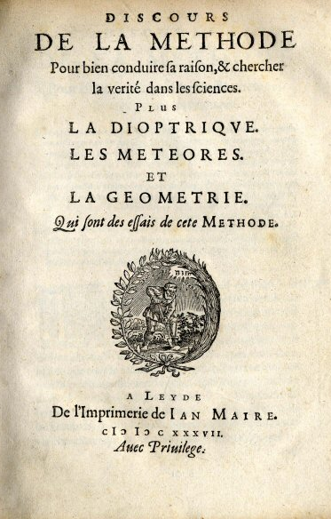
René Descartes (1637)

Slide 5
Judicial search for truth in criminal matters
A Sense of rigour
Human liberties or freedom are in jeopardy
Architecture of procedural rules to admit legally evidence
Parties that can challenge the legality of each evidence and the truthfulness of each witness
Level for a conviction:
Beyond a reasonable doubt (Common Law)
Decisive evidence (Civil Law)
Notes:
Expert note:
the quality of the evidence may be challenged,
the weight to be given to an event or testimony may be affected by credibility,
a procedural error may prohibit the admissibility of evidence
There may be a different version of the same event that rise a reasonable doubt on the conviction
The threshold for the guilt id high

Slide 6
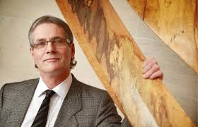
Wrongfull conviction in any country with any system
Notes:
Expert Notes:
Migard spend 25 years in jail for a murdur he id mot do. DNA solved the case later and the real agressor confessed.

Slide 7
Journalistic search for truth in investigative matters
Access to information Act requests
Questioning witnesses
Comparing documents (officials and non-officials)
Working with confidential sources
Witnessing event first-hand on the field
Research databases
Notes:
Expert notes:

Slide 8
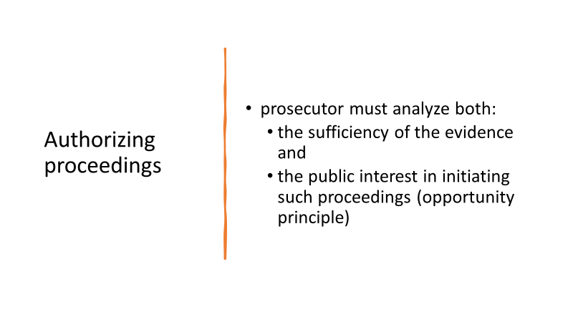

Slide 12
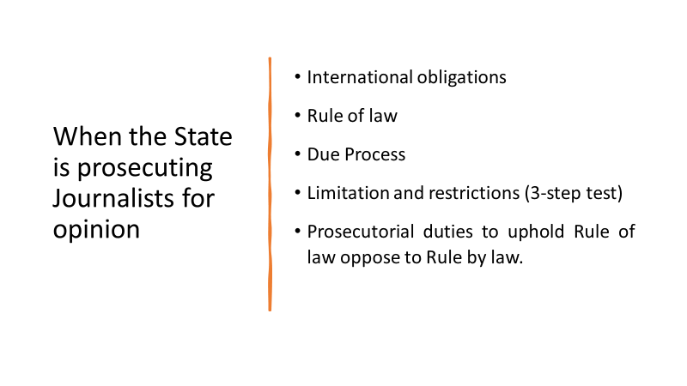

Slide 13
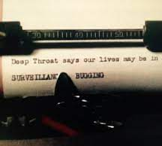
What is a source?
Notes:
Expert notes:

Slide 14
Sources for investigative journalist
What are they:
A source, who confidentially transmits information to a journalist, with the latter's commitment not to disclose its identity and whose maintenance of anonymity is essential to the relationship between the journalist and the source, must be treated in accordance with the rules of confidentiality and public interest
Why they are important:
The confidentiality of journalists’ sources must be protected in the exercise of the mission of informing the public
Notes:
Expert Notes:
How to they become confidentiel
International Covenant on Civil and Political Rights ICCPR (19) CASE OF GOODWIN v. THE UNITED KINGDOM(Application no. 17488/90)
European convention on human rights (10)
A source, who confidentially transmits information to a journalist, with the latter's commitment not to disclose its identity and whose maintenance of anonymity is essential to the relationship between the journalist and the source, must be treated in accordance with the rules of confidentiality and public interest. The confidentiality of journalists’ sources must be protected in the exercise of the mission of informing the public. Consequently, journalistic sources are confidential and should be treated as such at every stage of the investigation and judicial proceedings.
The prosecutor must ensure the protection of confidential data that may lead to the identification of a source in situations where journalistic sources could be revealed by means of investigation or during the proceedings.
Apart from highly exceptional circumstances, journalistic sources or information which could lead to the identification of a journalistic source, should not be consulted or made public without the journalist's express consent, in agreement with the source, or if this is not possible, by the media organization associated with the journalist, in agreement with the source.
In the highly exceptional circumstances where lifting the confidentiality of the journalistic source is the sole investigative element for the resolution of the case, all information or evidence that could lead to the identification of the source should be sealed and submitted to a competent judicial authority to determine the conditions of use and treatment. In the absence of such a judicial process, the prosecutor will have to determine whether an overriding and proportionate imperative of public interest justifies the lifting of confidentiality. In its determination, it should be considered whether the public interest in the administration of justice outweighs the public interest in preserving the confidentiality of the journalistic source, considering in particular:
▪ after having exhausted all other investigative grounds, the lifting of confidentiality proves the only element of evidence available for the resolution of a case,
▪ the consequences of the disclosure on the journalistic source and the journalist, and
▪ the impact on the freedom of the press.
This determination should be made or approved by a senior managerial authority of the prosecution service.
In any case, the journalist or the press organ representing the journalist should be able to intervene in the determination to assert their point of view.
One should regard as an indirect breach of the confidentiality of sources, the fact of seeking to discover the sources of a journalist by means of investigations relating to any person who, by reason of their habitual relations with a journalist, may have information to identify these sources.
It is recommended that only prosecutors with specialized training on protection of journalistic sources should be part of the determination process.
CCPR/C/GC/34 : it is normally incompatible with paragraph 3 to restrict the freedom of journalists and others who seek to exercise their freedom of expression to travel outside the State party, to restrict the entry into the State party of foreign journalists to those from specified countries or to restrict freedom of movement of journalists and human rights investigators within the State party (including to conflict-affected locations, the sites of natural disasters and locations where there are allegations of human rights abuses).
States parties should recognize and respect that element of the right of freedom of expression that embraces the limited journalistic privilege not to disclose information sources.

Slide 15
Steps to protect Journalistic sources
It sould be only a judicial decision to override the confidentiality of a source
With respect to the treshhold
Investigative stage
Take care to seal the elements which could make it possible to discover the identity of the sources
Police
Prosecutors

Slide 16
Best practice based on international standards
Allows journalists to not disclose information or a document that identifies a journalistic source unless :
the information or document cannot be obtained by any other reasonable means
and the public interest in the administration of justice outweighs the public interest in preserving the confidentiality of the journalistic source.
Search warrant can be issued only if a judge is satisfied:
No other way by which the desired information can reasonably be obtained
That the public interest in the prosecution of a criminal offence outweighs the journalist’s right to privacy in the collection and dissemination of information.
Notes:
Expert notes:
This proposal is partly from the new Canada Evidence Act to protect the confidentiality of journalistic sources. It allows journalists to not disclose information or a document that identifies or is likely to identify a journalistic source unless the information or document cannot be obtained by any other reasonable means and the public interest in the administration of justice outweighs the public interest in preserving the confidentiality of the journalistic source.
The enactment also amends the Criminal Code so that only a judge of a superior court of criminal jurisdiction or a judge within the meaning of section 552 of that Act may issue a search warrant relating to a journalist. It also provides that a search warrant can be issued only if the judge is satisfied that there is no other way by which the desired information can reasonably be obtained and that the public interest in the investigation and prosecution of a criminal offence outweighs the journalist’s right to privacy in the collection and dissemination of information. The judge must also be satisfied that these same conditions apply before an officer can examine, reproduce or make copies of a document obtained under a search warrant relating to a journalist.
Make reference to the study by a Canadian commission on all international perspective regarding the protection of the journalistic sources. Vincent Riendeau (commissioner)

Slide 17
Thank you
დიდი მადლობა
didi madloba
Sabin Ouellet
Sabin.ouellet@s2gmng.com

