Slide 1
Prosecuting from the Dark Net
Mark Carroll
Notes:
This presentation is aimed at providing a case example of the challenges experienced by prosecutors and police in dealing with cybercrime, and demonstrating the heavy reliance placed on digital material to convict the defendant in this case. This case was also a good example of effective inter agency working, international cooperation and the importance of thinking strategically about how evidence should be presented to a tribunal of fact

Slide 2
The speech on Twitter
Notes:
In August 2016 the suspect came to the attention of law enforcement for posting a speech on Twitter in support of the terror group Islamic State Iraq and Levant, which also showed interest in training and assisting ISIL to communicate covertly over the internet
Showing willingness to develop ways to disable drone technology.

Slide 3
The Suspect
Samata Ullah
Kenyan Connection
Notes:
Police had tracked Ullah down after being passed intelligence by the US FBI, who had been handed the information from authorities in Kenya, who had arrested another man.
Ullah was in regular contact with the man via encrypted Telegram chats in which he vowed to use his special skills to help in the IS campaign.
He told him he would take "whatever advice and knowledge I have and contribute it to the Caliphate“.
From December 2015, he had provided instructional videos on how to secure sensitive data and remain anonymous online with the use of the Tor programme and PGP (Pretty Good Privacy) encryption

Slide 4
Risk management
Threat to life – attack planning and proactive response
Working closely with British intelligence services
Management of armed surveillance
Victim management via disruption notices/relocation/target hardening
Notes:
The individual was clearly dangerous and the police were quite rightly concerned that they did not have control of the suspect, were not fully aware of the extent of his criminality and needed to make an intervention to disrupt the individual by closing down his nefarious activities. The police and security officials carry the risk and have to manage that appropriately. The awareness of the threat to life is one that is secondary to a prosecution but better awareness of the evidence gathering opportunities in such cases managing the
As specialist prosecutors within the Counter Terrorism Division of the Crown Prosecution Service we were contacted by police investigators soon after the suspect was identified, and the case was allocated to two prosecutors. Meetings were held with intelligence gatherers, terrorism investigators and specialist cyber officers.
Early police-prosecution cooperation is an important ingredient upon which to base a successful prosecution. Without the collaboration it becomes extremely difficult for prosecution teams to be prepared in advance of the arrest notification and to allocate appropriate resources to the case.
Substantial multi-agency engagement to ensure that all are fully sighted on risk and appropriate decision is made at pace

Slide 5
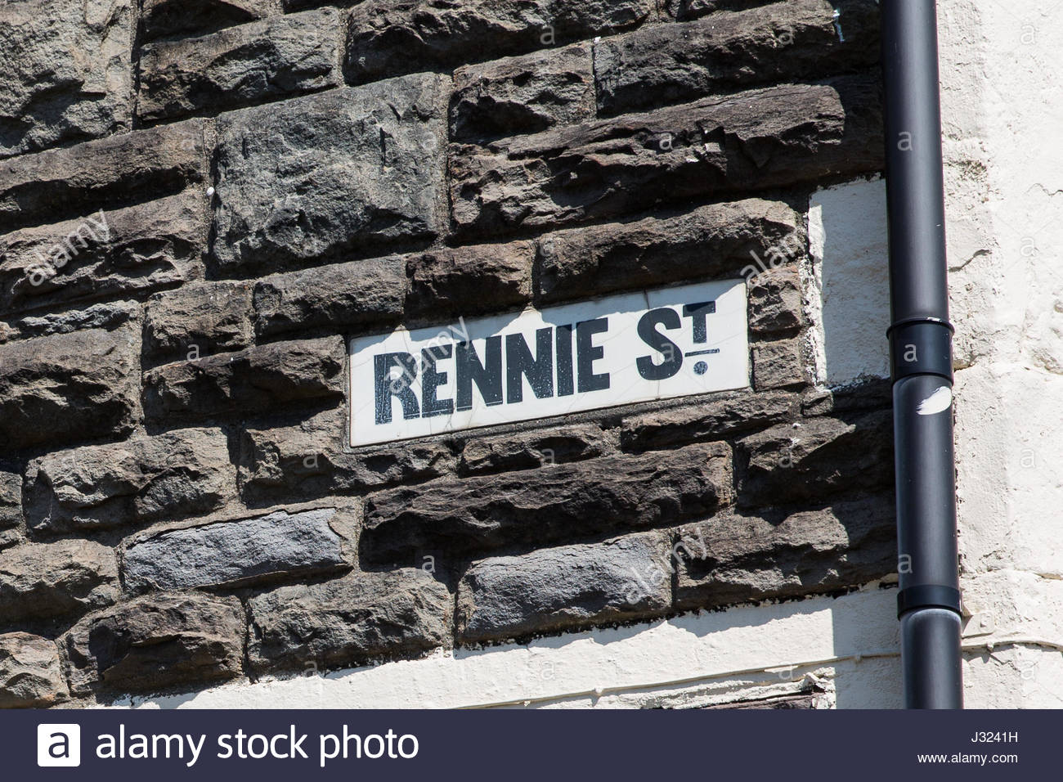
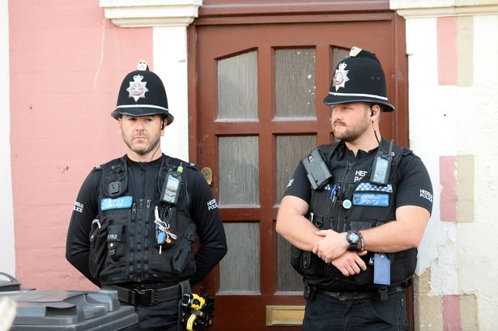
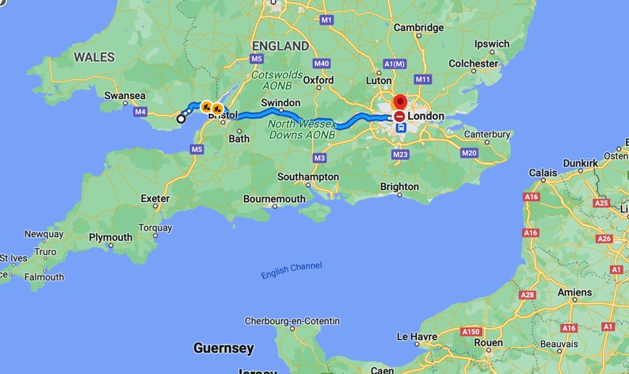
Executive Action - Arrest
Notes:
With security services, police and prosecutor discussions taking place a decision was made to arrest Mr Ullah. Arrest tactics and risk mitigation were discussed. But it is not for England and Wales prosecutors to direct the police, only advise. Police wanted to arrest the suspect outside of his home address, so there were no possibilities of wiping his computers or destroying the evidence remotely, as well as being in possession of digital devices in his pockets. That risk was mitigated by police surveillance and the unusual intervention of a stop by armed police officers and then the arrest. Search warrants and search strategies were put in place at his home address and assumed place of work. The arrest was made in September 2016. The suspect was moved from Cardiff to a police station in London where he was interviewed over five days.

Slide 6
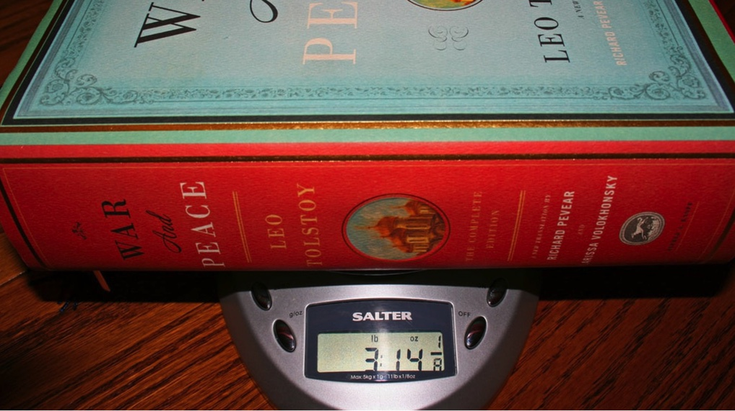
The search
Strategy required to triage digital material
8TBs of material found
Terrorism Act detention custody clock ticking
150 devices seized
Notes:
With the detention clock ticking, a search of the home address was conducted. This is always key for prosecutions involving cybercrime and darknet prosecutions. Having cyber experts conduct the searches. They know what to look for and is usually a very long number be it darknet passwords, crypto wallet keys or electronic devices and passwords. And the computer devices have to be managed appropriately, saved in their exact form and not modified post arrest to ensure continuity of the device.
In this case the police found
150 digital devices, including laptops, standalone computers, mobile telephones,
8 terrabytes of material, the equivalent of 630 thousand separate electronic files
30 separate sets of USB cufflinks which police believe he was planning to sell to terrorists
50 separate email addresses and 30 different twitter handles
8TB ……………………… the equivalent of 2.2m copies of the ebook of War And Peace.

Slide 7
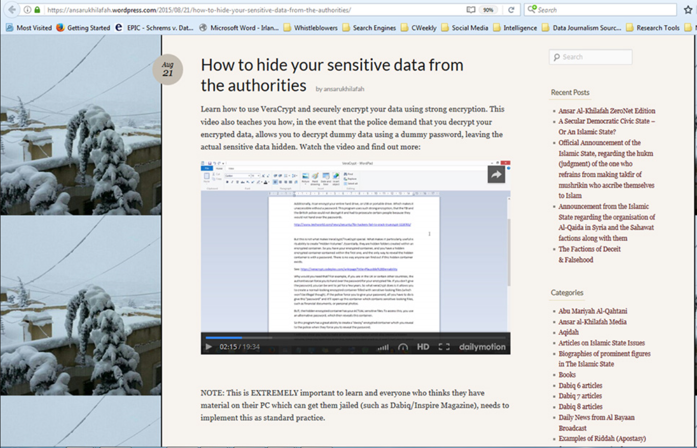
Evidence emerges – reports to Pros
Cyber Caliphate Army
Responsible for a blog and hacking website and offering hacking lessons
Production of videos with voice modulation and disguise
Cyber lessons & news updates…
....for DAESH supporters
Notes:
Ullah was a key member of a group calling itself the 'Cyber Caliphate Army' and gave other members of IS advice on how to communicate using the kind of sophisticated encryption techniques employed by online hackers. He claimed responsibility for various forms of terrorist related online activity including hacking, publishing death lists and publishing instructions on behalf of DAESH. Computer usage revealed research of ZeroNet and development stages of a blog website using the decentralised internet-like peer-to-peer network. He developed a website on computer hacking and kept numerous extremist documents and videos on electronic devices at his Cardiff home. In the instructional videos, he used voice modulation software to disguise his distinctive Welsh accent and wore woolly gloves to disguise his skin tone. The gloves and sweatshirt were later found in the suspect’s address providing corroborative evidence

Slide 8
SOURCES OF EVIDENCE
Digital media from SU’s devices and social media chat messages (High Tech evidence)
Open source capture of his website
Physical exhibits
Expert’s report from High Tech unit
Material secured from Kenya
Interview admissions
Notes:
There were a number of sources of evidence that police were able to discover both from the public web and darknet through to encryption keys. It included material from his own devices and social media messages, open source captures of his website blog, material seized from Kenya including text messages, physical exhibits such as the gloves and sweatshirt, and experts report to compare when the surveillance was conducted whilst he was in his home address, high tech police experts and finally admissions in interview when the weight of evidence produced quickly became overwhelming.

Slide 9
Assistance of the Kenyan authorities
View PDF
Notes:
Secured phone download of a defendant in custody in Kenya which contained relevant chat messages in support of ultimate charges. There were discussions over recruiting people from Turkish and Pakistani defence companies due to the technology held in those countries to destroy or jam drone and planes; although admitting it had to be done by stealth and subtlety as you can’t approach the potential recruits and just say “HI WE ARE ISIS, DO YOU WANT TO WORK FOR US”

Slide 10
Social media captures
Zeronet
Notes:
The Tor (the onion routing) browser is a web browser designed for anonymous web surfing and protection against traffic analysis. Although Tor is often associated with the darknet and criminal activity, law enforcement officials, reporters, activists, whistleblowers and ordinary security-conscious individuals often use the browser for legitimate reasons. In fact, it was the United States Navy that originally designed the browser to protect sensitive U.S. government communications.
Ullah had practically every covert communication device which required the police to think smartly in gathering evidence.
And this was helped by the defendant being great in theory but poor in reality, when it came to not doing as he was suggesting. Significance of Zeronet: The purpose of replicating the blog on Zeronet is that the Zeronet version is apparently protected from any interference, including from the authorities. If effective, this would allow illegal material to be posted, such as DAESH propaganda or instructional material, including on techniques of particular use to terrorists and would then preclude authorities from taking the material down. Essentially every time someone viewed his page a link would seed in that persons computer and make it impossible for the authorities to remove.

Slide 11
Mistakes
Had password files
Private keys for websites
Usernames, email addresses and passwords stored on social media
Unused Twitter was ‘hijacked’
He boasted about routing an IP address via the USA
Notes:
Because Ullah had practically every covert communication device it required the police to think smartly in gathering evidence.
And this was helped by the defendant being great in theory but poor in reality, when it came to not doing as he was suggesting. He wrote down all his passwords, had private website keys, and stored other identifying details on social media.

Slide 12
Guilty pleas to:
Membership of a proscribed organisation (DAESH)
Terrorist training: for providing instruction or training in the use of Tails, Persistence, Tor, PGP, Pigdin and Veracrypt
Preparing for terrorism
Being in possession of articles (x2) for terrorism
SENTENCE: 13 years in custody
Notes:
The police and prosecutors from the Crown Prosecution Service Counter-Terrorism Division spent months examining material seized in the operation. After the offences were charged the case was prepared with continued assistance from the police and computer experts into a presentable format. The defendant pleaded guilty before the trial was set in order to get a sentencing discount of a third court heard the alleged offences took place between 1 December 2015 and 22 September 2016.
It was said the defendant was responsible for a blog site said to contain information about Islamic State and cyber-security guidance. He was also charged with assisting others to commit acts of terrorism by researching an encryption program, developing an encrypted version of his blog site, and "directing the activities of an organisation which is concerned in the commission of acts of terrorism".

Slide 13
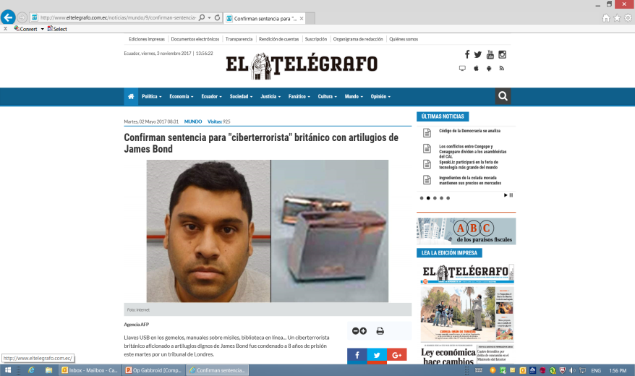
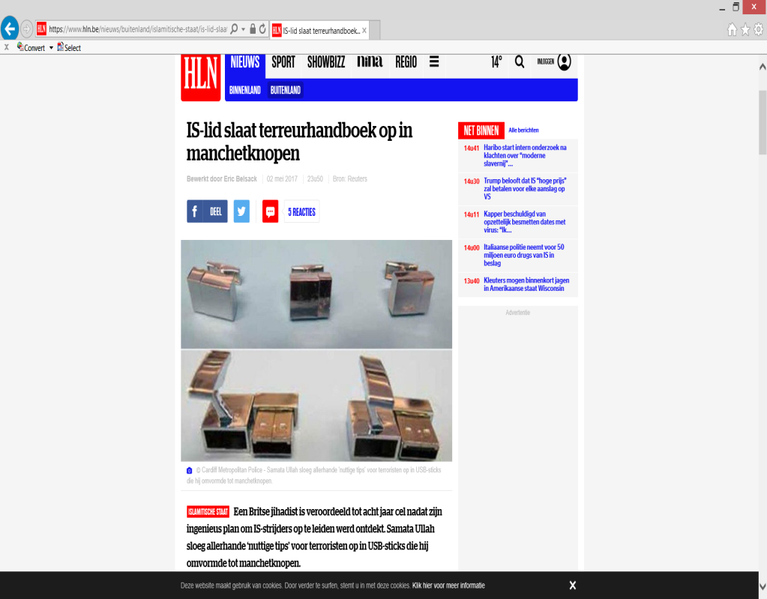
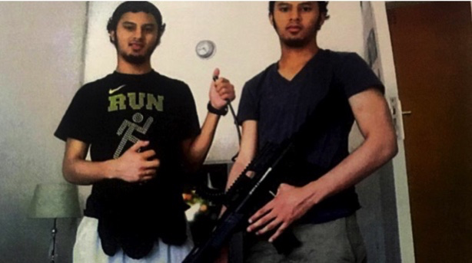
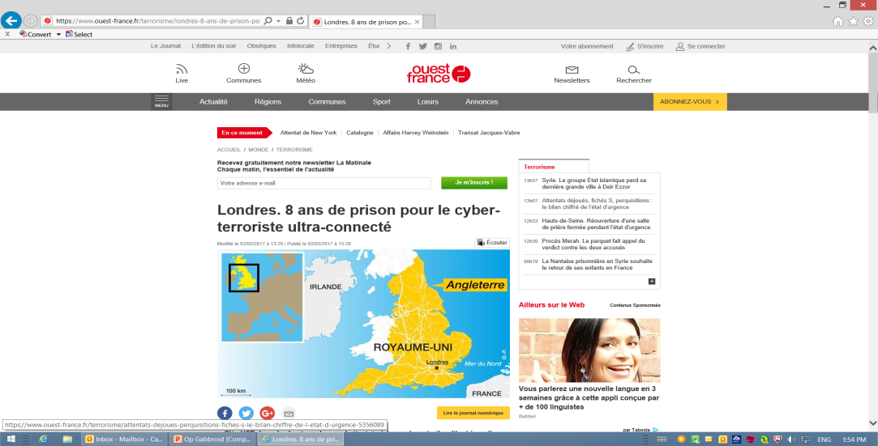
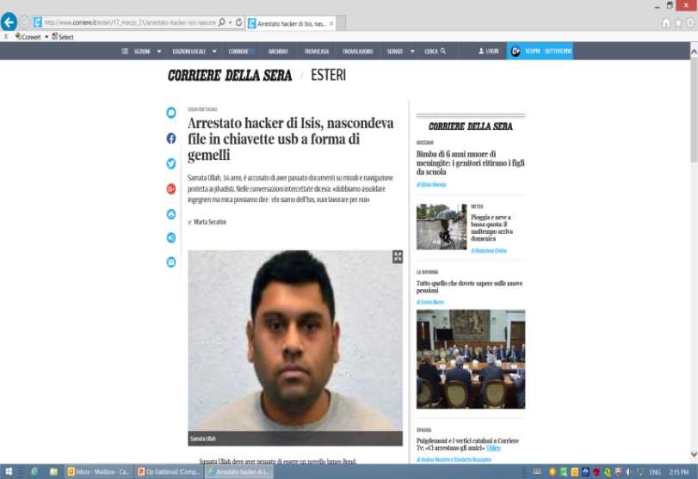
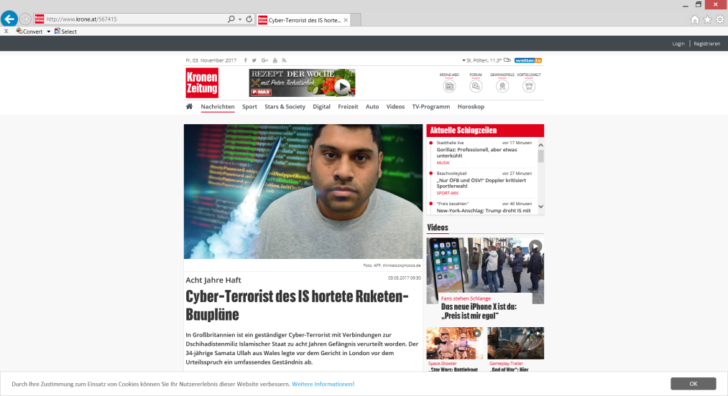
Notes:
The case received worldwide publicity, mainly because of the cufflinks, and one UK tabloid newspaper dubbed him the ‘Jihadi James Bond’. Material from the UK investigation was also passed to the South African authorities who developed a case against ‘The Thulsie Twins’ who were eventually convicted of terrorist offences, after protracted criminal proceedings.
In every serious or complex case in a post-case debrief should be held between the investigation and prosecution teams to bring out the learning in the case. Three questions are asked ‘What worked well, what could have be done better, what would be done differently next time?

Slide 14
Learning
Police awareness
Legislation
Training
Court
Cooperation
Notes:
Cyber legislation must keep up to date with technology and give investigators and prosecutors a full repertoire of offences to charge, with adequate sentencing powers. Even the ability to intercept communications and make controlled deliveries could be relevant in capturing security conscious individuals who are using the dark net.
All police and investigators should have basic cyber awareness to look out for relevant evidence in searches, such as passwords, encryption codes and social media account details.
All prosecutors should be trained to be able to present cases to court as well as assist police in developing cases evidentially and be able to explain the same to judges, or juries.
Investigators and prosecutors must cooperate as early as possible to identify criminal behaviour and ensure that risk management and all evidential capture opportunities are considered.
The case should not conclude once the suspect is charged and cooperation with law enforcement should continue throughout, and innovative ways of visual evidential court presentation should be used

