Slide 1
How to prosecute cybercriminals in Switzerland and abroad
Attorney General of Switzerland, Stefan Blättler
27th IAP ANNUAL CONFERENCE AND GENERAL MEETING - TBILISI
September 27, 2022
Notes:
I wish to express my sincere thanks to the International Association of Prosecutors for inviting me to this annual conference of the IAP.
It is with pleasure that I will be providing a brief overview of the prosecution of cybercrime by the Office of the Attorney General of Switzerland, from the perspective of criminal prosecution at the federal level.
To begin with, and as you are no doubt aware:
Cybercrime knows no territorial boundaries, it is multidimensional and complex, and cyber phenomena are constantly and rapidly changing.
Switzerland is a federal state which regards the fight against cybercrime to be a task incumbent on all of the federal and cantonal criminal prosecution authorities, making it a joint task. Therefore, results, at best in the form of an indictment or the dismantling of a system, can only rarely be achieved, and only as a joint effort.

Slide 2
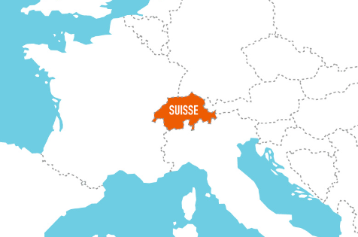
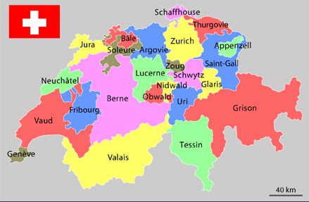
Jurisdiction in cybercrime matters
What is the competent authority in Switzerland for prosecuting cybercrime?
General authority: Public Prosecutor Offices of the cantons
Exceptional authority: Office of the Attorney General of Switzerland (OAG - Art. 23 and 24 Swiss Criminal Procedure Code)
26 cantons and the Confederation
Notes:
Switzerland, or « the Swiss Confederation» is actually a federal state made up of 26 cantons. At the judicial level, it has an Office of the General Attorney of Switzerland (OAG) and 26 Public Prosecutor Offices of the cantons.
The cantons deal with the largest share of cybercrime in Switzerland, which is growing steadily.
The OAG has the authority to prosecute international and technically very complex, serial cybercrime cases when the perpetrator(s) is(are) acting from abroad.
In the area of cybercrime, the cantonal and federal prosecution authorities (the police and the Public Prosecutor Offices) cooperate, in particular via a national platform: the Cyberboard.
As the Office of the Attorney General of Switzerland, the OAG has authority to investigate and prosecute offences falling within federal jurisdiction, as listed in Articles 23 and 24 of the Swiss Code of Criminal Procedure (CCP; SR 312.0) and in special federal laws. These are classic state protection offences, i.e. offences that are primarily directed against the Confederation or that strongly affect its interests.
But its authority also extends to the criminal prosecution of complex inter-cantonal or international cases of organised crime (including terrorism and its financing), money laundering and corruption as well as cybercrime. Under an optional federal jurisdiction, the OAG deals with cases of economic crime of national or international importance. Finally, the OAG also has jurisdiction over the enforcement of certain requests for mutual legal assistance from foreign prosecution authorities.
The field of Cybercrime (C), which is attached to the Mutual Legal Assistance, Terrorism, International Criminal Law and Cybercrime Division (RTVC) of the OAG, confers on the OAG the role of national criminal prosecution authority for cybercrime offences falling within federal jurisdiction.
The OAG conducts its criminal investigations in close collaboration with the Federal Office of Police – fedpol, and in particular with the Federal Criminal Police (FCP). The OAG also works closely with the cantonal prosecution authorities. As the OAG regularly conducts complex proceedings with international implications, intensive cooperation with foreign prosecution authorities is just as important.
The fight against cybercrime is a task for all federal and cantonal law enforcement authorities. However, cybercrime knows no territorial boundaries, it is multidimensional and the phenomena are constantly evolving.

Slide 3
Cybercrime in Switzerland
Challenge 1 – No criminal legislation specific to cybercrime
Swiss Criminal Procedure Code not adapted to criminal prosecution in the digital age
Major challenge: obtaining digital evidence
No standards for data processing in criminal proceedings
Slow mutual legal assistance process, not adapted to cybercrime
Preservation of data up to a maximum of 6 months
Request mutual assistance very rapidly!
Point of contact 24/7 (Art. 35 CPC) : fedpol
einsatzzentrale@fedpol.admin.ch
Notes:
Although crime has been moving increasingly into the virtual space now for years and criminal prosecution is also directed more and more towards the collection of digital traces, our criminal procedure law has not been adapted to these developments.
We do not have specific legal rules for the use of data in criminal proceedings. This term does not appear per se in the CPC as it relates to the gathering of evidence.
Data are not things, because they have no materiality.
International mutual legal assistance is a long and tedious process.
In Switzerland, legislation does not provide for the preservation of IP or telephone data beyond 6 months: older data cannot therefore be requested from Swiss providers.
It is therefore necessary to request mutual assistance as quickly as possible.
The Federal Office of Police in Switzerland – or fedpol – is the point of contact that can be reached 24/7 in accordance with Art. 35 of the CCC, at the address: einsatzzentrale@fedpol.admin.ch.

Slide 4
Perpetrator anonymity
Challenge 2 – In search of the perpetrator
In most cybercrime proceedings, perpetrators are:
Unknown
Professionnal
Anonymous
Mostly abroad
Objective: gathering evidence that can be used in court
Notes:
Most cybercrime proceedings are directed against unknown persons.
Perpetrators often act in a professional manner and
use common anonymisation techniques, such as VPN, proxy, botnet (networks of zombie computers*), identity theft, money mules.
The perpetrators are very / most often abroad.
The primary objective of these procedures is to identify and locate the perpetrator of the offence using evidence that can be used by the courts, including covert surveillance measures (Art. 269 ff CPC).
*Botnet (zombie computer networks): network of computers infected by perpetrators who take control remotely and use it to commit various crimes (DDoS, spamming, etc.) and anonymise their actions.

Slide 5
Mutual legal assistance
Challenge 3 – Complex and lengthy
2. Transmission to the Federal Office of Justice
4. Transmission to the prosecutor abroad
6 Foreign prosecution authorities collect the evidence
8. Transmission to the Swiss Federal Office of Justice
>
>
>
>
>
>
>
>
>
1. The prosecutor in Switzerland drafts the request for mutual legal assistance
3. Transmission to the competent authority abroad
5. The prosecutor abroad obtains a court order
7. Transmission to the competent authority abroad
9. Transmission to the prosecutor in Switzerland
Notes:
Here is an illustration of one of our main challenges in criminal prosecution: international mutual legal assistance.
As mentioned above, the perpetrators are mostly abroad and so is the data that needs to be gathered to identify them!
This process of international mutual legal assistance is time-consuming, costly and the outcome depends on the willingness of individual States to actively support the process.

Slide 6
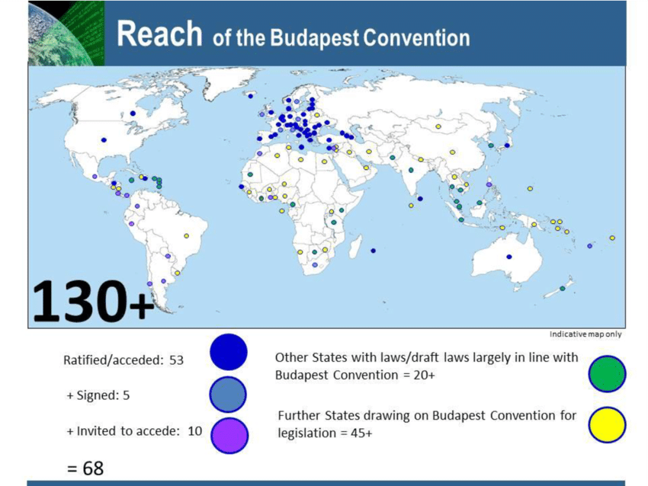
Internationality
Challenge 4 - Principle of territoriality > The Convention on Cybercrime – an important tool
Notes:
Principle of territoriality
The whereabouts of the data carrier or the person required to hand over the data is decisive for the question of jurisdiction.
Investigative actions abroad are conducted solely on the basis of a request for mutual legal assistance or public international law arrangements, e.g. Art. 29 and 32 of the Convention on Cybercrime (« CCC »).
Internet service providers should be obliged to respond directly to injunctions from the country where they conduct business, even if they do not have subsidiaries or branches there!
The access principle
The place of access is decisive for the question of jurisdiction.
Online searches of servers located abroad are legal (Swiss Federal Supreme Court decision 143 IV 270: case of an online search of a Facebook account by a prosecutor in Switzerland - not considered to be an act violating the territorial sovereignty of another State if carried out from a location in Switzerland).
International character:
Traces / data are almost never found in Switzerland.
Perpetrators are often located abroad.
In most cases, only the injured parties are in Switzerland.
There are challenges in managing the territoriality principle. Mutual legal assistance is too slow. There is a need for new and innovative approaches. The Convention on Cybercrime to begin with.
Essential framework / CCC – The Convention on Cybercrime
The main objective of this convention is to enable the pursuit of a common criminal policy aimed at protecting society against computer-related crime (cybercrime), in particular by adopting appropriate legislation and fostering international cooperation.
Switzerland signed the convention on November 23, 2001 and the convention entered into force for Switzerland on January 1, 2012.
The main contracting States outside the EU are: United States, Australia, Israel, Japan, Canada, Panama, Senegal, etc. (as at September 14, 2020).
Europol / Eurojust
Europol and Eurojust are also important in an international context. Switzerland is represented by liaison officers (Europol) and liaison prosecutors (Eurojust).

Slide 7
Public Private Partnership
Criminal reporting as a key factor – private sector information
Individuals (companies) are important parties for:
- quickly filing a complete complaint - quickly and properly preserving evidence - presenting their own evidence
The OAG and the cantonal Public Prosecutor Offices depend on information from the private sector as well as actively seeking information from companies (ISPs, banks, cyber security, universities, etc.).
Entre-prises
Poursuite pénale
Privés
Notes:
The more cybercrime is reported, the more the prosecution authorities are able to monitor such phenomena, as this allows them to obtain more evidence and clues.
Clear communication and the adoption of a clear stance by individuals is essential.
Good cooperation can be crucial to the success of the proceeding.
*ISP : Internet Service Providers

Slide 8
4 keystones for greater strength in criminal prosecution
To become even more efficient and effective, the prosecuting authorities involved need:
close collaboration with all partners, whether national / international
qualified cyber-investigators
a national database to identify cybercrime linkage
the provisions on mutual legal assistance to be adapted
Notes:
The contribution of the OAG in this regard is as follows:
We are committed to national and international cooperation. To this end, we promote and support cooperation, coordination and exchange of know-how between the various national prosecution authorities (Cyberboard)
We pursue the objective of improving the training and know-how of our own prosecutors and cyber-investigators, both in the operational and academic fields.
We are calling for the establishment of a national database identifying cybercrime linkage and thus facilitating and accelerating the work of the prosecuting authorities at the national level.
We support the idea that the rules of mutual legal assistance should be better adapted to the prosecution of cybercrime (reference to the Convention on Cybercrime and its draft 2nd Additional Protocol)

Slide 9
Thank you for your attention !

