Slide 1
Challanges in detecting and recovering proceeds gained from corruption Estonian example
Kairi Kaldoja
29.09.2022
Tbilisi, Georgia

Slide 2
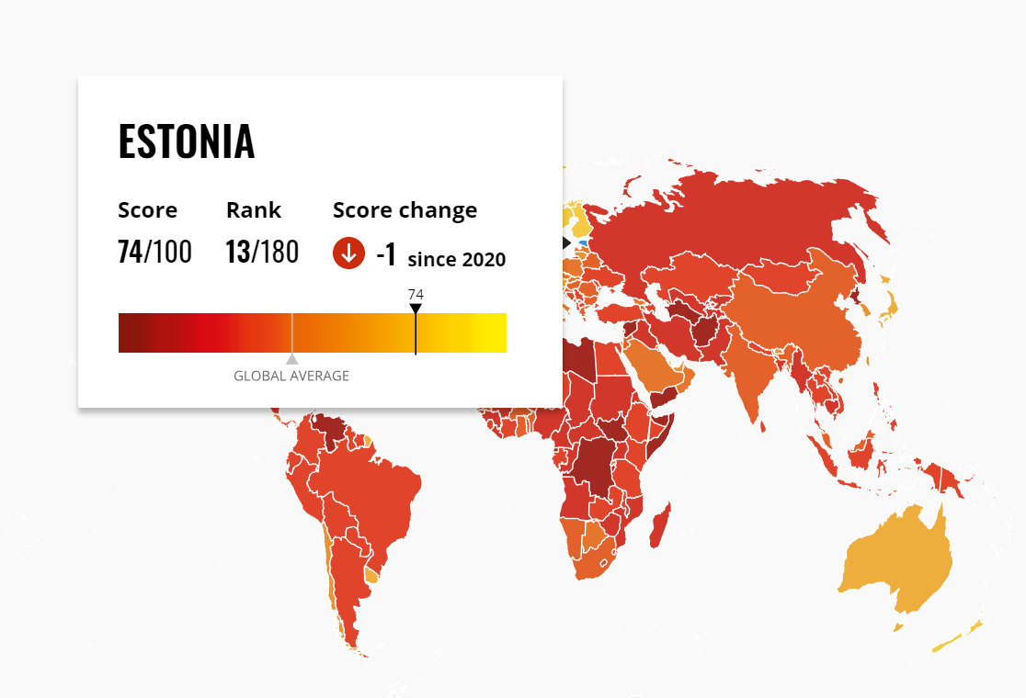
Corruption Perception Index

Slide 3
Legislation
Estonian Penal Code – chapter: breach of duty to maintain integrity
§ 294. Accepting of bribe
§ 296. Arranging of bribe
§ 298. Giving of bribe
§ 298¹. Influence peddling
§ 300. Violation of requirements for public procurement
§ 300¹. Violation of procedural restrictions

Slide 4
Legislation (2)
§ 83. Confiscation of object used to commit offence and direct object of offence
§ 83¹. Confiscation of assets acquired through offence
§ 83². Extended confiscation of assets acquired through criminal offence
§ 84. Substitution of confiscation

Slide 5
The biggest challenge
§ 300¹. Violation of procedural restrictions
Knowing violation of a procedural restriction established by the Anti-corruption Act to a large extent is punishable by a pecuniary punishment or up to one year's imprisonment.

Slide 6
Legislation – Anti-corruption Act
Procedural restrictions
Connected persons
the decision is made or the act is performed with respect to the official or a person connected to him or her
the official is aware of an economic or other interest of that official or a person connected to him or her and which may have an impact on the act or decision
the official is aware of a risk of corruption
official's spouse, grandparent, official's or his or her spouse's parent and descendant of official's parent, including official's child and grandchild. For the purposes of this Act, a parent is also deemed to include an adoptive parent, parent's spouse and foster parent, and a relative in descending line is also deemed to include an adopted child and spouse's child;
legal person in which at least 1/10 of the holding or the right to acquire a holding belongs to an official or a person connected to him or her;
legal person in which the official or any person specified in clause 1) or 4) of this subsection is a members of the management or controlling bodies for the purposes of the Income Tax Act;
person who has a shared household with an official, and any other person whose position or activities have a significant and direct impact on the official outside his or her official position or whom the position or activities of an official outside his or her official position significantly and directly influence or who is subordinate to the orders issued by an official outside his or her official position or who acts in the interests or on account of an official.

Slide 7
Case-study
Businessman
Mr B
Vice Mayor
VM

Slide 8
Vice Mayor VM
Businessman Mr B

Slide 9
Vice Mayor VM
Businessman Mr B

Slide 10
Corruption or business?
Proceeds gained from corruption?

Slide 11
THANK YOU

