Slide 2
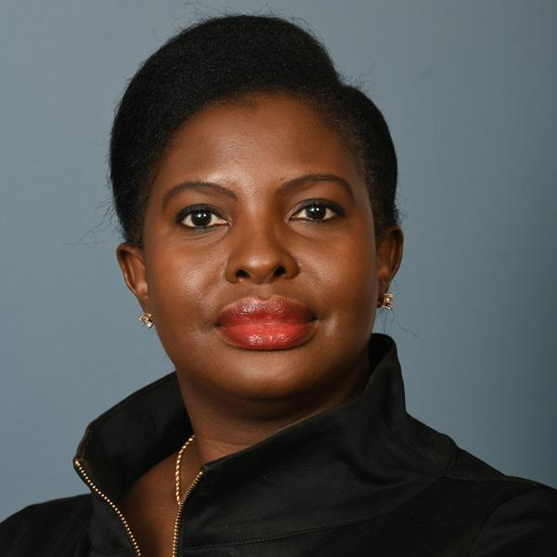
FINANCIAL INTELLIGENCE UNITS & THE EGMONT GROUP
Presented by Mrs. Xolisile Khanyile
Chair of the Egmont Group
Director of South Africa’s FIC
Career Prosecutor

Slide 3
THE EGMONT GROUP
166 Financial
Intelligence Units
(FIUs)
Provides a secure platform for exchanging financial intelligence
Promotes the sharing of expertise & knowledge

Slide 4
WHAT DO FIUs DO?
Receipt
Dissemination
FIU
Reporting Entities
Competent Authority
OUR SERVICES
FIU
Feedback
Results of Investigation

Slide 5
WHY DO FIUs &
THE EGMONT GROUP
DO WHAT THEY DO?
1
To better combat ML/TF
2
Knowledge is power
3
To improve the global AML/CFT framework
4
To promote integrity, transparency, & accountability within the AML/CFT community

Slide 6
IMPORTANCE OF PUBLIC-PRIVATE PARTNERSHIPS (PPPs)
2. Based on mutual trust,
oriented to meet FIU needs
4. Consider jurisdiction’s size, characteristics, risk and context
1. Be set up in co-creation, prioritizing issues
3. Goal-oriented, mutual benefits and added value for all
5. Complement
existing STR/SAR reporting regimes

Slide 7
IMPORTANCE OF PUBLIC-PUBLIC
COOPERATION (PPCs)
PPCs can mitigate ML/TF risk in four areas:
Asset-tracing and securing of assets
Money laundering of serious tax crimes
Intervening on organized crime at a local level
Counter Terrorist Financing

Slide 8
EXAMPLE: FIU-LATVIA -
2022 BEST EGMONT CASE AWARD (BECA) RECIPIENT
01
The case involves the ABLV Bank
02
Demonstrates the handling of a complex professional ML case
Established financial intelligence exchange mechanisms involving FIUs from 25 jurisdictions
03
02
Demonstrates the handling of a complex professional ML case

Slide 9
EXAMPLE: FIU-LATVIA -
WHAT HAPPENED?
February 13, 2018: FinCEN published a notice of proposed rulemaking against the Latvian “ABLV Bank,” finding it a bank of primary ML concern
June 12, 2018: ABLV initiated voluntary liquidation procedures, and its license was revoked one month later by the EU Central Bank.
As FIU Latvia began assessing the bank, it became evident that ABLV had systematically engaged in ML offences.
ABLV customers were generally non-residents, and of the over EUR 300 billion transiting through the bank between 2013-2018, much was transferred to dozens of different jurisdictions

Slide 10
FIU-LATVIA/ABLV CASE –
NEW PRECEDENTS
Formation of a multilateral cooperation forum, the International Financial Intelligence Taskforce (IFIT)
Development and implementation of custom digital tools to automate tracing
Mobilized the use
of public-private partnerships

Slide 11
FIU-LATVIA/ABLV CASE –
SUCCESSES
Over 570 LEA reports, 300
criminal proceedings, at least 25,570 orders to freeze funds,
and at least 38 court cases
seizing at least EUR 25 million.
Over 2000 incoming and outgoing requests exchanged between FIU Latvia and other FIUs.
Financial intelligence used to start 13 criminal proceedings with the Corruption Prevention Bureau and help corruption cases abroad.

Slide 12
FIU-LATVIA/ABLV CASE –
CHALLENGES
Legal - Several jurisdictions were limited in their ability to cooperate multilaterally by their legal framework
Capacity - Certain procedural aspects created cooperation bottlenecks
Technology – FIU data exchange is still limited by different approaches toward data analytics, and different rights to exchange and analyze data, especially in a multilateral framework
Trust - a lack of control over information, its analysis, and eventual dissemination can
challenge multilateral cooperation

Slide 13
FIU-LATVIA/ABLV CASE –
SIGNIFICANT LESSON
The most significant lesson learned from the cooperation within the IFIT is that multilateral cooperation among FIUs can be and in fact is efficient and it works well, albeit it seems a rather underused tool in the FIUs’ arsenal. More importantly, it can achieve results not only in the FIU and jurisdiction leading the cooperation, but in all the participating jurisdictions that would not have been possible solely within bilateral cooperation – both operational results and secondary results.

Slide 14
1
THANK YOU
Xolisile Khanyile
mail@egmontsecretariat.org

