Slide 1
International Cooperation in Cybercrime Cases
Timothy C. Rank
U.S. Department of Justice ICHIP
Cybercrime Liaison Prosecutor at Eurojust

Slide 2
Overview
Issue – Cross-Border Digital Evidence
U.S. Efforts to Create Sustainable Networks
G7 24/7
ICHIP Network
RLA Network
FBI Legat/Cyber ALAT Network
Eurojust MLA Project

Slide 3
G7 24/7 High Tech Crime Network
Over 80 member states worldwide
More than G7 countries (and different than Budapest 24/7)
All states encouraged to join this network
Prosecutor or police officer
Available 24/7
Can preserve electronic evidence held by service providers
Requests in English
Technical knowledge
Legal knowledge

Slide 4
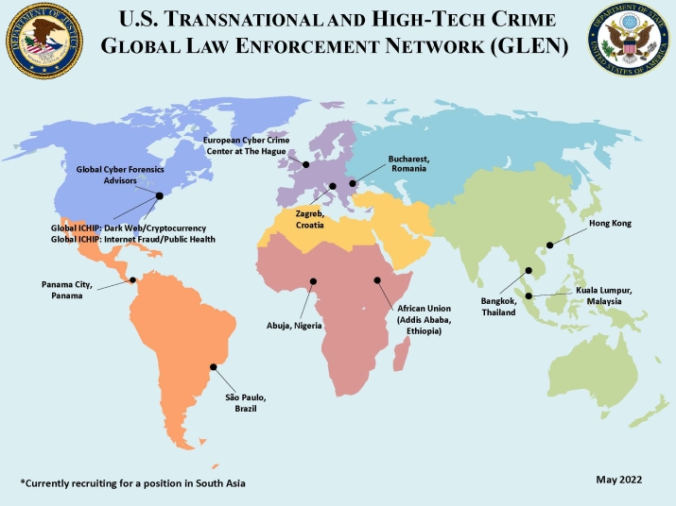
ICHIP Network

Slide 5
ICHIP Network
Twelve ICHIP Attorney Advisors
Regional Advisors located in Abuja, Addis Ababa, Bangkok, Bucharest, Hong Kong, Kuala Lumpur, Panama City, São Paulo, The Hague, and Zagreb
Two global subject matter experts, one specializing in Dark Web and Cryptocurrency and the other in Internet Fraud and Public Health
Two GCFAs who specialize in digital forensics training
A federal law enforcement agent in São Paulo

Slide 6
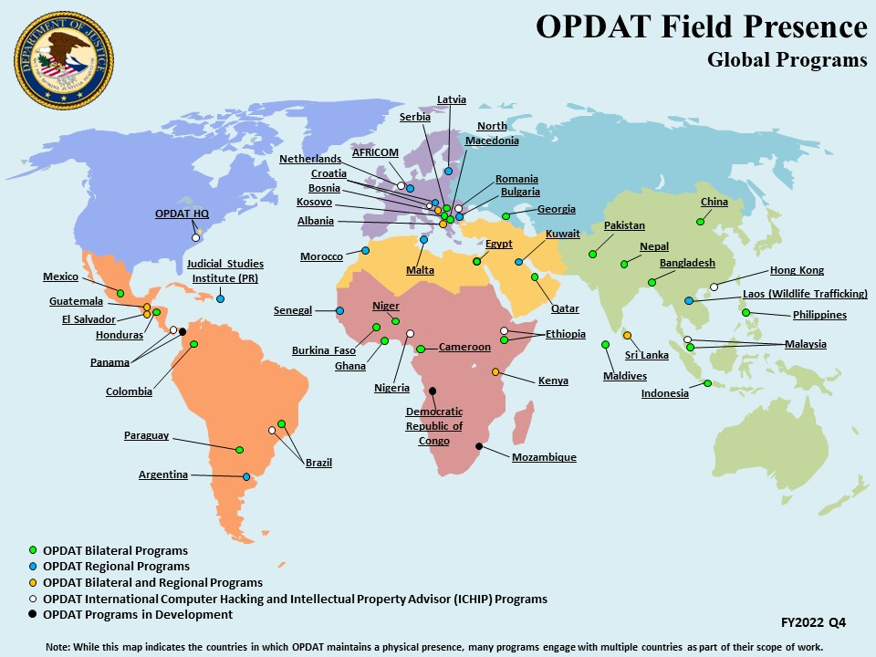
OPDAT/RLA Network

Slide 7
OPDAT/RLA Network
OPDAT stations experienced prosecutors (Resident Legal Advisors (RLAs)) at Embassies throughout the world
Focus on cybercrime, counter-terrorism, organized crime, money laundering, anti-corruption, human trafficking
Building bilateral and multilateral relationships

Slide 8
FBI Legat/Cyber ALAT Network
63 Legal Attaché (Legat) offices located in cities around the globe and provide coverage for more than 180 countries, territories, and islands
Work with permission and in cooperation with host country, and develop relationships with law enforcement and judicial authorities
Regional cybercrime experts (Cyber ALATs) focus on assistance with cyber investigations and capacity building

Slide 9
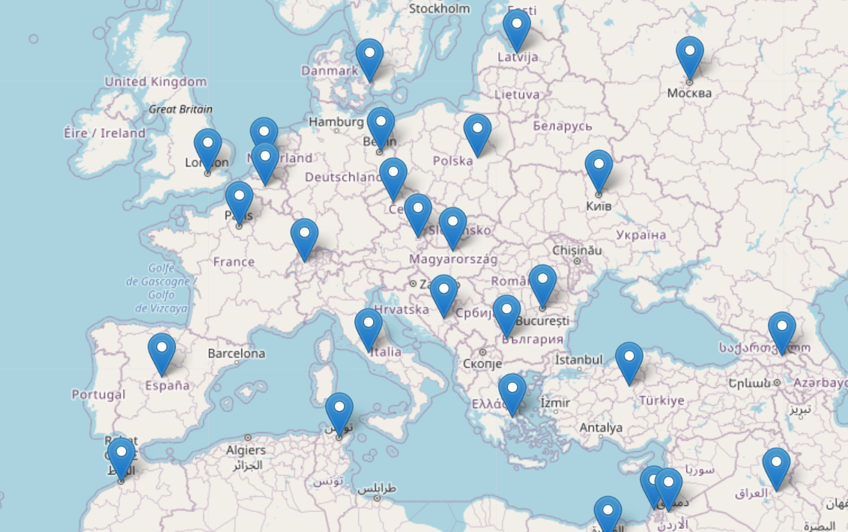
FBI Legat/Cyber ALAT Network

Slide 10
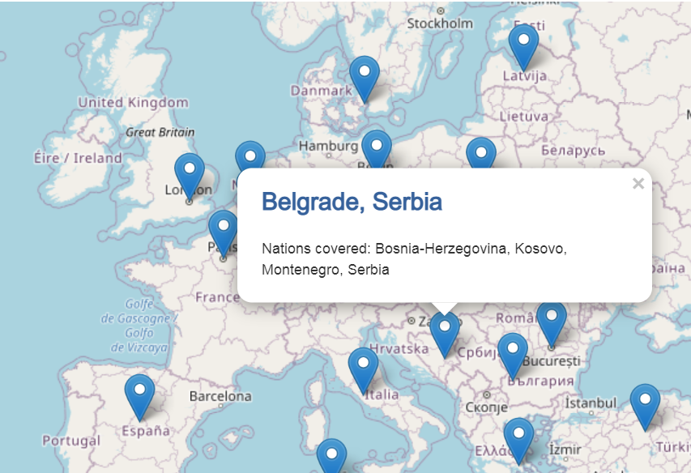
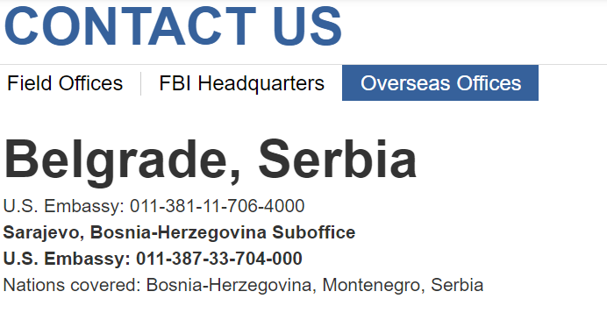
FBI Legal Attaché (LEGAT) Network
FBI Legat/Cyber ALAT Network

Slide 11
Eurojust
Eurojust is a coordination hub supporting prosecutions at the national or sub-national level that require collaboration with other countries
Eurojust has no independent prosecuting authority. Countries detail prosecutors and support staff to Eurojust. These national desk representatives work to advance their home country cases but are not part of the prosecution team.

Slide 12
Eurojust
Eurojust
Evidence Sharing
Law enforcement-to-law enforcement
Mutual legal assistance requests
Location of witnesses
Data privacy
Admissibility of evidence
Contact points

Slide 13
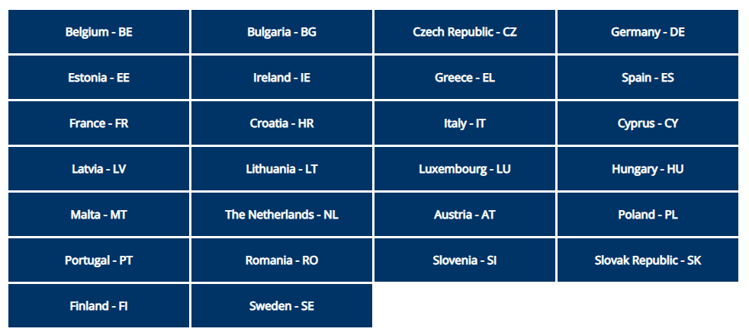
Eurojust
Eurojust

Slide 14
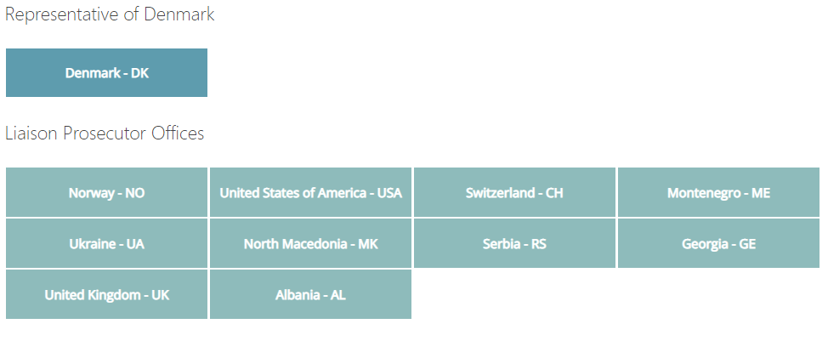
Eurojust
Eurojust

Slide 15
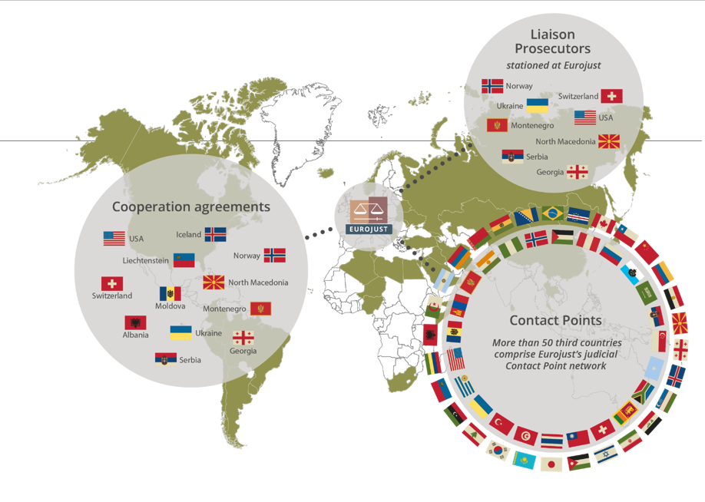
Eurojust
Eurojust

Slide 16
Eurojust – MLA Expert Project
Collaboration between Eurojust and USDOJ Office of International Affairs (OIA)
Designated experts in Eurojust countries (Member States and Partners)
Points of contact for obtaining evidence from U.S.-based internet service providers
Receive specialized training from OIA and are part of network with direct contact with counterparts in OIA section dealing with electronic evidence

Slide 17
Questions?

