Slide 1
the
Second Additional Protocol
to the
Budapest Convention
“Second Additional Protocol to the Convention on Cybercrime on enhanced co-operation and disclosure of electronic evidence”

Slide 2
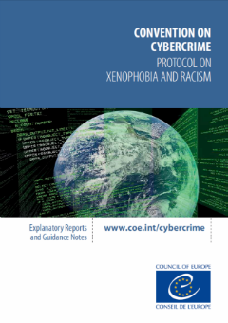
Budapest Convention
opened for signature in 2001 and in force in 2004
currently (September 2022) 67 Parties
other 13 other States have already signed it or been invited to accede
the most important reference around the world on cybercrime and electronic evidence
2003: First Additional Protocol (on the criminalization of acts of a racist and xenophobic nature committed through computer systems) in force since 2006
the Convention is still a valid and updated legal framework
the evolution of information and communication technologies requires the adoption of some new specific solutions

Slide 3
a new landscape
information and communication technologies constantly evolve
mankind benefits from many positive outcomes from that permanent process
but also, several challenges
regarding criminal justice, a number of them respect rule of law and gathering electronic evidence

Slide 4
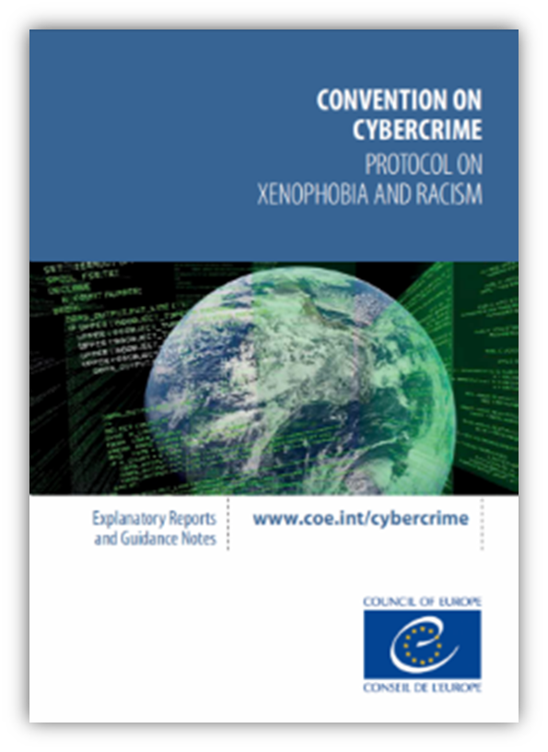
a new environment
traditional mutual legal assistance tools and channels have limited effectiveness
a number of national laws already allow their national authorities to transborder access to data
unilaterally
without the knowledge and formal consent of the other country
20 years have gone after the drafting of the Budapest Convention
regarding the penal substantive aspects, the Convention remains fully valid and updated, as a reference
with respect to the operational side, in view of the new introduced technologies, some specific solutions are needed

Slide 5
the famous cloud
evidence in remote servers
in other countries
multiple or unknown locations
new difficulties (territoriality and jurisdiction)
where is the evidence (both physically and legally)?
which legal framework applies?
which entity or service provider controls the sought information, in case?

Slide 6
the T-CY established the “Protocol Drafting Plenary” (national experts appointed by the Parties to the Budapest Convention)
task: drafting a proposal of a protocol
besides, the “Protocol Drafting Group”, a smaller working group, in charge of working on the concrete text of the protocol, in between plenary sessions
In practice, discussions about the protocol aimed to answer questions such as
how to get information from subscribers efficiently
how to obtain data (evidence) in emergency situations
how to draw more effective forms of mutual legal assistance
the challenge
In June 2017, the T-CY Committee agreed on the Terms of Reference for the preparation of the Second Additional Protocol to the Budapest Convention.
The negotiation process started in September 2017, and it was originally expected to be completed by December 2019.
It was postponed and just ended in May 2021.

Slide 7
19 and 20 September 2017
The first meeting of the Protocol Drafting Group was held in Strasbourg
43 experts from 28 countries and the European Commission attended this meeting
The draft Protocol was concluded in May 2021 by more than 100 experts of 66 countries
Opened for signature:
12 May 2022
.

Slide 8
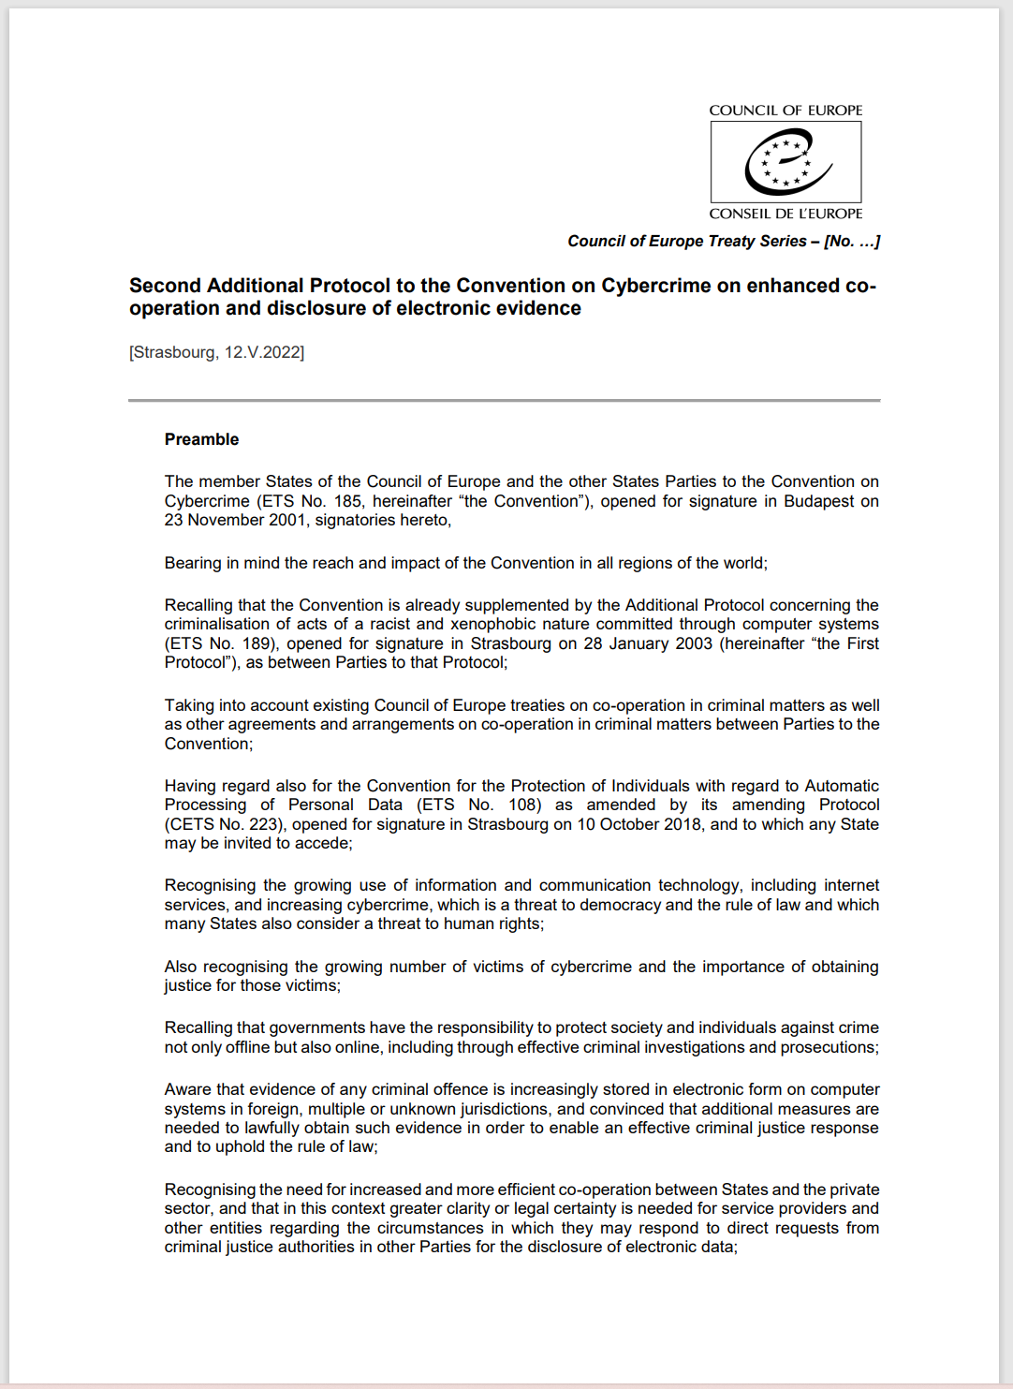
The Protocol includes
formal standard provisions (such as on its purpose, scope of application, effects, or territorial application, among many other)
conditions and safeguards and a very detailed regime on protection of personal data
from a substantive point of view
some very innovative provisions
provisions similar to provisions also existent in other treaties (transpose into the cyber environment measures already applicable to other forms of criminality)

Slide 9
More relevant provisions of the Protocol, in substance
Languages of requests
Request for domain name registration information
Direct disclosure of subscriber information
Giving effect to orders from another Party for expedited production of data
Request for domain name registration information
Expedited disclosure of stored computer data in an emergency
Emergency MLA
Video conferencing
Joint investigation teams and joint investigations

Slide 10
Thank you
Questions?

