Slide 1
osce.org
Emphasizing a Victim-Centered Approach in Human Trafficking Investigations and Prosecutions

Slide 2
Closing the Gap: The need for a comprehensive CTHB response
It is estimated that there are about 25 million victims of human trafficking globally. In 2020, 109.216 victims were identified worldwide, yet only 9876 traffickers were prosecuted
***
1 prosecution for every 2531 victims
In 2020, 109.216 victims were identified worldwide
but
Why are we falling short?

Slide 3
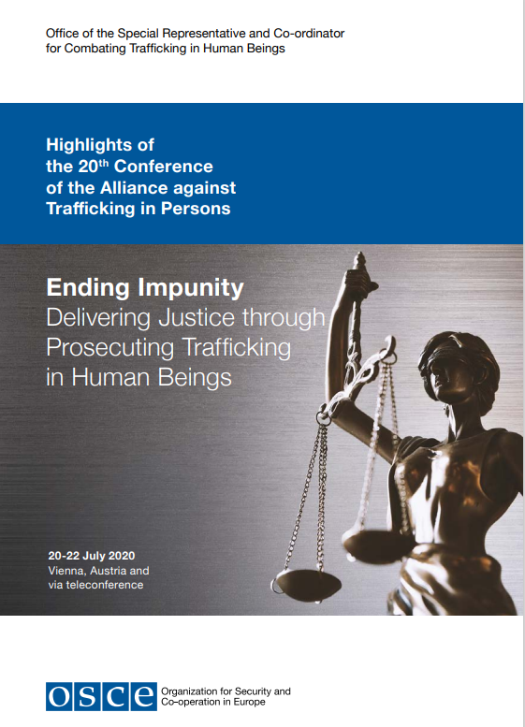
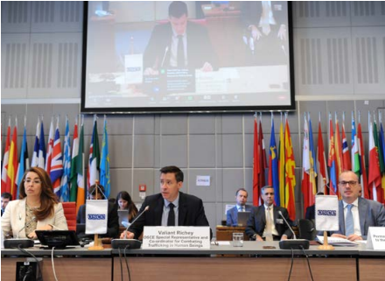
“Ending Impunity - Delivering Justice” through Prosecuting Trafficking in Human Beings
The 20th Conference of the Alliance against Trafficking in Persons

Slide 4
The way forward in countering impunity Recommendations from the 20th Alliance Conference
Protection and promotion of the rights of victims
Through a victim-centered,
gender-sensitive,
trauma-informed approach
Political Will
Laws and Legislations
Knowledge and Capacity
Date and Research
Working smarter
Using Financial investigations
Leveraging the use of technology
Sustainable training
Training of all Anti-trafficking stakeholder but also actors from adjacent sectors
Specialization and Cooperation
Specialized Anti-trafficking units
Multi-agency cooperation
Joint-Investigation teams

Slide 5
Why a Victim-centered approach?
Trafficking in Human Beings is not only a serious crime and security threat to states but also a human rights violation
There shouldn’t be any shortcuts in the protection and promotion of the rights of victims.
The use of a victim-centred, gender-sensitive and trauma-informed approach by the criminal justice system is highly important in implementing effective prosecutorial responses
Supported victims lead to stronger cases.
***

Slide 6
What does a victim-centred approach means for criminal justice actors?
“Justice” is often viewed through the lens of conventional criminal justice systems:
Police investigations Prosecution Judgement Punishment
A victim-centered approach to the investigation and prosecution of THB cases means prioritizing the best interest of the victim at all stages of the process.

Slide 7
What does a victim-centred approach means for criminal justice actors?
Protection from further harm
Physical harm
Retaliation
Not causing further harm
Avoiding re-traumatization
Taking time to build rapport und “digging deeper” to understand
Doing what is within your power and ability to help the victim
Multi-agency collaboration and referral
Listening to (and meeting) the unique needs of victims
Psychological harm
No judgement and blame
Being mindful of potential “Clash of different priorities”
Listen to survivor

Slide 8
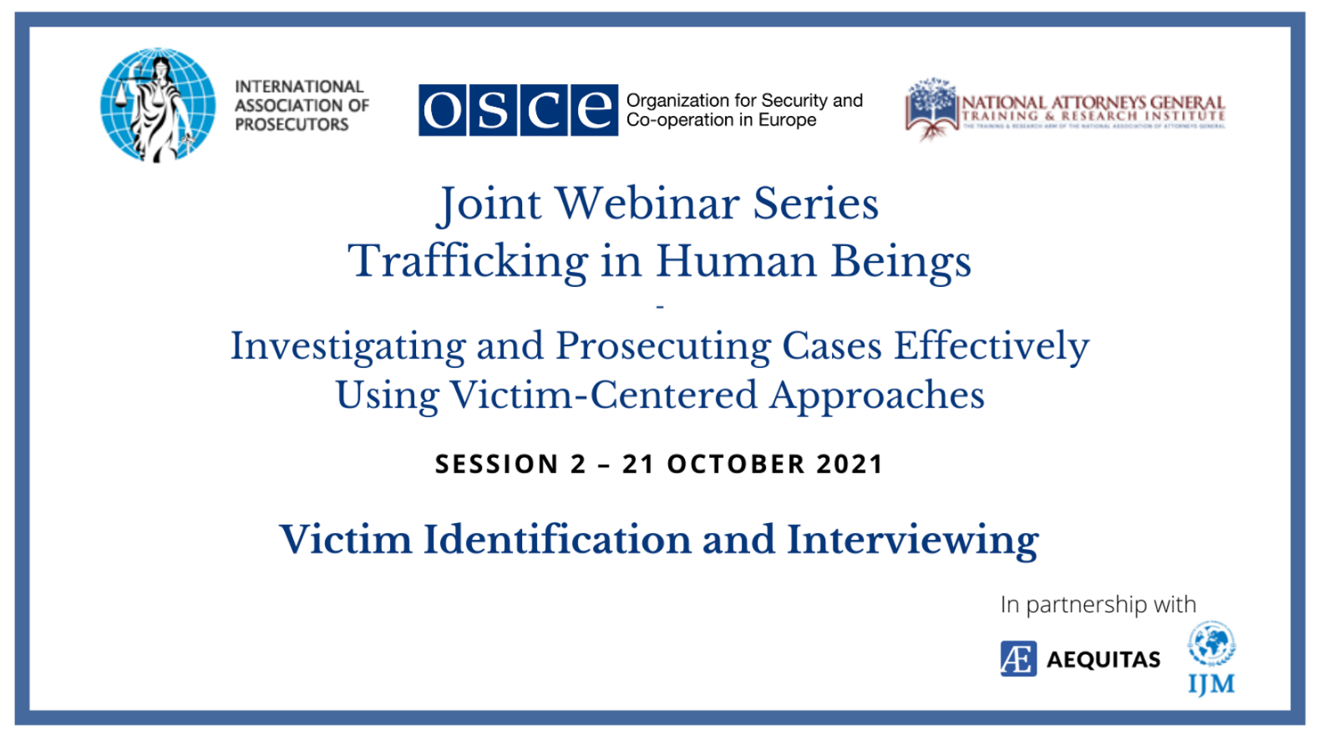
What we are doing in the OSCE
Trainings

Slide 9
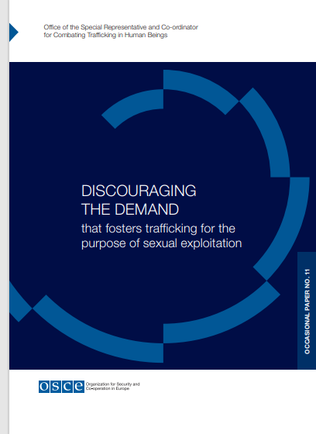
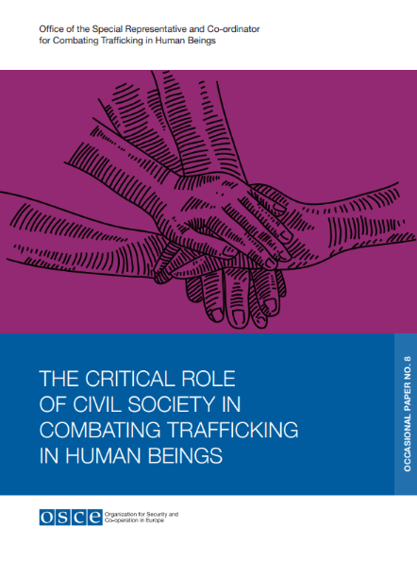
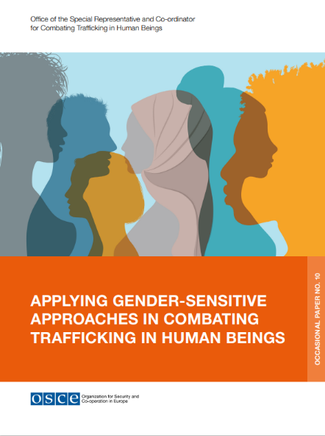
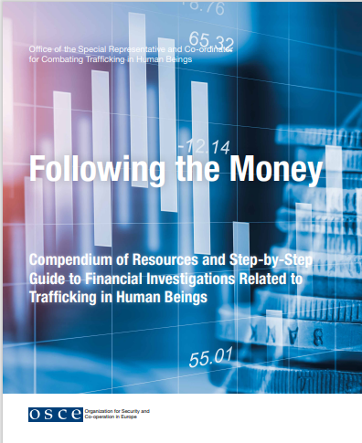
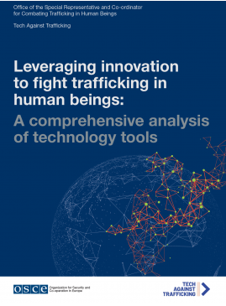
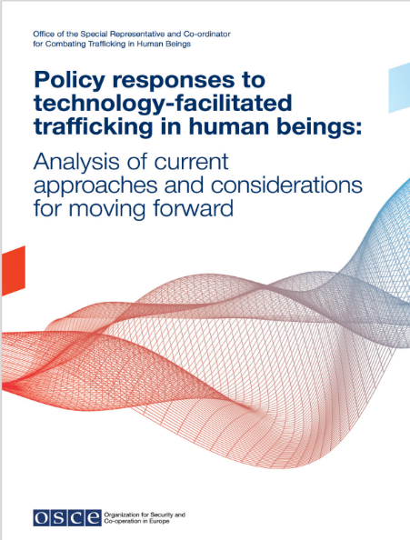
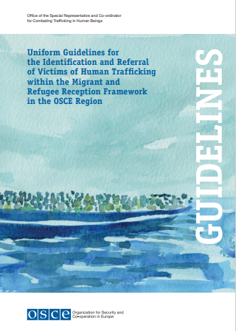
What we are doing in the OSCE
Publications

Slide 10
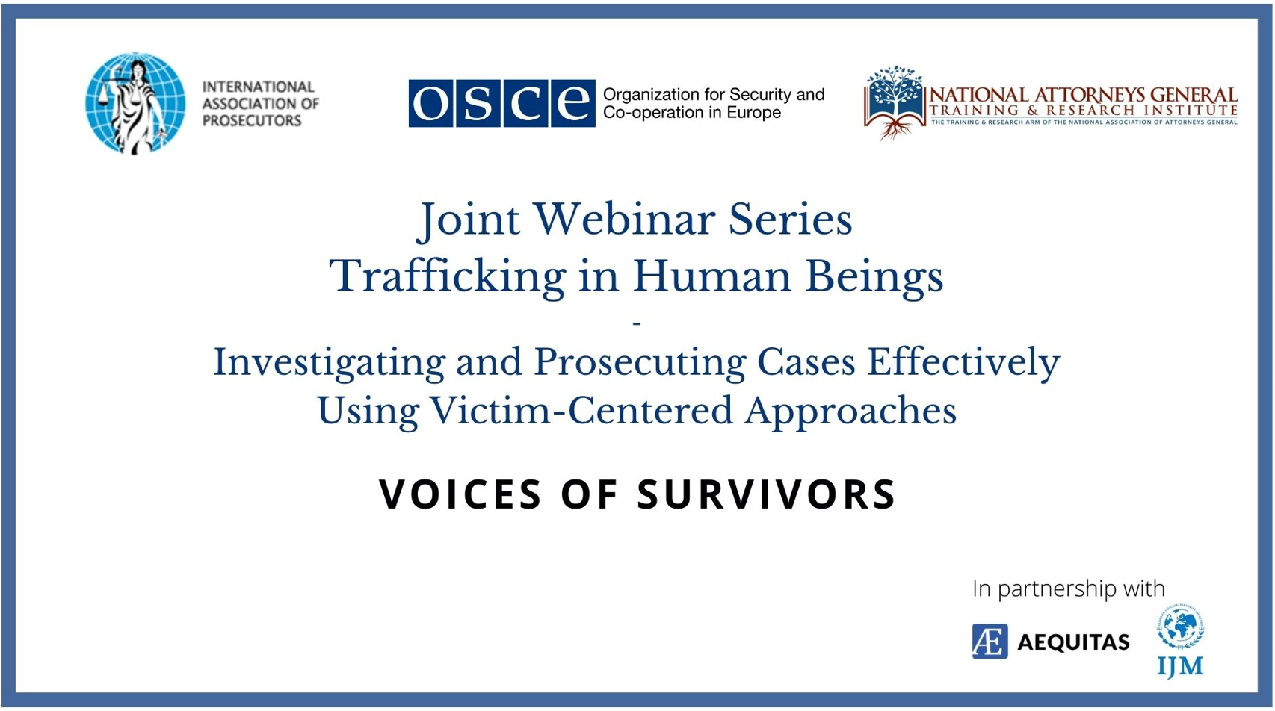
What we are doing in the OSCE
Using Survivor Expertise in Events, Conferences and Trainings

Slide 11
What we are doing in the OSCE?
Engaging survivors as experts and partners

