Slide 1
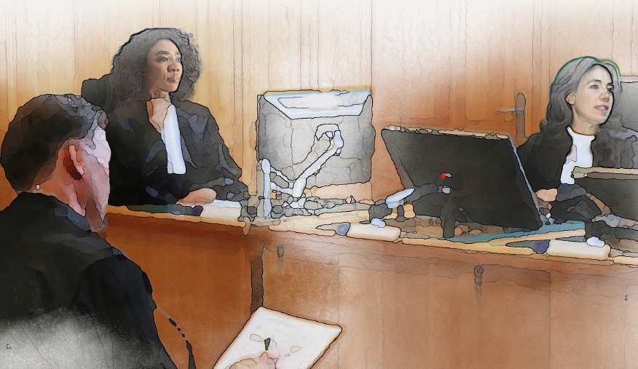
Devising and delivering the pilot course in Siracusa – February 2022: The way forward and the MOOC
Notes:
In December 2020 the Guidelines for Prosecutors on Cases of Crimes Against Journalists were published, and since then work has been ongoing to develop a training Programme that will be accessible for all prosecutors across the World.
Slide shows the cover of the guidelines
To test the ideas that both the IAP and UNESCO had about the content of such a training programme it was decided that a pilot course would be developed, to which delegates from a group of invited countries would come to ‘Road Test’ the concept and the proposed content.

Slide 2
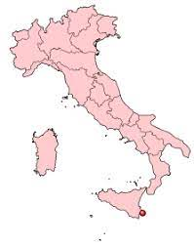
Notes:
The location of the pilot course was the Siracusa International Institute for Criminal Justice and Human Rights, located on the tiny island of Ortigia, in Sicily.
Ortigia is known as the historical heart of Syracuse and is joined by three bridges. It's known as the 'old town' - and it's an absolute treasure! It is brimming with two and a half thousand years of history and many notable buildings and ruins are available to investigate.
The Institute is an Italian not-for-profit foundation (ONLUS) acknowledged by a Decree of the President of the Republic of Italy of 16 May 1980, dedicated to education, training, and research in the fields of international and comparative criminal justice and human rights.
But that description does not do justice to either the extremely high quality of the courses that it facilitates, or the beauty of the building and the training facilities it is able to provide. If you have not been there you MUST go!

Slide 3
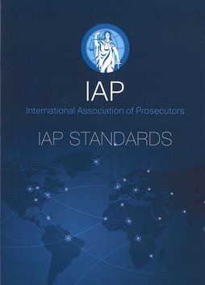
Notes:
The focus of the pilot – which was held in February 2022 over 5 days - was to introduce the guidelines to a selected group of prosecutors from 13 countries across the Globe, and to expose them to the importance of the right to freedom of expression in building and maintaining a democratic society.
Additionally, the IAP was very keen to showcase the IAP prosecution standards that had initially been adopted in April 1999.
The International Association of Prosecutors' Standards of Professional Responsibility and Statement of the Essential Duties and Rights of Prosecutors is a statement designed to serve as an international benchmark for the conduct of individual prosecutors and of prosecution services.
The IAP intended that this should not simply be a bold statement but rather a working document for use by prosecution services to develop and reinforce their own standards. Much of the Association's effort over the last 20 years has been directed to promoting the Standards and their use by working prosecutors throughout the world.

Slide 4
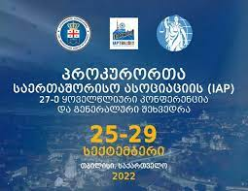
Notes:
And of course we want to reinforce the powerful messages given out earlier this week about the importance of independence for prosecutors such as that delivered by Shamila Batohi, National DPP of South Africa who said:
"With great powers of prosecutors comes great responsibility. Notwithstanding being under attack from the inside, the South African Prosecution Service will deliver a firm and fair prosecution of former government authorities."
"Those who fear a fair prosecution the most will attack a responsible prosecution service the most."

Slide 5
Notes:
In a session devoted to the role of the modern prosecutor the delegates were given an opportunity to familiarise themselves with the Standards, and we then focused on the following issues
Independence,
Impartiality ( acting without fear, favour or prejudice)
The critical role of prosecutors in conducting effective criminal proceedings,
The need for cooperation with investigators and other actors in their respective criminal jurisdictions,
Empowerment and the role of the State in Preventing, Protecting and Prosecuting – in other words the Three Ps.
We also had discussions about the key skills required to be an effective prosecutor in the modern world, and the ethical considerations that must be to the forefront when prosecutors have difficult casework decisions to make and where they may be subject to improper or undue influence seeking to affect those decisions.

Slide 6
Journalist Guidelines - Aims and objectives
• Highlight challenges
• Raise awareness of typologies – and targeting of female journalists
• Structured approach for prosecutors
• Heightened public interest
• Expose delegates to experts
Notes:
In the context of introducing the delegates to the Journalist Guidelines, our aims and objectives were to
• highlight the unique challenges that crimes against journalists present for prosecutors
• Raise awareness of the types of crimes commonly involved – described in the guidelines as typologies – and how female journalists can be the subject of specific targeting, and the reasons why that is
• Offer a structured approach for prosecutors to follow when assessing both the evidence and the public interest when dealing with suspected crimes against journalists
• Emphasise the heightened public interest in bringing offenders to justice when the victims are journalists
• Expose delegates to Internationally renowned experts in the field of journalism and criminal investigation

Slide 7
7 Sections of the Guidelines
(1) Investigations and advisory assistance.
(2) Stages in cases of and preserving integrity of evidence.
(3) Protection of sources.
(4) Protection of victims, witnesses, immunities, and collaborating witnesses.
(5) Mutual legal assistance and extradition.
(6) Gender-based crimes and other forms of hate crimes
(7) Post-conflict jurisdictions and transitional justice issues.
Notes:
Underpinning these aims were a detailed examination of the 7 sections of the Guidelines:
(1) providing insight on the conduct or supervision of investigations and advisory assistance to law enforcement agencies.
(2) identifying stages for proceedings in cases of crimes against journalists and preserving the integrity of evidence.
(3) emphasizing the importance of protection of journalistic sources.
(4) discussing the protection of victims, witnesses, immunities, and advantages for collaborating witnesses.
(5) examining the issue of mutual legal assistance in criminal matters and extradition.
(6) recognizing the specificities of gender-based crimes and other forms of hate crimes on journalists, and
(7) analysing post-conflict jurisdictions and transitional justice issues.

Slide 8
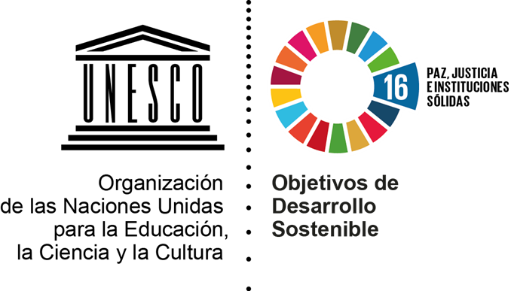
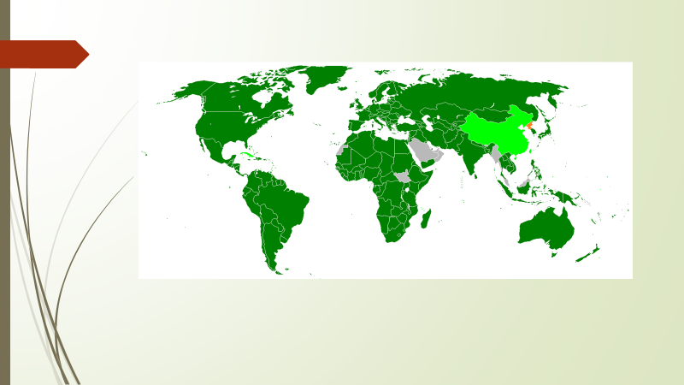
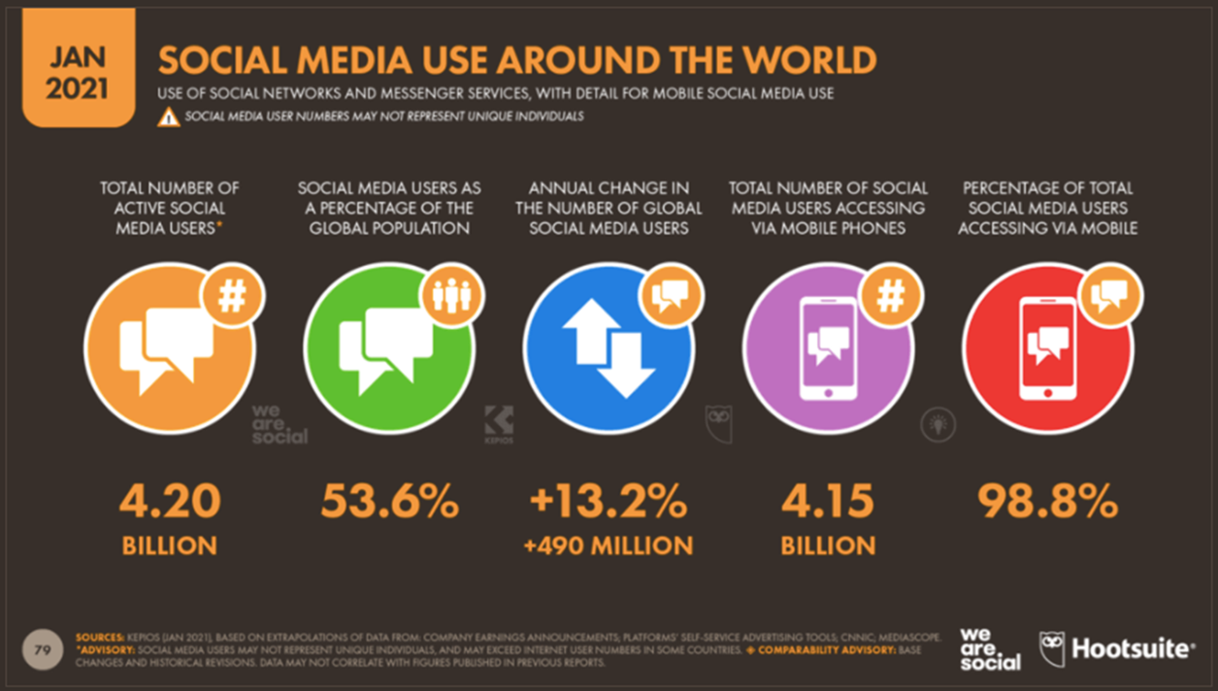
Notes:
What we were NOT doing during the pilot was seeking to alter the way National prosecution services function or provide a prescriptive way of approaching these cases.
As Sabin mentioned when dealing with the drawing up of the guidelines, they are meant to be applicable to both civil and common law systems, and we had delegates from both systems on the course.
The pilot course was delivered by Sabin and me, and we were very fortunate to be joined by three colleagues from UNESCO.
Guilerme Canela, whose main presentation was entitled Freedom of Expression: bedrock of democratic societies, where he challenged delegates to consider what Freedom of expression meant to them, how Freedom of Expression has been built through history, the international standards, and their relevance.
Mehdi Benchelah who covered KEY CONCEPTS AND JURISPRUDENCE ON FREEDOM OF EXPRESSION - highlighting permissible restrictions on freedom of expression, access to information and press freedom according to international standards, citing some examples of how international and regional bodies and courts have interpreted or embedded these standards
Namara Burki who asked delegates to think how prosecution services might use social media more effectively.

Slide 9
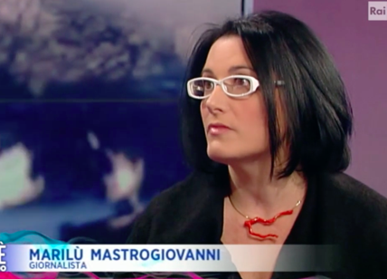
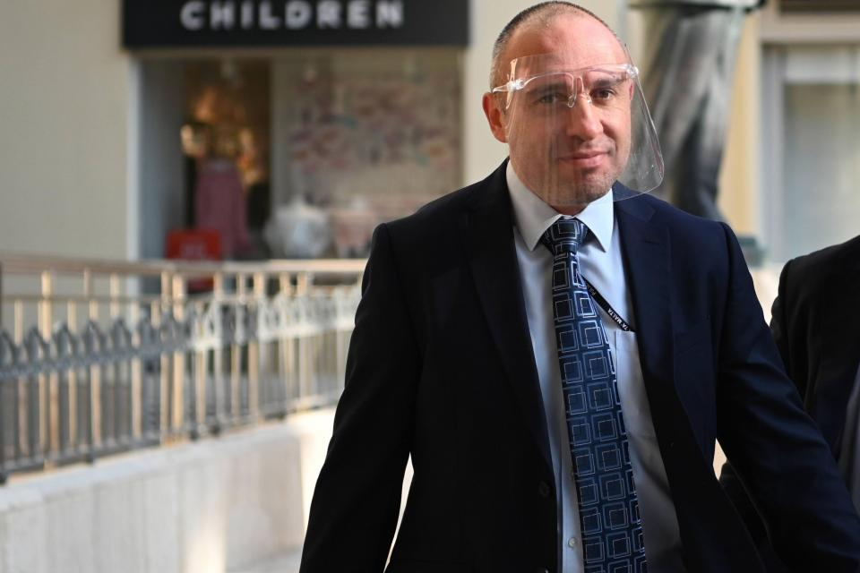
Notes:
Additionally, there were international experts, including from Canada, Malta, and Italy, who covered a diverse range of relevant topics such as
Targeted surveillance and hurdles to Justice and accountability,
The effective investigation and prosecution of crimes against journalists,
A presentation entitled, ‘From the Mediterranean to the eastern borders, the new walls against human rights and the enemies of journalism’.
The feedback was very positive and since then locally sponsored events for prosecutors covering Freedom of Expression and Crimes against Journalists have been held in Thailand, Uzbekistan, and India.
The slide shows two of our International experts
Marilu Mastrogiovanni, and Italian journalist who has required police protection because of death threats made to her and her family because of her investigative journalism.
Keith Arnaud, chief Maltese police investigator in the murder case of journalist Daphne Caruana Galizia

Slide 10
Pilot Course Evaluation
1. The course met my expectations in terms of:
a. Substantive knowledge 95%
b. Practical skills and techniques 95%
c. Social and networking opportunities 96%
2. The topics covered in the course were relevant to my daily work 95%
3. The course contributed to my professional development 96%
Average rate - 95%
Notes:
Feedback from Siracusa, the Overall Course Evaluation
We were very pleased with the feedback and evaluation. The slide shows the percentage scores from the delegates.
The results are contained in the slide currently being shown:
[1. The course met my expectations in terms of:
a. Substantive knowledge 95/100
b. Practical skills and techniques 95/100
c. Social and networking opportunities 96/100
2. The topics covered in the course were relevant to my daily work 95/100
3. The course contributed to my professional development 96/100
Average satisfaction rate - 95%]
Beneath the overall scores we also received detailed feedback on the individual sessions. Given the very positive feedback received from the delegates at Siracusa we feel confident to use the material developed for that course that as the starting point for designing the next stage of the process.

Slide 11
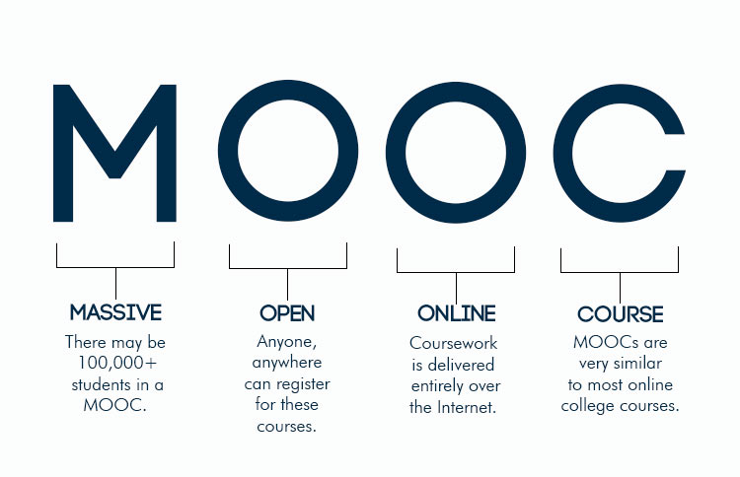
Notes:
That next stage of the process will be to develop a MOOC (Massive Open Online Course) that all prosecutors, wherever they are in the World, will be able to join online. This is currently scheduled to take place towards the end of 2022 or early 2023. It will consist of modules designed to enhance the understanding of prosecutors about the importance of Freedom of Expression and Access to Information and will also feature the Guidelines and explain how prosecutors have a crucial role to play in protecting journalists and ensuring that crimes and attacks against them do not go unpunished.
The course will also reinforce the importance of the ‘three Ps’ (Prevention, Protection, and Prosecution) in ensuring the safety of journalists and how prosecutors can contribute to the building of just and peaceful societies, by reinforcing the rule of law and fundamental freedoms.
What is a MOOC and why are we using this method rather than face to face training?
What is a MOOC? Some of you may be unfamiliar with the term, and even those who are may have not participated in one. In summary, Massive Open Online Courses (MOOCs) are free online courses available for anyone to enrol. MOOCs provide an affordable and flexible way to learn new skills, advance your career and deliver quality educational experiences on a large scale.
Millions of people around the world use MOOCs to learn for a variety of reasons, including career development, changing careers, college preparations, supplemental learning, lifelong learning, corporate eLearning & training, and more.

Slide 12
Notes:
In the context of Freedom of Expression there have been two important MOOC events over the last two years.
In the Spring of 2021, the Bonavera institute and UNESCO collaborated in a joint MOOC on international standards of freedom of expression. The MOOC covered regional and international human rights law safeguards for freedom of expression, including press freedom, access to public information, safety of journalists and challenges created by the digital world. The course was free and open to legal professionals from all justice systems with an interest in human rights. It was well supported and received very positive feedback.
The MOOC consisted of five weekly Modules convened by academics and supplemented by the insights and experiences of prominent guest speakers. Every module introduced and discussed a relevant topic with respect to the international and regional protection of freedom of expression: each featured accessible background material, comprehension quizzes, and a forum for further discussion on our digital platform, as well as a live Webinar.

Slide 13
Notes:
Building on the success of this MOOC, UNESCO was keen to develop some training for investigators, because in 2020 a UNESCO study of 65 countries had pointed to a sharp rise in violations of press freedom during protests, including harassment, intimidation, attacks, arrests and even killings of journalists, often carried out by police and security forces. They considered that a lack of police training on how to maintain order while enabling journalists to do their job was considered a major contributor to this problem.
UNESCO has already trained 8,500 police in 17 countries in Latin America, Africa, and the Arab region through local partnerships. This work will be expanded and accelerated through a new agreement with the International Police Association, which has 372,000 members in nearly 100 countries.
Police and the media are both crucial players in ensuring freedom of expression
Police and security forces are critical in ensuring that journalists can do their jobs safely and that any violations against press freedom are investigated and punished in accordance with the law.

Slide 14
Notes:
In the summer of this year, 2022, this MOOC, entitled Press Freedom and Safety of Journalists: was developed and delivered by UNESCO and the IPA.
This MOOC was designed to train police worldwide and build skills among police and security personnel in upholding freedom of expression, protecting journalist safety and ensuring that security forces are aware of their vital role in protecting journalists and in ensuring a safe environment conducive to freedom of expression. Good, transparent communication with the media will also improve the public image of the police services.
The MOOC was based on the UNESCO Training Manual on Freedom of Expression and Public Order. It is aimed at police, security forces and law enforcement agencies, including trainers of police officers, gendarmerie, emergency preparedness, security and police trainees, intelligence officers, riot police, spokespersons of police and investigators.
Both the MOOC and a global training of trainers will be designed and delivered by IBZ Castle Gimborn, the training and educational facility of the International Police Association, in North Rhine-Westphalia, Germany.
The live webinar that concluded the MOOC was broadcast on 26 September – only two days ago.
So, based on our experience of delivering the pilot course and our joint experiences of the two MOOCs that I have just outlined gives us to believe that this approach to learning about Freedom of Expression and prosecuting crimes against journalists will be both effective and successful.

Slide 15
1. Freedom of expression International and regional conventions, role of journalists in a democratic society
2. The role of the prosecutor in effective prosecution of crimes against journalists.
3. Evidential issues, elements and practice of international cooperation and examples of best practice.
4. Criminal defamation, Rule of Law, Due process of Law, Rabat Plan, democracy
5. Journalistic methods, protection of Journalistic confidentiality, Gender based offences against journalists
Notes:
The Prosecutors MOOC – content
We have recently submitted a proposal jointly to the IAP and UNESCO setting out a draft outline for the prosecutor MOOC. We have proposed five online modules, where participants will work their way through a series of presentations and exercises broken down into individual lessons. Each module will conclude with a short assessment, with questions based on the content of the modules.
Participants who successfully complete the assessments will receive a certificate. The sixth and final module will be a live webinar where invited experts will lead a discussion designed to draw together all the themes of the preceding modules.
In summary our five proposed modules will be headed as set out in the slide
1. Fundamentals about freedom of expression International and regional conventions, and the role of journalists in a democratic society
2. The role of the prosecutor in effective prosecution of crimes against journalists.
3. Evidential issues, elements and practice of international cooperation and examples of best practice.
4. Fundamentals about criminal defamation, Rule of Law, Due process of Law, Rabat Plan, democracy, International and regional conventions
5. Fundamentals about Journalistic methods and protection of Journalistic, Confidentiality riles, Investigative method to protect confidentiality, Gender base offences against journalists

Slide 16
Notes:
How will it look in practice?
Each 60-minute module will consist of some reading to be carried out by delegates before they participate in the module, some introductory pre-recorded input from Sabin or me, a guest speaker or speakers presenting a pre-recorded podcast, and finally a quiz probably consisting of approximately 5 questions that they will need to answer 80% successfully before being allowed to progress to the next module.

Slide 17
Example MOOC Module content
Search for truth: the judicial mechanism and Journalistic methodology
Objectives
Sub-Objectives
Theme/Content
Activities/Guest speakers
Notes:
I have chosen one lesson from a module designed by Sabin to show how we have approached the design:
OBJECTIVES
Understand the methodology for the search for truth: the judicial mechanism and Journalistic methodology
SUB-OBJECTIVES
Identify general scope of freedom of expression
Understand the contribution of freedom of expression in building democracies.
THEME / CONTENT
Documents: reading ICCPR, GC34, ECHR, ACHR, AFCHR, ECHR, Ct decision.
Video about the timeline of freedom of expression
Video presentation of the scope of Freedom of expression
Mastering concept before going to part two (Supra-nationality)
ACTIVITIES and GUEST SPEAKERS
Reading ICCPR articles 19 and other regional instruments
Invitee: Guilherme Canela de Sousa (UNESCO) 15 min Webinar recording
Hyperlink to ECHR on scope of Freedom of Expression
Activity 1 – Quiz on scope of freedom of expression 5 min to access part 2

Slide 18
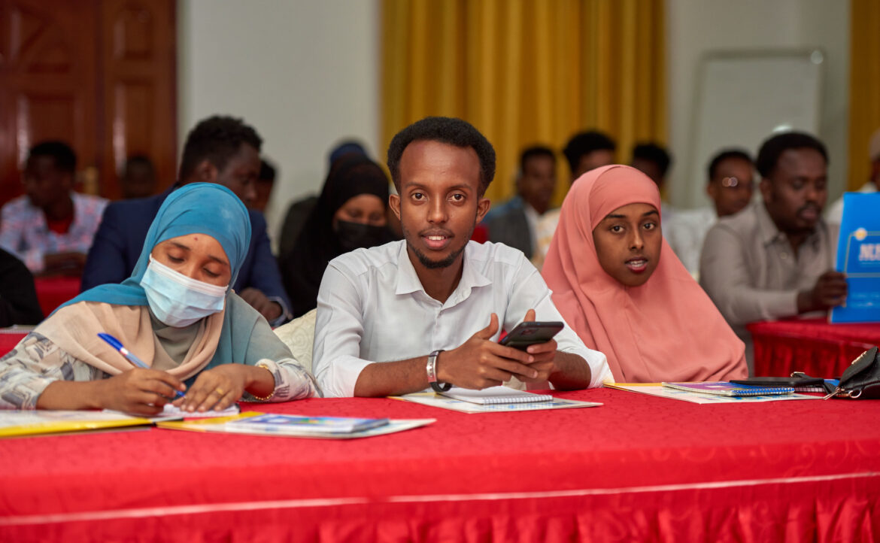
Initiatives
Somalia journalists adopt a National Action Plan to strengthen work safety and security
Notes:
When we come to draw together the content for the prosecutor MOOC we will be keen to point delegates in the direction of initiatives that have been taken worldwide over the last few years. We will obviously rely on the experts, UNESCO, to share initiatives that they are familiar with, but we would also really value your input when we come to questions at the end of the session to share any intelligence you have about what may have been introduced in your jurisdiction, or something that could be introduced in the future.
The slide references two initiatives, firstly the UK action plan on the safety of journalists that was launched in 2021, and secondly a Somali Action plan that was introduced very recently, in August 2022.

Slide 19
Notes:
Question time

Slide 20
1. Any specific matters to be covered in the MOOC?
2. Do prosecutors have sufficient knowledge of Freedom of Expression and Access to information to do their job effectively?
3. Examples of successful prosecutions of crimes against journalists?
4. Examples of initiatives?
5. Any other questions?
Notes:
1. Based on your experiences of prosecuting these crimes are there any specific matters you would wish to be covered in the MOOC?
2. Do you think that prosecutors have sufficient knowledge of Freedom of Expression and Access to information to do their job effectively – if not where do you think there are gaps in their knowledge that we could usefully address in the MOOC?
3. Do you have any examples of successful prosecutions of crimes against journalists we could incorporate into the MOOC syllabus?
4. Do you have any examples of initiatives in this area of work that you could share with us so we can point MOOC delegates to examples that they may wish to consider
5. Any other questions?

