Slide 1
About the cooperation between the prosecution and the police in the Netherlands

Slide 2
Lenneke Bronkhorst LLM MSc
*Public prosector - Arnhem
*Head of the Centre for International Legal Assistance in criminal matters

Slide 3
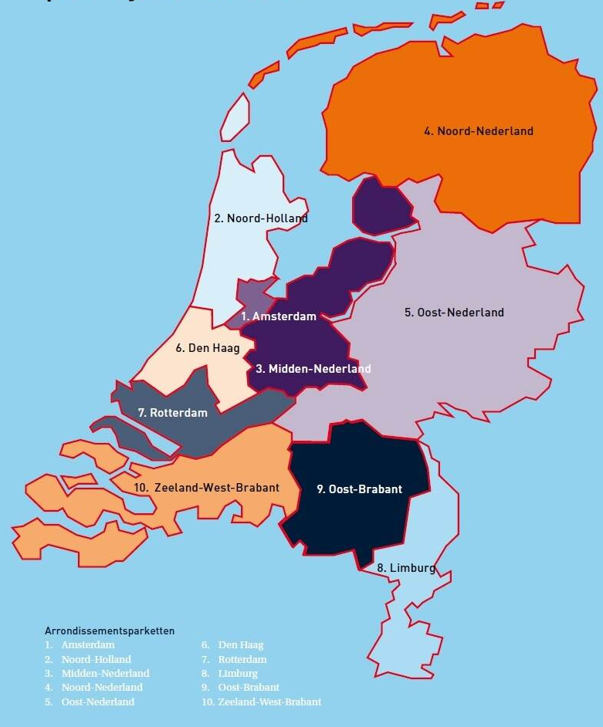
Openbaar Ministerie Public Prosecution Service

Slide 4
ZSM

Slide 5
HIC
High impact crime

Slide 6
Competencies

Slide 7
Challenges

Slide 8
Concluding remark;
only in working together,
we can make a difference

Slide 9
Thank you very much for your attention
Have a great conference
I look forward to meeting all of you

