Slide 1
27th ANNUAL CONFERENCE & GENERAL MEETING
TBILISI, GEORGIA
25 – 29 SEPTEMBER 2022
Challenges obtaining digital evidence FROM abroad
CHALLENGES

Slide 2
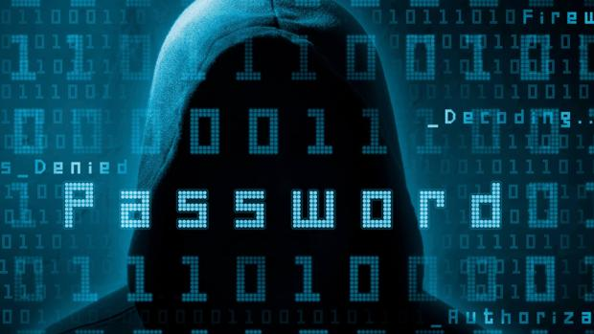
Cybercrime dynamics in its constant evolution state has transformed the way in which perpetrators committed crimes, mainly from an individual, isolated and uncoordinated practice of local reach to a more complex group activity with transnational networks.

Slide 3
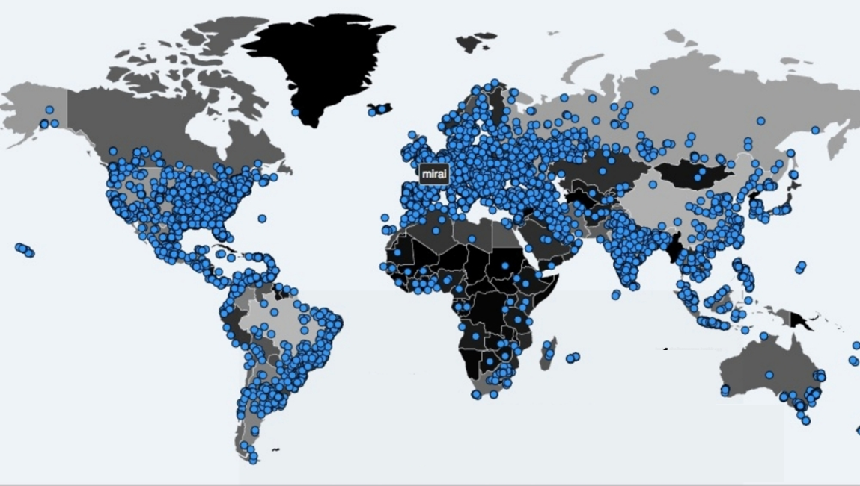
TransnaTionality- International cooperation

Slide 4
Budapest CONVENTION
Countries Adopting Convention
Argentina, Perú, Dominican Republic , Colombia, Costa Rica, Chile, Panama and Paraguay
Guatemala: starting adoption stage
México and Brasil have received invitation
Ecuador : in process of adapting codes to adopt convention

Slide 5
INTERNATIONAL COOPERATION AMONG STATES

Slide 6
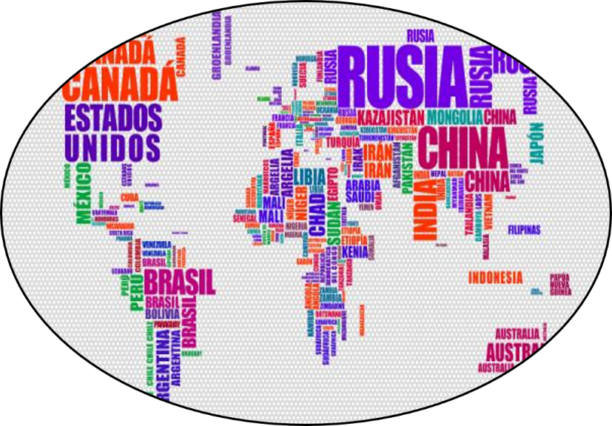
COOPERAtion between states and private sector

Slide 7
COOPERAtion between states and private sector

Slide 9
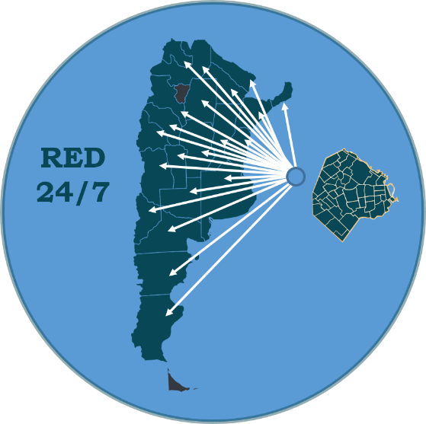
ncmec
El niño/a está en daño inminente
Es probable que el niño/a sea víctima
El niño/a ha sido victimizado y se necesita
más información para determinar el riesgo
El informe fue presentado por una empresa
de tecnología registrada
Prioridad 3
Prioridad 2
Prioridad 1
Prioridad E

Slide 10
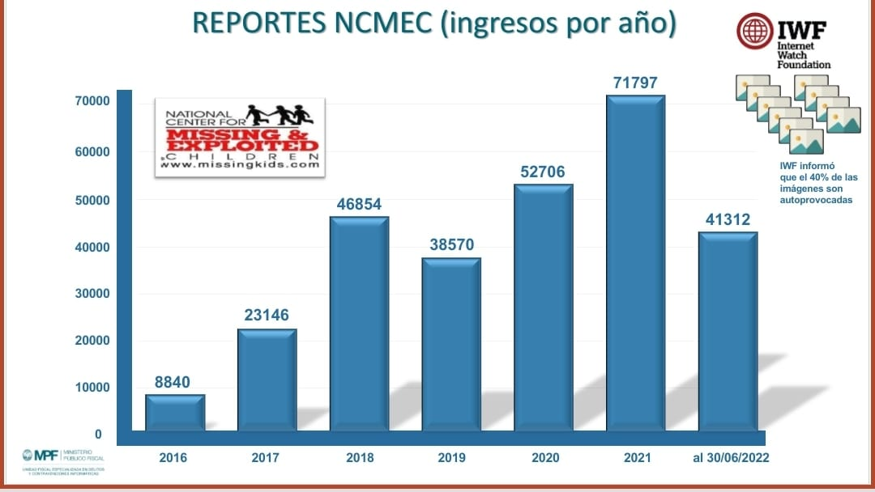
Ingreso anual de Reportes ncmec

Slide 11
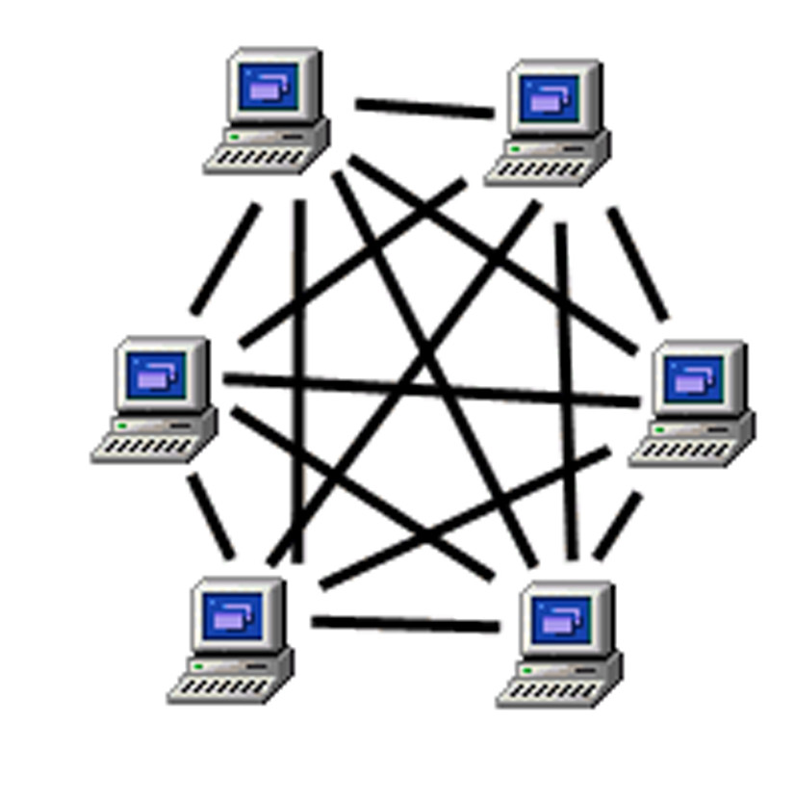
International investigations
Redes p2p (PEER TO PEER)

Slide 12
Transnational Data Access needed search
External server accessed by Internet
Informatics system in a foreiGN country
In Cloud
TOR mecHanisms TO ANONYMIZE AND MASK IP

Slide 14
CoOrdination strategies among different pOlice department officeS
Legal Tools

Slide 15
ORAL LITIGAtION

Slide 17
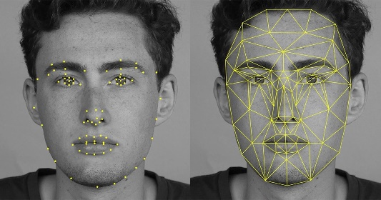
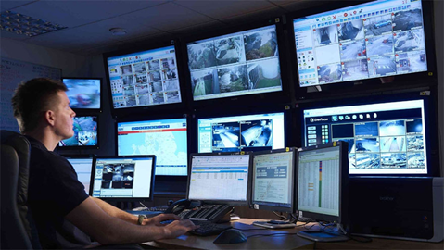
legislation Challenges
Criminal Law: In 2008, the 23388 act was updated to include some Cybercrimes in the Criminal Code (like scams, frauds, informatics damage, illegitimate access to a computer system, child pornography, child grooming). Yet, cybercrime rapid pace of evolution challenges legislation; e.g : Ransonware has not been legislated yet.
Criminal Procedure: Objet vs. Data. Digital undercover agent, remote forensics, cyber patrolling and measures proposed in BC.

Slide 18
SPECIALIZING DIGITAL INVESTIGATIONS: SPECIALIZED PROSECUTORS’ OFFICES
To investigate the crimes set forth in the Resolutions that create them.
To coordinate appropriate investigation criteria and strategies with the Special Units of the Specialized Security Forces.
To develop action protocols to facilitate and unify criteria for obtaining digital evidence.
To promote cooperation agreements with the private sector for the efficient fulfillment of Justice requirements.
To constantly train the Prosecution Team.

Slide 19
THANK YOU VERY MUCH!!!
Daniela Dupuy
ddupuy@fiscalias.gob.ar
@danydupuyok

