Slide 1
New and Emerging Typologies in Terrorists'’ Use of Cyber-Space
David Scharia, Director
Chief of Branch
United Nations, Counter Terrorism Executive Directorate

Slide 2
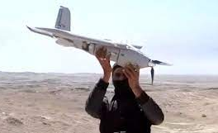
Unmanned Aerial Systems

Slide 3
Metaverse, live streaming and gaming platforms

Slide 4
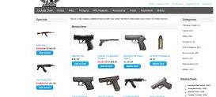
VPN and Darknet
Darknet and VPN

Slide 5
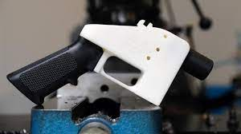
VPN and Darknet
3D Printing

Slide 6
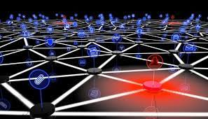
Autonomous systems (IOT)

Slide 7
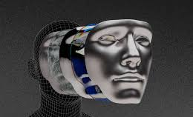
AI and Deep Fakes

Slide 8
Virtual Payment Methods

Slide 9
Recommendations
Update Legislation
Build Capacity of Prosecution Services
PPP
Governance
Internatational Cooperation
Human rights and Rule of Law

Slide 10
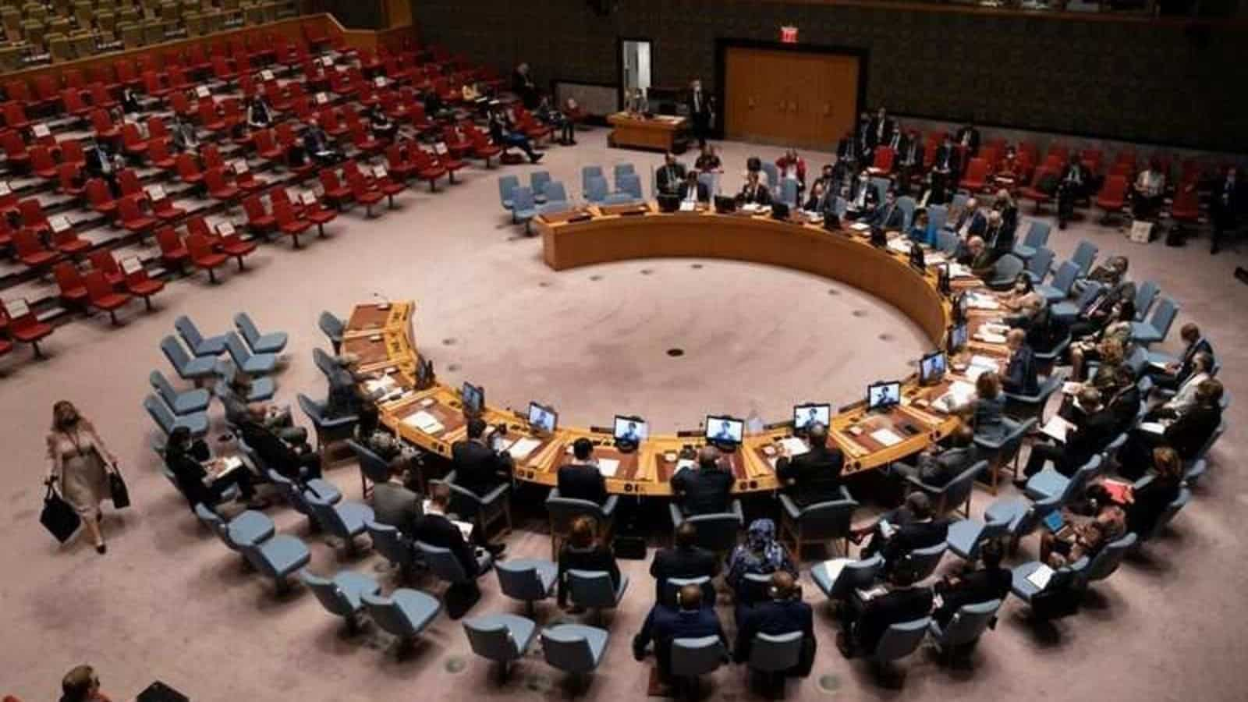
Thank You
David Scharia, Director
Chief of Branch
United Nations, Counter Terrorism Executive Directorate

