Slide 1
Türkiye’s Digital Transformation across the Criminal Justice System “Türkiye’s e-Justice System-UYAP ” Dr. İlknur ALTUNTAŞ General Prosecution Office of the Supreme Court of Appeal Republic of Türkiye
Notes:
Cover 1

Slide 2
National Judiciary Informatics System (UYAP)
E-justice system as a part of e-government projects in Türkiye
Created in 2004 for carrying out justice services in an electronic environment

Slide 3
National Judiciary Informatics System (UYAP)
Covers all courts and other judicial units including prisons
Transmits all judiciary processes, case management, hearings, correspondences, and transactions into the electronic environment
Enables paperless office structure

Slide 4
THE OBJECTIVES OF UYAP
Transparency
Cost-Effectiveness
Trustworthiness
Efficiency
Notes:
THE MAIN OBJECTIVES OF UYAP INFORMATION SYSTEM
Transparency, economical, trustworthy and efficient

Slide 5
All judicial proceedings in a digital environment
More efficient
justice system
Less bureaucratic procedures
Judicial services in a digital environment for all stakeholders of the judiciary and government units
Less workload
Effective flow of information
and documents &standardization
Saving paper
Notes:
To Support functional and efficient justice system,
To Reduce bureaucracy
To Reduce workload of judicial process,
To Ensure paperless office environment,
To Provide Digital Transformation in Justice,
To Eases every legal practitioner’s life, Lawyers, citizens, experts, government units, etc.
To Provide standardization, effective flow of information and documents.

Slide 6
JUDICIAL UNITS IN UYAP
Chief Public Prosecutor's Offices
Penal Institutions
Criminal, Civil and Administrative Courts
Forensic Medicine Units
Central and Provincial
Organization of the Ministry of Justice
Probation Units
Enforcement-Bankruptcy Offices
High Judicial Bodies
Notes:
UNITS IN UYAP INFORMATION SYSTEM
-Central and Provincial Organization of the Ministry of Justice
-Civil, Criminal and Administrative Courts
-Chief Public Prosecutor's Offices
-Enforcement-Bankruptcy Offices
-Penal Institutions
-Forensic Medicine Units
-Probation Units
-Higher Judicial Bodies

Slide 7
USER PROFILES OF UYAP
Members of High Judicial Bodies
Police Units
Judges and Prosecutors
Gendarmerie Units
Staff of High Judicial Bodies
Coast Guards Units
Ministry Staff
Lawyers
Prison Staff
Citizens
Staff of Forensic Medicine
Experts
Arbitrators and Mediators
Notes:
UYAP USER PROFILES
-Members of Higher Judicial Bodies
-Judges and Prosecutors
-Staff of Higher Judicial Bodies
-Ministry Staff
-Prison Staff
-Staff of Forensic Medicine
-Police Officers
-Gendarmerie Units
-Coast Guards
-Lawyers
-Citizens
-Experts
-Arbitrators and Mediators

Slide 8
Data about UYAP
Daily Average
3 million 600 thousand
Documents uploaded to the system
Daily Average
13 million
Documents read by users
Annual average
800 million documents issued
Notes:
IN UYAP INFORMATION SYSTEM
-Annual average
eight hundred million Documents Are Produced.
-Daily Average
3 MILLION 600 THOUSANDS
Documents are added to the system.
-Daily Average
13 MILLION
The Document is Read by Users.
-Instant Average
two hundred and fifty thousand
Users are Using the System.

Slide 9
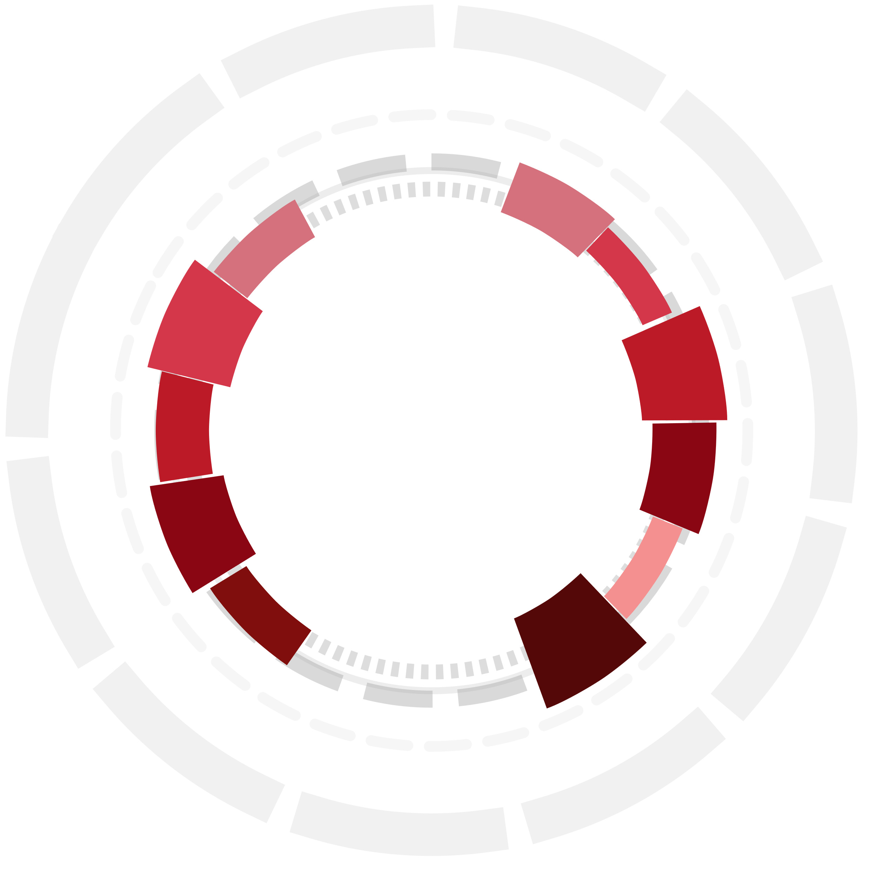
Directorate of General Police
Central Bank of the Republic of Türkiye
General Command of Gendarmerie
Ministry of Finance
Ministry of Health
Bank Association
Post and Telegraph Corporation
Directorate General of Land Registers
Social Security Institution
Notes:
- Directorate General Of Land Registers
- Social Security Institution
- Ministry of Health
- Post and Telegraph Corporation
- Türk Telekom
- Directorate General of Police
- Central Bank of the Republic of Türkiye
- General Command Of Gendarmerie
- Banks Association
- E-Government (türkiye.gov.tr)
- Ministry Of Finance

Slide 10
PURPOSES OF UYAP INTEGRATIONS
Enabling access to judicial proceedings and all kinds of information in a timely and cost-effective manner
Contributing to expediting the judiciary
Data updating
Ensuring accessible and consistent statistics for supportive decision mechanisms
Preventing incorrect data entry and ensuring standardization in the data
Saving on labor and hard copy documentation
Notes:
Making judicial activities easier with least cost, able to access all kinds of information that will contribute to the judicial activities in electronic environment,
Contributing to the acceleration of the justice speed,
Avoiding unaccurate data entries and duoublication, to ensure standardization in data,
Keeping up-to-date data, serving up-to-date data,
Ensuring accessible and consistent statistics in order to meet the needs of decision support mechanisms,
Saving on labor, expenses of delivery and documentation,

Slide 11
162 INTEGRATIONS WITH 52 INSTITUTIONS via UYAP
Criminal Record Archive and Record Inquiry Integration
Financial Crimes Investigation Board
Information Technologies and Communications Authority
Notes:
UYAP has 162 integrations with 52 institutions
Main integrations with:
- Criminal Record Archive and Record Inquiry Integration
- Information Technologies and Communications Authority (BTK), Historical Traffic Search (HTS) and International mobile device ID (MCKS) Integration for activation and deactivation of mobile devices
- Land Registry and Cadastre Information System (TAKBİS)
Integration for Land Registration e-Foreclosures
- Ministry of Interior, General Directorate of Population and Citizenship Affairs Integrations
- Ministry Of Treasury And Finance Revenue Administration and Finance Accounting Integrations
- Ministry of Finance Financial Crimes Investigation Board Integration (MASAK)
- PTT A.Ş. Integrations
- Social Security Agency Integrations

Slide 12
162 INTEGRATIONS WITH 52 INSTITUTIONS
General Directorate of Population and Citizenship Affairs
Land Registry and Cadastre Information System
Post and Telegraph Corporation
Social Security Agency
Notes:
UYAP has 162 integrations with 52 institutions
Main integrations with:
- Criminal Record Archive and Record Inquiry Integration
- Information Technologies and Communications Authority (BTK), Historical Traffic Search (HTS) and International mobile device ID (MCKS) Integration for activation and deactivation of mobile devices
- Land Registry and Cadastre Information System (TAKBİS)
Integration for Land Registration e-Foreclosures
- Ministry of Interior, General Directorate of Population and Citizenship Affairs Integrations
- Ministry Of Treasury And Finance Revenue Administration and Finance Accounting Integrations
- Ministry of Finance Financial Crimes Investigation Board Integration (MASAK)
- PTT A.Ş. Integrations
- Social Security Agency Integrations

Slide 13
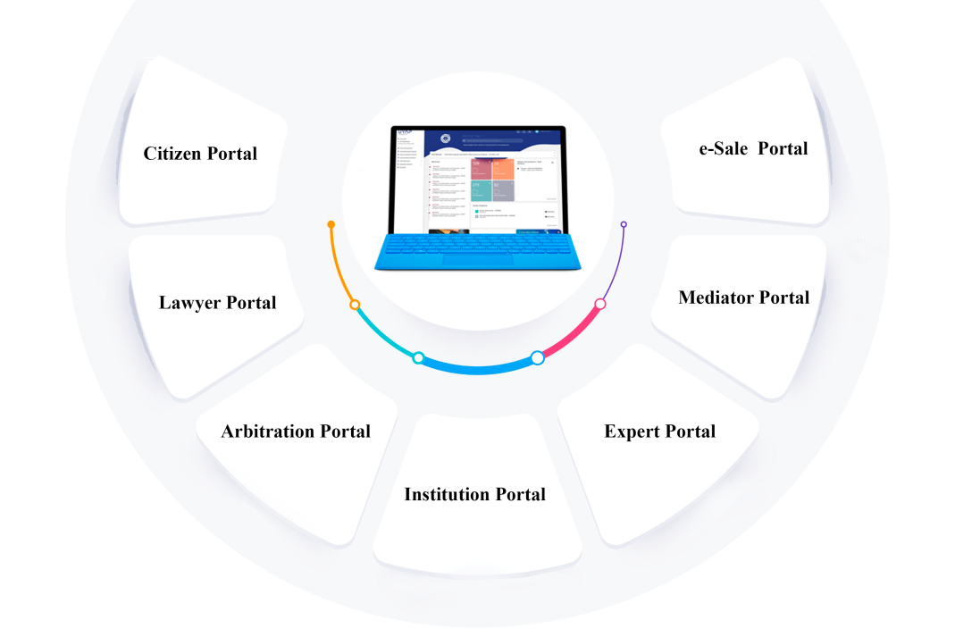
UYAP PORTALS
Notes:
UYAP provides portals for citizens, lawyers, arbitrators, institutions, experts and mediators.

Slide 14
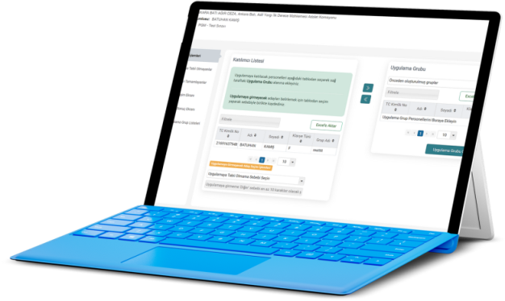
UYAP CITIZEN PORTAL
Securing access of Turkish citizens to the judiciary in the electronic environment
Accessing and following-up lawsuits, to which they are a party, in judicial and administrative justice units and enforcement offices
Filing lawsuits at civil courts
Notes:
UYAP Citizen Portal has been developed with the aim of enabling citizens to access the judiciary acts in electronic environment faster and to make the judicial services better.
Citizens are no longer required to physically visit the courthouse in order to review court files appointed to them.
They can submit petitions and take copies from submitted documents.
They can deposit court expenses and litigation costs with the court.

Slide 15
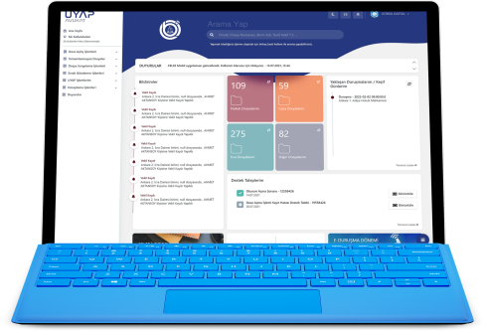
UYAP LAWYER PORTAL
Delivering a petition of complaint to the Chief Public Prosecutor's Offices
Accessing and reviewing case files and enforcement proceedings, to which they are a party
Initiating enforcement proceedings
Obtaining copies from case files
Notes:
One of the main objectives of UYAP System is to facilitate the access of individuals and institutions, especially citizens and lawyers, to the judiciary in electronic environment and to enable them to use judicial services more effectively.
For this purpose, one of the services implemented within the scope of UYAP Information System is "UYAP Lawyer Information System (Lawyer Portal)".
- Access and examine in detail their case files and enforcement proceedings,
- File süit; civil and administrative judicial cases,
- Initiate enforcement proceedings,
- Obtain copies from case files,
- File a lawsuit against the Council of State as a court of first instance,
- Add all kinds of documents to the case file in the system,
- Send a petition of complaint to the Chief Public Prosecutor's Offices,

Slide 16
UYAP LAWYER PORTAL
Filing a lawsuit at the Council of State as a court of first instance
Submitting documents to be added to the case file
Filing civil and administrative judicial cases
Notes:
One of the main objectives of UYAP System is to facilitate the access of individuals and institutions, especially citizens and lawyers, to the judiciary in electronic environment and to enable them to use judicial services more effectively.
For this purpose, one of the services implemented within the scope of UYAP Information System is "UYAP Lawyer Information System (Lawyer Portal)".
- Access and examine in detail their case files and enforcement proceedings,
- File süit; civil and administrative judicial cases,
- Initiate enforcement proceedings,
- Obtain copies from case files,
- File a lawsuit against the Council of State as a court of first instance,
- Add all kinds of documents to the case file in the system,
- Send a petition of complaint to the Chief Public Prosecutor's Offices,

Slide 17
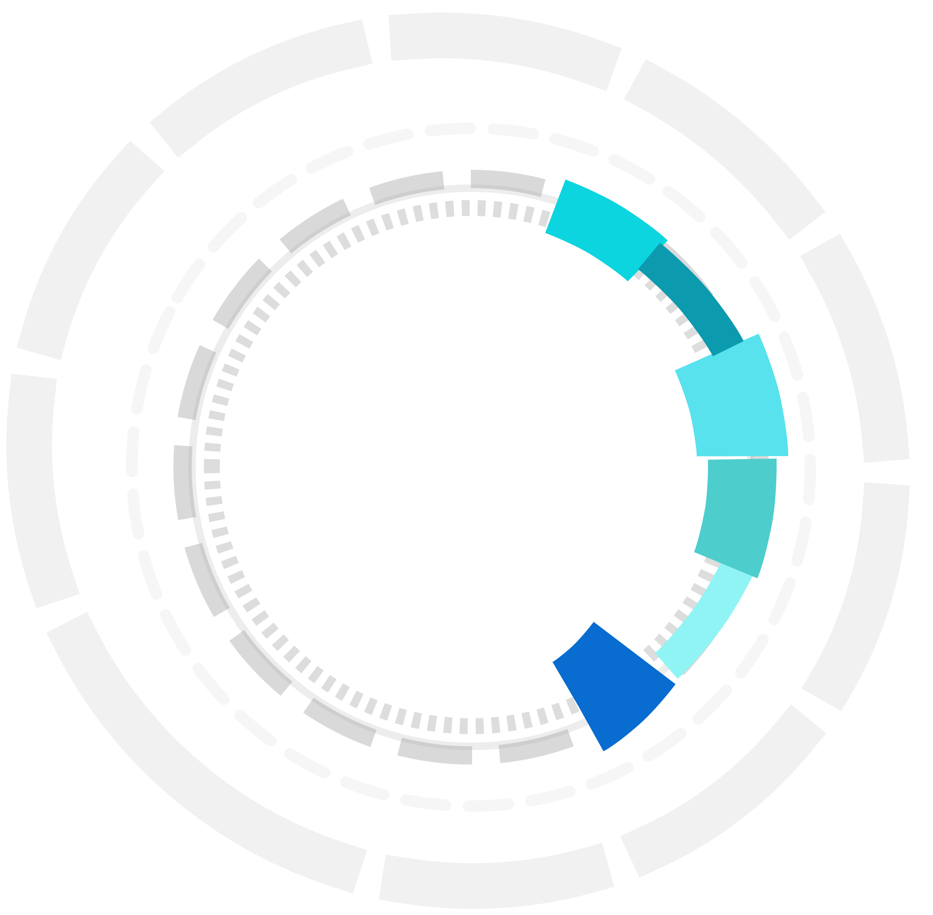
«CELSE» LAWYER MOBILE APPLICATION
Accessing the hearing information of cases, to which they are a party
Viewing information on which hearings completed
Obtaining information on hearing progress and the time of the hearing
Sending a letter of excuse
Viewing information on case documents, accessing notifications about the case progress, and also participating in e-hearings, if authorization is granted
Accessing to the monthly hearing calendar
Notes:
Via the CELSE Mobile Lawyer application lawyers are able to;
- Access the hearing information of their cases and presence information about the trial judge,
- Access Information on which of the hearings on the courts' hearing list have been completed,
- In real-time, they can access the information about which hearing is in progress and how soon their own hearing will start.
if they cannot attend the hearing, Send an excuse notification,·
They can view case cover information and documents, access notifications about the case progress if they allow it, and also participate in an e-hearing via the application,
With the Agenda feature, they can access the monthly hearing calendar.

Slide 18
E-HEARING (UYAP)
Due to the need during the pandemic, work initiated in June 2020 (under the management of the Ministry of Justice)
th
Began to be used on September 15, 2020
Established in all courthouses in 81 city centers all around Türkiye by 01.01.2022
Actively used in 2448 Civil Courts
“191.437 e-Hearings held so far”
Notes:
Due to the coronavirus epidemic disease, it emerged as a need and its work was started.
It has been developed on a secure video conferencing system under the management and control of our Ministry.

Slide 19
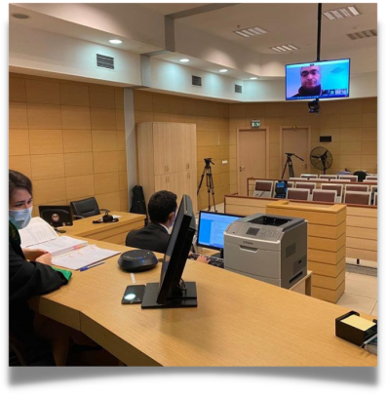
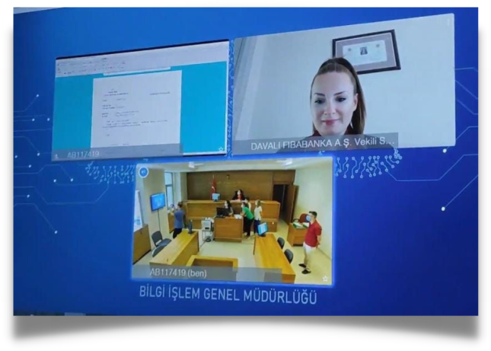
E-HEARING (UYAP)
“Lawyer’s attendance hearings via video conference at any place” (after confirmation of their identity of being a lawyer by a judge via the lawyer’s electronic signature)
Notes:
With the e-Hearing System, lawyers can attend the hearings in the civil courts to which they are a party, via video conference from wherever they are.

Slide 20
Annual Average with Electronic Notification System
50 million
e-notifications sent
1 billion TL
saved
2.000 tons
paper spared
30.000 trees
saved

Slide 21
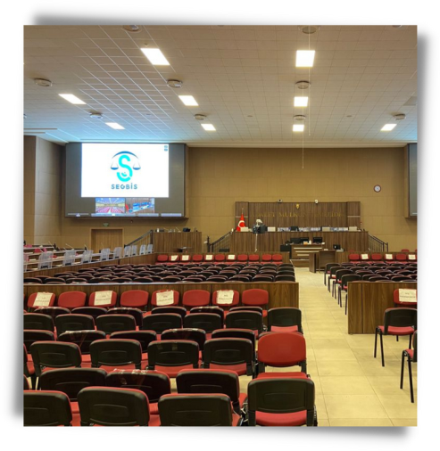
SEGBİS (AUDIO AND VIDEO CONFERENCE SYSTEM)
Began to be used in criminal courts in 2012
“2.375 000 interviews so far”
Holding and recording of audiovisual interviews in court rooms and penal institutions
3.100 000 000 TL saved by not performing 2.300 vehicle transports daily
Notes:
SEGBİS started to be used in criminal courts for the first time in 2012, and 2,375,000 interviews were made until this date.
Thanks to SEGBİS, 3,100,000,000 (Three Billion Hundred Million) TL savings have been achieved since 2,300 transfers are not performed per day.

Slide 22
39 Awards
(22 of which are international)
Notes:
TOTALLY 39 AWARDS, 22 OF WHICH ARE INTERNATIONAL

Slide 23
On a yearly basis;
“6.998.206.764 digital documents created” (on average)
“100.000 trees saved”
(approximately)
by avoiding the use of paper since 2004

