Slide 1
Challenges and responses to COVID-19: Experience of Azerbaijani prosecutors
Dr. Kamran AlIyev
Prosecutor General of
the RepublIc of AzerbaIjan

Slide 2
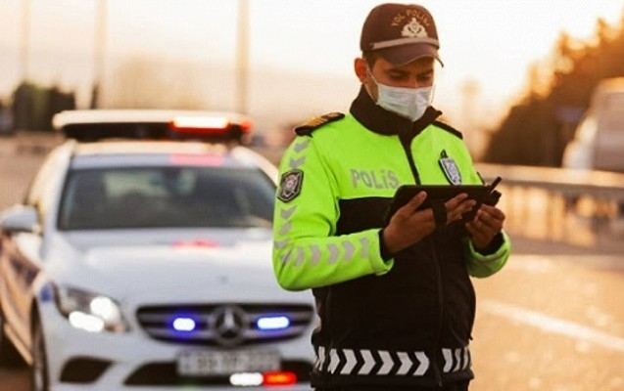
Challenges
Special quarantine regime applied: 24th March 2020
Free movement restrictions for citizens
No access to prosecutors’ offices and courts
Court proceedings postponed
Difficulties in evidence gathering
Delays in pre-trial investigations
Need to respect fair trial rights

Slide 3
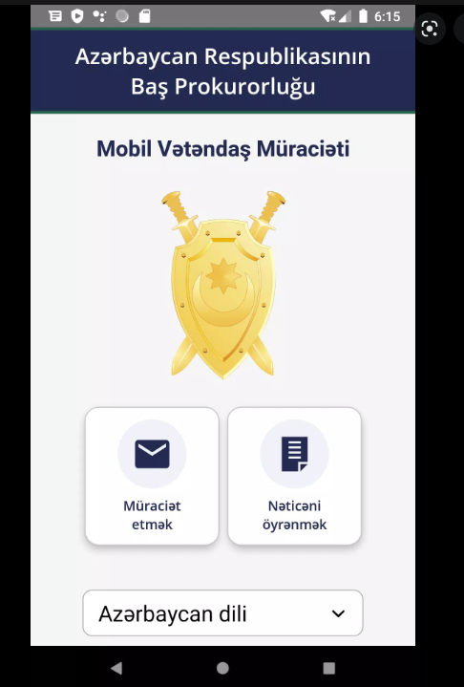
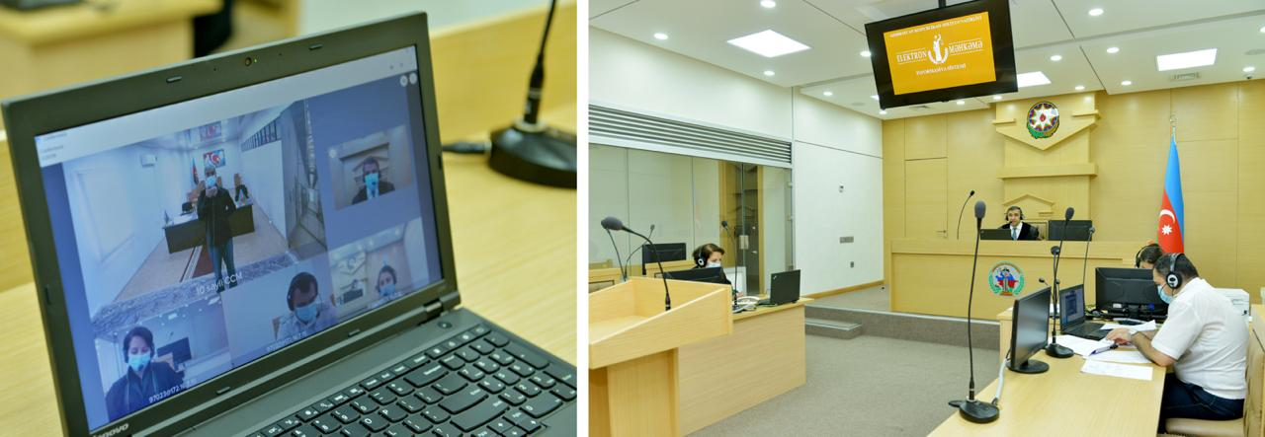
Responses
Crisis Response Team at the Prosecutor’s Office
New mobile application
Criminal proceedings via e-system and videoconferencing

Slide 4
Challenges & Responses
Need to prevent the spread in the penitentiary institutions
Priority for non-custodial restrictive measures
In 740 cases, detention was substituted with home confinement
Conditional early release for 2000 prisoners
Prison terms decreased for 3200 prisoners
Foreign nationals extradited to home jurisdiction
Presidential pardon for 200 individuals over 65 years old

Slide 5
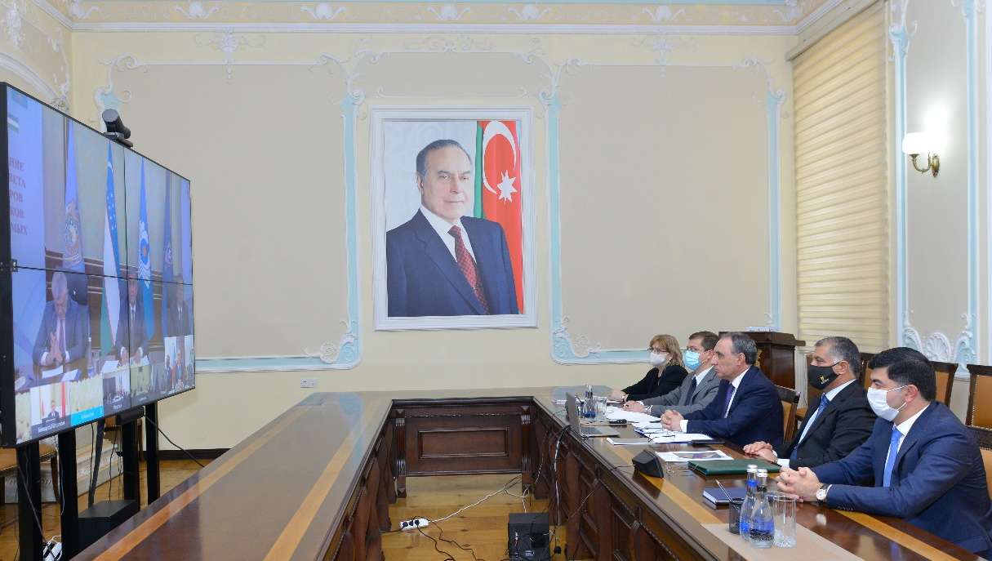
Challenges & Responses
Need to ensure safety of participants of criminal proceedings
Need to replace infected staff
Performance of duties in shifts
Videoconferencing for internal events
3 prosecutors, 8 judges
and 11 defence lawyers died

Slide 6
Challenges
1,6 billion USD Government aid projects for vulnerable groups
New crime trends emerged
Embezzlement in distribution of funds
Bribery and fraud in provision of medical services
Bribery and forgery to avoid quarantine restrictions
False vaccine certificates

Slide 7
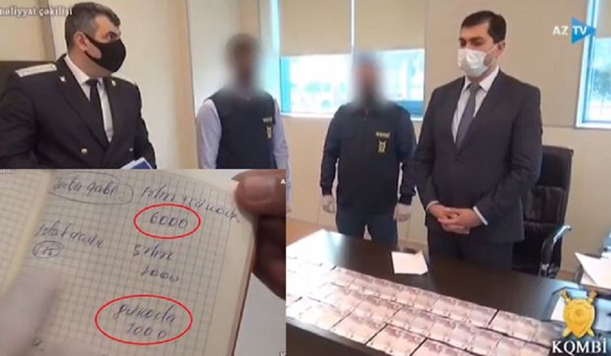
Responses
New crimes and administrative offences introduced
Criminal cases on violations of quarantine regime
Covert operations detecting bribery and fraud
Monitoring mass media to detect violations

Slide 8
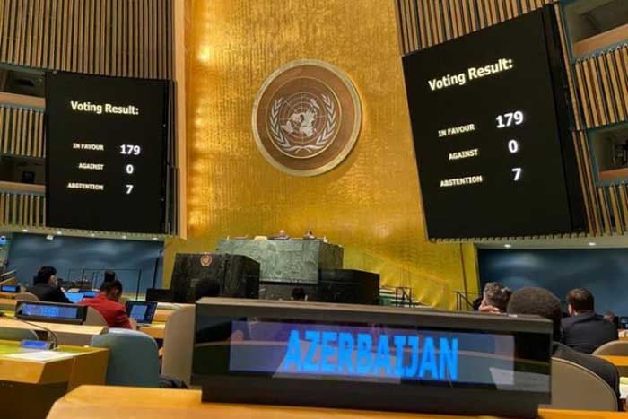
Global Solidarity
UN General Assembly Resolution sponsored by Azerbaijan
“On equitable access to COVID-19 vaccines for all countries”
Financial and humanitarian aid to 80 countries
A million dose of vaccine provided to 14 countries free of charge

Slide 9
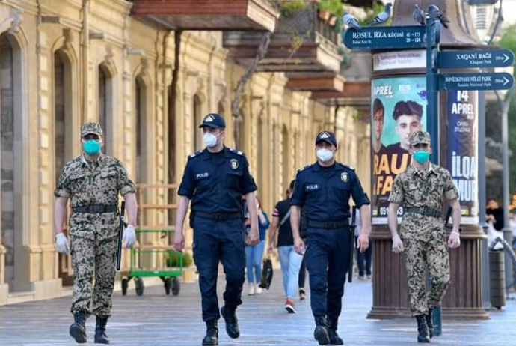
Azerbaijan
Total population: 10 million
The first infection case: 28th February 2020
Special quarantine regime applied: 24th March 2020
Approximately 800 thousand infected (10%)
10.000 fatal cases (0,1%)

Slide 10
Thank you for your attention.

