Slide 1
- Tracing, seizing & freezing virtual assets Annika Wennerström, subject matter specialist (IT-crimes), Swedish Prosecution Agency

Slide 2
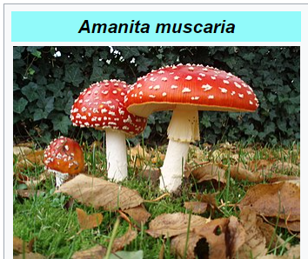
Darknet marketplace Flugsvamp 2.0 - April 24, 2015 – Sept 24, 2018
Buyers: ca. 17 000
Vendors: ca. 600
Drug trades: 311 340
Turnover: 49 319 bitcoin (BTC).
(Value on the date of transaction: ca 40 million USD)
Profit admin: 1 479 BTC (3 % commission)
(Value, date of transaction: 11 million USD)
(Value, date of indictment: 133 million USD)
Seizures: 72,8 BTC + 43.235 EUR (cash)
Preservations (Binance): 209 BTC, 171 Monero (XMR)

Slide 3
Legal challenges
Crypto currencies are digital information; immaterial and virtual.
Laws for seizing, forfeiting, sequestration written for (fiat) money (USD, SEK, Euro etc).
Regulations in money laundering legislation:
Anti Money Laundering (AML)
Know Your Customer (KYC).
Notes:
CC are immaterial, virtual, without physical location
Applying crypto currencies (CC) on laws written for money (seizing, forfeiting, sequestration)
The money laundering legislation (5AMLD)
Purpose: prevent the misuse of the financial system for the purpose of money laundering
Non-regulated actors; wallet providers (soft/hardware), mixers, tumblers
Wallets with built-in mixing function.
CC are immaterial, virtual, without physical location
Applying crypto currencies (CC) on laws written for money (seizing, forfeiting, sequestration)
The money laundering legislation (5AMLD)
Purpose: prevent the misuse of the financial system for the purpose of money laundering
Non-regulated actors; wallet providers (soft/hardware), mixers, tumblers
Wallets with built-in mixing function.

Slide 4
Practical challenges
Resources and expertise within prosecution and law enforcement agencies.
The tracing of transactions – the money trail.
Presentation of evidence in courts.

Slide 5
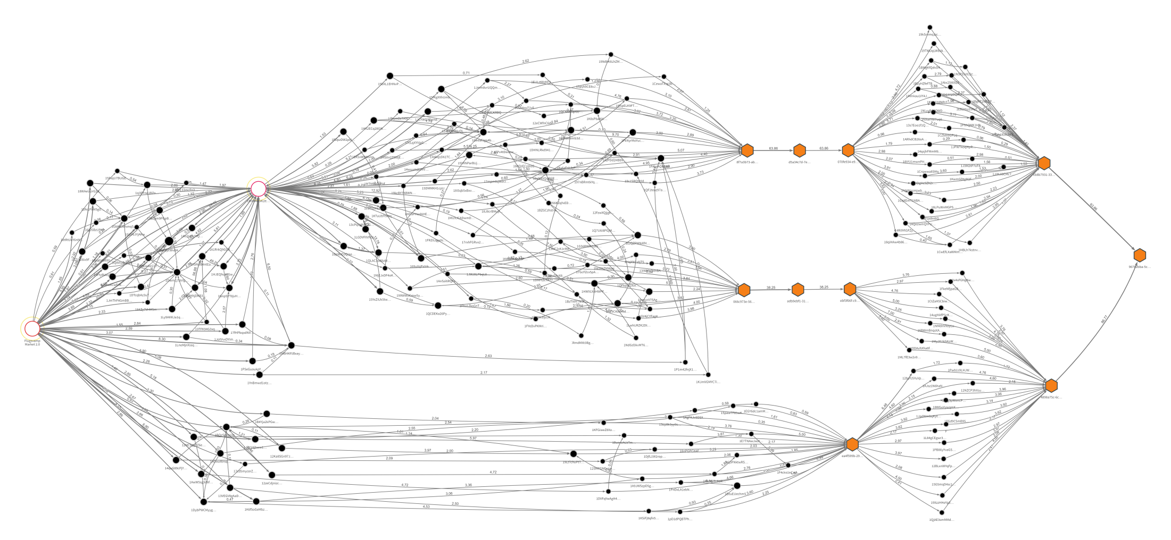
Tracing transactions
Mixer service
Flugsvamp 2.0 market place
Suspects bank account

Slide 6
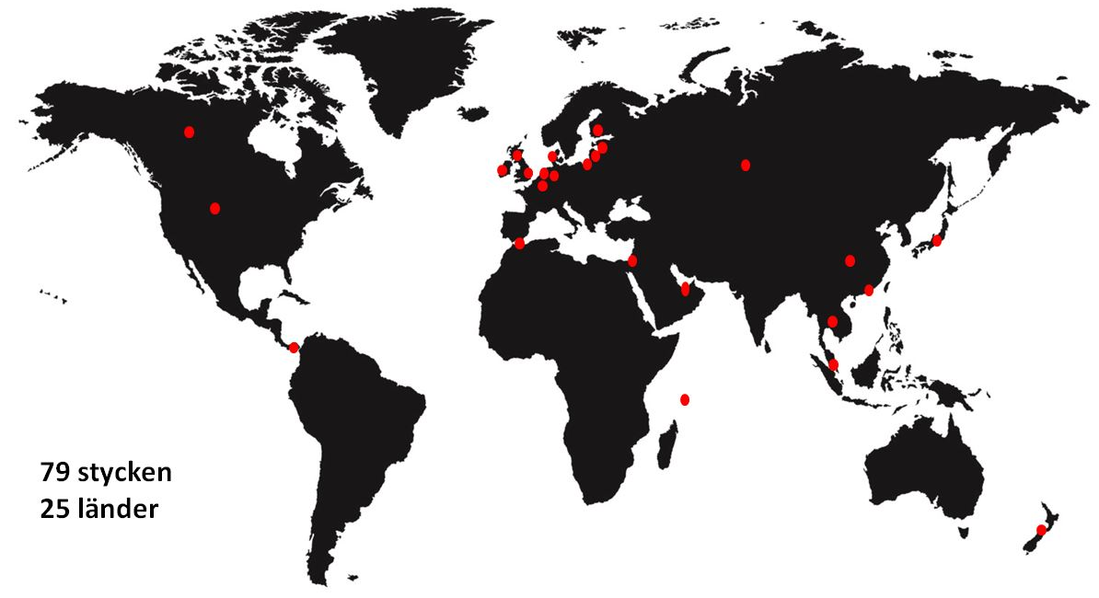
International cooperation

Slide 7
The courts
No previous knowledge can be assumed in court.
Police staff can testify and/or assist the prosecutor.
Charts, glossaries, step-by-step presentations.

Slide 8
Securing crypto currency
Criminal wallets
Crypto transaction from a criminal wallet (hardware/software) to a police wallet.
Custodial wallets (third party)
Jurisdiction
Freezing order / seizure

Slide 9
Conclusions
Information from actors in the crypto market is important evidence for identification of suspects.
Crypto currency assets can be retreived and confiscated as criminal profit.

Slide 10
Key success factors
SKILLS
- Specialized experienced teams
FRIENDS
International cooperation
TIME
endurance and patience

Slide 11
მადლობა, tack, thank you
www.aklagare.se

