Slide 1
Tracing, Seizing, and Freezing Virtual Assets International Association of Prosecutors
eun young choi
Director
national cryptocurrency enforcement team
U.S. Department of justice

Slide 2
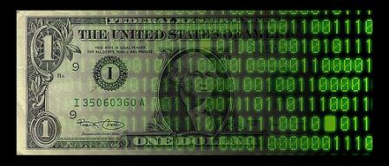
Why is Tracing, Seizing, and Freezing Virtual Assets Important?
Disruption – Deprive criminals of their ill-gotten gains
Especially where arrest is not possible
Make Victims Whole – Return stolen funds to victims of crime
Actor Attribution – Key evidence to identify the true identity of the criminals involved

Slide 3
Crypto Challenges
Immutable / Irreversible
Cross-border nature
Anonymity / Pseudonymity
Anti-Money Laundering (AML) / Know-Your-Customer (KYC) Policies
Anonymity Enhanced Cryptocurrencies (obscured blockchains)
Obfuscation Methods
Mixers/Tumblers
Chain Hopping
Off-Chain Transactions
Opportunities to Seize (Hosted v. Unhosted Wallets)

Slide 4
Key Principles
Move quickly, but be patient
International cooperation to meet a cross-border challenge
FATF Standards – AML/KYC Policies
Preservation of Evidence (24-7 Network / Budapest Convention)
Mutual Legal Assistance Treaties
Gather Evidence
Execute Searches
Arrest and Extradition
Capacity Building – at home and abroad

Slide 5
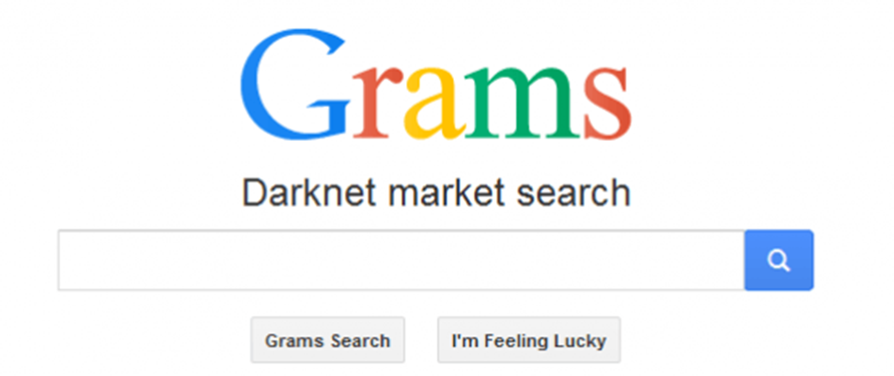
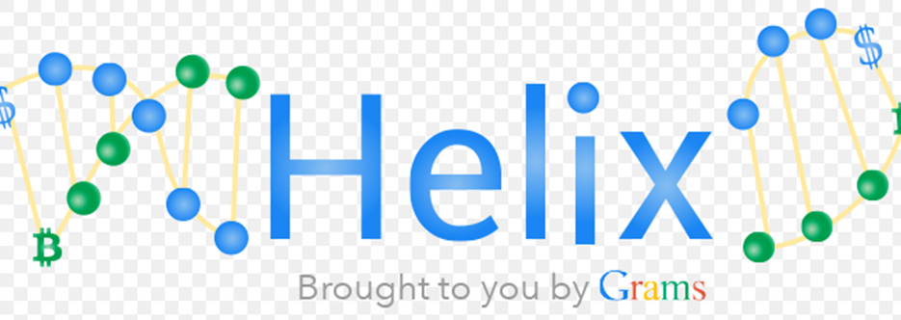
Case Study: Grams and Helix

Slide 6
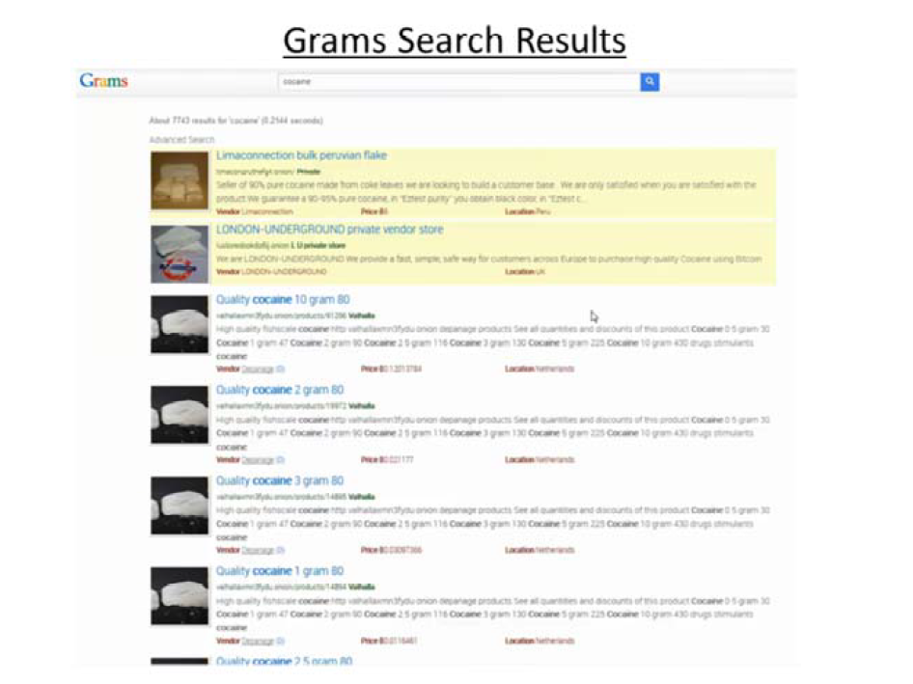
Grams and Helix

Slide 7
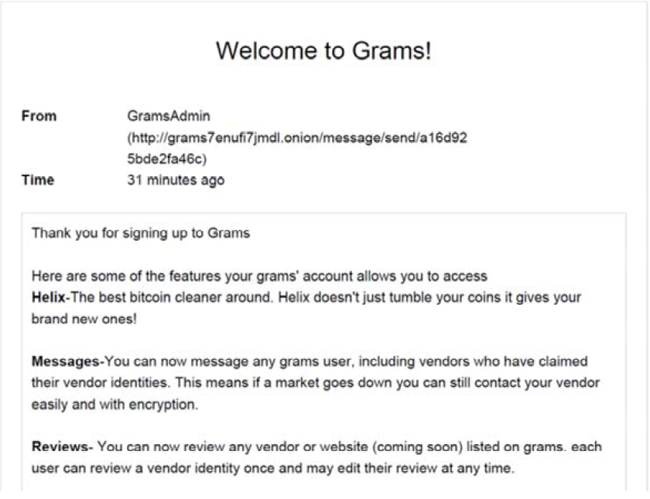
Grams and Helix

Slide 8
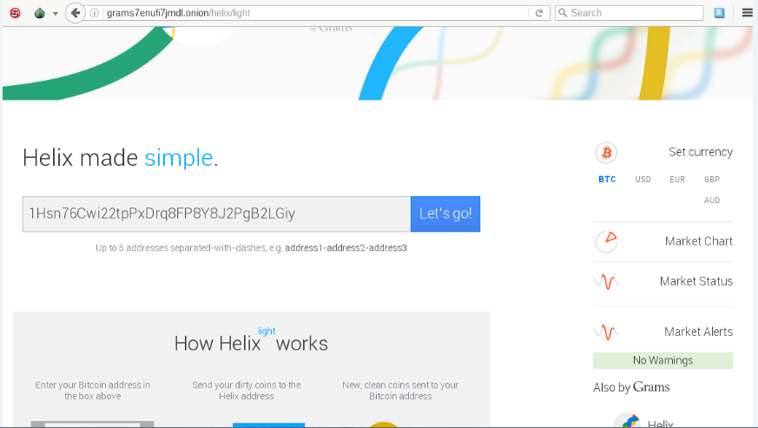
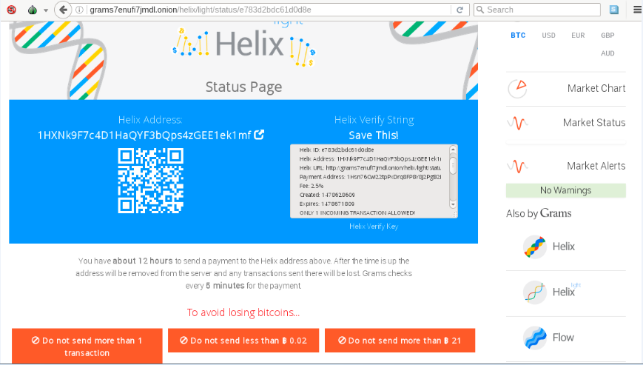
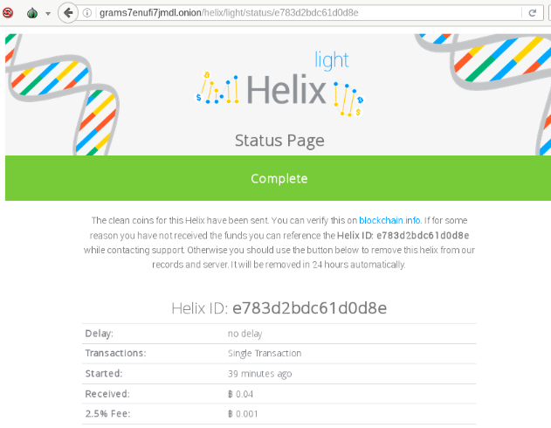
How Helix Worked
User enters Bitcoin address where clean coins are to be sent
User Deposits “dirty” coins to Helix
Helix charges User a 2.5% fee
“Clean” bitcoin deposited into user’s wallet, minus ~2.5% fee

Slide 9
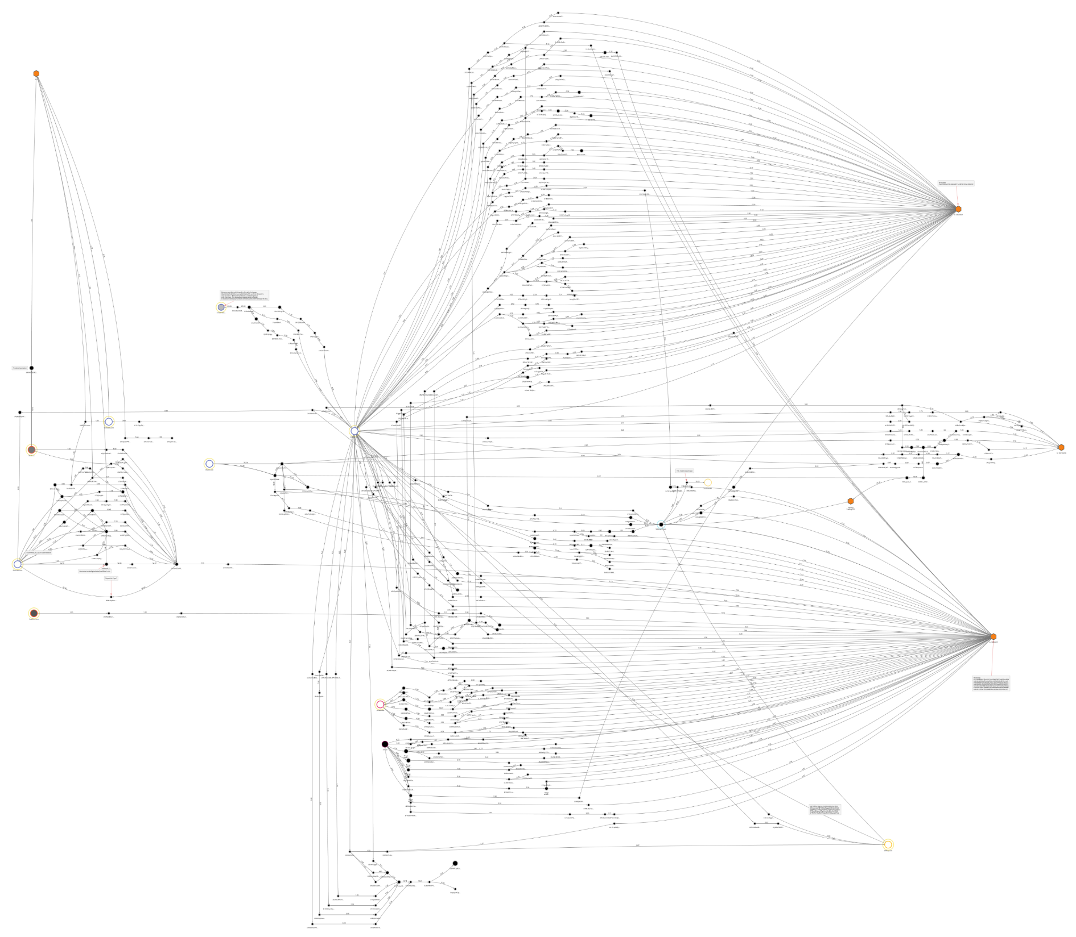
Blockchain Analytics

Slide 10
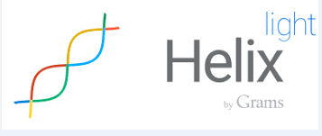
Volume of Helix Transactions
More than 354,468 bitcoins between June 2014 and December 2017 (when site shut down by admin)
Valued at $311,145,854 at time of transaction
Top Senders of bitcoin include known criminal marketplaces
End Recipient
356,000 BTC
Unknown customers
Transaction Fees

Slide 11
“gramsearch”
Bitcoin Clusters
Bitcoin sent from clusters to Online Payment Processor and Helix at about the same time
“gramsearch” bitcoin addresses from seized market
Online Payment Processor
Online payment processor that facilitates the purchase of goods using bitcoin.

Slide 12
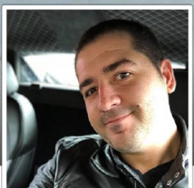
Online Payment Processor Transactions
Online Payment Processor
$100,000 total value gift cards
Bitcoin clusters linked to “gramsearch” and Helix
Bitcoin transactions processed by Online Payment Processor
Email Address for
Larry Harmon

Slide 13
Virtual Currency Exchanges
80% of bitcoin funding VCE-2 sourced from clusters linked to Helix
Virtual Currency Exchange-2
Accounts owned by
Larry D. Harmon
Virtual Currency Exchange-3
Bitcoin clusters linked to Helix
25% of bitcoin funding VCE-3 sourced from clusters linked to Helix

Slide 14
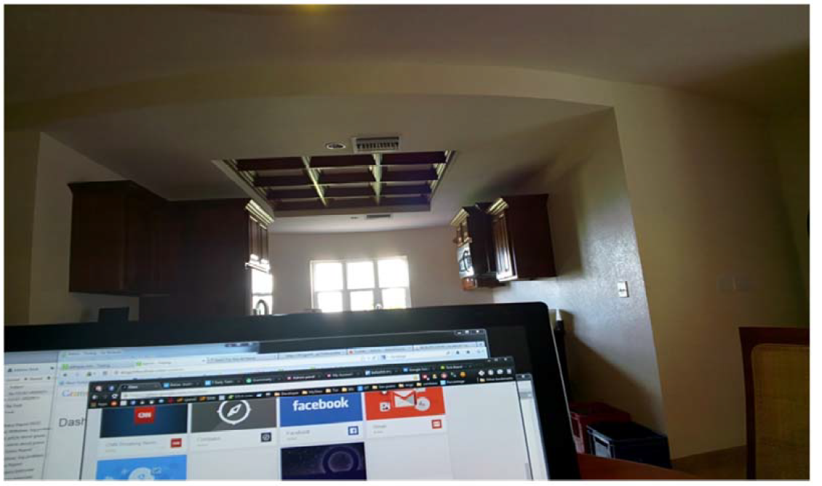
Search of Email Address

Slide 15
Picture of Laptop

Slide 16
Harmon Profiting from Helix

Slide 17
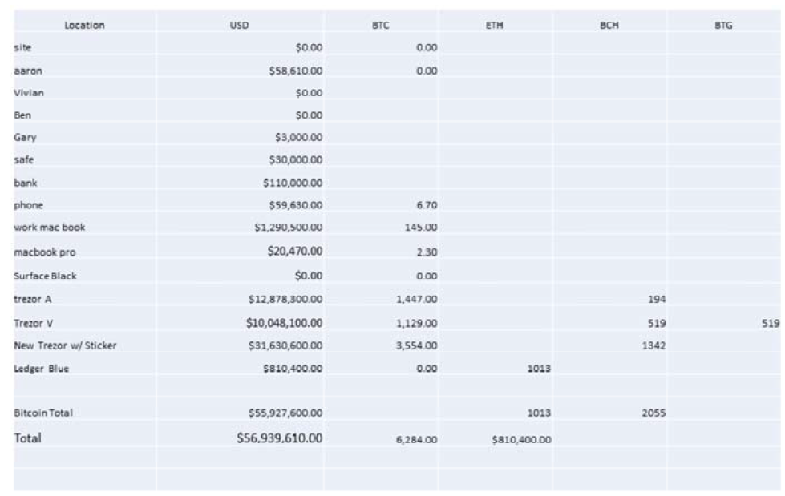
Harmon Profiting from Helix
$56,939,610

Slide 18
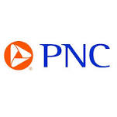
Flow of Funds
Exchange accounts held by Harmon
VCEs
Cash from sales of bitcoin
Bitcoin sent to
Peer-to-peer sales
Bitcoin Clusters linked to Helix

Slide 19
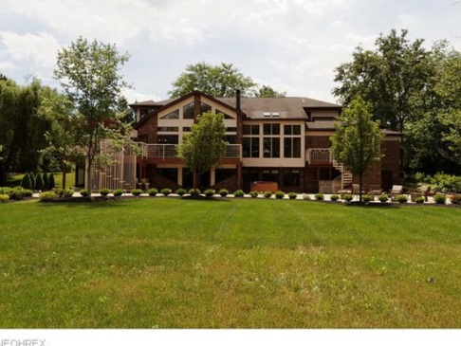
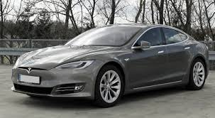
Flow of Funds
Tesla Model S and Model X
Leased $2,107/month
Primary Residence in Akron, Ohio
$4,023/month
Maiden Lane Lofts
$1500/month
Tesla Model 3
$55,000 purchase

Slide 20
Charges
Indictment against Larry Harmon:
Count 1: Conspiracy to Launder Monetary Instruments (18 U.S.C. § 1956(h))
Max 20 years
Count 2: Operating an Unlicensed Money Transmitting Business (18 U.S.C. § 1960)
Max 5 years
Forfeiture Allegation on Counts 1 and 2: Government will seek forfeiture of “any property, real or personal, involved in the offense, and any property traceable thereto.”

Slide 21
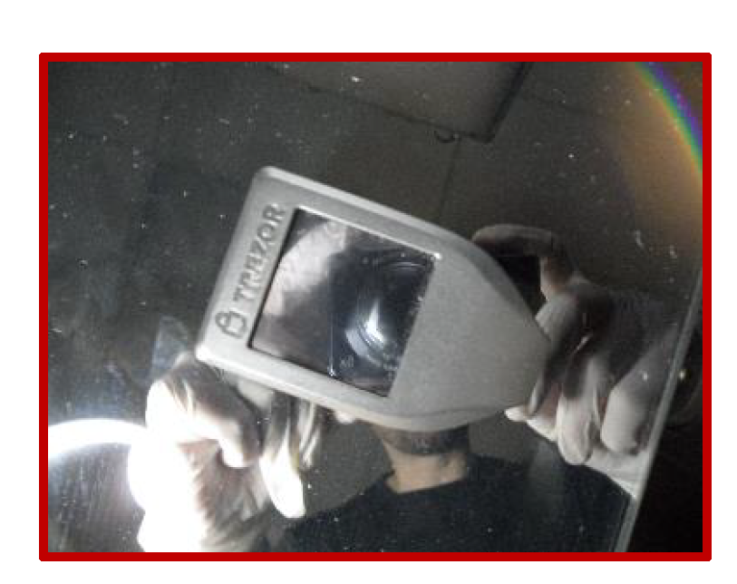
Search Warrants and Arrest
Search of Apartment in Belize (via MLAT request)
Arrest of Harmon and searches at home and business offices in Akron, Ohio (Feb. 6, 2020)
Arrest at 2nd Floor of office building – recovered Trezor cryptocurrency storage device magnetically attached underneath a table
Law enforcement seized 4,168.9815353 Bitcoin seized from Trezor (~$ 42M USD at time)
712.6 Bitcoin from Trezor was transferred out of Trezor hidden wallets after arrest and detention of Defendant

Slide 22
Missing Bitcoin
16 Wallets with ~4,877 BTC traceable to Helix
Feb. 6, 2020 – Apr. 18, 2020 –
No movement
Apr. 19, 2020 – Apr. 24, 2020 –
8 BTC transactions into new wallets
712.6003 BTC total (~$5,397,083.98 at time)
Moved through use of mixers

Slide 23
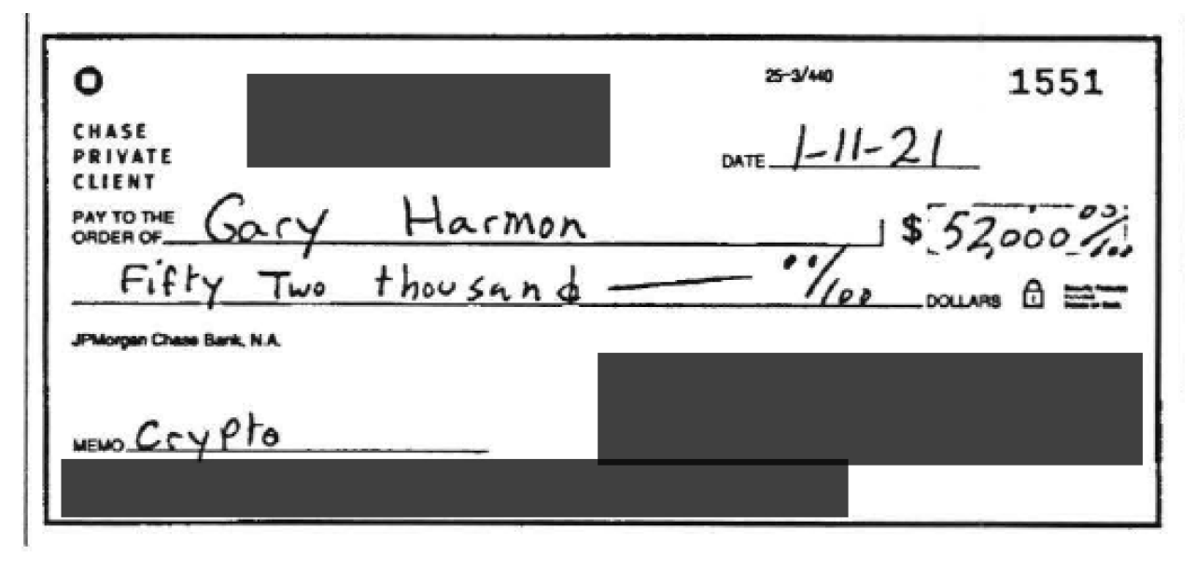
Missing Bitcoin

Slide 24
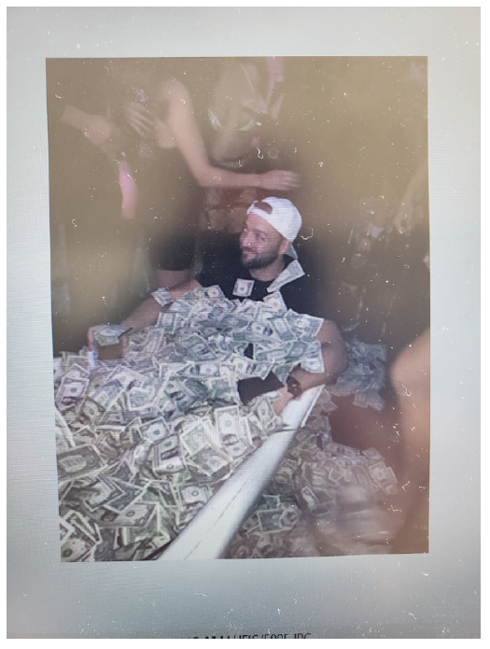
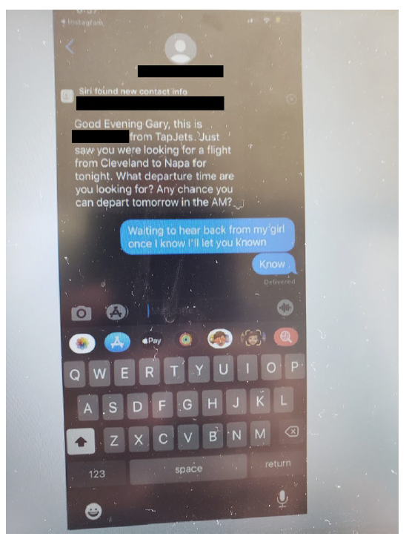
Gary Harmon

Slide 25
Status of Cases
United States v. Larry Harmon
Pleaded guilty to Count 1: Conspiracy to Launder Monetary Instruments
Awaiting Sentencing
United States v. Gary Harmon
Charged with eight counts of Money Laundering, (18 U.S.C. § 1956(a)(1)(B)(i); Obstruction of an Official Proceeding (18 U.S.C. § 1512(c)(2)); Removal of Property to Prevent Seizure (18 U.S.C. § 2232(a))
Pending trial early 2023

Slide 26
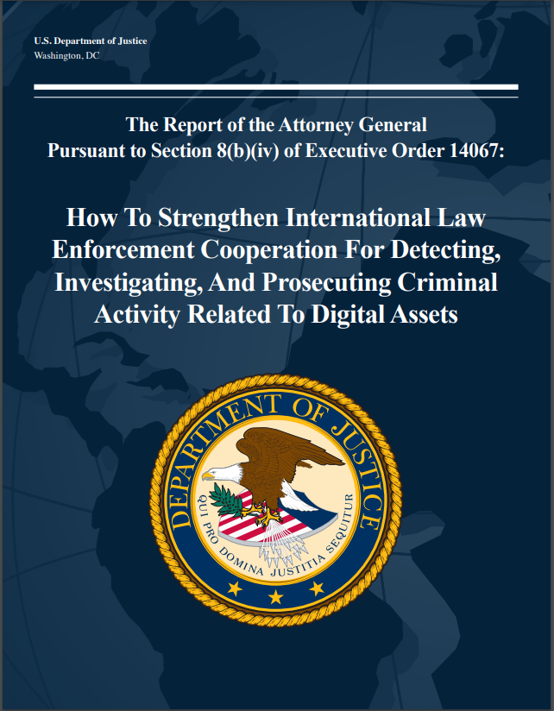
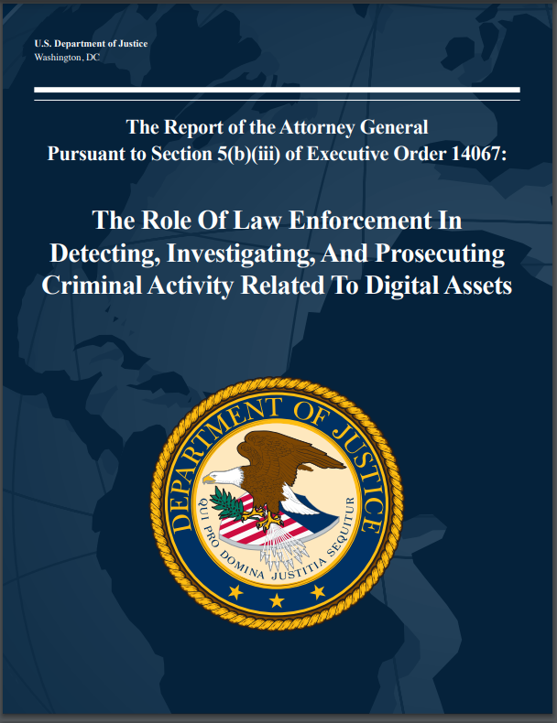
Additional Resources

Slide 27
Questions?
Eun Young Choi
Eun.Young.Choi2@usdoj.gov
Director, National Cryptocurrency Enforcement Team (NCET)
U.S. Department of Justice

