Slide 1
Cryptocurrency and Money Laundering
NatARAJ J MUNEESAMY
Principal State Counsel - MAURITIUS

Slide 2
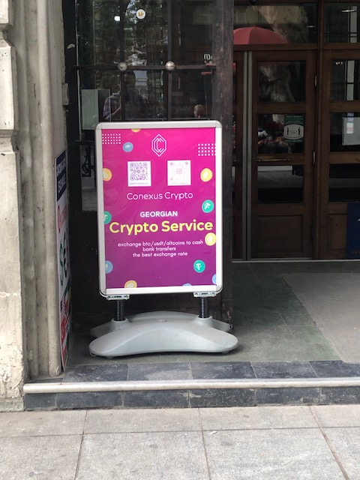
Not tangible but Real
Cryptocurrency
Not tangible
But works like any other currency
Is being used by criminals to launder proceeds

Slide 3
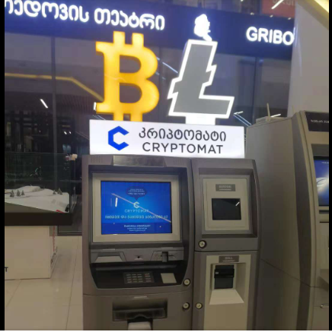
39 Crypto ATMs around Tbilisi

Slide 4
$15.8 trillion transaction volume in 2021
Total transaction volume grew to $15.8 trillion in 2021, up 567% from 2020’s totals.
More cybercriminals are using cryptocurrency.

Slide 5
Illicit addresses receive $14 billion in 2021 compared to $7.8 billion in 2020

Slide 6
More licit than illicit use
However, traced increase in illicit transaction volume was just 79%
Relatively low compared to 567% increase
Indicating that licit cryptocurrency usage is higher than illicit use

Slide 8
Caveat
However, figures based on identified illicit addresses only
Possible correlation with:
Rise of regulations
Law enforcement becoming more efficient
Or low detection
Still represents $14 billion of illicit transactions though

Slide 9
Trends – Stolen funds ($8 billion in 2021)

Slide 10
Money Laundering
Cybercriminals want:
(i) to move their ill-gotten funds to a service where they can be kept safe from the authorities and
(ii) eventually convert to cash or use the crypto in a jurisdiction where it is legal tender

Slide 11
Terrorism Financing
In 2019 and 2020, Al-Qaeda raised cryptocurrency through Telegram channels and Facebook groups.
In 2021, Al-Qassam Brigades, Hamas’ military wing, collected more than $100,000 in donations.
As opposed to ML, TF transactions can come from licit sources.

Slide 12
Cryptocurrencies laundered - $33 billion since 2017

Slide 13
Far from the estimated $800 billion to $2 trillion of fiat currency is laundered each year
Crypto transactions can be traced to the wallet
But still a problem and potential for growth
Tracing can have limits if:
Encryption is used
Offline deposits are made/ money deposited with intermediaries
If law enforcement agencies are not even looking or equipped to look for crypto transactions

Slide 14
Not just bitcoin
Bitcoin’s money laundering activity is the least concentrated by far. - just 19% of all Bitcoin sent from illicit addresses,
57% for stablecoins (backed by a hard asset such as currency)
63% for Ethereum
68% for Altcoins
Over 10,000 cryptocurrencies

Slide 15
Recovery of digital assets
What is the asset in question?
Cryptocurrency
NFT
METAVERSE

Slide 16
NFT (Non–fungible Token)
Non-fungible – something unique that cannot be replaced with something else.
For example, a bitcoin is fungible — trade one for another bitcoin, and you will have exactly the same thing.
A one-of-a-kind trading card, however, is non-fungible.
If you traded it for a different card, you’d have something completely different.
Music, a picture, etc
Recent craze: Digital Art

Slide 17
Monet – a pond of water lilies - sold at $ 24.1 million

Slide 18
Beeple digital art – sold at Christie’s $69 million in 2021!

Slide 19
NFT popularity skyrocketed in 2021
In 2021, a minimum of $44.2 billion worth of cryptocurrency used to purchase NFTs.
This is a huge contrast to the $106 million in 2020 !
Two forms of illicit activity with NFT
Wash trading to artificially increase the value of NFTs (selling it to yourself to increase its value – use of different wallets – not regulated)
Money laundering through the purchase of NFTs

Slide 20
Money laundering and NFT - increasing

Slide 21
METAVERSE(S)

Slide 22
Metaverse
A virtual world where you can interact, buy or sell digital items (including digital assets)
Metaverse market could be worth between $8 trillion and $13 trillion by 2030, with total metaverse users hitting around 5bn.
Around 160 metaverses
You can transact using cryptocurrency.
Identity theft, data hacks, breaches, and other financial scams are all possible in the metaverse
Similar to stealing someone’s personal information and accessing their digital wallets for illicit activities.
Unregulated
Jurisdictional issues? Where is the perpetrator located?
Decentralised : no centralized landscape or a clear picture about what or who is ultimately responsible for regulations and enforcement.
What about assets?
Someone living in a 40m2 apartment might own a mansion in the metaverse

Slide 23
Challenges
Limited Logistics/resources
Crypto is highly traceable
Provided law enforcement knows how to trace
Emergence of privacy-preserving coins
For example, the coin Monero utilizes a number of privacy-enhancing technologies, like obscuring IP addresses, to obfuscate the identities of those involved in trades and to improve the fungibility of tokens. (other examples include Darkcoin or Zerocoin)
Exchanges that convert money into crypto and crypto into money are not all properly regulated
They do not all adhere to KYC and other AML/CFT practices that banks have to abide by.

Slide 24
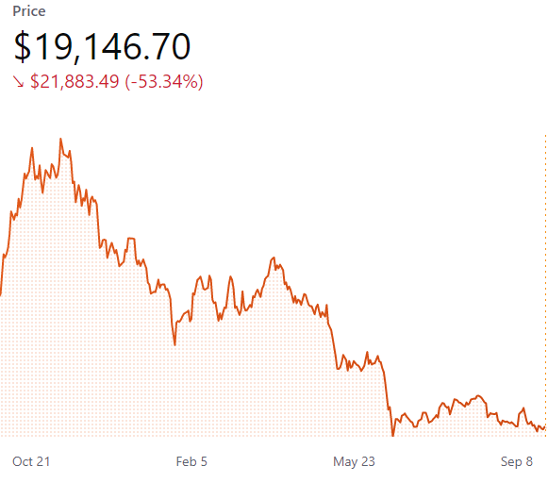
Bitcoin from S40K to $19K in a year
Volatility of cryptocurrencies’ value makes it difficult to conduct interlocutory sales.
Not the same as selling a seized car or boat
Where the assets remain in the original wallet of the criminal, the risk of their transfer remains because the criminal may still have access to the seed phrase or password.

Slide 25
Way forward
Regulation / KYC obligations/ STR
FATF – Recommendation 15 (VASPs to be registered, licenced, supervised)
Initial purchases of crypto most likely to go through the traditional banking system
Banks should specifically focus on payments made to companies selling or buying crypto
Flag STRs for transactions over a certain sum
That implies that banks have a list of merchants dealing in crypto

Slide 26
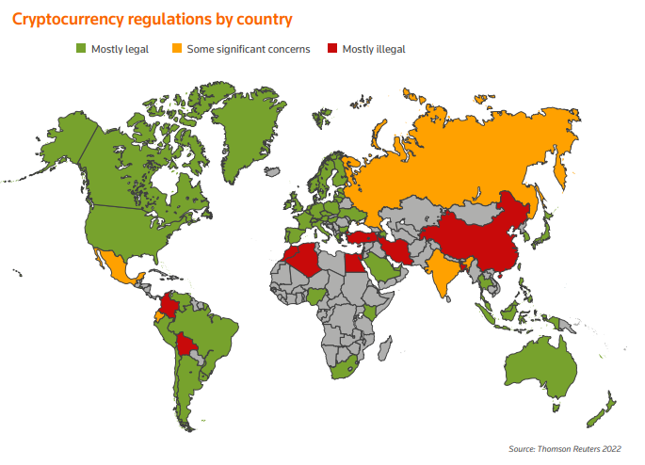
Common approach
Common understanding and approach
How to define cryptocurrency
Regulate its use
Investigation and Prosecution
Model law on cryptocurrencies
To avoid loopholes
Avoid abuse
Prevent impunity
Facilitate asset recovery

Slide 27
Pooling of efforts
Logistics and resources are key
Digital tools to investigate crime (interception of content data and traffic data, remote forensic software, etc.)
Digital tools to trace and disrupt crimeware
Databases for profiling Platforms for cross-border information exchange among law enforcement
Maintaining risk-based profiles based on transactional activities Real-time payment screenings
Creation of lists: fraud lists, blacklists, frozen lists, etc.
Better information exchange (digital platforms, automatic exchange of information)
Digital tools for searching for and obtaining beneficial ownership information in the databases
These are limited and might not be the main priority of govt
Should these not be pooled at regional or international level given the transnational and increasing omnipresence of crypto-transactions?

Slide 28
Do not take a gamble!
Regulate
Investigate
Cooperate
Coordinate

