Slide 1
Challenges and Strategies
Digital Transformation in the Post-Pandemic Era in Singapore
Tai Wei Shyong
Deputy Attorney-General
Singapore
Property of AGC - Not to be reproduced without permission.

Slide 2
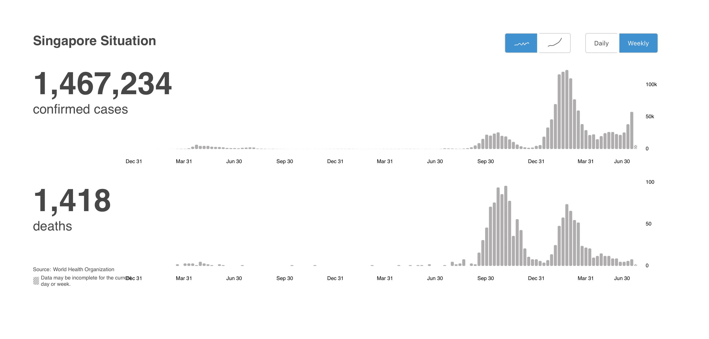
Covid-19 in Singapore
Snapshot of COVID-19 cases in Singapore
As of 3 January 2020 to 4 July 2022

Slide 3
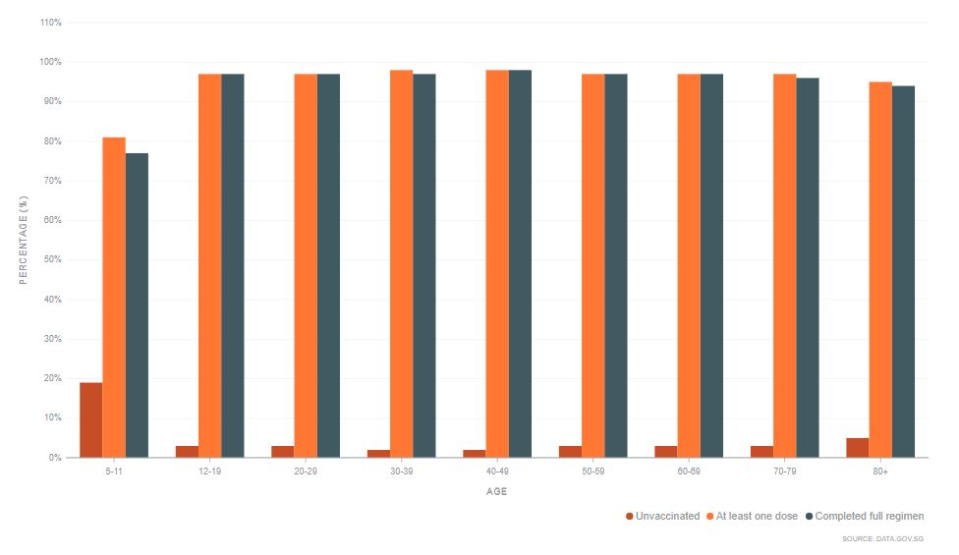
Vaccination status of Singapore’s population (by age group)
Vaccination statistics
As of 2 September 2022
97% of the total population have received at least one dose.
93% of the total population have completed the full regimen.
79% of the total population have received booster shots.

Slide 4
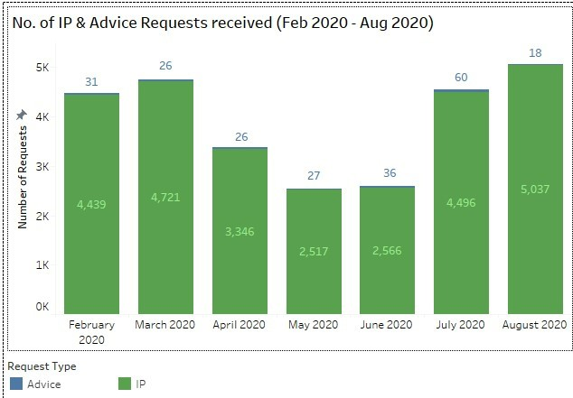
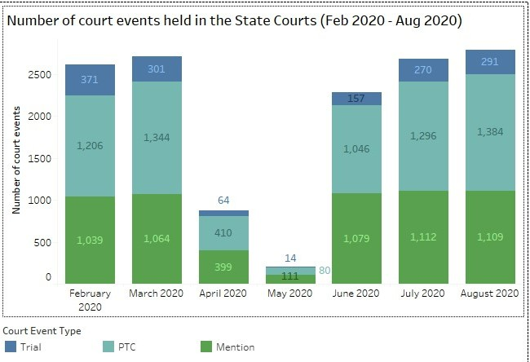
No. of investigation papers handled (Feb 2020 – Aug 2020)
No. of cases heard in the State Courts (Feb 2020 – Aug 2020)

Slide 5
Disruption and Challenges Faced
Hearings during this period were conducted using electronic means of communication, dispensing with the need for physical attendance before the court
During this time, courts only heard matters which were essential and urgent
Use of technology (Zoom hearings) to deal with court matters without parties physically attending the mentions
Arrangements made for witnesses to testify via Zoom under s 28(1)(a) of the COVID-19 (Temporary Measures) Act 2020
First trial conducted completely via Zoom during the Circuit Breaker
Cooperation between the courts, the Criminal Bar, prosecuting agencies and AGC
Digitisation of case management processes
Digitisation of files so that decisions can be made by Prosecutors who are not able to access physical files remotely
Physical interaction between prosecutors and police investigators was reduced and replaced with remote meetings
Prosecution of high and immediate number of Covid-19 related cases

Slide 6
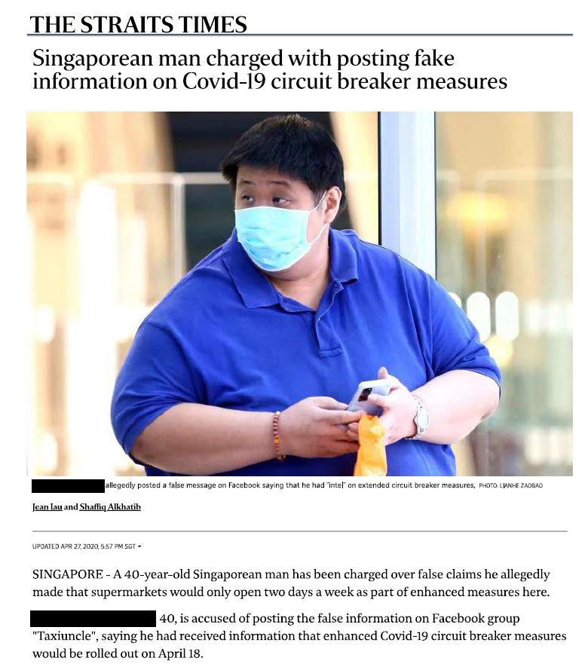
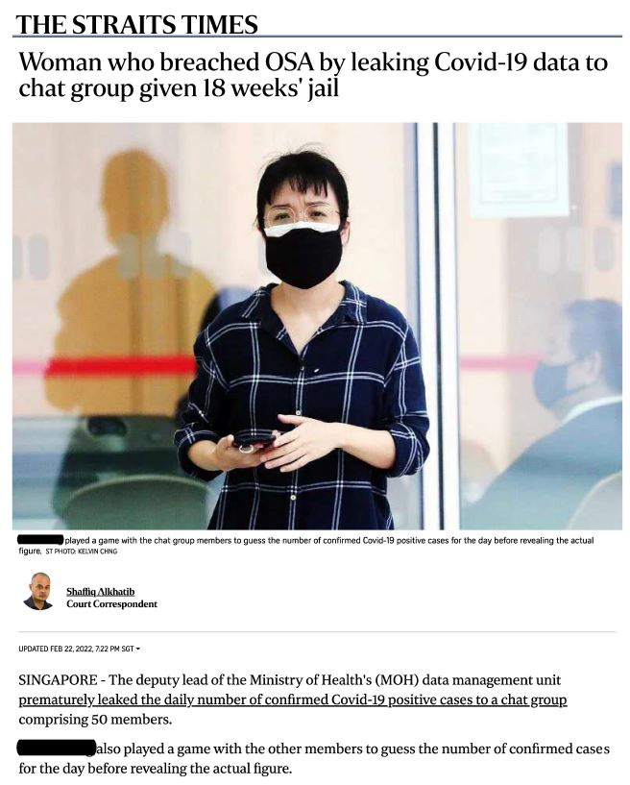
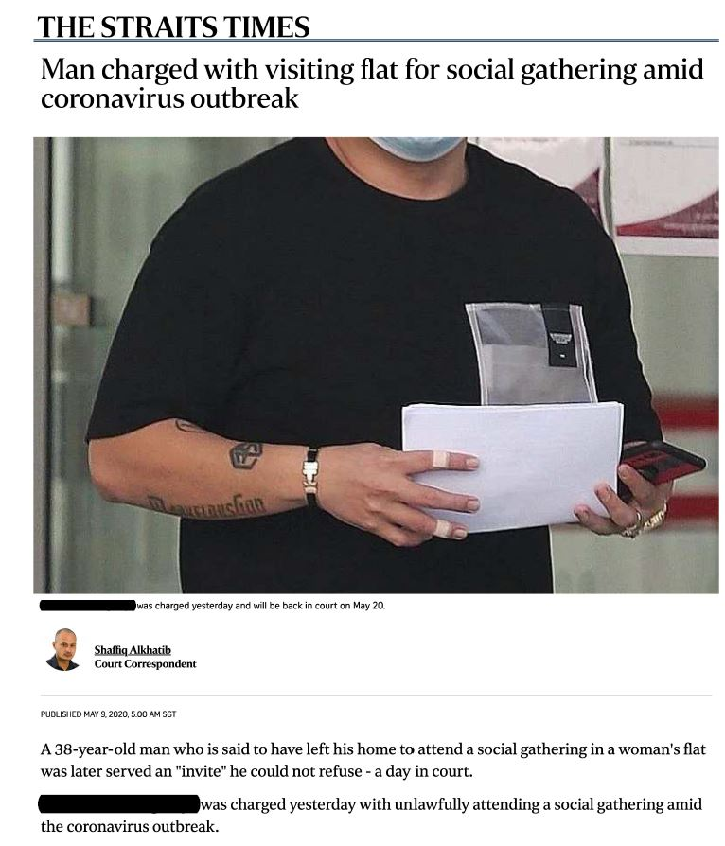
Source: https://www.straitstimes.com/singapore/courts-crime/man-to-be-charged-for-spreading-fake-news-on-covid-19-circuit-breaker
Source: https://www.straitstimes.com/singapore/courts-crime/man-charged-with-visiting-flat-for-social-gathering
Source: https://www.straitstimes.com/singapore/courts-crime/moh-officer-leaked-covid-19-related-data-to-group-and-played-game-to-guess-number-of-cases

Slide 7
Moving Forward
Use of remote technology to hear cases
Largely a matter for the judiciary to decide
Useful to maintain electronic hearings for some court cases, in particular for pre-trial hearings and plead guilty mentions
Enhancement of electronic workflows and digitalisation of files
Policy of “Digital from the Start, to the Core”
A more seamless digital system from the police to the prosecutor by the end of 2024
Fundamental review of the entire criminal justice work process, including the use of asynchronous hearings
Backlog of criminal cases
Dealing with legacy Covid-19 related prosecutions
Rise in online scams with digitalisation

