Slide 1
International Cooperation, Big Data Delay and the Effect on Victims

Slide 2
Overview
Case Study
International Cooperation
Big Data
Victim Impact
Lessons Learned

Slide 3
United States v. Elad Gaber
2010 Los Angeles victim comes forward
2011 Joint Investigation with Israel Police
2012 MLAT evidence obtained
2012 Arrested in Israel
2014 U.S. Federal Indictment
2017 Extradition Request
2018 Defendant Fights Extradition
2020 Defendant Extradited
2021 Defendant Pleads Guilty
2021 Defendant Sentenced

Slide 4
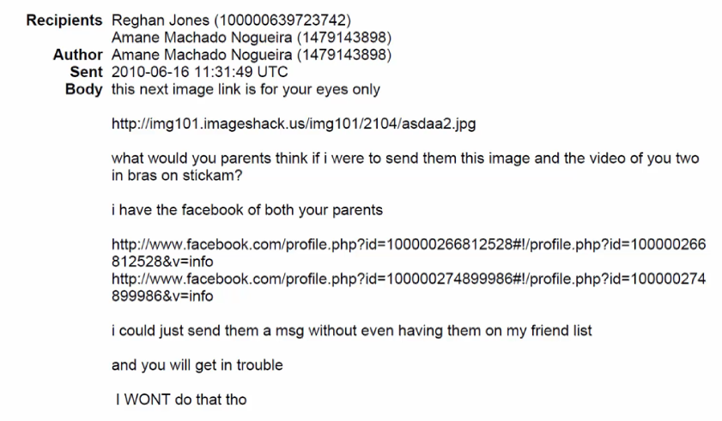
Sextortion Crime

Slide 5
United States v. Elad Gaber
2010 Los Angeles victim comes forward
2011 Joint Investigation with Israel Police
2012 MLAT evidence obtained
2012 Arrested in Israel
2014 U.S. Federal Indictment
2017 Extradition Request
2018 Defendant Fights Extradition
2020 Defendant Extradited
2021 Defendant Pleads Guilty
2021 Defendant Sentenced

Slide 6
International Cooperation

Slide 7
United States v. Elad Gaber
2010 Los Angeles victim comes forward
2011 Joint Investigation with Israel Police
2012 MLAT evidence obtained
2012 Arrested in Israel
2014 U.S. Federal Indictment
2017 Extradition Request
2018 Defendant Fights Extradition
2020 Defendant Extradited
2021 Defendant Pleads Guilty
2021 Defendant Sentenced

Slide 8
United States v. Elad Gaber
2010 Los Angeles victim comes forward
2011 Joint Investigation with Israel Police
2012 MLAT evidence obtained
2012 Arrested in Israel
2014 U.S. Federal Indictment
2017 Extradition Request
2018 Defendant Fights Extradition
2020 Defendant Extradited
2021 Defendant Pleads Guilty
2021 Defendant Sentenced

Slide 9
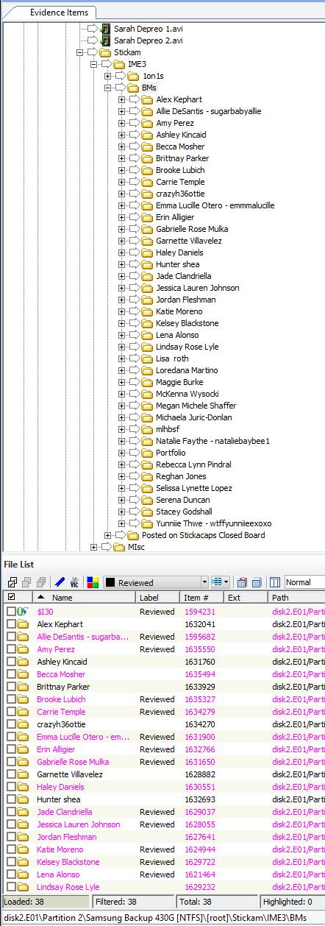
Big Data Problems
Terabytes of Data
Sensitive Material

Slide 10
United States v. Elad Gaber
Sept 2010 Los Angeles victim comes forward
2011 Joint Investigation with Israel Police
2012 MLAT evidence obtained
2012 Arrested in Israel
2014 U.S. Federal Indictment
2017 Extradition Request
2018 Defendant Fights Extradition
2020 Defendant Extradited
2021 Defendant Pleads Guilty
2021 Defendant Sentenced

Slide 11
Victim Issues
Victims in different locations
Victims with different issues and needs
Issues with different outcome preferences

Slide 12
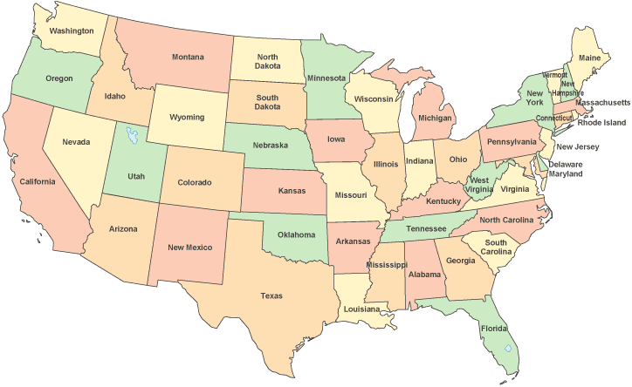

Slide 13
United States v. Elad Gaber
Sept 2010 Los Angeles victim comes forward
2011 Joint Investigation with Israel Police
2012 MLAT evidence obtained
2012 Arrested in Israel
2014 U.S. Federal Indictment
2017 Extradition Request
2018 Defendant Fights Extradition
2020 Defendant Extradited
2021 Defendant Pleads Guilty
2021 Defendant Sentenced

Slide 14
Cooperation Lessons Learned
International Cooperation
Reach Out Early and Often
Establish Relationships with Victim Services in all countries/areas
Understand the legal pitfalls of all jurisdictions
Leverage your experts

Slide 15
Dig Data Lessons Learned
Use Forensic Software
Less Analysis
Faster Results

Slide 16
Victim Lessons Learned
Victim Best Practices
Record Interviews (video if possible)
Use NGOs and Victim Services
Understand how delay effects victims

Slide 17
United States v. Elad Gaber
Sept 2010 Los Angeles victim comes forward
2011 Joint Investigation with Israel Police
2012 MLAT evidence obtained
2012 Arrested in Israel
2014 U.S. Federal Indictment
2017 Extradition Request
2018 Defendant Fights Extradition
2020 Defendant Extradited
2021 Defendant Pleads Guilty
2021 Defendant Sentenced

Slide 19
Questions?
Lana Owens owenslm@state.gov lana.mortonowens@usdoj.gov

