Slide 1
Evolution of dark web market prosecutions
Timothy C. Rank
U.S. Department of Justice ICHIP
Cybercrime Liaison Prosecutor at Eurojust

Slide 2
Overview
How do Dark Web Markets Work
Evolution of Cases
Silk Road
Alpha Bay/Hansa
Wall Street Market
Hydra Market

Slide 3
U.S. Approach
Specialized Units in Department of Justice and U.S. Law Enforcement
Global presence
International partnerships

Slide 4
Global Network –
Both Broad and Narrow
Department of Justice
93 U.S. Attorney’s Offices
Computer Crime and Intellectual Property Section
National Cryptocurrency Enforcement Team
ICHIP Network
RLA Network
U.S. law enforcement offices around the world
FBI, USSS, IRS, DEA, HSI
And global partnerships

Slide 5
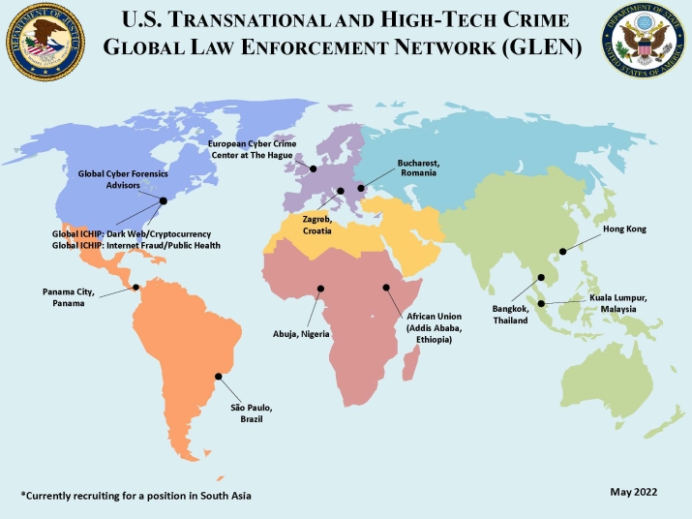
ICHIP Network

Slide 6
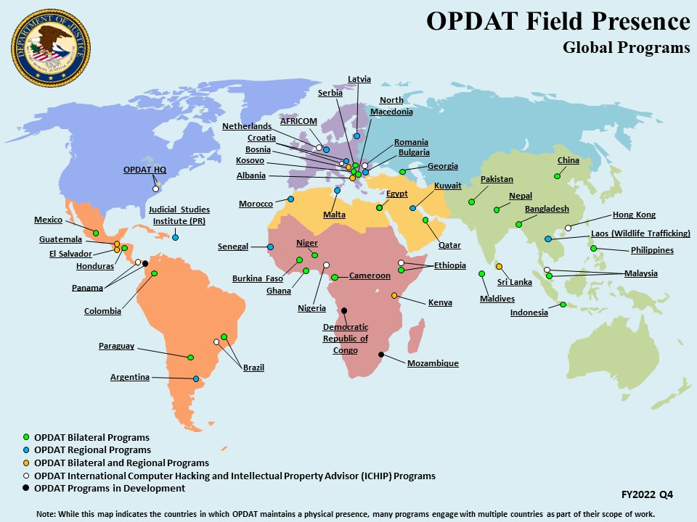
OPDAT/RLA Network

Slide 7
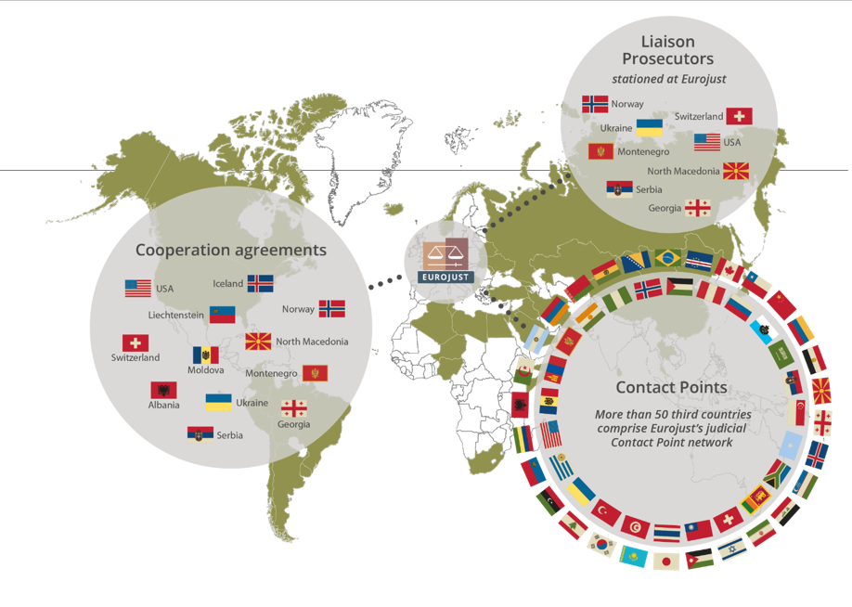
Eurojust
Eurojust

Slide 8
Dark Web Markets

Slide 9
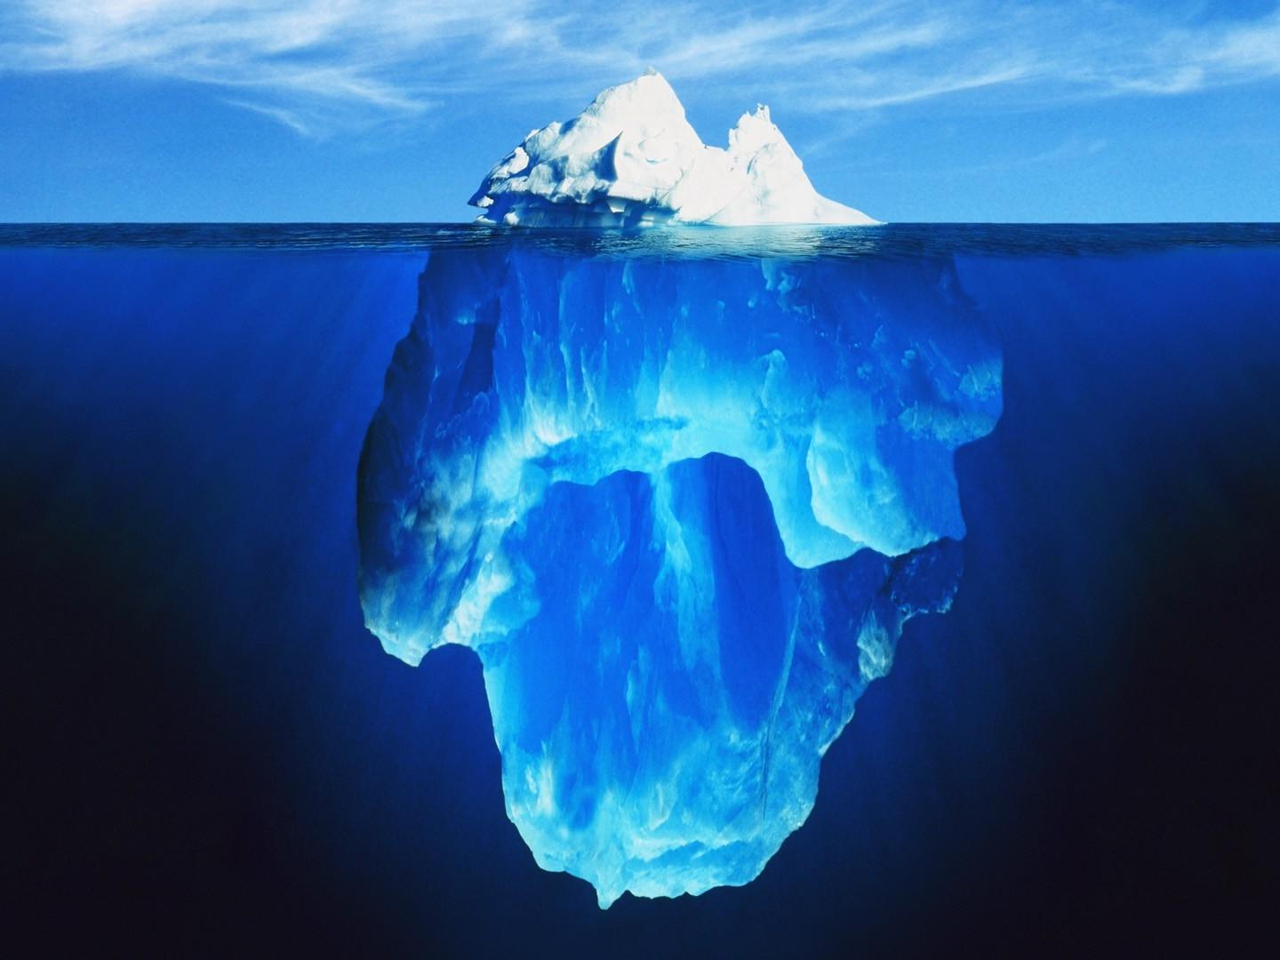
Surface Web
(~indexed)
Deep Web
> 99%
Dark Web
Notes:
Surface web:
-Indexed part of the internet, meaning it can be found on Google
Deep web:
-Unindexed, so can’t find it on Google,
-Often only accessed by direct URL or IP address, and may require password or other security access
-Examples include court records, content on libraries
Dark Web:
-Part of deep web, but two important distinctions
Intentionally hidden
-Makes it attractive to criminals because it helps avoid the issue of being identified through the IP layer
-Thus, this is where we find criminal forums nowadays
(2) In part because it is intentionally hidden, requires specific software to access
-Most common example is TOR network
What is TOR?

Slide 10
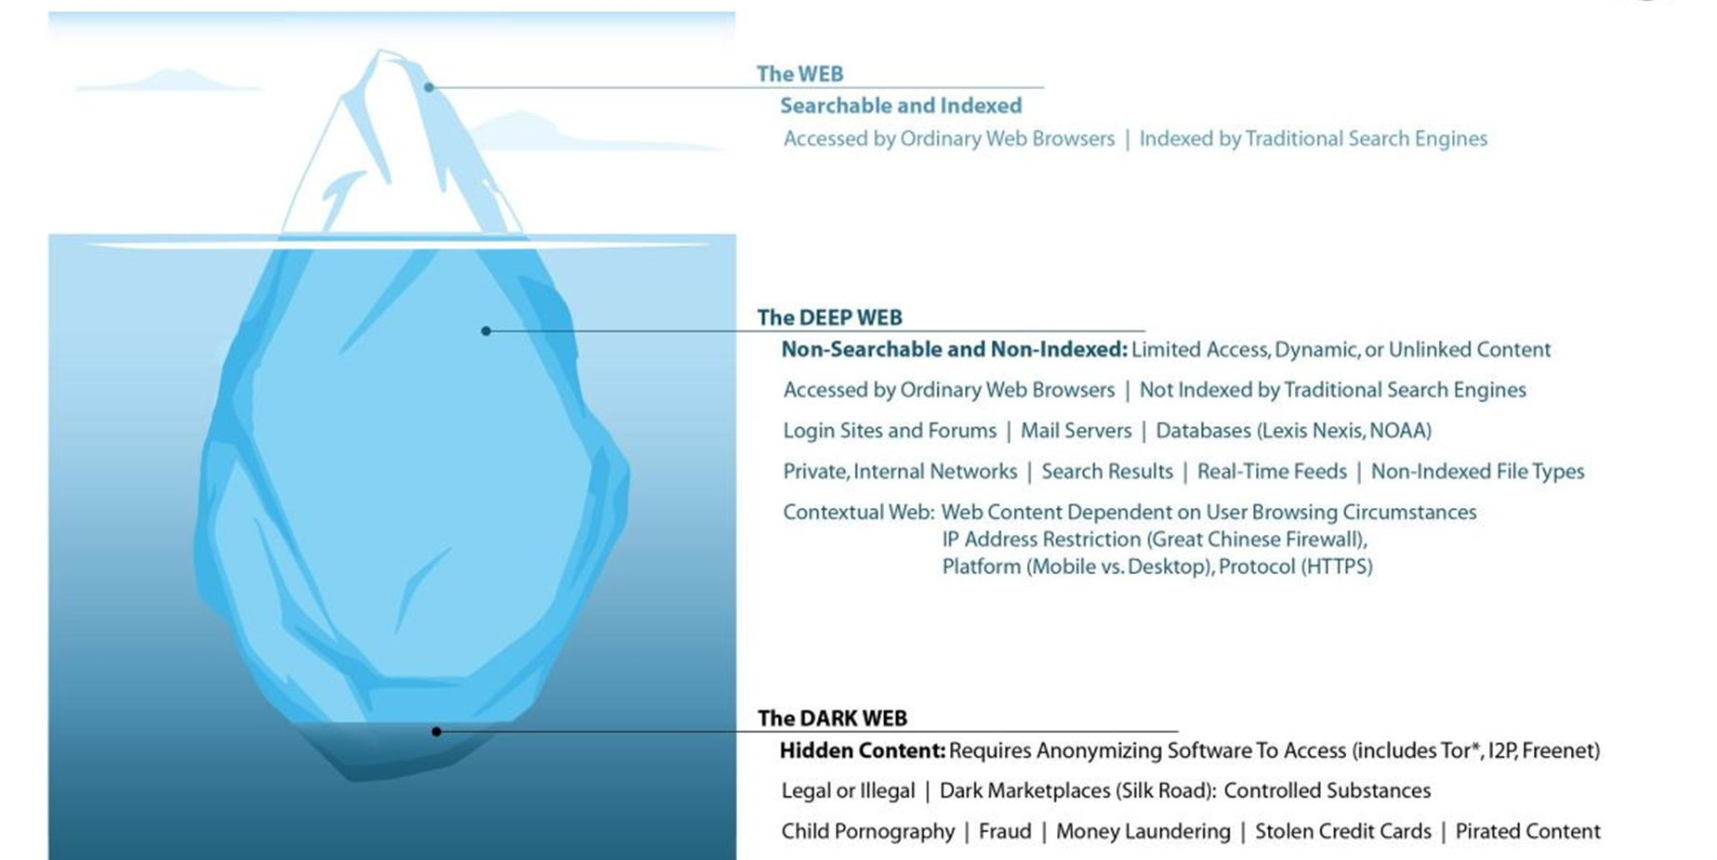
Notes:
Surface web:
-Indexed part of the internet, meaning it can be found on Google
Deep web:
-Unindexed, so can’t find it on Google,
-Often only accessed by direct URL or IP address, and may require password or other security access
-Examples include court records, content on libraries
Dark Web:
-Part of deep web, but two important distinctions
Intentionally hidden
-Makes it attractive to criminals because it helps avoid the issue of being identified through the IP layer
-Thus, this is where we find criminal forums nowadays
(2) In part because it is intentionally hidden, requires specific software to access
-Most common example is TOR network
What is TOR?

Slide 11
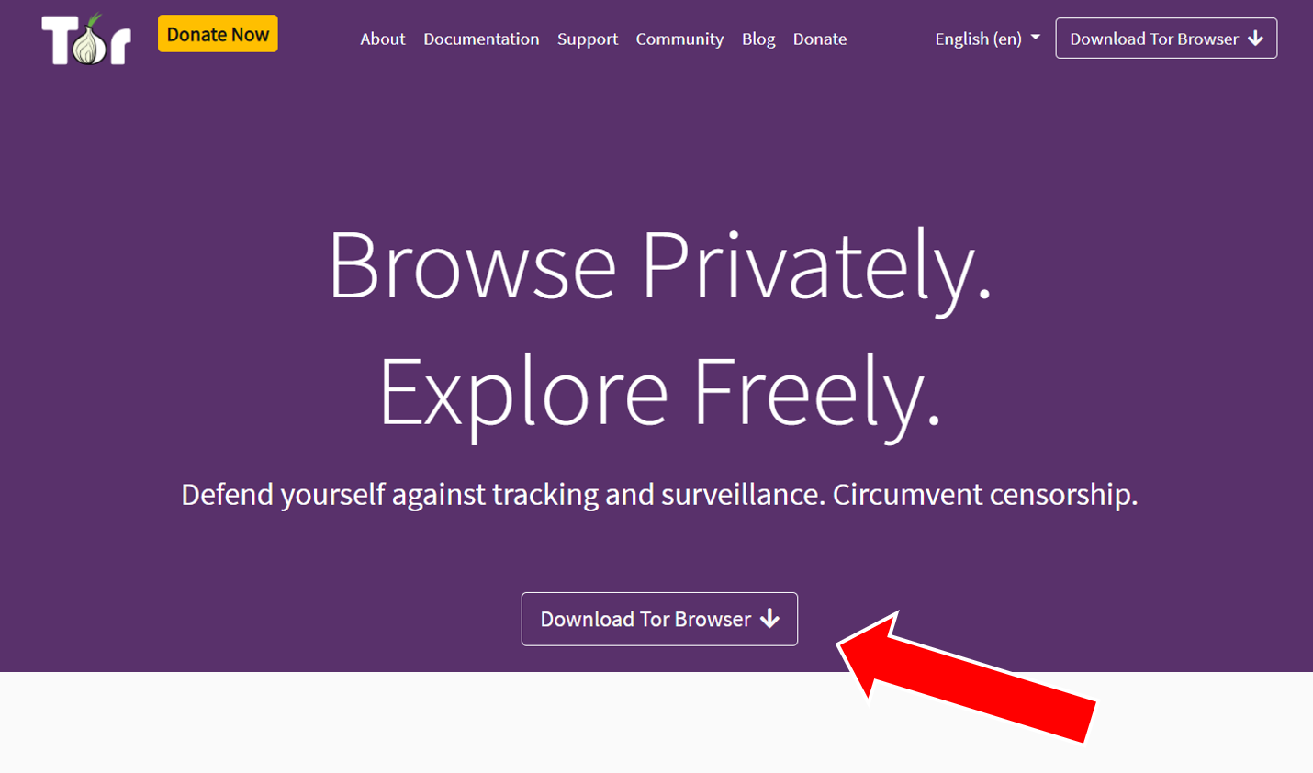
Notes:
Surface web:
-Indexed part of the internet, meaning it can be found on Google
Deep web:
-Unindexed, so can’t find it on Google,
-Often only accessed by direct URL or IP address, and may require password or other security access
-Examples include court records, content on libraries
Dark Web:
-Part of deep web, but two important distinctions
Intentionally hidden
-Makes it attractive to criminals because it helps avoid the issue of being identified through the IP layer
-Thus, this is where we find criminal forums nowadays
(2) In part because it is intentionally hidden, requires specific software to access
-Most common example is TOR network
What is TOR?

Slide 12
Notes:
Surface web:
-Indexed part of the internet, meaning it can be found on Google
Deep web:
-Unindexed, so can’t find it on Google,
-Often only accessed by direct URL or IP address, and may require password or other security access
-Examples include court records, content on libraries
Dark Web:
-Part of deep web, but two important distinctions
Intentionally hidden
-Makes it attractive to criminals because it helps avoid the issue of being identified through the IP layer
-Thus, this is where we find criminal forums nowadays
(2) In part because it is intentionally hidden, requires specific software to access
-Most common example is TOR network
What is TOR?

Slide 13
Notes:
Surface web:
-Indexed part of the internet, meaning it can be found on Google
Deep web:
-Unindexed, so can’t find it on Google,
-Often only accessed by direct URL or IP address, and may require password or other security access
-Examples include court records, content on libraries
Dark Web:
-Part of deep web, but two important distinctions
Intentionally hidden
-Makes it attractive to criminals because it helps avoid the issue of being identified through the IP layer
-Thus, this is where we find criminal forums nowadays
(2) In part because it is intentionally hidden, requires specific software to access
-Most common example is TOR network
What is TOR?

Slide 14
Notes:
Surface web:
-Indexed part of the internet, meaning it can be found on Google
Deep web:
-Unindexed, so can’t find it on Google,
-Often only accessed by direct URL or IP address, and may require password or other security access
-Examples include court records, content on libraries
Dark Web:
-Part of deep web, but two important distinctions
Intentionally hidden
-Makes it attractive to criminals because it helps avoid the issue of being identified through the IP layer
-Thus, this is where we find criminal forums nowadays
(2) In part because it is intentionally hidden, requires specific software to access
-Most common example is TOR network
What is TOR?

Slide 15
Notes:
Surface web:
-Indexed part of the internet, meaning it can be found on Google
Deep web:
-Unindexed, so can’t find it on Google,
-Often only accessed by direct URL or IP address, and may require password or other security access
-Examples include court records, content on libraries
Dark Web:
-Part of deep web, but two important distinctions
Intentionally hidden
-Makes it attractive to criminals because it helps avoid the issue of being identified through the IP layer
-Thus, this is where we find criminal forums nowadays
(2) In part because it is intentionally hidden, requires specific software to access
-Most common example is TOR network
What is TOR?

Slide 16
Dark Web Market Prosecutions/Takedowns
2013-2022

Slide 17
Silk Road
2013

Slide 18
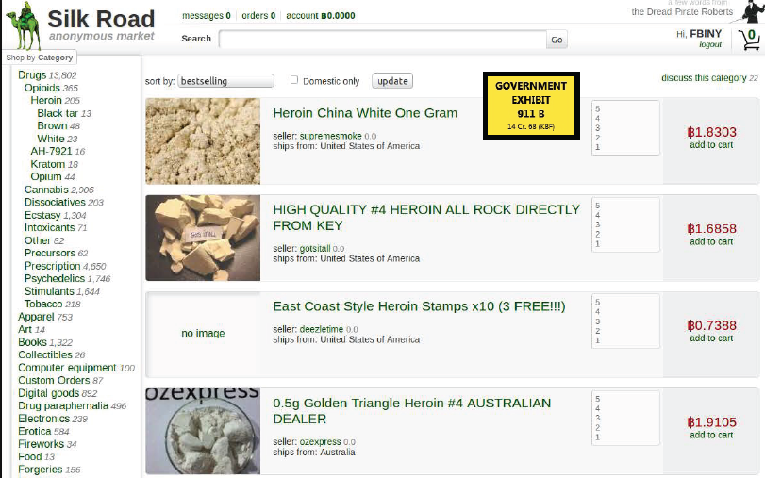
Silk Road

Slide 19
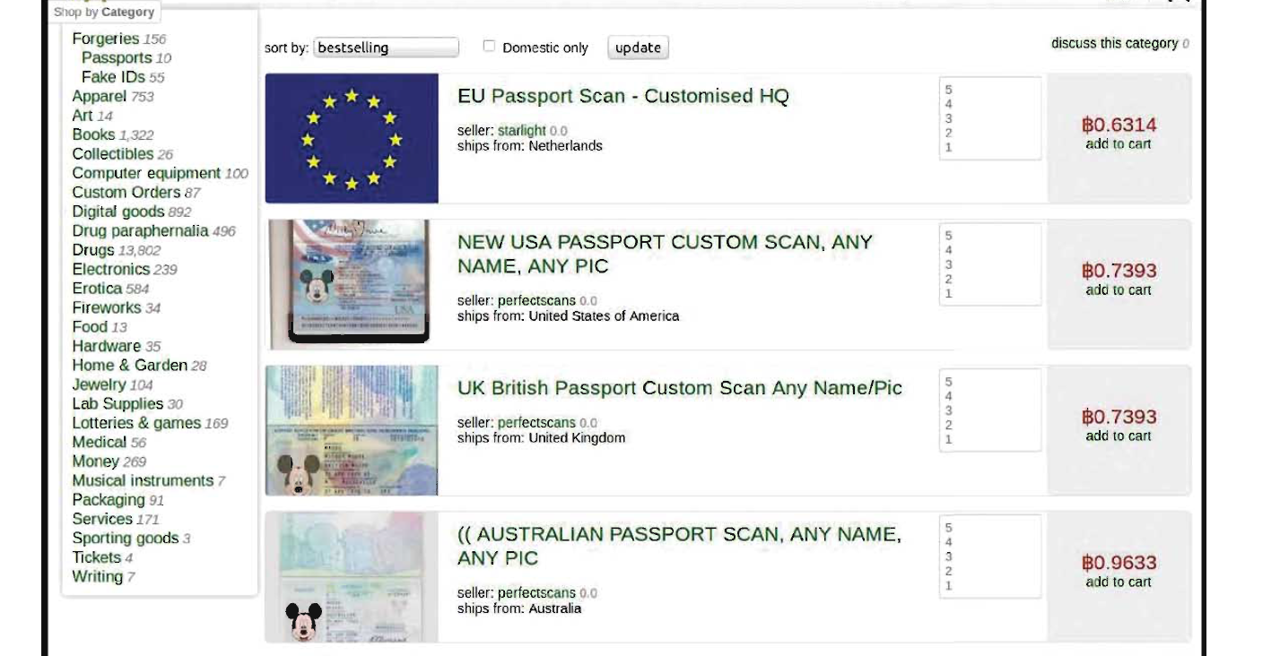
Silk Road

Slide 20
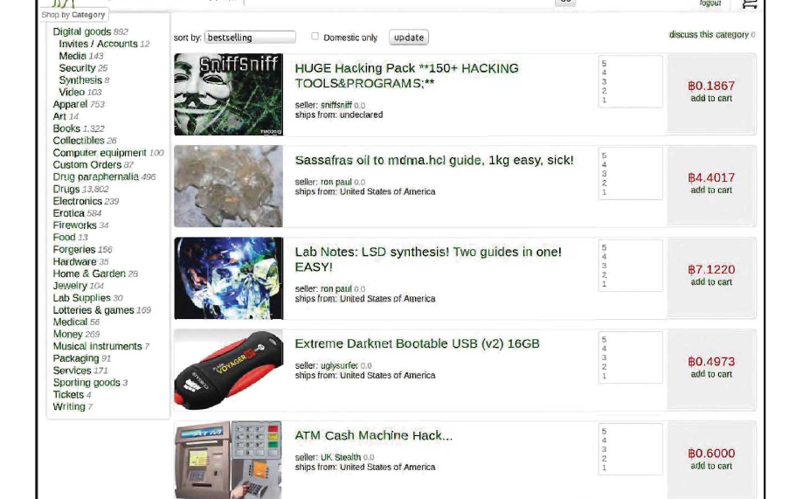
Silk Road

Slide 21
Silk Road
Government assumed control of the account of one support staff member
Account had access to internal communications with other administrators
Identified main administrator, Ross Ulbricht, through email address associated with early marketing efforts for Silk Road

Slide 22
Silk Road
Ulbricht arrested when he was at the library
While Ulbricht was logged in, FBI created distraction in the library and team grabbed the laptop

Slide 23
Silk Road
Search of Ulbricht’s Laptop
Journals describing how Ulbricht created and operated site
Thousands of pages of chat logs with employees
Silk Road business records
Bitcoin wallets containing 144,341 Bitcoins, then worth approximately $18 million USD (Now ~$2.7 billion)

Slide 24
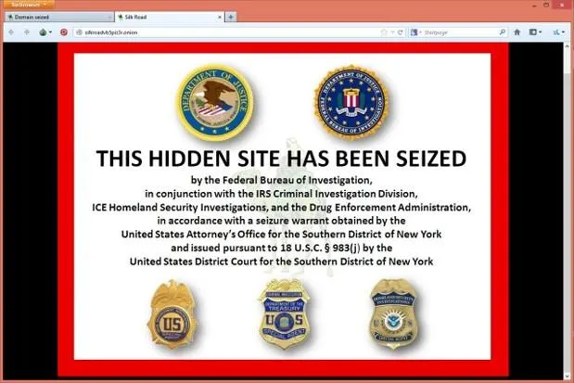
Silk Road

Slide 25
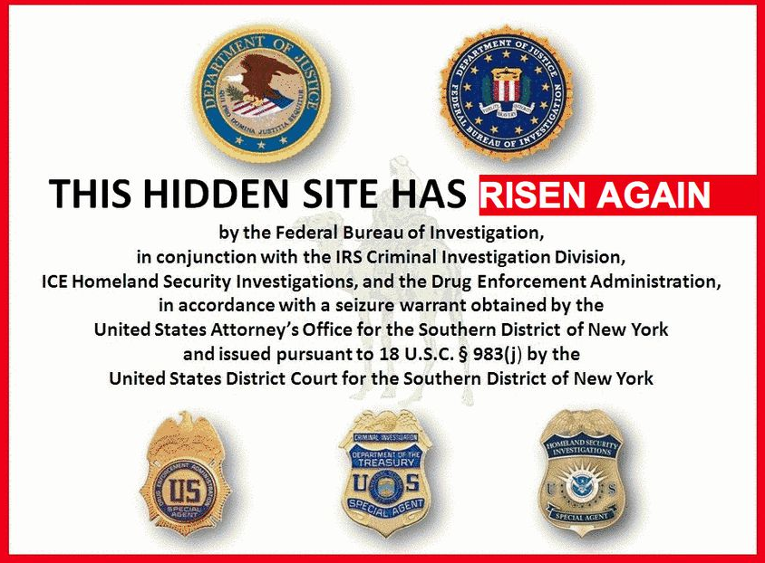
Silk Road 2.0

Slide 26
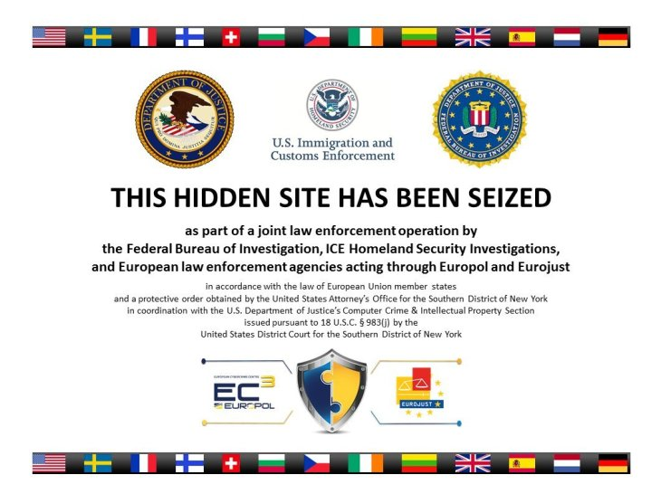
Silk Road 2.0

Slide 27
Silk Road
Trial, conviction, and life sentence for Ross Ulbricht

Slide 28
Alpha Bay/Hansa Market
2017

Slide 29
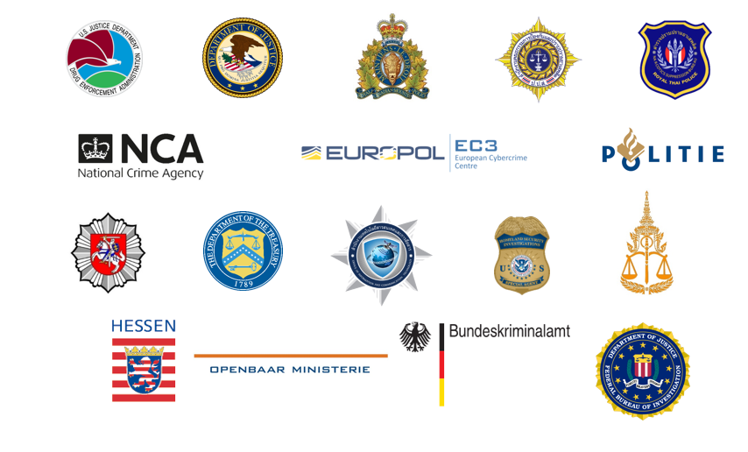
Alpha Bay/Hansa Market

Slide 30
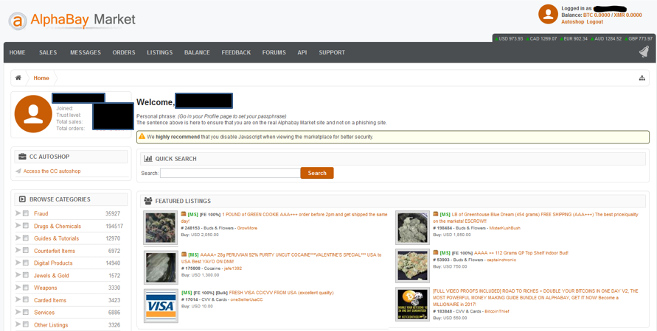
Alpha Bay

Slide 31
Alpha Bay

Slide 32
Alpha Bay
U.S. investigators discovered identity of administrator Alexandre Cazes through Hotmail account used for welcome and password reset emails early in existence of Alpha Bay, which was in turn associated with a LinkedIn account
Requested assistance of RCMP, as Cazes appeared to live and work Québec, Canada

Slide 33
Alpha Bay
RCMP surveillance on house and company
During traffic stop for speeding (Jan 2017), Cazes disclosed he lived in Thailand
Arrested in Thailand in July 2017
When arrested, he was logged into his laptop performing an administrative reboot on an AlphaBay server

Slide 34
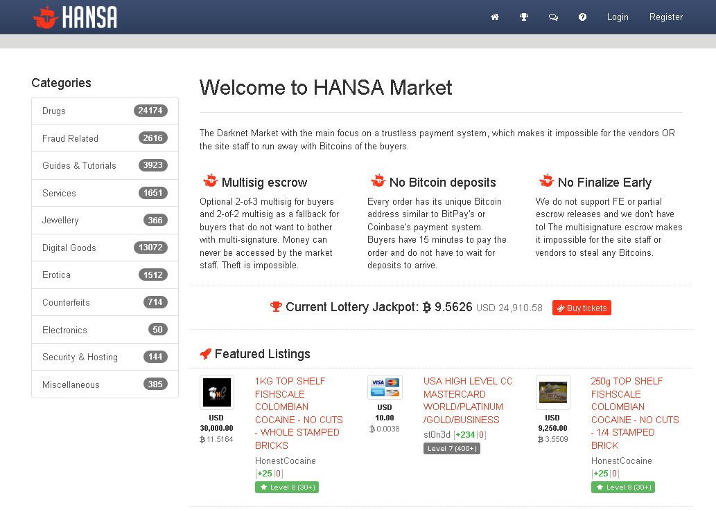
Hansa

Slide 35
Takedown

Slide 36
Takedown
June 20, 2017
Germany: DE and NL arrested administrators in two locations (BKA / LKA Saxony)
Lithuania: NL and Lithuanian police gained access to servers, transferred them to NL
Netherlands: Synchronized servers in Lithuania and Netherlands, updated code, migrated to Dutch servers
June 23-July 4, 2017
Hansa run by Dutch National Police

Slide 37
Wall Street Market
2019

Slide 38
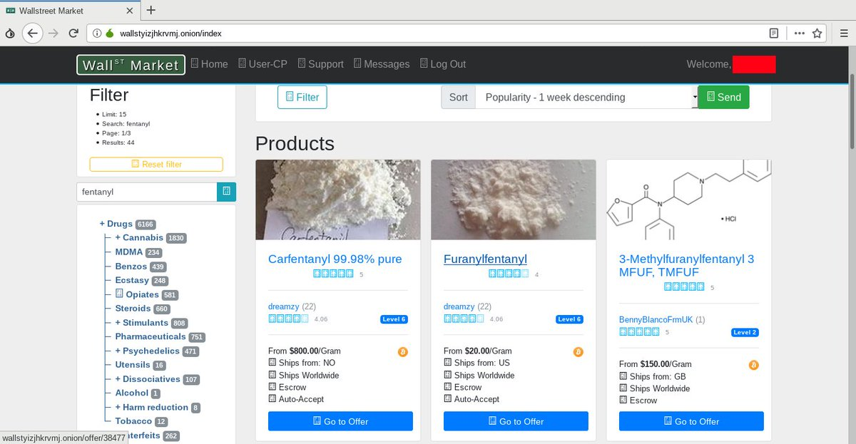
Wall Street Market

Slide 39
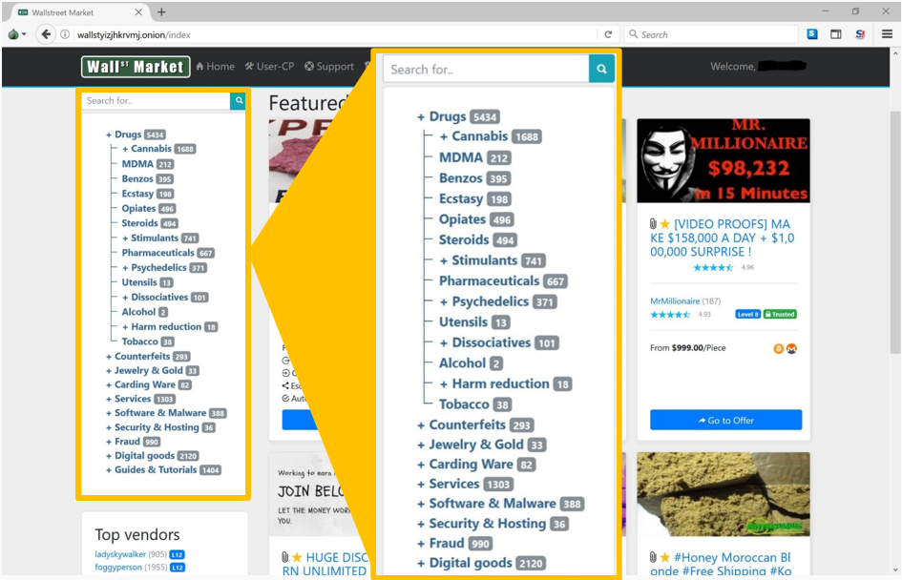
Wall Street Market

Slide 40
Wall Street Market
Up until April 2019, world’s second largest dark market
1.15 million users
April 2019, administrators engaged in “exit scam”
All virtual currency held in marketplace escrow and user accounts, approximately $11 million in virtual currencies, diverted into the defendant’s accounts.

Slide 41
Wall Street Market

Slide 42
Hydra Market
2022

Slide 43
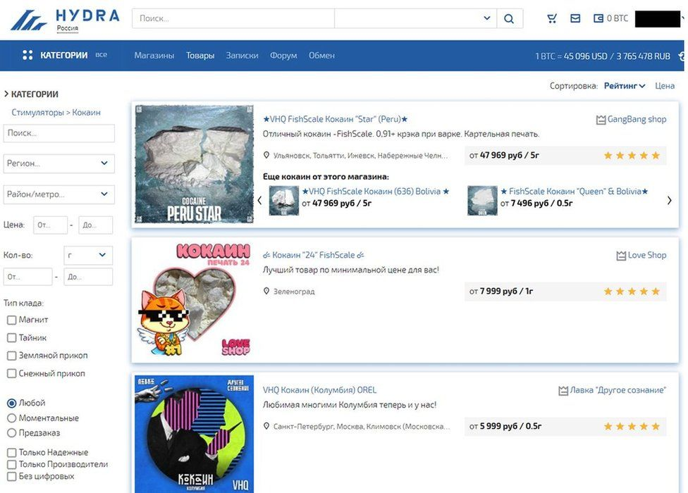
Hydra Market

Slide 44
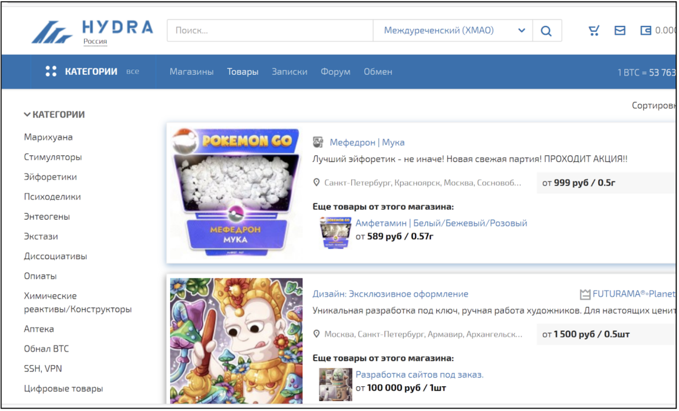
Hydra Market

Slide 45
Hydra Market
In 2021, estimated 80% of all darknet market-related cryptocurrency transactions
17 million customers and 19,000 seller accounts
In six years of existence, approximately $5.2 billion in cryptocurrency
In addition to the typical (narcotics, fake passports, hacking tools/services), Hydra also offered money laundering of cryptocurrency – to cash

Slide 46
Hydra Market

Slide 47
Hydra Market
Seizure of the Hydra servers and cryptocurrency wallets containing $25 million worth of BTC in Germany by the German Federal Criminal Police (the Bundeskriminalamt), in coordination with U.S. law enforcement.

Slide 48
Darknet Market and Takedown Date | Estimated Volume of Transactions (USD)
Silk Road (Oct 2013) | $100s of Millions
AlphaBay (July 2017) | > $1 Billion
Hydra (April 2022) | >$5.2 Billion

Slide 49
Key Points
International Collaboration
Specialization of law enforcement
Follow the money and take the money
Persistence
Mistakes always happen and the internet never forgets

Slide 50
Key Points
Investigations/seizures/takedowns cause instability
Instills lack of trust
Which results in successful markets closing down on their own, with exit scams
Which creates further instability

